Slide 1
How, when and why of DEI
Why are we here?
A Rashard Dacus, MD

Slide 2
No financial disclosures

Slide 3
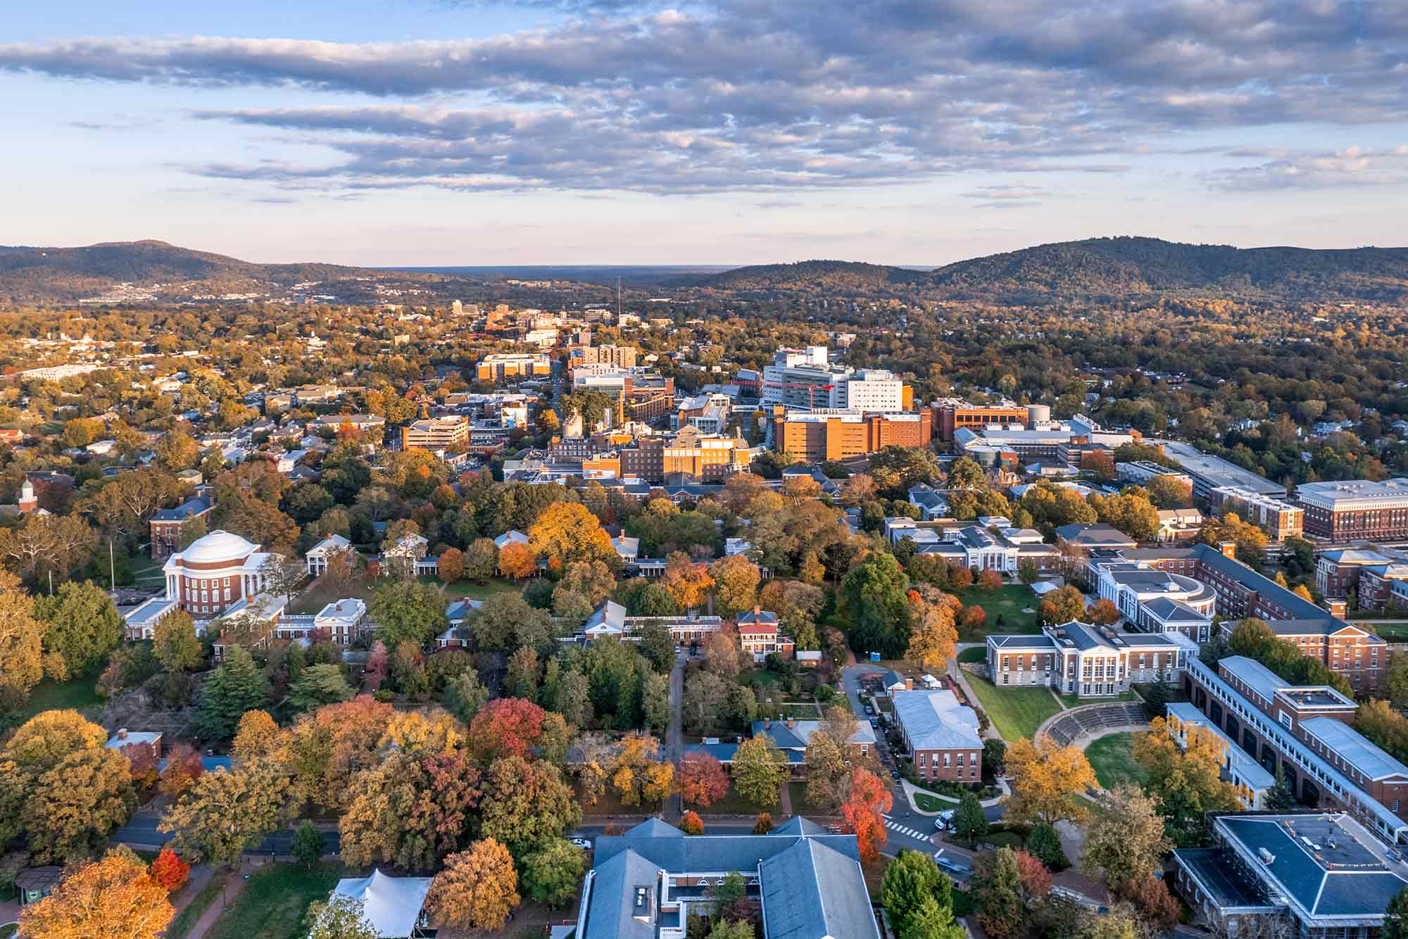

Slide 4
Why are we here?
Knowledge
Support
Encouragement

Slide 5
Knowledge
Some things we know
    Orthopaedic surgery is the least diverse specialty
    Since 2020, institutions have pushed diversity (up 55%)
    The physician population is becoming younger
    Gender and ethnic parity if currently distant
Lots of things we do not know
    How is the data being collected?
    What do we do with the data?
    Are diversity positions supported similar to others?
    How to create sustainable processes
    Why has the attrition rate for DEI roles been so high?

Slide 6
Support
Often there is no roadmap
Are we on the right path?
Does this role augment my CV or take time that could go to other work?
Are you being compensated?
Is it enough?
Is there education that is needed and if so, where?
What has worked for others?

Slide 7
Encouragement
You are not alone
    Similar challenges across the board
There are resources
    Diversity certification
    ODLC
The pendulum is swinging (slowly)
Starting is the hardest part
    Budget, buy in, time
Rapid change is rarely sustained
    Look for easy wins

Slide 8
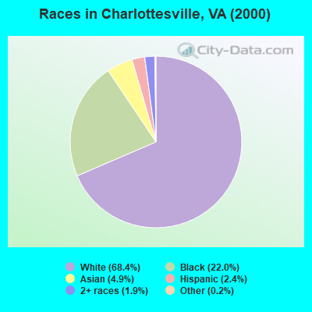
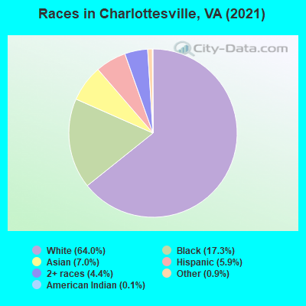
Demographics have seen minimal change in 20 years.

Slide 9
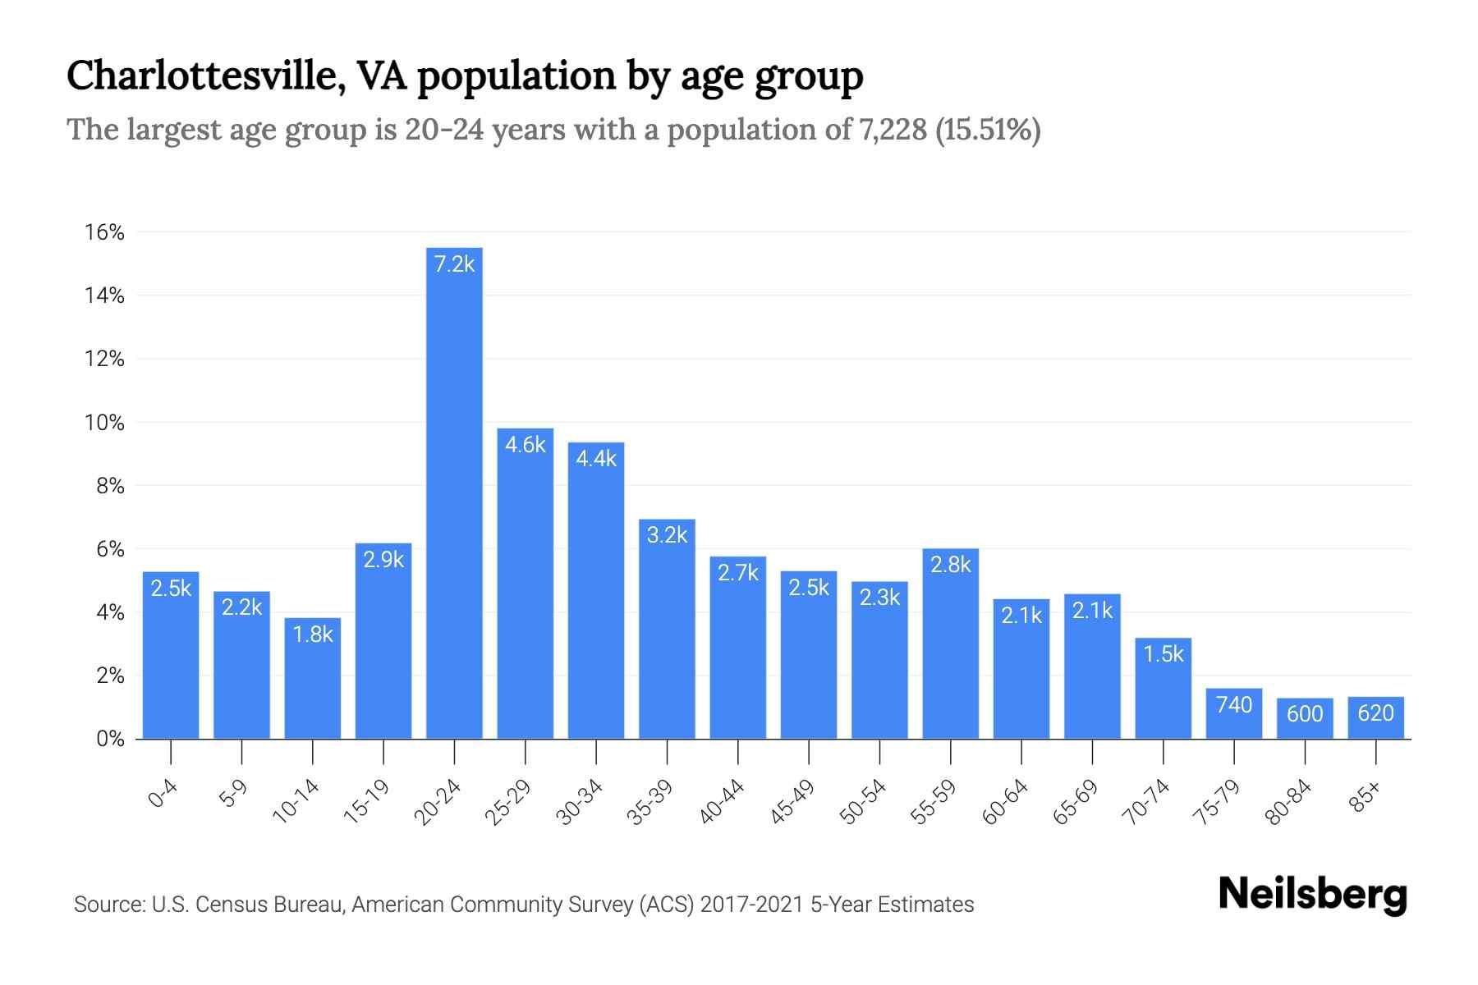
Similar to may college towns

Slide 10
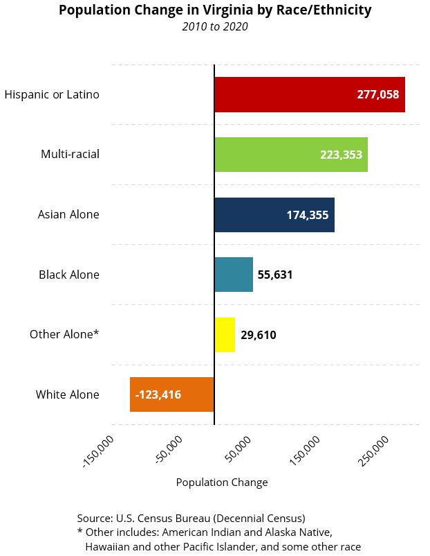
The state however is seeing a significant shift in population demographics
Military influence?
Northern Virginia?
Increase in factory, construction and agricultural work?
Political environment?

Slide 11
Are we making any change?
Faculty
    Chief Diversity Officer
    JEDI program
    Retention and Recruitment
Residents
    HCDI
    GME
Patient services
    Financial Assistance
    Interpreter Services
    Access

Slide 12
Faculty
Strategic Plan
    3 pillars
    Cultivating healthy communities and belonging for all
JEDI program
    Lead by the CDO
    Each Department has a representative
    Orientation, Research, Collaborative partnership
Departmental Recruitment
    Current capstone project on standardizing efforts
Retention
    While rates are high, URM faculty are the majority
Wellness
    Continued micro-aggressions and lack of inclusion

Slide 13

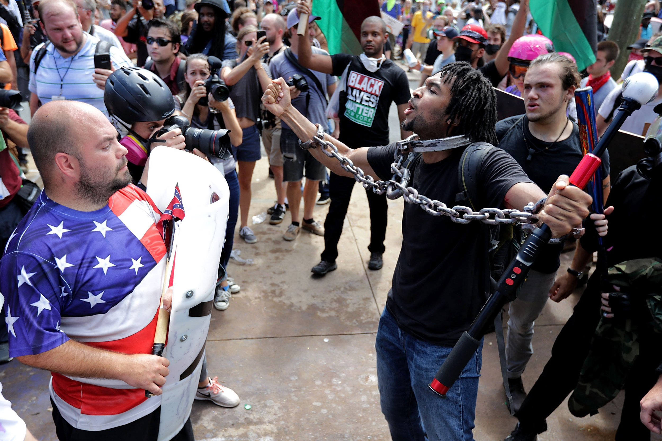


Slide 14
Residents
Housestaff Council for Diversity and Inclusion
    8-10 residents from across the health system
    2 faculty mentors
    GME support and funding
    In 2021, received the MLK Award from the Health system
Graduate Medical Education
    Mission statement in bold
    Host a 2nd look weekend for minority students
    Host a URiM Leadership Program with travel stipend
Departmental Initiatives
    Scholarships for away rotations
    Focus on holistic views of applicants
    Ortho (4% AA, 28% female)

Slide 15
Patient services
Financial Assistance
    Currently have representatives in OCIR
    Continue to perform urgent surgery
Interpretation Services
    Heavy utilization of Cyracom
    14.5% of patient population, over 3% Spanish
    Currently only 9 Spanish interpreters and 1 part-time sign
Access
    Continued focus on access
    Ortho currently over 90% IV within 14 days

Slide 16
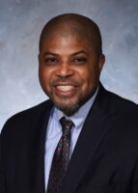
2.7% (National average in academic Ortho is 1.5%)

Slide 17


Why Does This Matter?
Erica Taylor, MD MBA
Orthopaedic Surgeon
Duke Health Integrated Practice CMO of DEI
Vice Chair of EDI, Duke Orthopaedics
Founder, Orthopaedic Diversity Leadership Consortium

Slide 18
Financial Disclosures
Founder & CEO, Orthopaedic Diversity Leadership Consortium
Sponsors:
Stryker
Johnson & Johnson DePuy Synthes
Tru-Colour Bandages
Total Joint Orthopaedics

Slide 19



Evolution of DEI in Health Care
WHAT
What does it mean to be diverse?
WHY
Why is health equity important?
HOW
How do we make sustainable change?
How do we create a culture of respect and belonging?
What is inclusion?
Equity vs. Equality?
Why does diversity matter to patients and learners?
Notes:
So first, let’s review our departmental approach which was presented during our 2021 State of the Department. For the past several years, we examined the “what” of DEI. We then, as an institution and department dove deep into our “Why” particularly in 2020 and 2021. towards the latter half of 2021, we began to ask the questions of how, both internally and in orthopaedics in general. That is how we created our RAD strategy, including the intentional process evolution of how we recruit, how we disitrbute accountability, and how we fost development of our teams and ourselves.

Slide 20
WHAT IS YOUR WHY? (3S Framework)
SYSTEM
STRATEGY
SELF

Slide 21
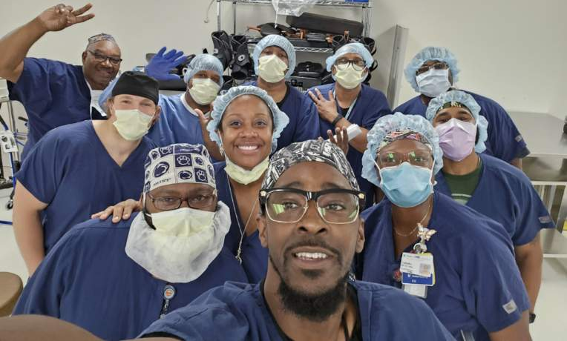
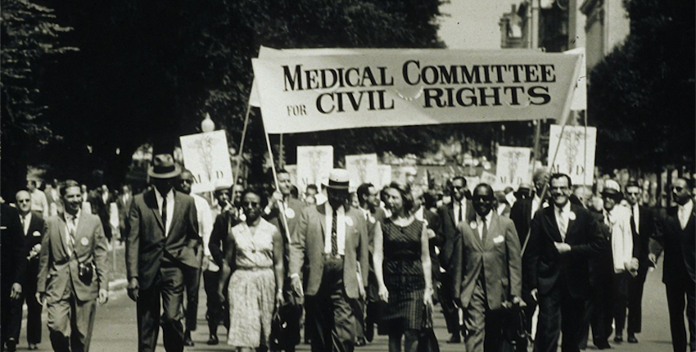
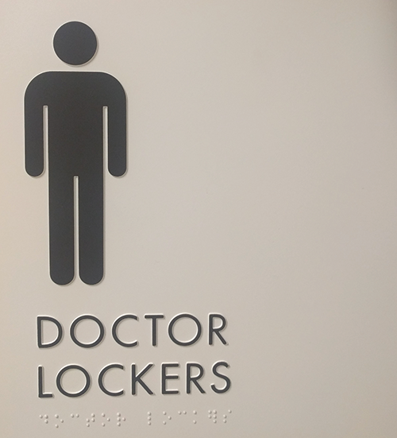
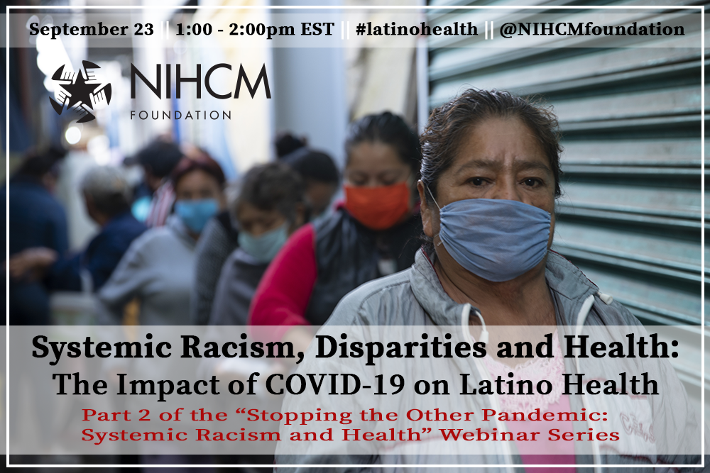
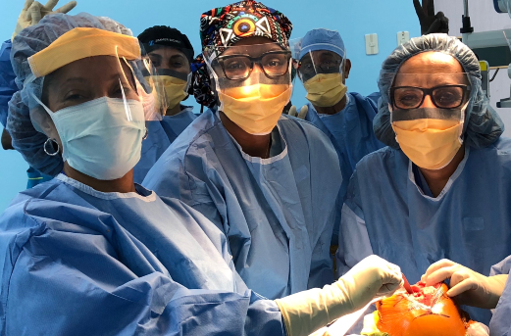
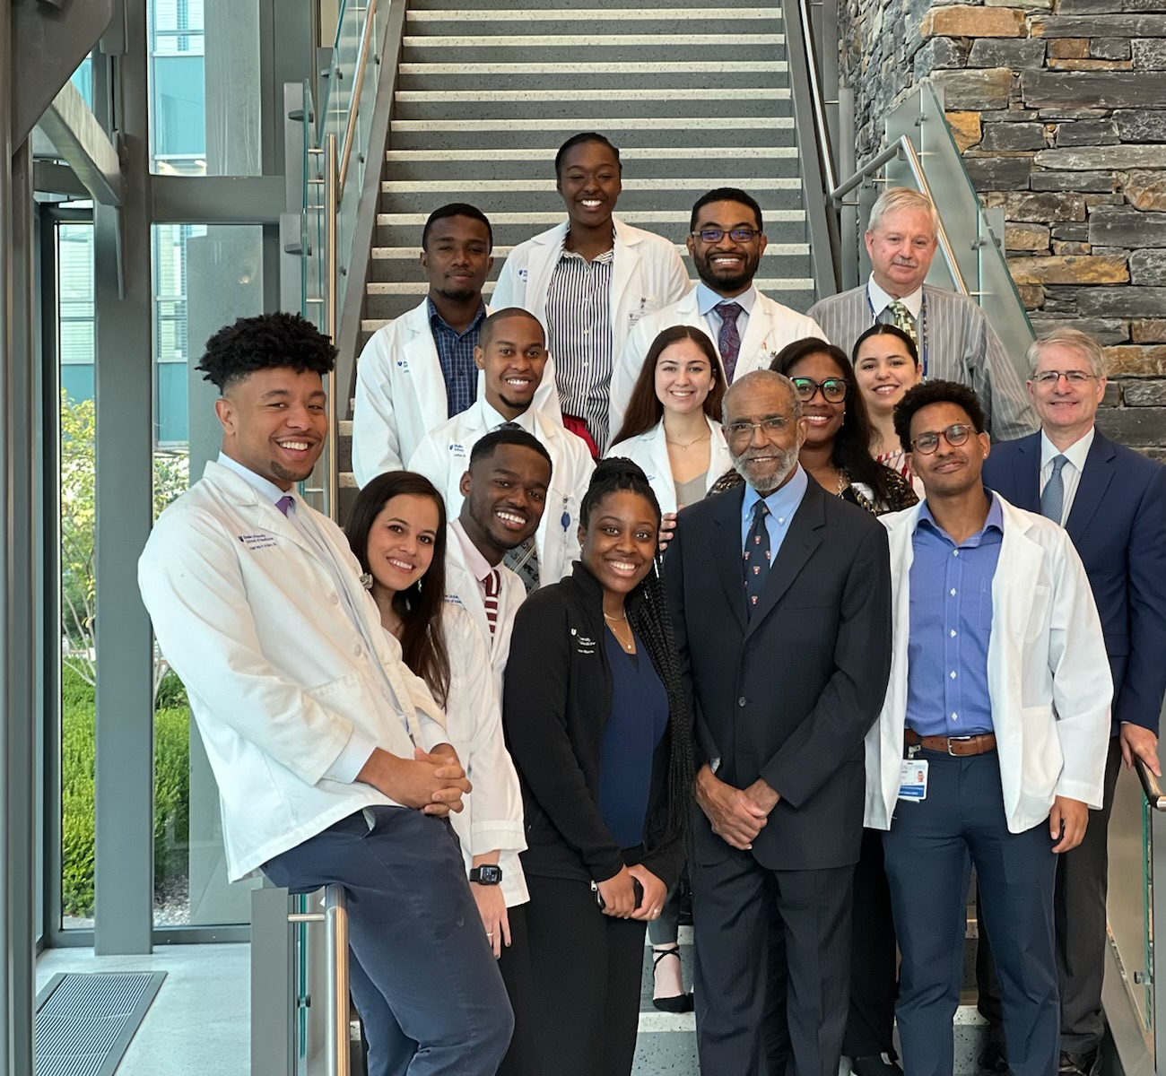
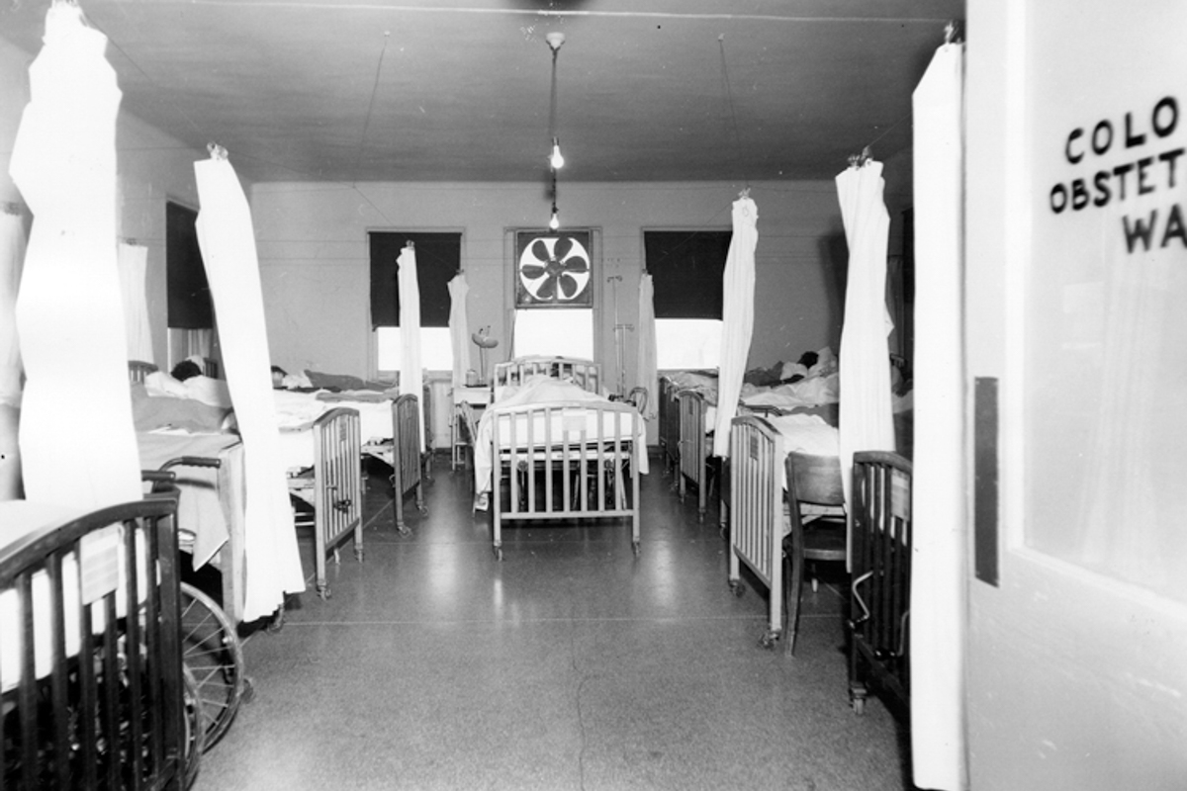

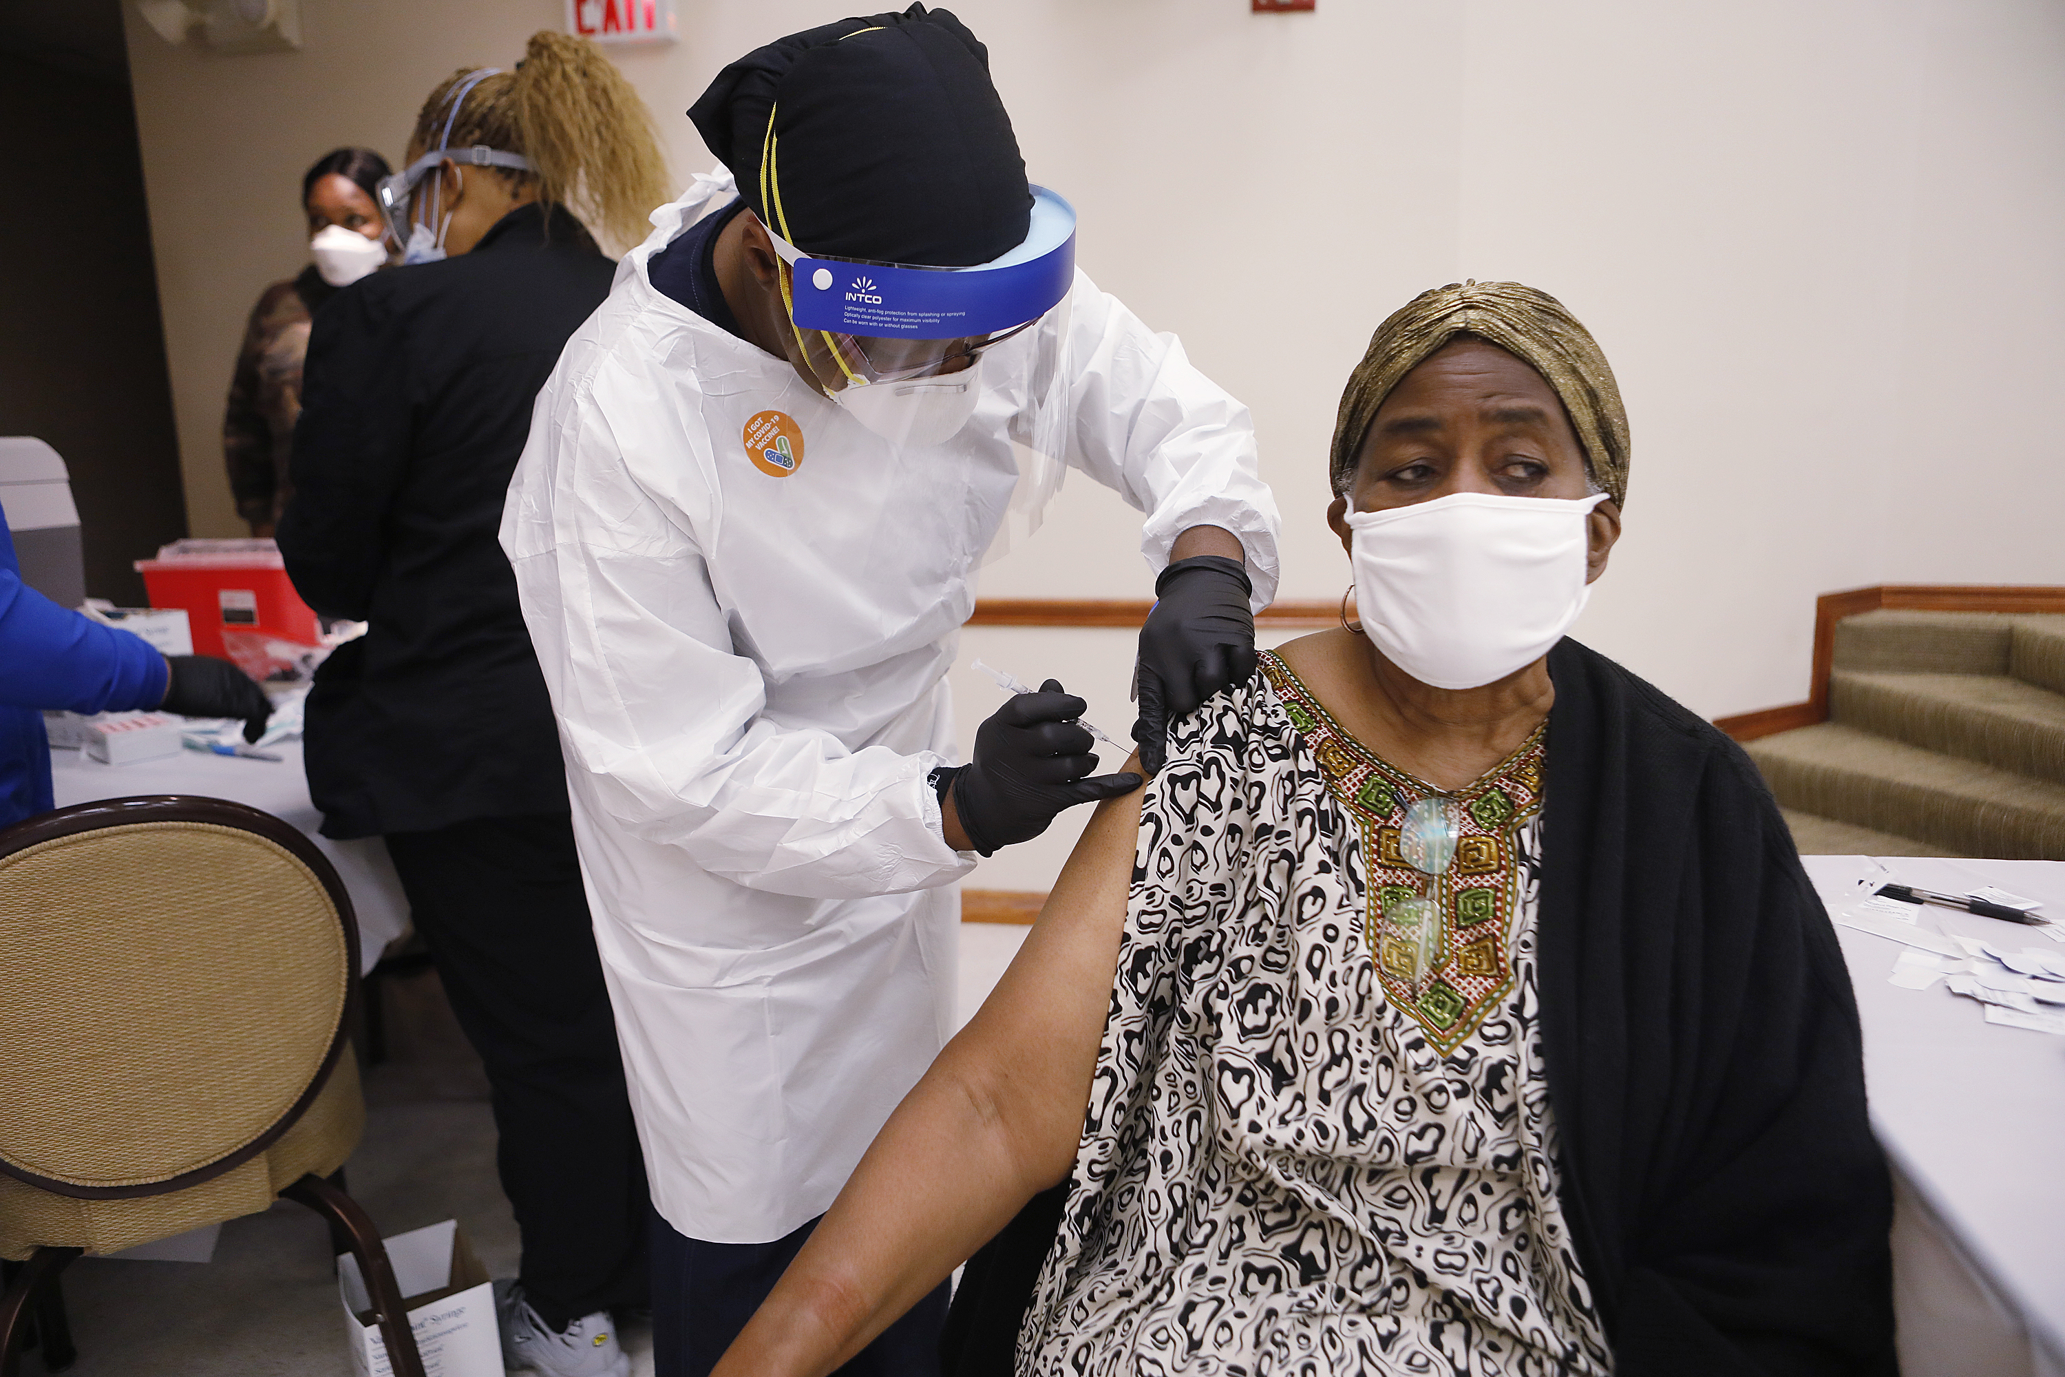
SELF

Slide 22

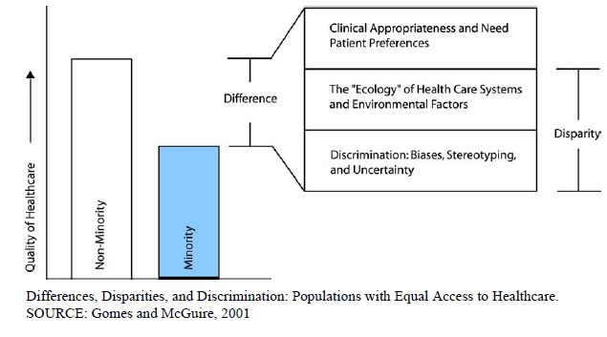
Racial and ethnic disparities in healthcare exist and are unacceptable.
Disparities in healthcare occur in the context of broader historic and contemporary social and economic inequality, and evidence of persistent racial and ethnic discrimination.
Bias, stereotyping, prejudice, and clinical uncertainty on the part of healthcare providers contribute to racial and ethnic disparities

Slide 23

Racial and ethnic disparities in healthcare exist and are unacceptable.
Disparities in healthcare occur in the context of broader historic and contemporary social and economic inequality, and evidence of persistent racial and ethnic discrimination.
Bias, stereotyping, prejudice, and clinical uncertainty on the part of healthcare providers contribute to racial and ethnic disparities
Increase the proportion of underrepresented U.S. racial and ethnic minorities among health professionals.
Integrate cross-cultural education into the training of all current and future health professionals.

Slide 24
WHAT IS YOUR WHY? (3S Framework)
SYSTEM
STRATEGY
SELF

Slide 25
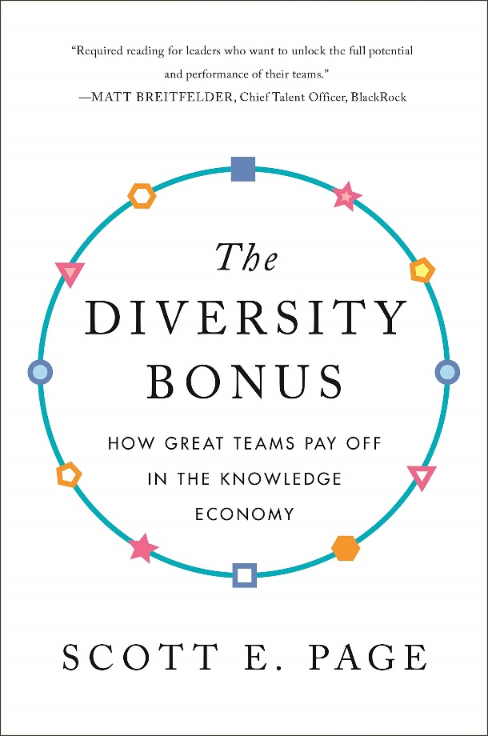
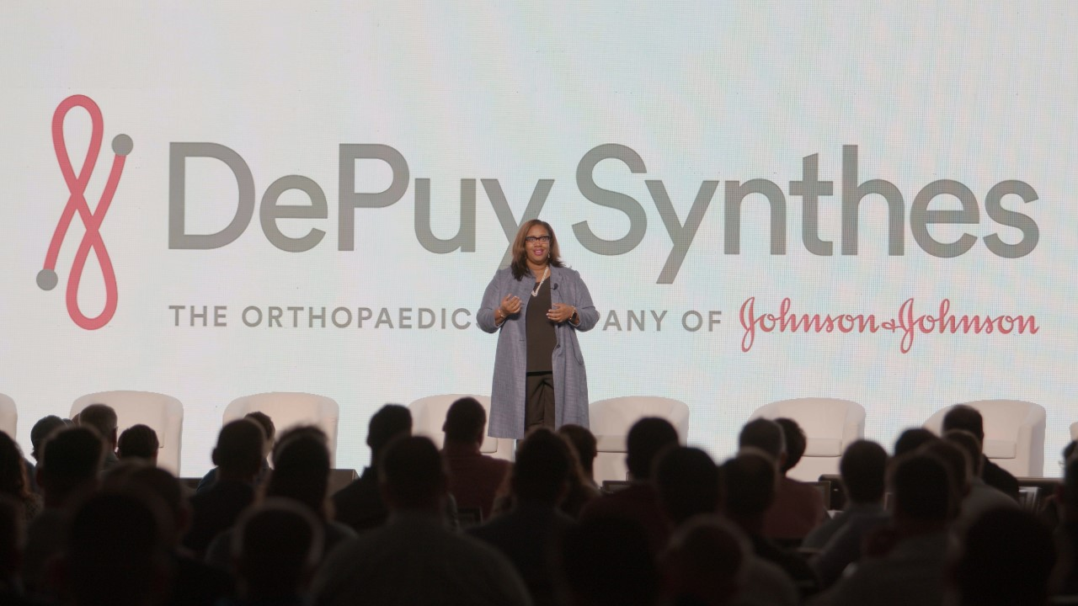
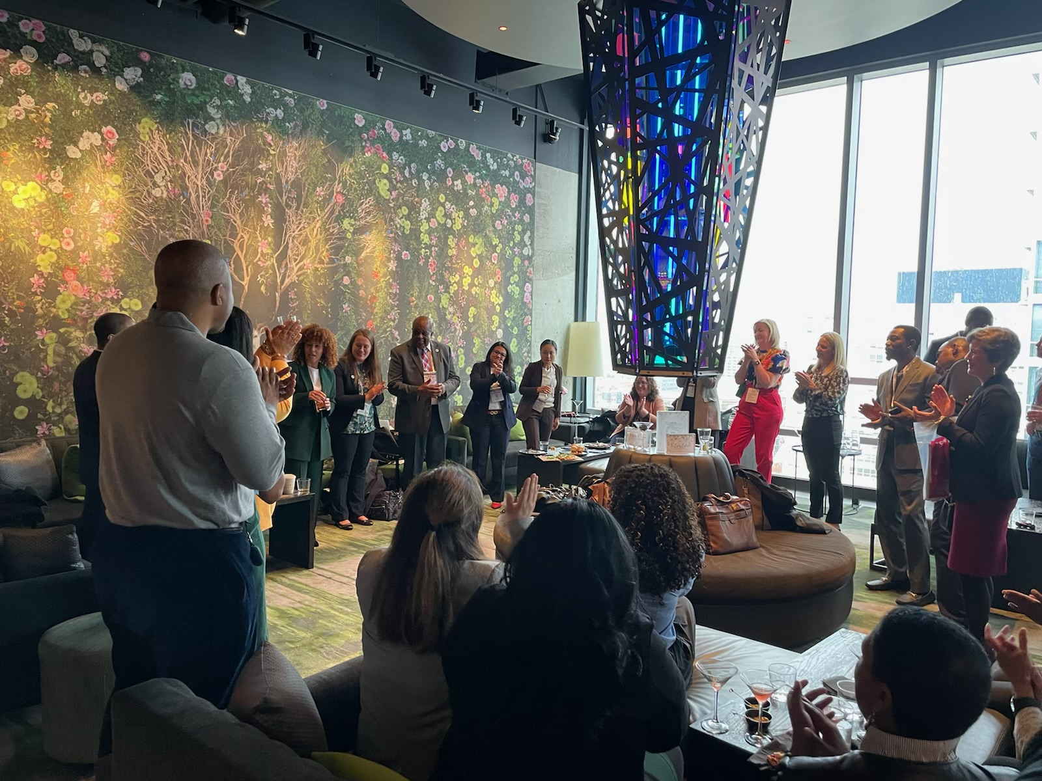
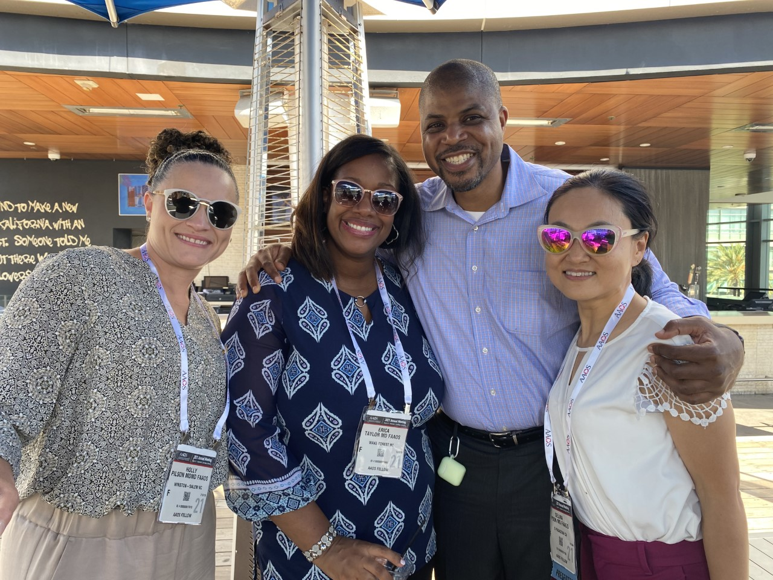
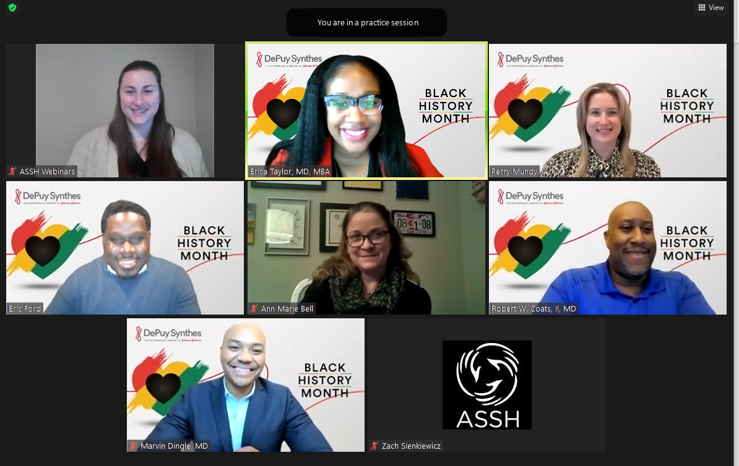
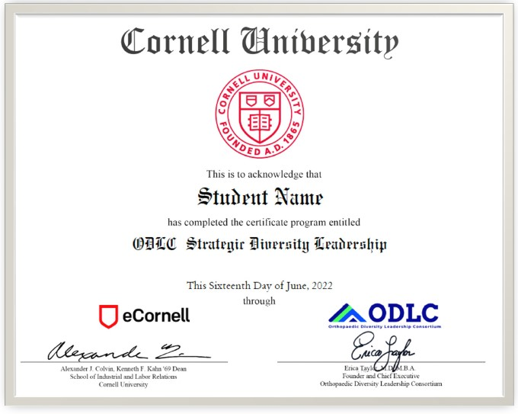

STRATEGY

Slide 26
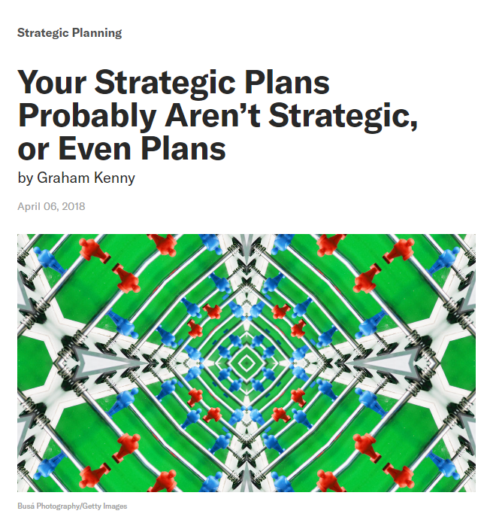
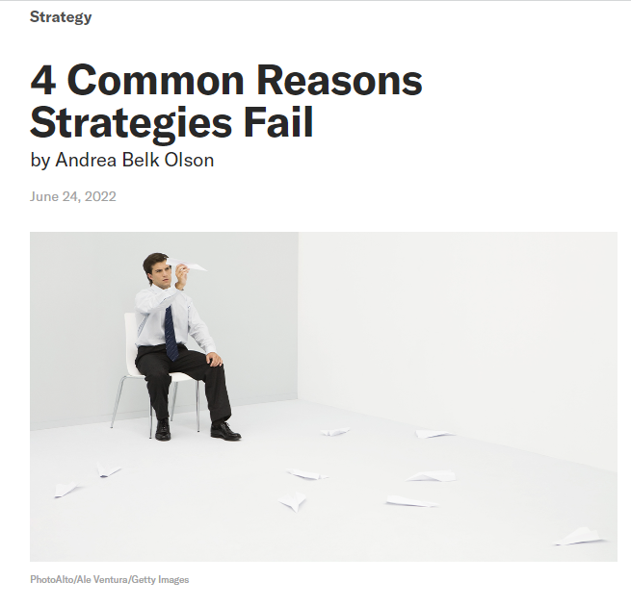
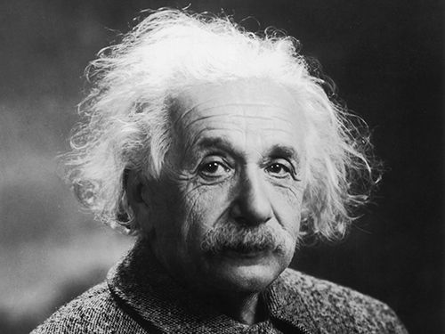
“STRATEGY”
“We can’t solve problems by using the same kind of thinking we used when we created them.”
Error #1: Not understanding the problem.
Strategy
Error #2: Not understanding the organization’s capabilities.
Objective
Action
Error #3: Not understanding the immovable pressures.
Error #4: Not understanding the cultural landscape.

Slide 27
WHAT IS YOUR WHY? (3S Framework)
SYSTEM
STRATEGY
SELF

Slide 28
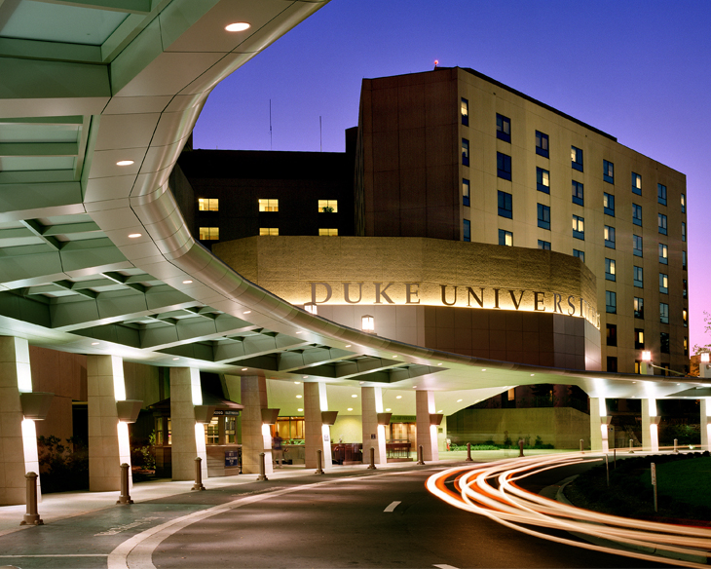
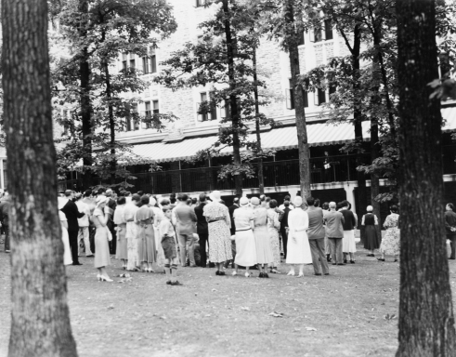
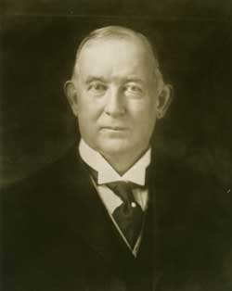
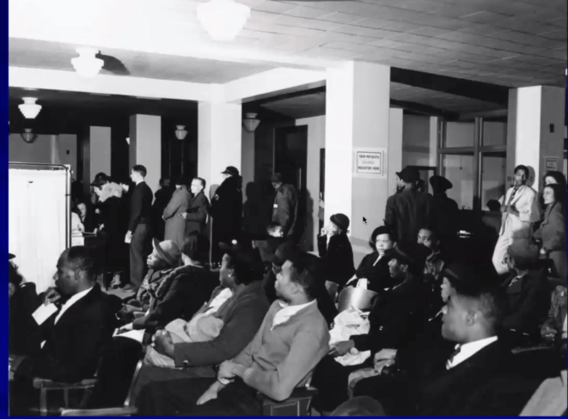
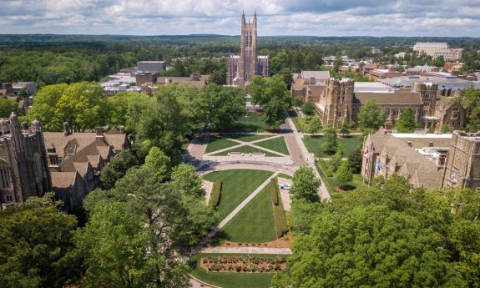
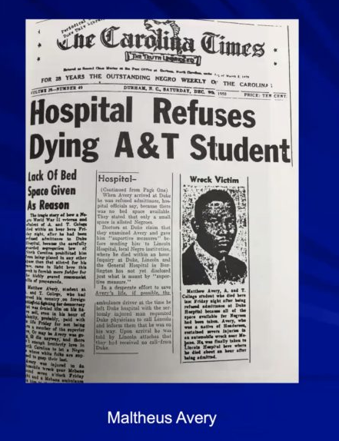
SYSTEM
Are there policies that our systems have in place TODAY that are causing harms that won’t be recognized until TOMORROW?

Slide 29
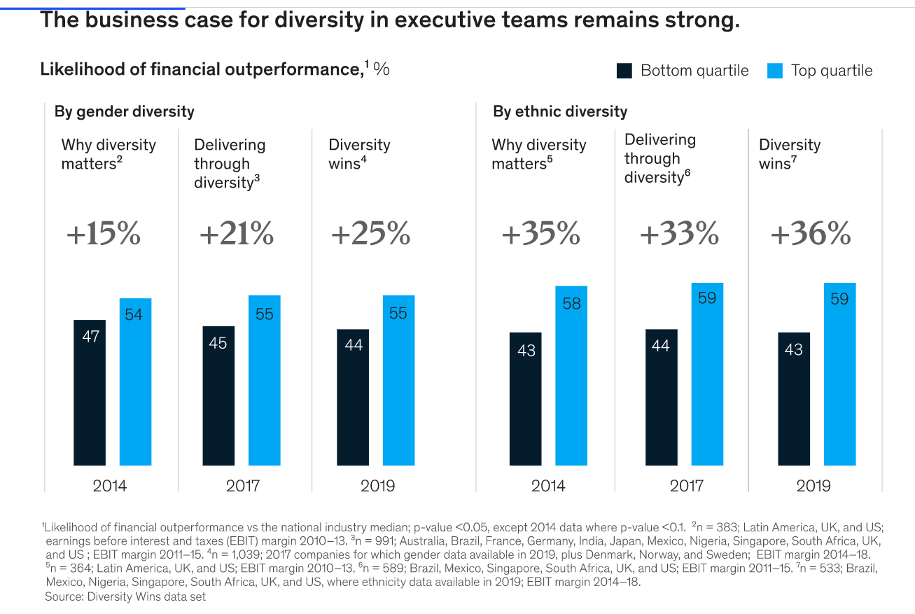

Economic Benefits

Slide 30
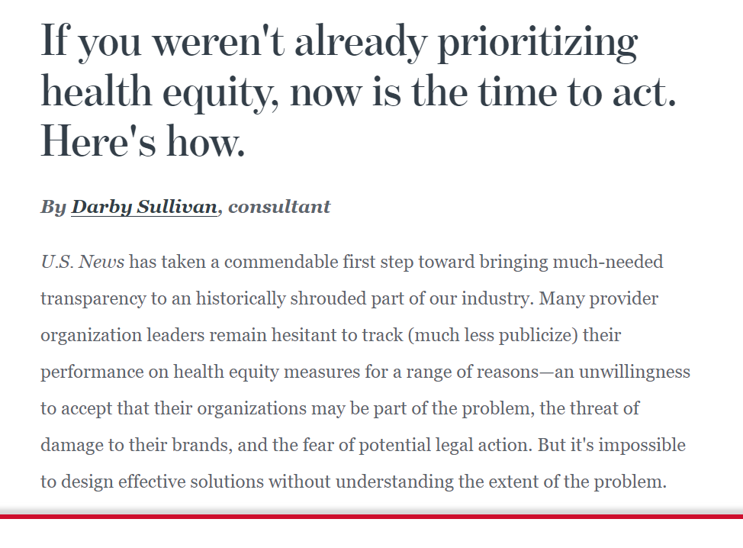
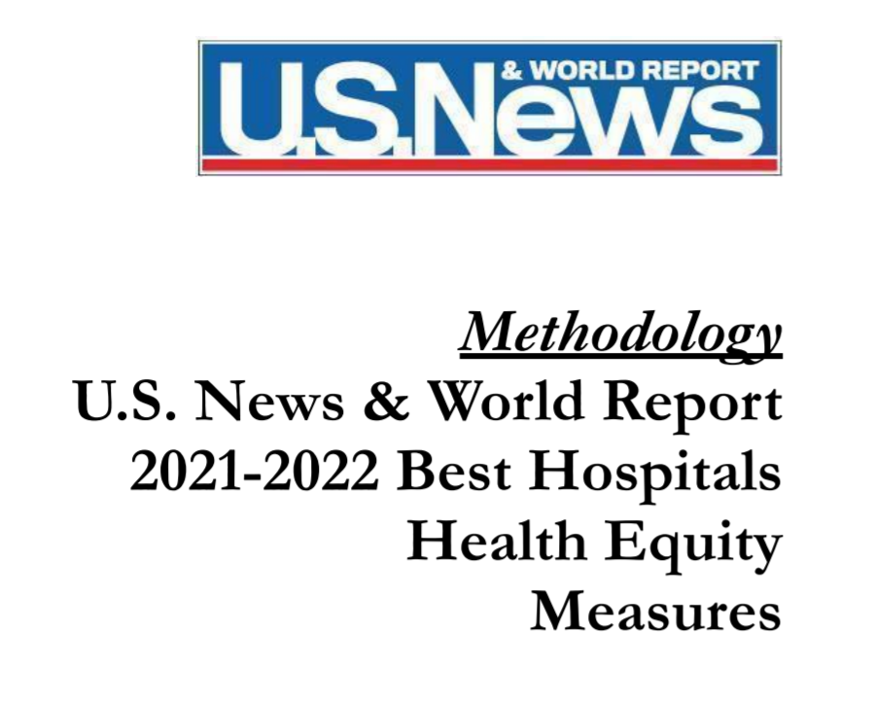
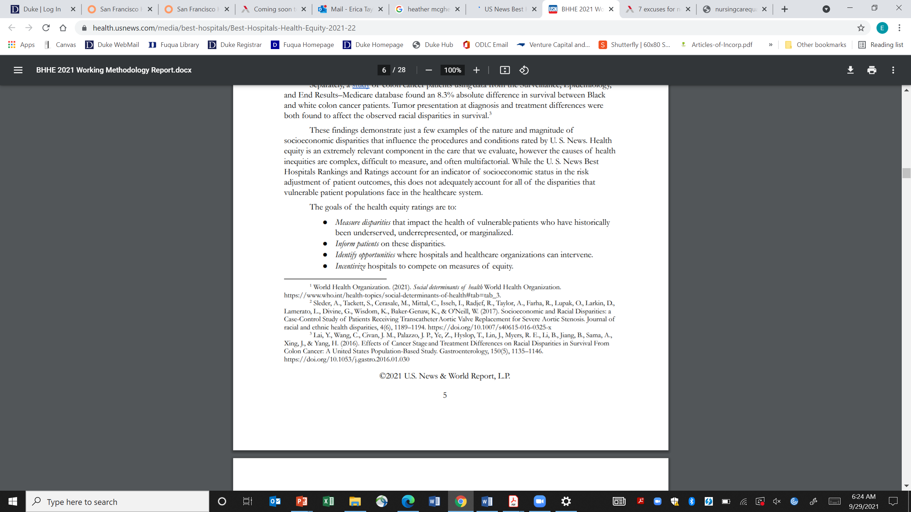


Slide 31
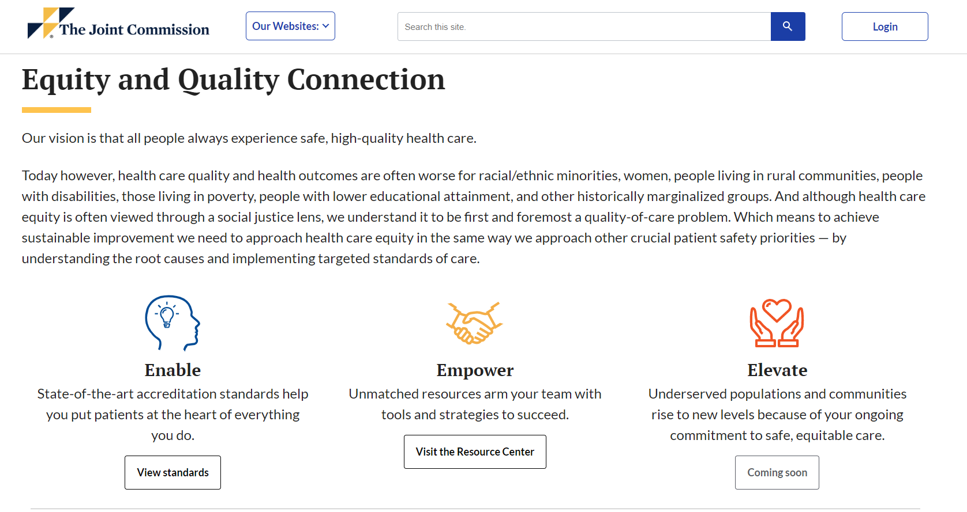
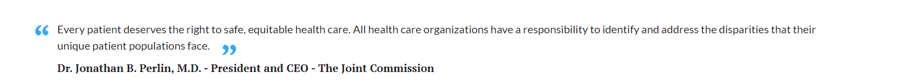

Slide 32

What aRE Systems Addressing Today?
EFFECTIVE?
COMPLETE?
ALIGNED?
Issues of Retention & Recruitment
Health
Disparities
Resource
Equity
Threats to Culture
Social Determinants of Health
Anti-Racism
Implicit Bias and Microaggressions

Slide 33
WHAT
What does it mean to be diverse?
WHY
Why is health equity important?
HOW
How do we make sustainable change?
How do we create a culture of respect and belonging?
What is inclusion?
Equity vs. Equality?
Why does diversity matter to patients and learners?
SYSTEM
STRATEGY
SELF

Slide 34

Reflection
WHY ARE YOU HERE?
WHAT WILL KEEP YOU HERE?
WHO NEEDS YOU TO BE HERE?
WHAT WILL IT TAKE FOR YOU TO BRING OTHERS HERE?

Slide 35
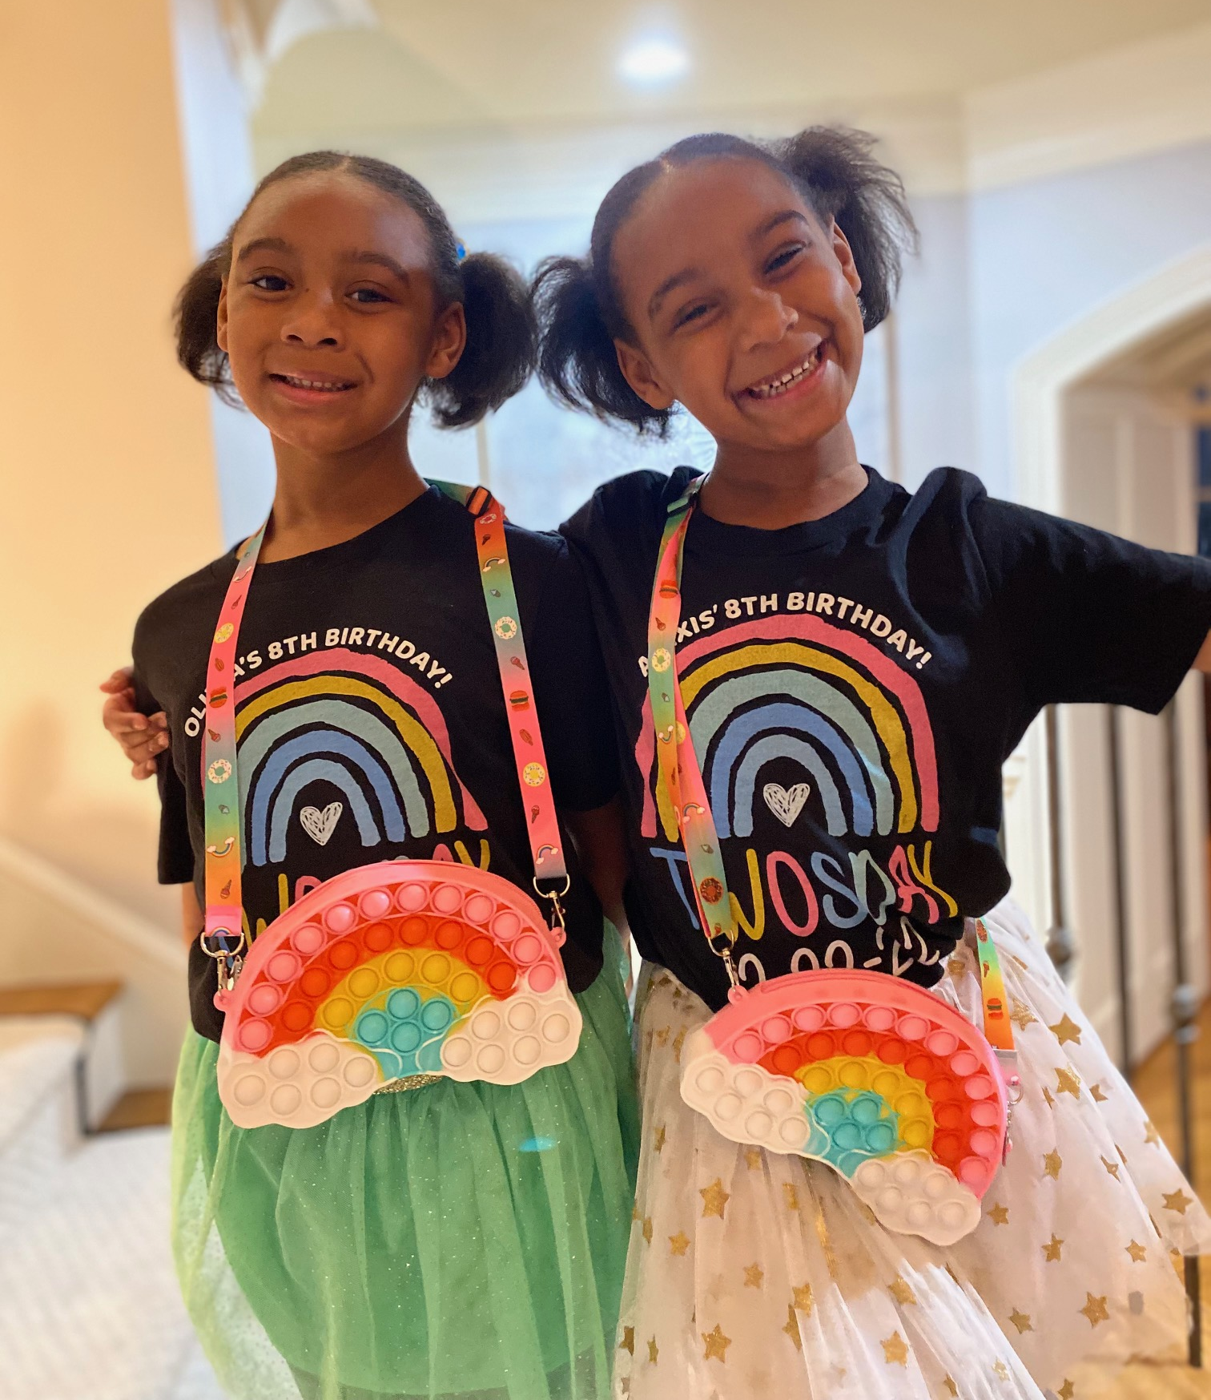
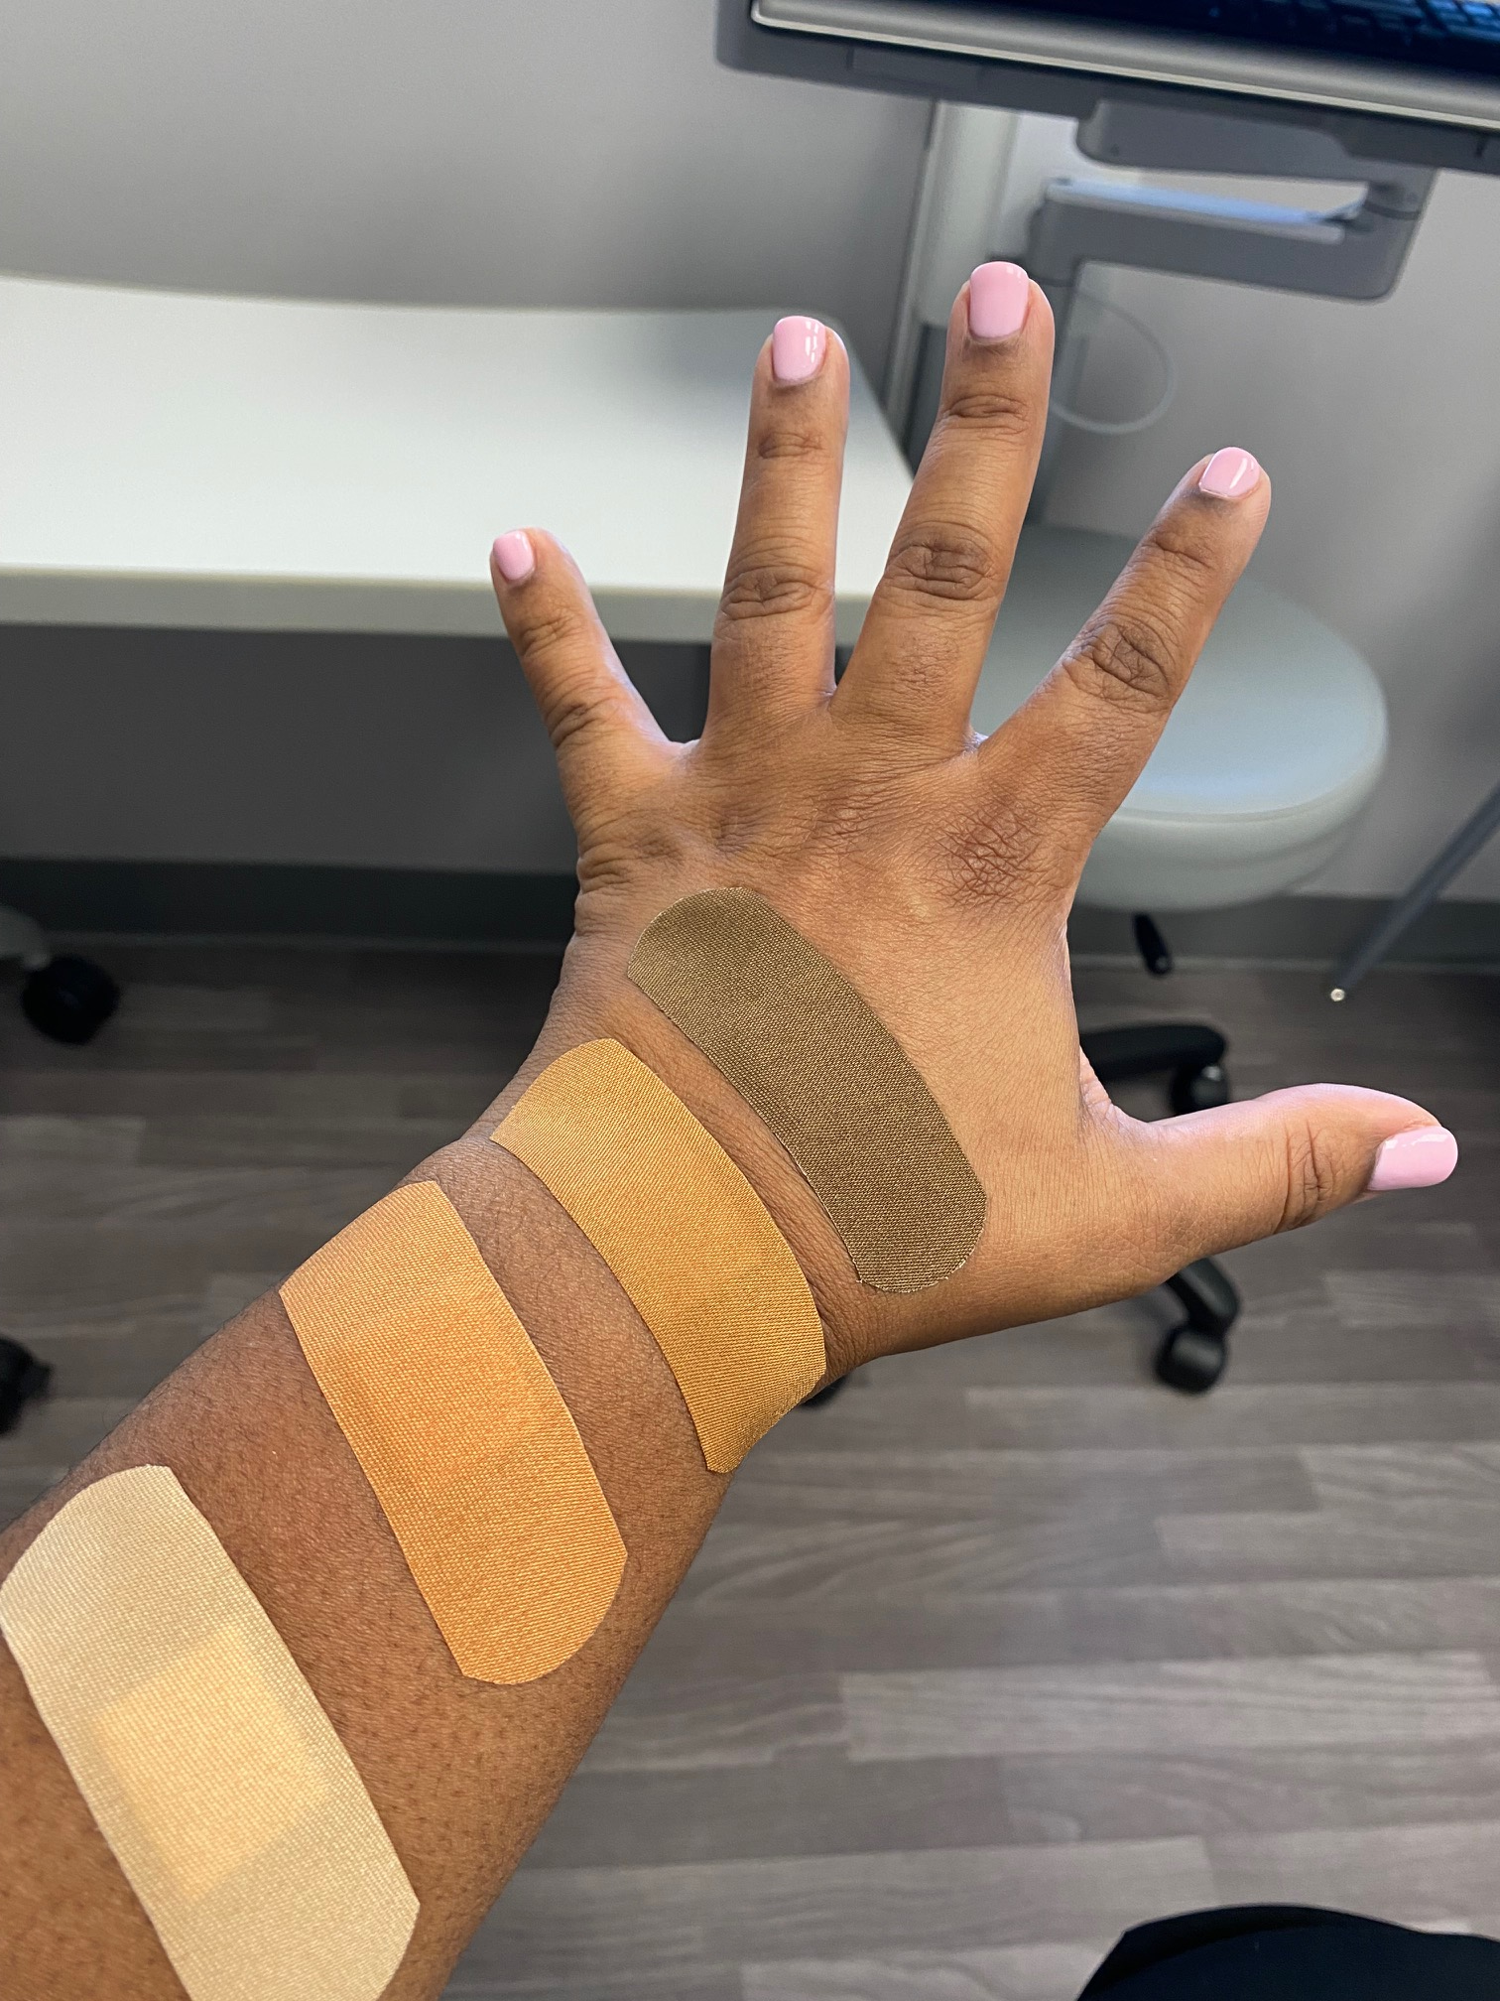
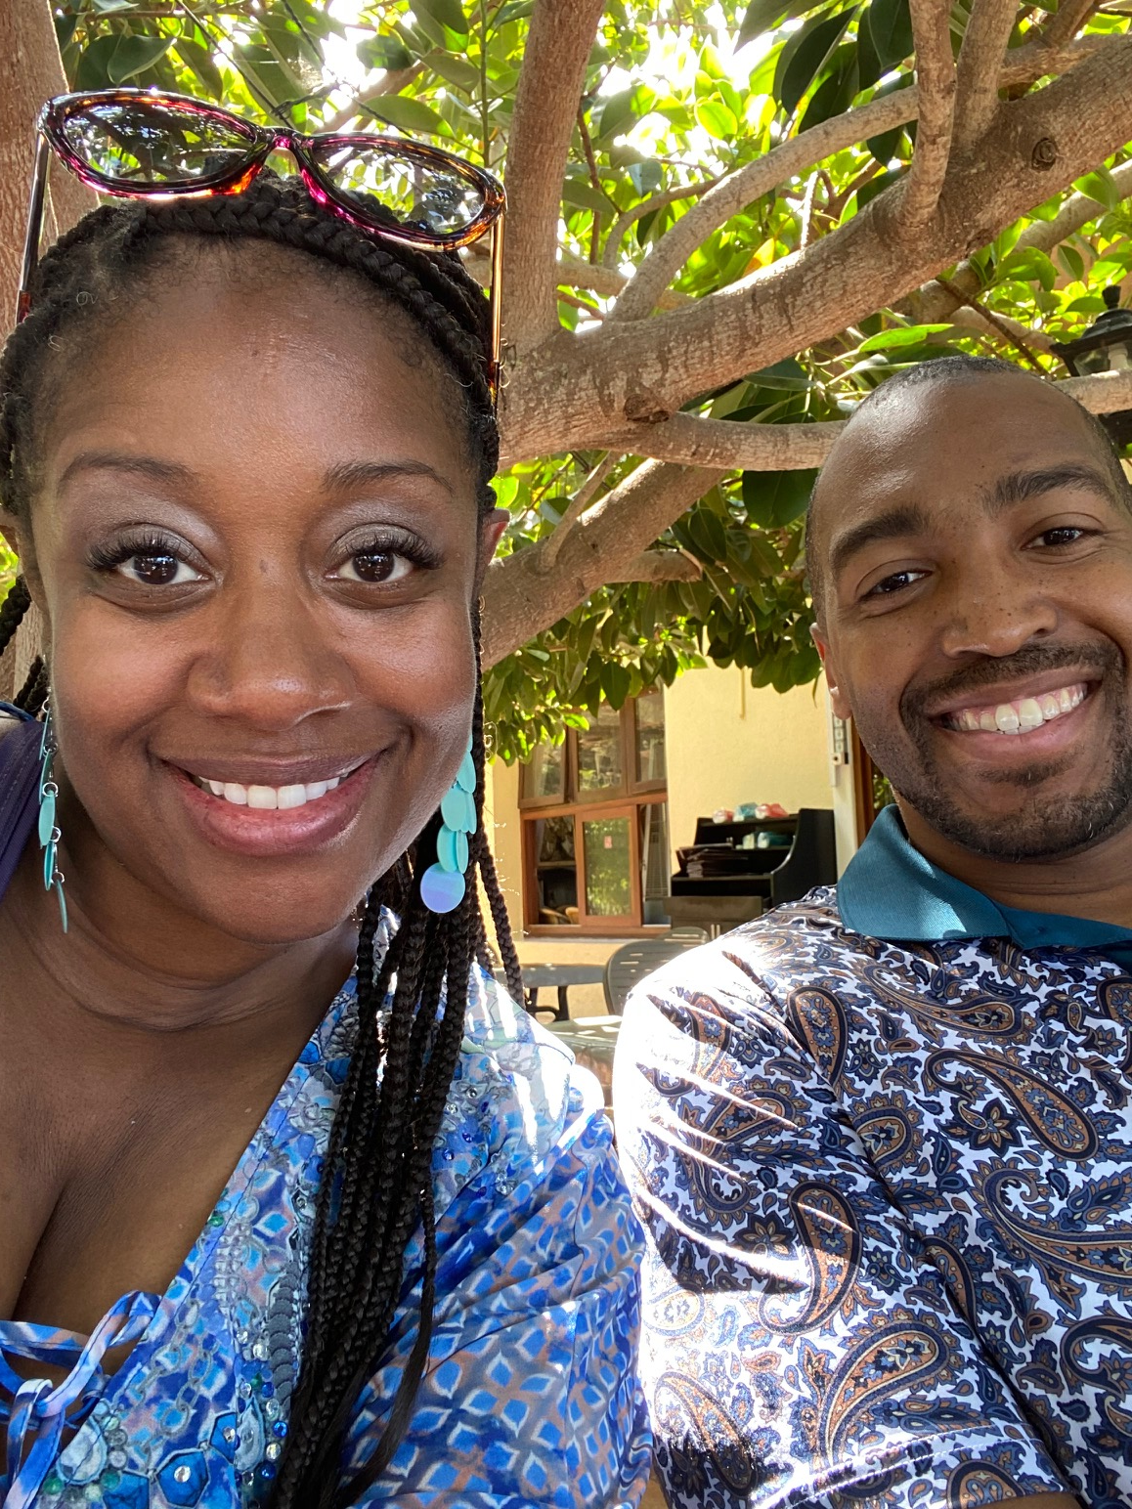
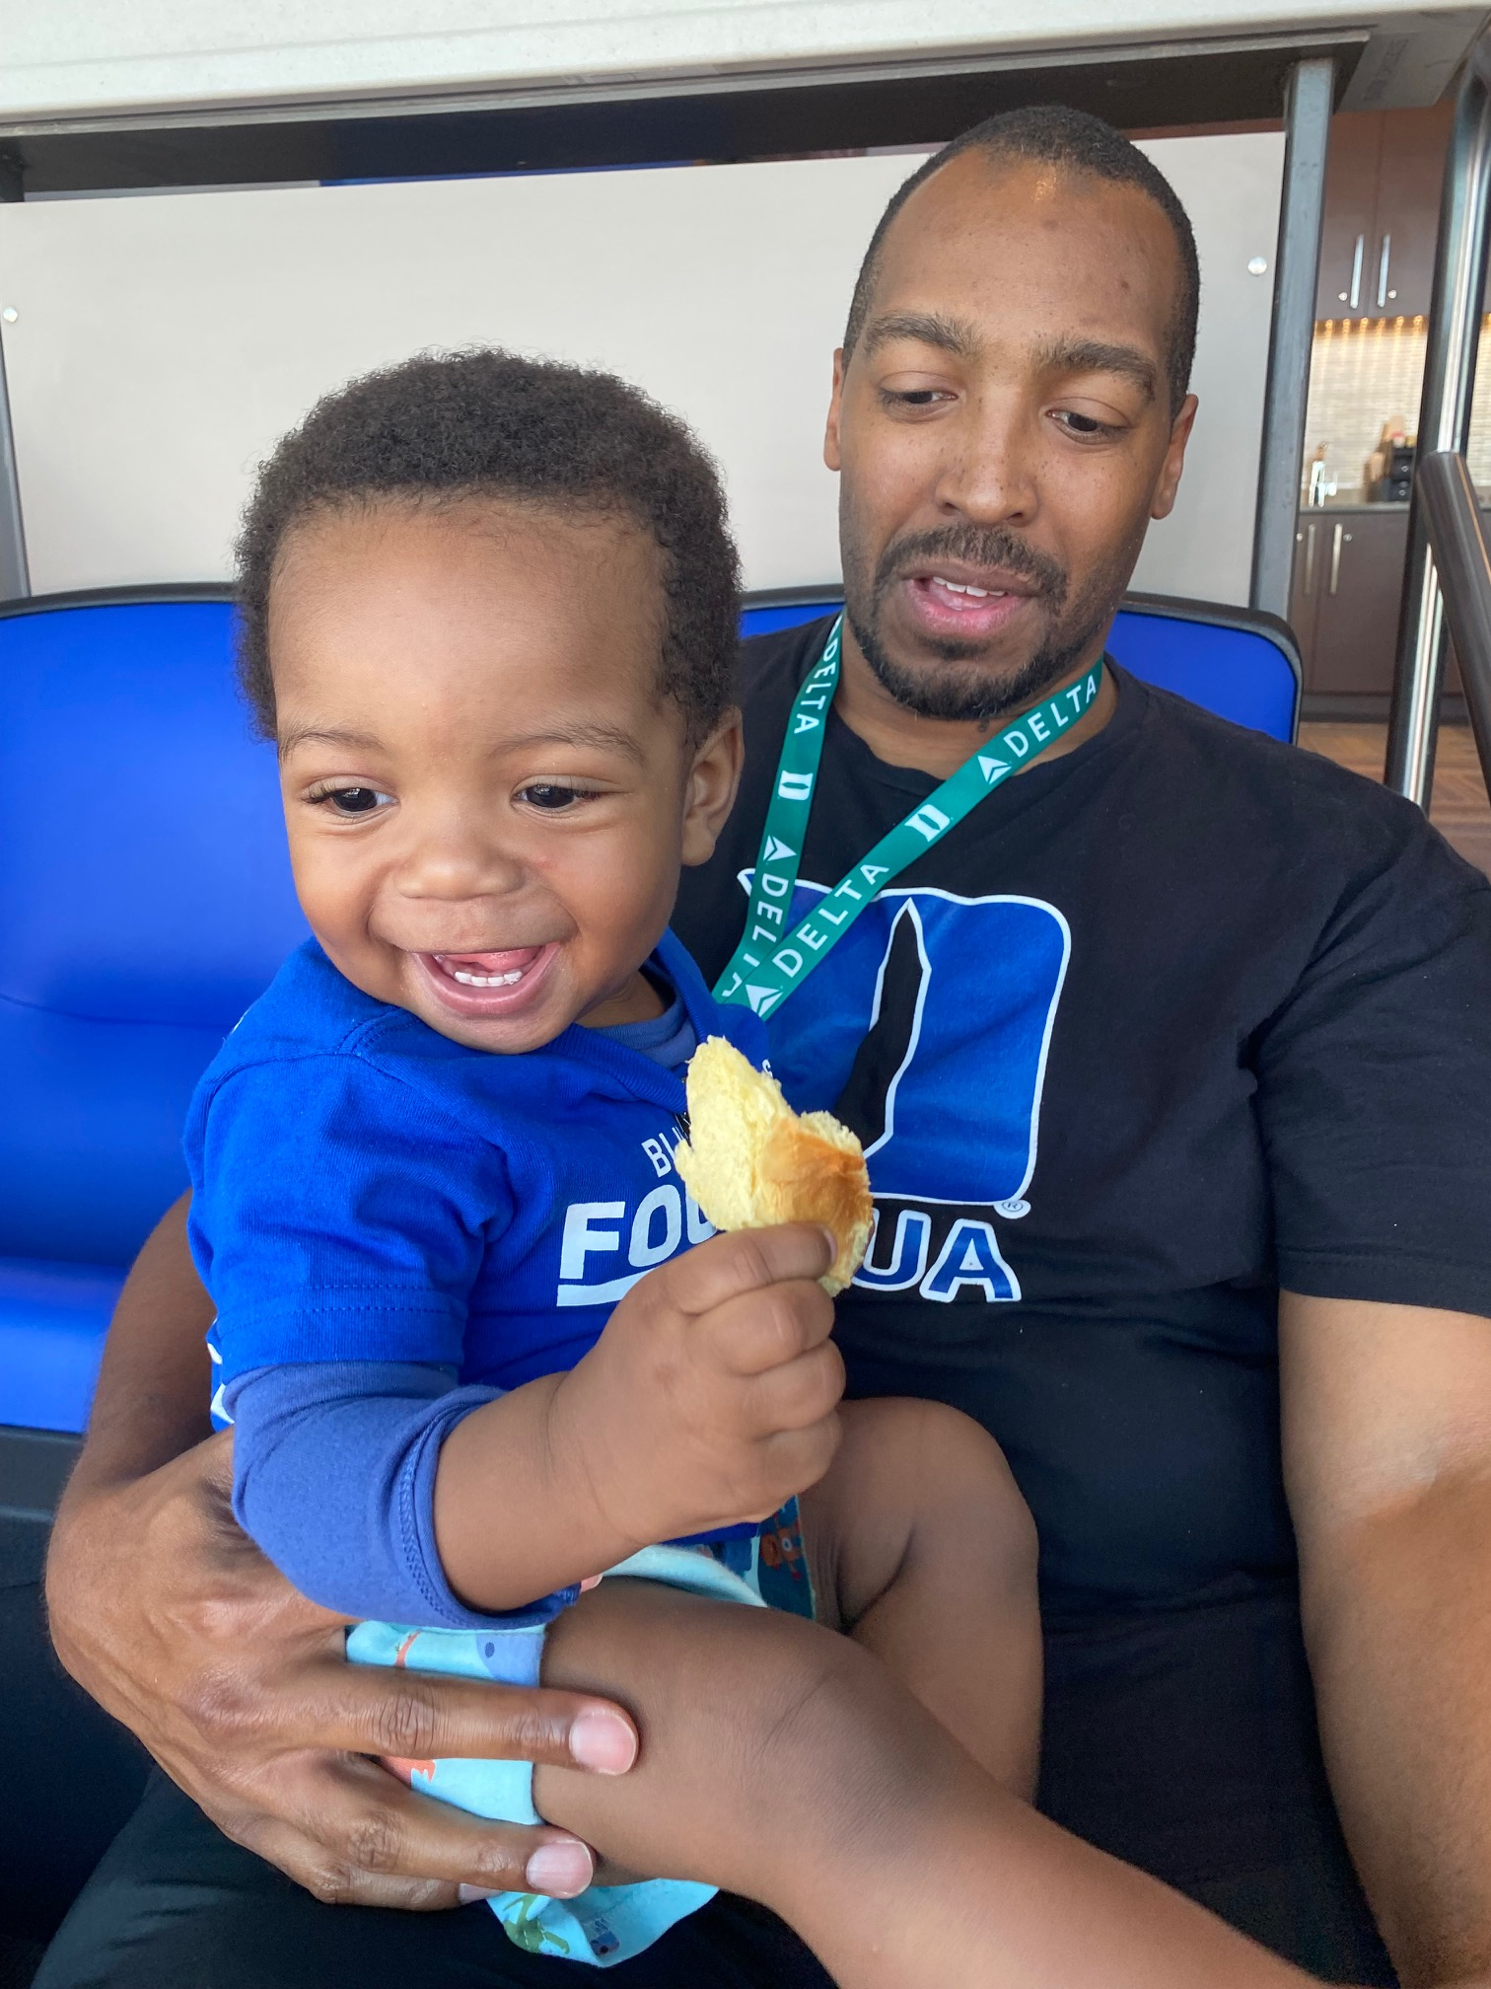

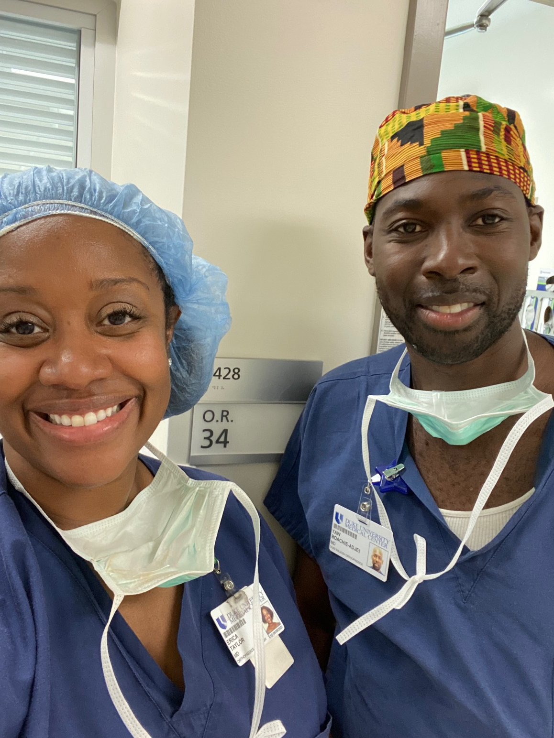
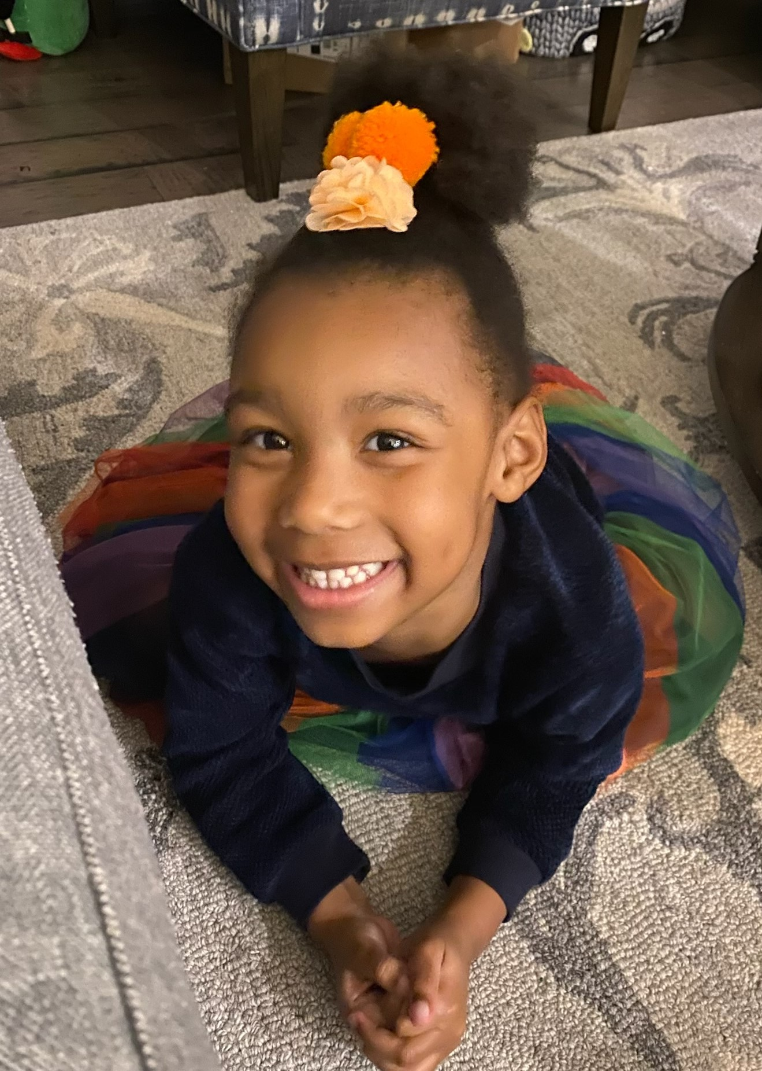
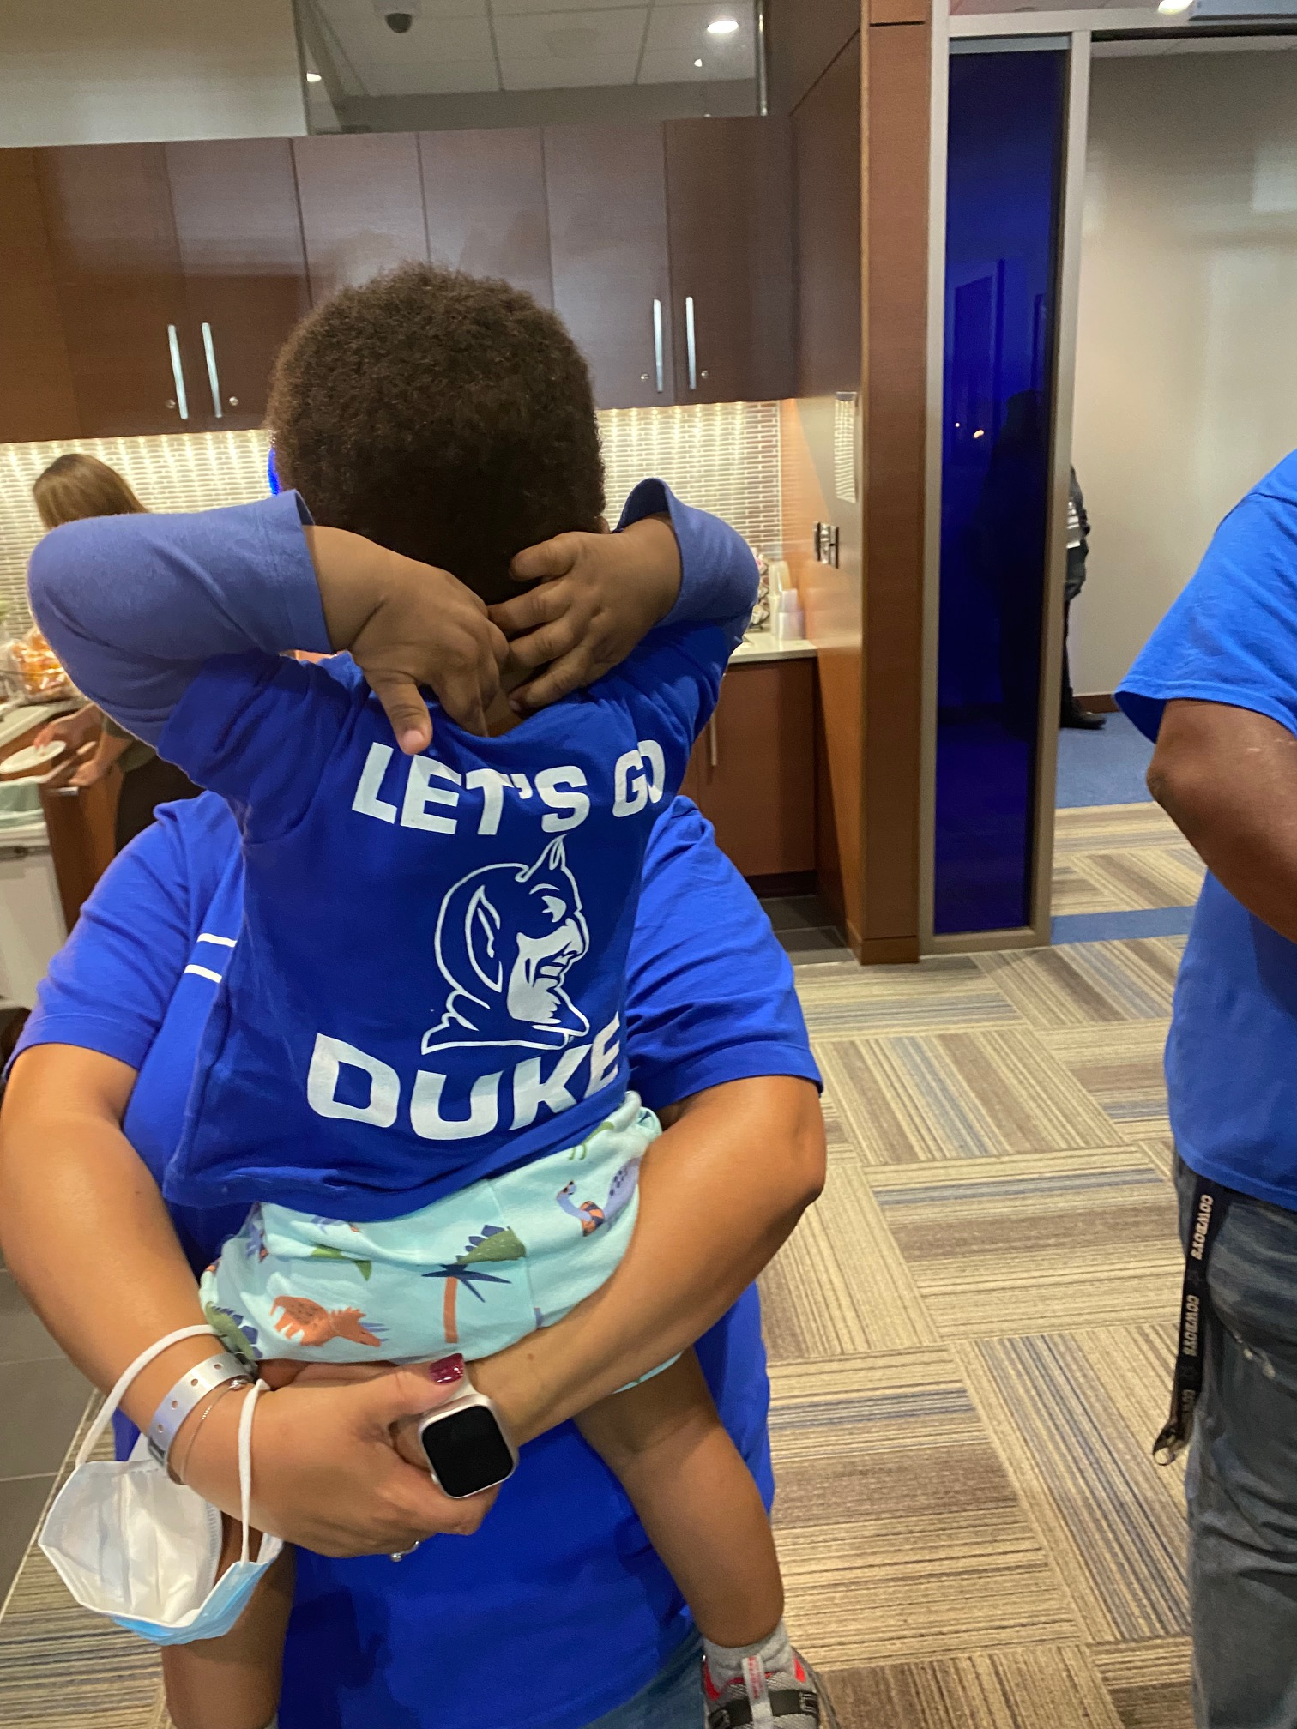

My “Why”

