Slide 1
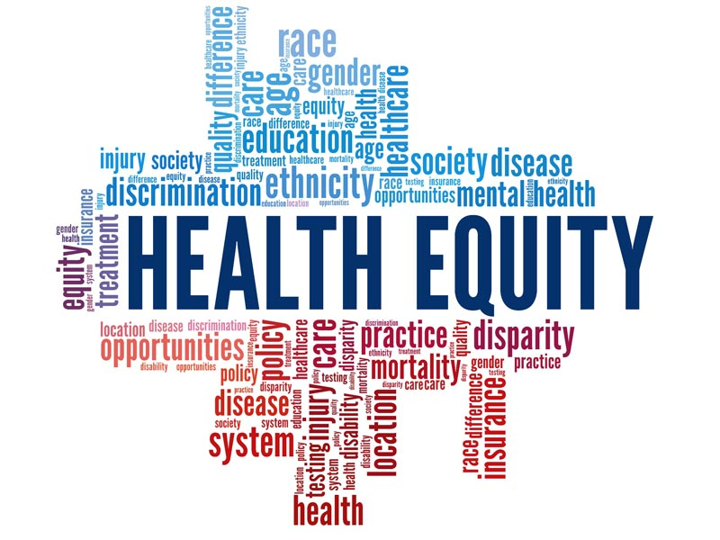
Integrating Genomics and Public Health Approaches to Achieve Health Equity
Keith L. Keene, Ph.D.
Professor, Department of Public Health Sciences;
Resident Faculty, Center for Public Health Genomics
Director, Center for Health Equity and Precision Public Health
2024 Johns Wooten Neurology Symposium
May 4, 2024

Slide 2
Disclosures
No conflicts of interest to report
Funding provided by the National Institutes of Health, American Heart Association, Bristol Myers Squibb, and Walking for My Life 5K Stroke Walk sponsored by Faith Christian Center International

Slide 3
The University of Virginia Center for Health Equity and Precision Public Health (CHEPPH) is an interdisciplinary center devoted to integrating Precision Medicine, Public Health, and Health Informatics approaches to improve the health and well-being of rural, economically challenged, and racial/ethnic-minority populations.
Goal: Utilize inclusive (DEI) approaches to reduce disparities, promote health equity, and create a diverse workforce population where every person has the opportunity to “attain his or her full health potential”:
Research
Community Outreach and Engagement
Education and Training Pipelines
Public Health
Genomics and Precision Health
Health Equity

Slide 4
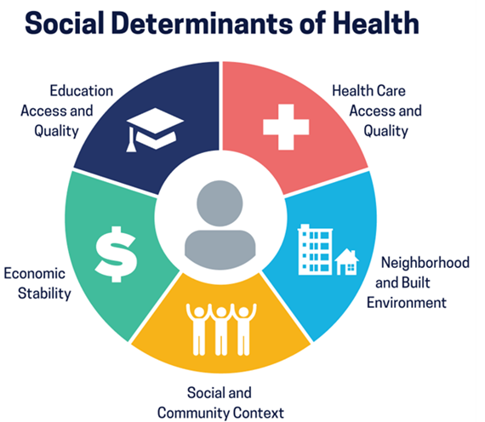
Health Disparities and Health Equity
Health Disparities- The disproportionate burden (differences) of disease (and death) by race/ethnicity, gender, age, geographical region, socioeconomic status (SES), etc.
Incidence, prevalence, mortality, and disease burden
Health equity- every person has the opportunity to “attain his or her full health potential” and no one is disadvantaged from achieving this potential because of socially determined circumstances

Slide 5
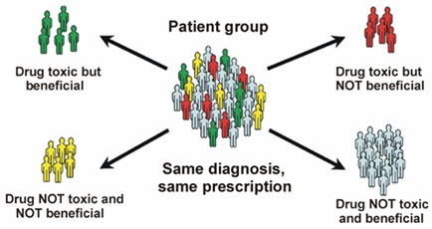
Precision (Personalized) Medicine
Eliminates the “one-size fits all” approach
Goal of giving “the right treatments at the right time, every time to the right person”

Slide 6
Precision Public Health
New field focused on delivering the right interventions to the right population
Utilizes data and technology (e.g., genomics, spatial analysis, big data) in public health practice to the investigate and control health threats in communities and target communities/small groups with precise health interventions
E.g. COVID-19- Approaches required rapid and iterative collection, analysis, and visualization of genomic, epidemiologic, geospatial, and contact tracing data

Slide 7
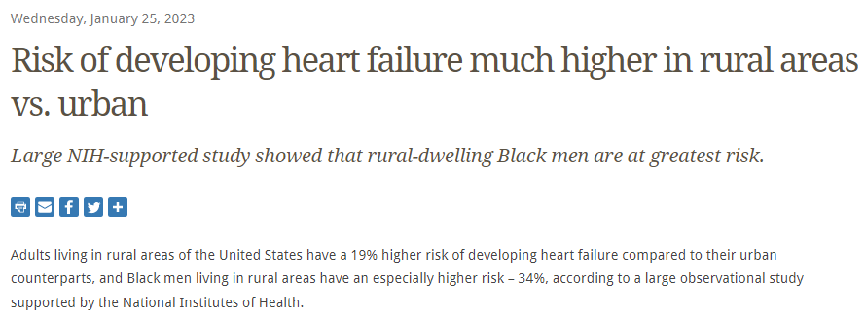
Rurality
Notes:
Approximately 26% of Virginians live in rural communities, which covers nearly 88% of the state.

Slide 8
Percentage Living in Poverty, 2018
Charlottesville- 22.1%

Slide 9
Health Disparities
Built and Physical Environment Poverty
Nutrition Lifestyle and Exercise
Quality/Access to Health Care Education and Health Literacy
Stress
Genetics Historical and Childhood Trauma Racism

Slide 10
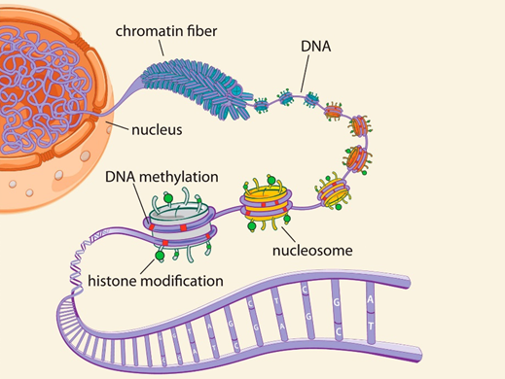
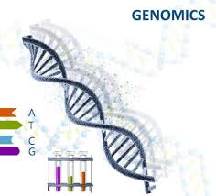
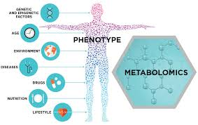
Research (Team Science) and Integrative Omics
Complex Diseases
Epigenomics
Notes:
Integrative approach- multi-omics offers opportunity to understand flow of information that underlies disease
Epigenomics focuses on genome-wide characterization of reversible modifications of DNA or DNA-associated proteins, such as DNA methylation or histone acetylation. Covalent modifications of DNA and histones are major regulators of gene transcription and subsequently of cellular fate. Those modifications can be influenced both by genetic and environmental factors, can be long lasting, and are sometimes heritable
Metabolomics simultaneously quantifies multiple small molecule types, such as amino acids, fatty acids, carbohydrates, or other products of cellular metabolic functions. Metabolite levels and relative ratios reflect metabolic function, and out of normal range perturbations are often indicative of disease. Quantitative measures of metabolite levels have made possible the discovery of novel genetic loci regulating small molecules, or their relative ratios, in plasma or other tissues
Genomics focuses on identifying genetic variants associated with disease, response to treatment, or future patient prognosis. In such studies, thousands of individuals are genotyped for more than a million genetic markers, and statistically significant differences in minor allele frequencies between cases and controls are considered evidence of association.

Slide 12
General Approach
Gene Identification
Candidate Gene
Linkage
Fine Mapping
Identify ALL Variants
Determine Causal Variant
Functional Studies
Biochemical Pathway
Disease Relevance

Slide 13
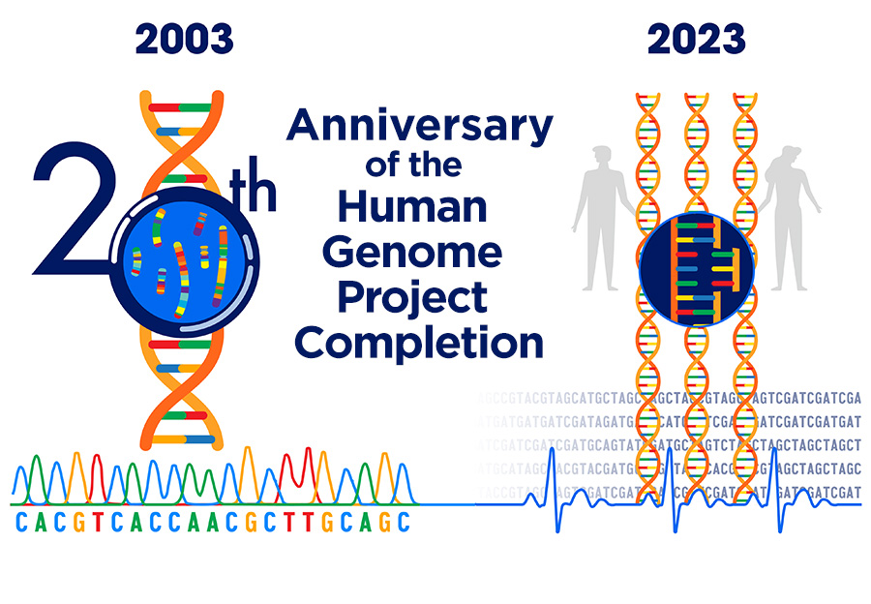
Notes:
Launched in October 1990 and completed in April 2003, the Human Genome Project’s signature accomplishment – generating the first sequence of the human genome – provided fundamental information about the human blueprint, which has since accelerated the study of human biology and improved the practice of medicine.

Slide 14
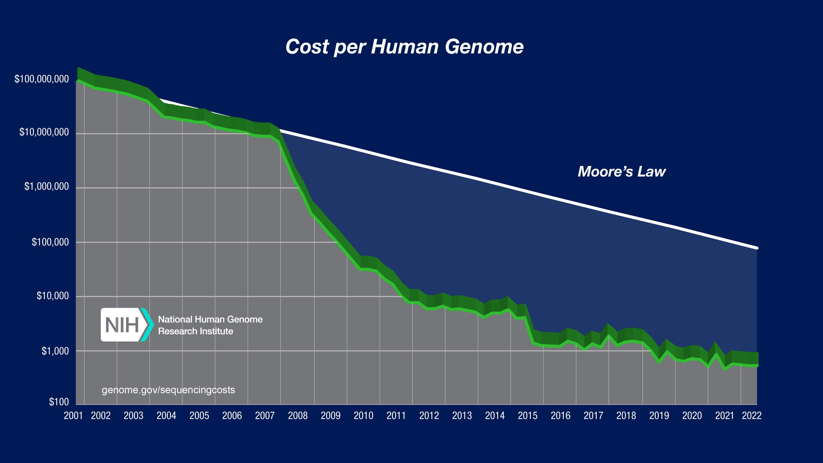
Notes:
Launched in October 1990 and completed in April 2003, the Human Genome Project’s signature accomplishment – generating the first sequence of the human genome – provided fundamental information about the human blueprint, which has since accelerated the study of human biology and improved the practice of medicine.

Slide 15
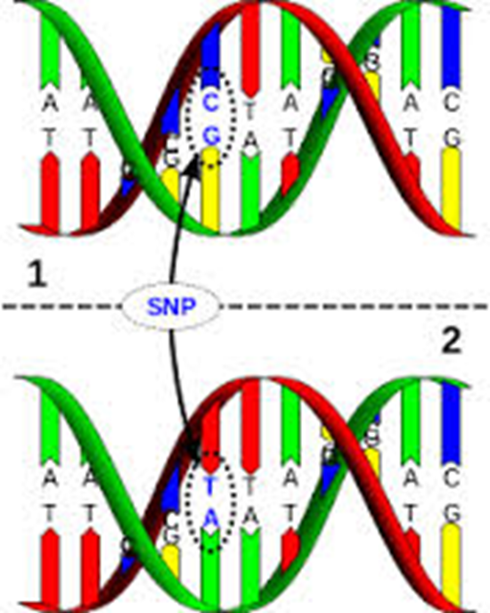
Genome-wide Association Study (GWAS)
Allow for the interrogation of genetic variants (i.e. SNPs) spanning the entire genome for associations with disease phenotypes
Requires no prior knowledge of gene (variant) function in relation to the disease of interest

Slide 16
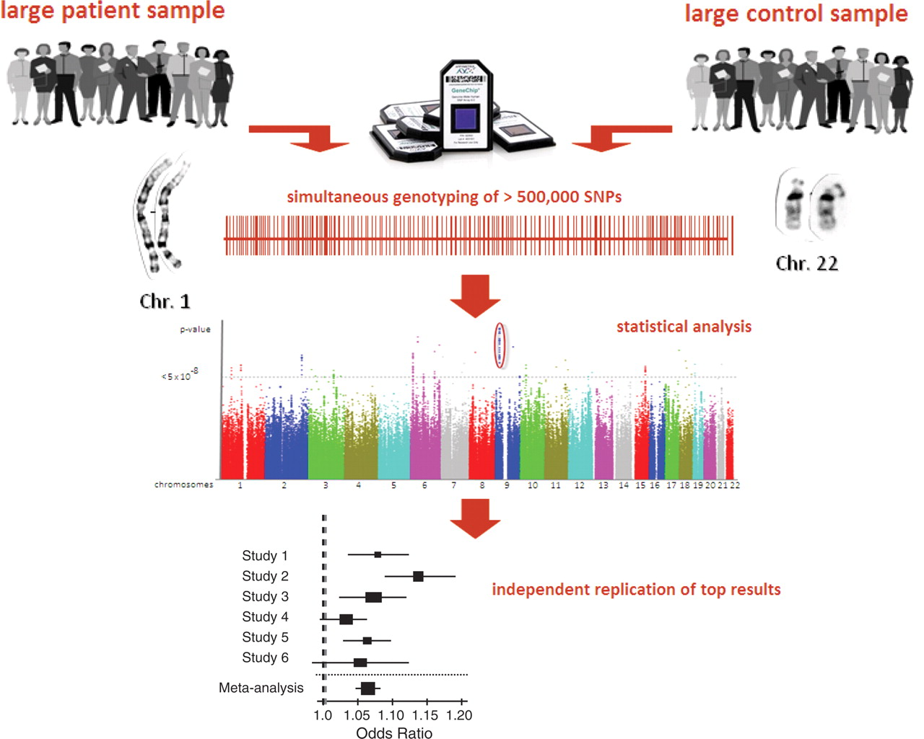
Principle of genome-wide association studies (GWAS)
From Eur Heart J 2010; 31:918-925

Slide 18
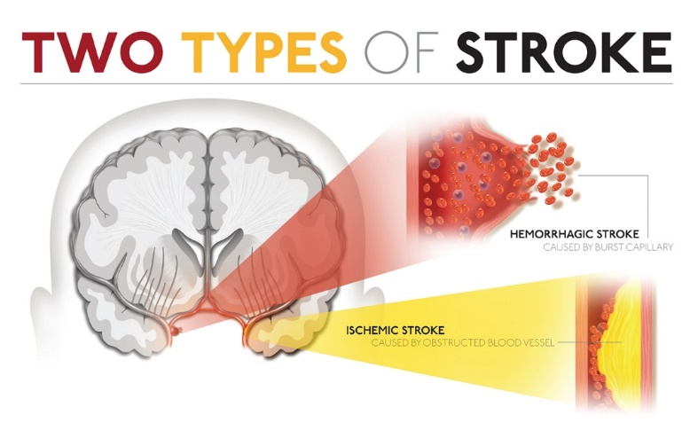
Stroke
5th Leading cause of death in the United States
Someone suffers a stroke every 40 seconds
Every 4 minutes someone dies of stroke
Number one cause of serious, long-term disability
40% of stroke survivors will suffer a recurrent stroke within 5 years of their first stroke
Complex disease
h²= 40%
Modifiable risk factors: Hypertension, diabetes, smoking
Notes:
1. What is a stroke, statistics of stroke ( 795,000 Americans will suffer a stroke, 1 out of 6 individuals globally will suffer a stroke in their lifetime, stroke is also the number one cause of long-term disability). 2. Recurrent strokes, how prevalent are they? What are the major types of stroke? Describe each and say which one you are focusing on.

Slide 19
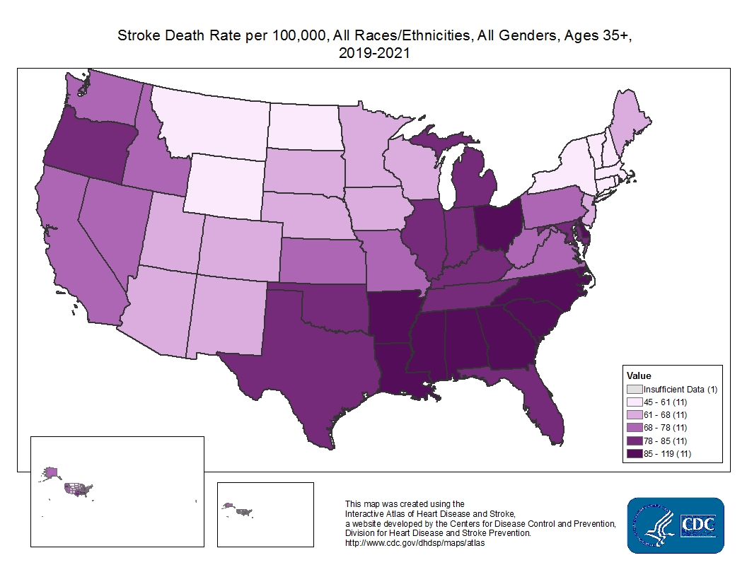

Slide 20
African American Stroke Statistics
African Americans are more impacted by stroke than any other racial group in the United States
2x greater rate of first stroke
Suffer strokes earlier in life
More severe and disabling strokes compared with Caucasians
Twice as likely to die from stroke

Slide 21
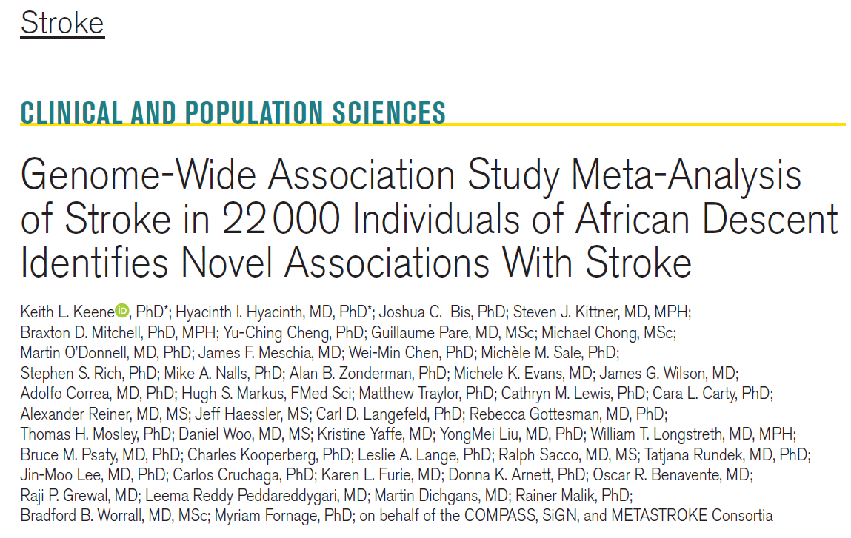
Consortium of Minority Population Genome-Wide Association Studies of Stroke
Aug 2020- largest GWAS of stroke in populations of African descent to date (3,734 cases- 18,317 controls from 13 cohorts) identified 24 loci (16 validated)
American Heart Association 2020 Stroke Progress and Innovation Award (3rd Prize)

Slide 22
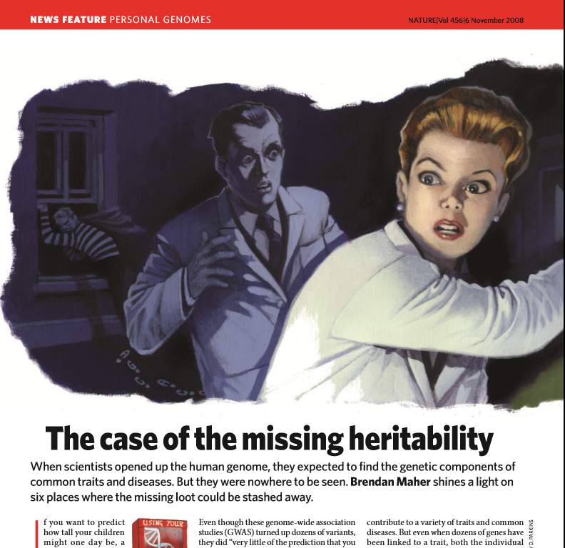
Advanced methods- prs
Replication across populations
“Actionable Genes”
Examples: Precision Health and Clinical Utility, Functional Genomics, etc.

Slide 23
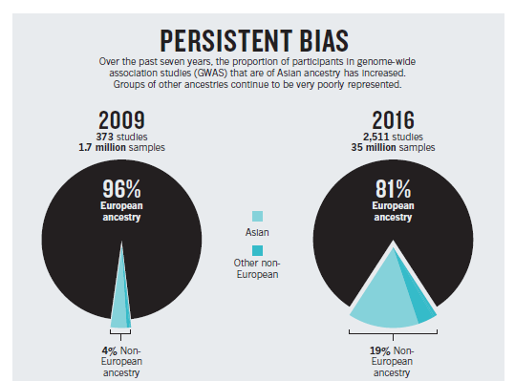

Slide 25
Changing Demographics

Slide 26
Diversity and Inclusion is Essential
Representation- having people who look and sound like the community they serve
data show that minority patients have better outcomes when they receive their clinical care from individuals of their own race/ethnicity
Participation- increased diversity in research and clinical trial studies
Translation- generating data/results that are relevant/applicable to diverse populations
Elimination- curing disease, eliminating disparities and other barriers

Slide 27
Vitamin Intervention for Stroke Prevention (VISP) Trial
Multi-center, double-blind, randomized, controlled clinical trial
Designed to determine if vitamin supplementation reduced recurrent cerebral infarction, nonfatal myocardial infarction or mortality
Enrolled ischemic stroke patients
3-120 days after stroke
Follow for 2 years
Age ≥ 35
Modified Rankin ≤ 3
Homocysteine levels above the 25th percentile

Slide 28
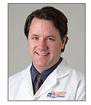
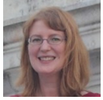
VISP Genotypic Data*
Sex | Race
 | European American | African American | Other
Female | 604 | 116 | 45
Male | 1121 | 142 | 72
Total | 1725 | 258 | 117
*Genotyped on the Illumina HumanOmni1-Quad-v1 array
RFA-HG-08-004 Genome-wide Association Studies of Treatment Response in Randomized Clinical Trials – Study Investigators (U01)
Pharmacogenomic studies in VISP: results & implications for clinical trial
Design. Joint PIs: Michèle M. Sale, Ph.D. and Bradford B. Worrall, M.D.

Slide 29
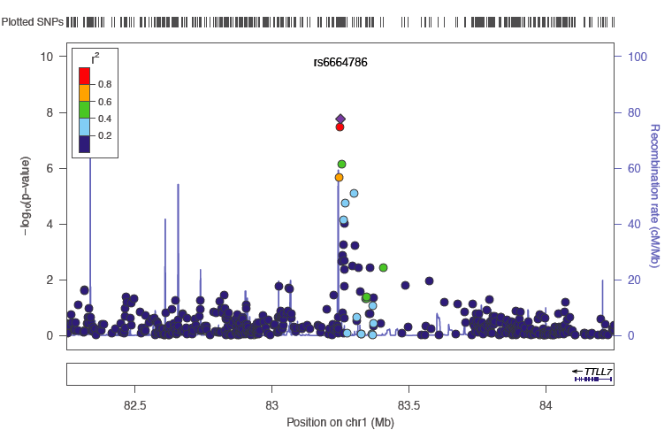
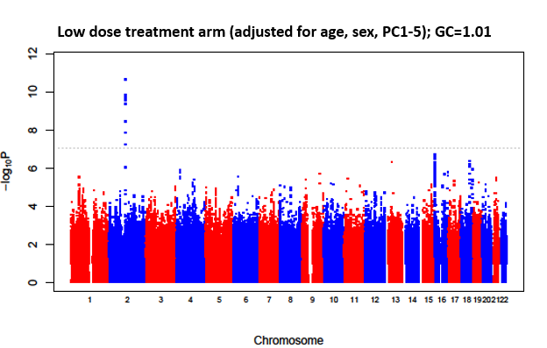
Recurrent stroke survival analysis (GWAS)
(under review) Frontiers Diversity in Genetic Risk of Recurrent Stroke: A Genome-Wide Association Study Meta-Analysis. Chad M. Aldridge, Nicole D. Armstrong, N. Abimbola Sunmonu, Deepak Palakshappa, Arne Lindgren, Annie Pedersen, Tara Stanne, Christina Jern, Jane Maguire, Fang-Chi Hsu, Keith L. Keene, Michele Sale, Marguerite R. Irvin, Bradford B. Worrall

Slide 30
Epigenetics
Epigenetics refers to chemical alterations in DNA and/or associated histone proteins that influence the genome without altering its genetic sequence
Epigenetic factors can be both stable and dynamic
Environment and behaviors, such as diet and exercise, can result in epigenetic changes
Implicated in several biological processes and diseases, especially cancer
Epigenetic information may be passed on across generations (e.g. effects of trauma can be passed down through generations)
DNA methylation is a widely accepted epigenetic factor that may be important in disease

Slide 31
UnMeth. Meth.

Slide 32
DNA Methylation, FOCM, and Stroke
Elevated homocysteine levels have been associated with several diseases, including cardiovascular disease and stroke
Cross-talk between the FOCM pathway, homocysteine, DNA methylation, and cardiovascular disease risk
Subset methylation study
200 samples
485,512 methylation loci

Slide 34
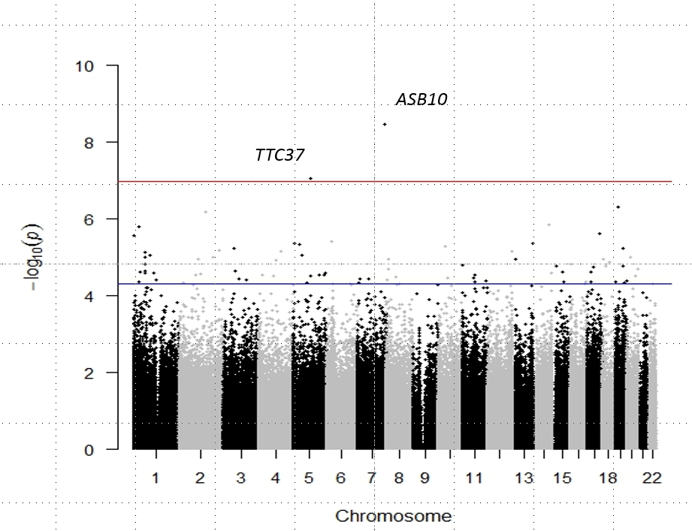
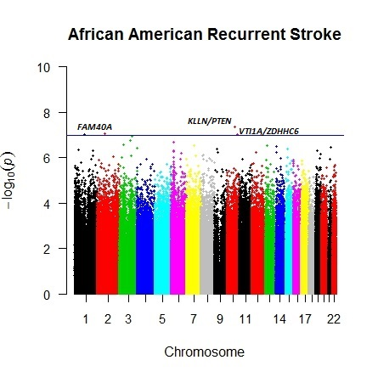
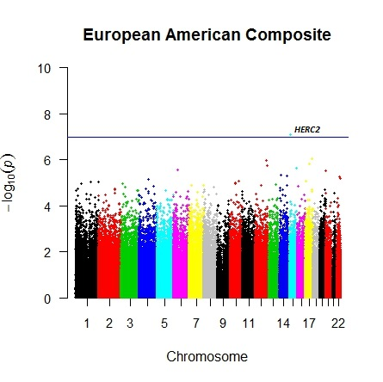
Epigenetics- EWAS
Notes:
Genome wide significance 5x 10 -8

Slide 35
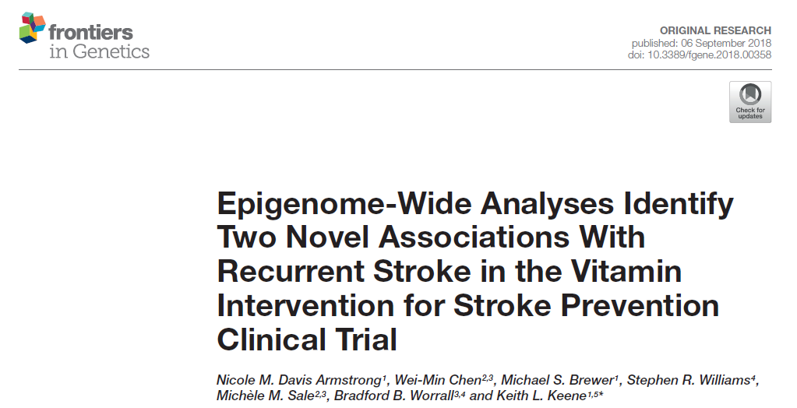
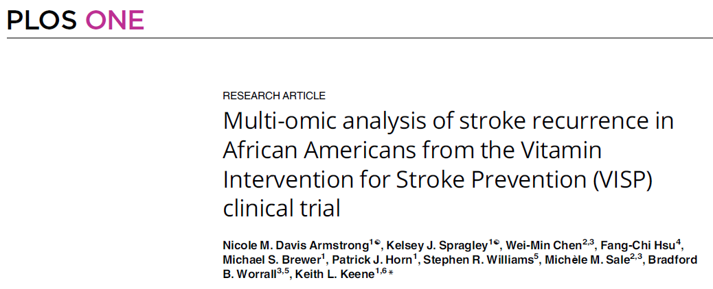

Slide 36
Beyond Traditional EWAS

Slide 37
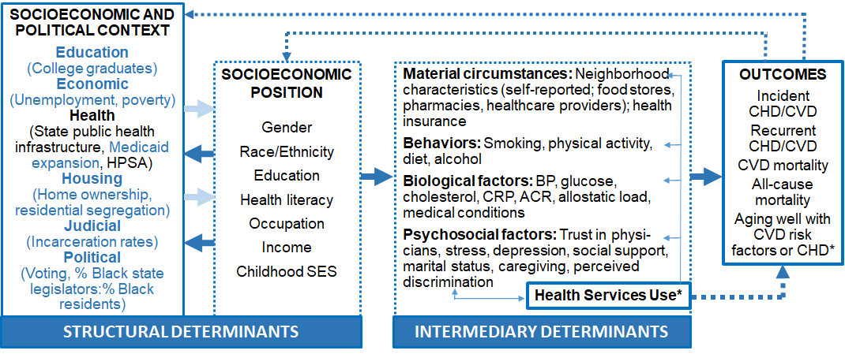
Figure 1. The WHOCSD framework adapted for this project. BP = blood pressure. CHD = coronary heart disease. CRP = C-reactive protein. = cardiovascular disease and stroke. HPSA = health professional shortage area. SES = socioeconomic status.

Slide 38
Expanded
Biological
Multi-Omics
Social-Behavioral
Tobacco
Environmental
Built-Neighborhood
Clinical
EHR Data
Alcohol
Exercise
Exposures (e.g. pollution)
Biomarkers
Quality of Care
Access to Care
Education
Poverty

Slide 39
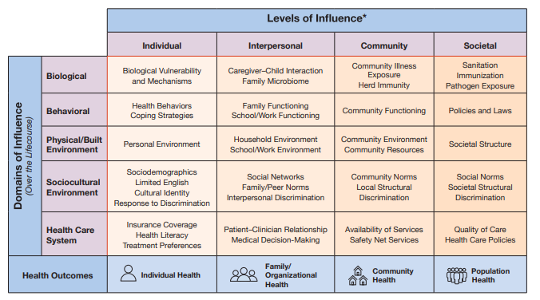
Summary
Health equity is a complex topic
Need to design biomedical (genomics) research through a health equity lens

Slide 40
Funding Opportunities
Investigator-Initiated Research in Genomics and Health Equity (R01) RFA-HG-23-017
Transformative Research to Address Health Disparities and Advance Health Equity (U01) RFA-NR-24-004
Community-Engaged Health Equity Research in Neuroscience Initiative (R01 RFA-NS-24-006 or R34 RFA-NS-24-007)

Slide 41
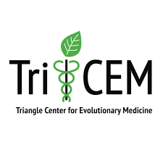
Acknowledgements
University of Vermont
Depts Medicine and Pathology
Mary Cushman, M.D., M.Sc.
Wake Forest University School of Medicine
Jasmin Divers, Ph.D.
Fang-Chi Hsu, Ph.D.
Lingyi Lu, M.S.
Deepak Palakshappa, M.D., MSHP
James Toole, M.D.
East Carolina University
Michael Brewer, Ph.D.
Kyle Summers, Ph.D.
Toyin Babatunde, Ph.D.
Patrick Horn, Ph.D.
Nicole Davis Armstrong, Ph.D.
Keeden Hopkin
Jessica Kennedy
Mitchell Williams
Dalon Paredes
Dunya Safa
Catherine Darcey
Kelsey Spragley
Nicole Mitchell
Josie Salisbury
Mariama Ibrahim
Hannah Turner
Children’s Hospital of Philadelphia
CIDR
Illumina, Inc.
Affymetrix, Inc.
Project SuGAR, COBRE, SLEIGH, REGARDS, CIMS, and VISP (GARNET) participants and study staff
Sea Island Families Project Citizen Advisory Committee
University of Virginia
Chad Aldridge, PT, DPT, MS-CR, NCS
Cheryl Bryan
Paul Campolieto
Fang Chen, Ph.D.
Wei-Min Chen, Ph.D.
Rahwa Ghiorghis (MSSRP)
Xuanlin Hou, M.S.
Yiqi Huang
Michele Sale, Ph.D.
Joe Mychaleckyj, D.Phil.
Uma Nayak, Ph.D.
Bradford Worrall, M.D.
Andrew Southerland, M.D.
Shaneela Malik, M.D.
Jamie Kramer
N. Abimbola Sunmonu, M.D.
Stephen Williams, Ph.D.
University of Alabama at Birmingham
Dept Nutrition Sciences
W. Timothy Garvey, M.D.
Kerry Lok, Ph.D.
Dept Public Health Sciences
George Howard, Dr.P.H.
Virginia Howard, Ph.D.
Marguerite R. Irvin, Ph.D.
Anh Le
Medical University of South Carolina
Dept Medicine
Jackie EuDaly
Jyotika Fernandes, M.D.
Gary Gilkeson, M.D.
Kelly Hunt, Ph.D.
Diane Kamen, M.D., M.S.
Anna Meyer
College of Nursing
Ida Johnson Spruill, R.N., Ph.D.
College of Dental Medicine
Nicole Marlow
Phillip Werner
Walking for My Life 5K Stroke Walk sponsored by Faith Christian Center International (Charlottesville, VA)

