Slide 1
Medical School
Debt Management
Everything you need to know
(in 30 minutes or less)
Margaret baxton
Melissa livoti
office of financial aid
Uva school of medicine

Slide 2
During Medical School
Debt management begins during school:
  Minimize debt as much as possible – be wary of the “drop in the bucket” way of thinking
  Search for outside scholarships
  Talk to your financial aid office
  Make – and stick to – a budget
Keep track of your loans
  Know all the terms and conditions of your loans
  Be organized so there are no surprises later

Slide 3
Types of Loans
Federal Student Loans
  Subsidized (undergrad)
  Unsubsidized
  Graduate PLUS
  Other: Perkins, PCL, LDS, HPSL
  Consolidation
Private Student Loans
  Private education loans (from a bank)
  Institutional loans (from your school)
Other Private Debt
  Bank or personal loans
  Credit card debt
  Residency/relocation loans
  Try the Motley Fool Debt Workbook
During undergrad and medical school, you may borrow a variety of loans.

Slide 4
Locating your Loans
You should receive periodic statements from all of your loan servicers, even during school.
If you’re unsure:
Ask your financial aid office
Ask your parents
Federal Loans: nslds.ed.gov
Private loans: check your credit report
  www.annualcreditreport.com
It is your responsibility to make sure your loan servicer is able to contact you.
Make sure your contact information is
up-to-date!

Slide 5
Get – and Stay – Organized
Create a file for each servicer
  Keep copies of everything, and notes on all conversations.
Get a username and password for each servicer’s website.
Know your terms and interest rates for all of your loans.
  If you have old loans that are variable or not Direct Loans, consider consolidation: studentloans.gov
Keep spouse/significant other informed so s/he can help.
OPEN YOUR MAIL.
  Do not ignore your servicer’s requests, even if you think they’re mistaken.

Slide 6
Options during Residency
Internship/Residency Forbearance
  No payments are due, interest accrues
Repayment
  Standard repayment
  Extended repayment
  Graduated repayment
  Income-Driven Repayment: based on your income and family size
Make a plan for residency before you start.
For your federal loans, you may choose to repay,
or not.
For private loans, contact your loan servicer.

Slide 7
Internship/Residency Forbearance
Available for federal subsidized, unsubsidized, Grad PLUS, and consolidation loans (not Perkins)
Good for 12 months at a time, must fill out the right form and have it signed by residency program
“Mandatory” – lender may not refuse
Check your account online to make sure forbearance is applied correctly
Beware accruing interest
  Set aside money each month in an emergency fund, then pay your interest before it capitalizes if you don’t have an emergency

Slide 8
Loan Repayment
Repayment plan options:
Standard
  10-year level repayment – default if you don’t choose otherwise
Extended
  Up to 25 years – will lower the monthly payment, increase total interest if you actually take 25 years to repay
Graduated
  Starts out low, increases every 2 years – we don’t recommend it
Income-Based
  IBR, PAYE, or REPAYE, depending on eligibility – 15% or 10% of your “discretionary” income, regardless of debt level

Slide 9
Income-Based Plans
Payment of 10-15% of AGI that exceeds 150% of poverty line
  IBR: 15%, available on all federal Stafford loans
  PAYE: 10%, “new borrower” as of 10/1/07, must have received a loan 10/1/2011
  REPAYE: 10%, available to all Direct Loan borrowers – this plan is usually best for single medical residents
Must reapply every year and submit tax returns
  IBR/PAYE: can file taxes separately to avoid using spouse’s income
Remaining debt forgiven after 25 years (20 for PAYE)
Eligible for Public Service Loan Forgiveness
Financial benefits
  IBR/PAYE: Small subsidy on unpaid sub loan interest
  REPAYE: half of all unpaid interest will be subsidized
  Unpaid interest will not capitalize as long as you are in the same plan

Slide 10
After Residency
Fellowship: Federal loans are eligible for the Graduate Fellowship Deferment
  No payments are due, no interest accrues on subsidized loans
Options during financial difficulty
Loan Repayment/Forgiveness Programs
Repayment

Slide 11
Options During Financial Difficulty
Federal loans:
Economic Hardship Deferment
Unemployment Deferment
General Forbearance (up to 3 years)
  Call and ask BEFORE you are late on a payment
Forgiveness upon death or total permanent disability
  So: do not purchase life insurance to cover your loans
Private loans:
Ask your servicer, find out about capitalization

Slide 12
Loan Repayment Programs
NIH: www.lrp.nih.gov
  $70,000 for 2+ years of biomedical or behavioral research in one of five research areas -- clinical; pediatric; health disparities; contraception and infertility; and clinical research for individuals from disadvantaged backgrounds
NHSC: nhsc.hrsa.gov/loanrepayment
Military:
  www.goarmy.com/amedd
  www.navy.com/healthcare/physicians
  www.afit.edu/adhplrp
Indian Health Service:
  www.ihs.gov/loanrepayment
State programs: www.aamc.org/stloan

Slide 13
Public Service Loan Forgiveness
Must have Direct Loans (can consolidate)
Must make 120 monthly payments under qualifying plan (IBR/PAYE/REPAYE)
Must work in public service during those 120 months
  Any government or non-profit [501(c)(3)] organization
Remaining debt after 10 years will be forgiven
Good option if you can pay during residency and plan to have a low income for 5+ years
No program to “join” – submit employment certification form and then apply at end of 10 years
Once you submit employment certification, loans will be transferred to Fedloan Servicing

Slide 14
Loan Repayment
Three general approaches after residency:
Fast & Furious
  If you’re making $150,000 and can live on $50,000, then you’ll have (after taxes) about $60,000/year to throw at your loans
  You can always prepay (pay more than required) without penalty
Standard Repayment
  Sign up for the 10-year repayment, pay extra when you can
Slow and Steady (pays the most)
  Take as long as possible to repay, to keep your monthly payment low – minimizes the impact of your student loan payment on your Debt-to-Income ratio (important if you’re getting other credit)
  May be a decent option if your interest rates are fixed and low

Slide 15
Loan Repayment - Tips
Debt repayment – two methods: highest-rate vs snowball repayment
Sign up for automatic payments
  You’ll never get a late fee, and there may be incentives
  Balance your checkbook!
Put alerts on your calendar – due dates, form reminders, recertifying income, etc.
The interest you pay is tax-deductible, but maybe only while you’re in residency (income limits)
  Higher education tax benefits: www.irs.gov/publications/p970

Slide 16
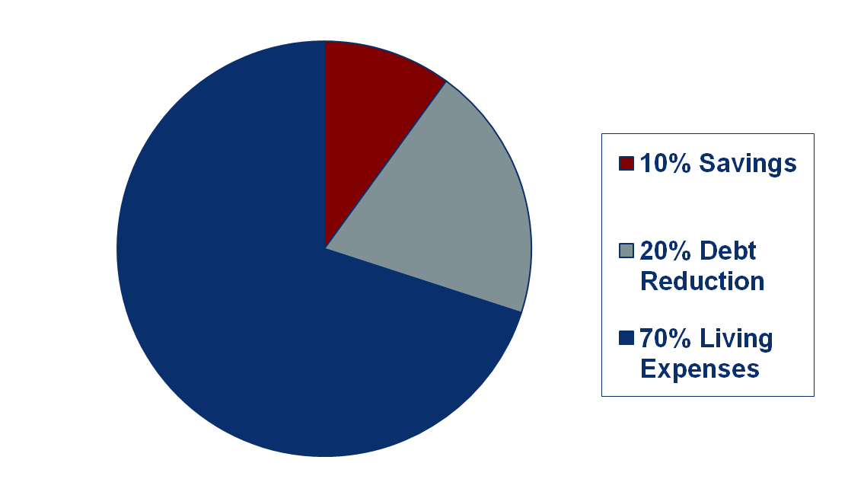
Loan Repayment - Tips
Stick to a budget.
If you’ve never made a budget before:
If you bring home $3000/month, that’s $300 to savings, $600 towards debt reduction, and $2100 to live on.
Every time you get a raise: 1/3 for taxes, 1/3 for debt/savings.
Don’t hesitate to see a financial professional if needed.

Slide 17
Resources
AAMC’s FIRST:
https://students-residents.aamc.org/financial-aid/
Department of Ed Ombudsman
www.ombudsman.ed.gov
877-557-2575
www.annualcreditreport.com
Studentloans.gov
www.donotcall.gov and opt out:
1-888-5OPTOUT
www.optoutprescreen.com

Slide 18
UVA School of Medicine
Financial Aid Office
Claude Moore medical education building, room 1140
(434) 924-0033
Margaret baxton: med7q@virginia.edu
Melissa LiVoti:
mal5je@virginia.edu

