Slide 1
Creating the Organizational Foundation for Joy in Medicine™
Help physicians thrive through structured institutions

Slide 2
Over 50% of US physicians experience some sign of burnout. It is estimated that 80% of burnout is related to organizational factors.

Slide 3
What drives burnout and what are the effects?
Burnout is driven by:
high workloads
workflow inefficiencies
increased time spent in documentation
loss of meaning in work
social isolation at work
cultural shift from health values to corporate values
Burnout has repercussions at a personal and professional level

Slide 4
What are the effects of burnout on an organization?
Health professional burnout is a threat to the clinical, financial, and reputational success of an institution for quality, humanitarian, and financial reasons.
Quality | Humanitarian | Financial
Each 1 point increase in burnout correlates with a 3-10% increase in likelihood of physicians reporting medical errors | Greater rates of dissatisfaction, divorce, drug and alcohol abuse, and depression | Replacement costs per physician costs between $500,000 to $1 million * Over $5 million annually

Slide 5
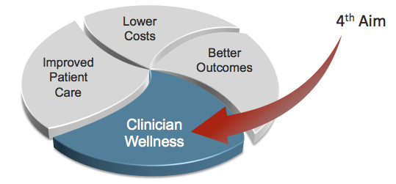
What is the goal?
Achieve the Quadruple Aim, with the fourth aim of clinician well-being.
Create a joyful practice environment and create structural elements that support joy, purpose, and meaning in work.
In return, a more engaged, satisfied workforce will provide better, safer, more compassionate care to patients.

Slide 6
Nine steps to help clinicians thrive through organizational changes
Culture of Wellness
Engage senior leadership
Track the business case for well-being
Resource a Wellness infrastructure
Measure burnout and the predictors of burnout longitudinally
Strengthen local leadership
Develop interventions and evaluate their impact

Slide 7
Nine steps to help clinicians thrive through organizational changes
7. Improve workflow efficiency and maximize power of team-based care
8. Reduce clerical burden and tame the EHR
9. Support the physical and psychosocial health of the workforce
Efficiency of Practice
Personal Resilience

Slide 8
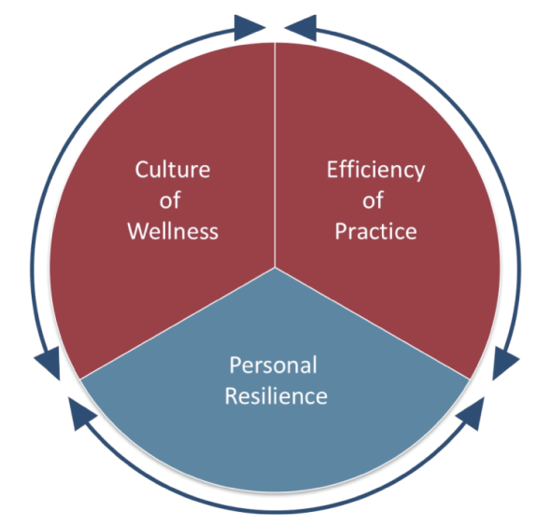
Three Domains of the Stanford Wellness Framework
Culture of Wellness: Creation of work environment with a set of normative values, attitudes, and behaviors that promote self care, personal and professional growth, and compassion for colleagues, patients, and self
Efficiency of Practice: Value added clinical work accomplished divided by the time and energy spent
Personal Resilience: Set of individual skills, behaviors, and attitudes that contribute to personal physical, emotional, and social well-being, including the prevention of burnout
©2016 Stanford Medicine

Slide 9
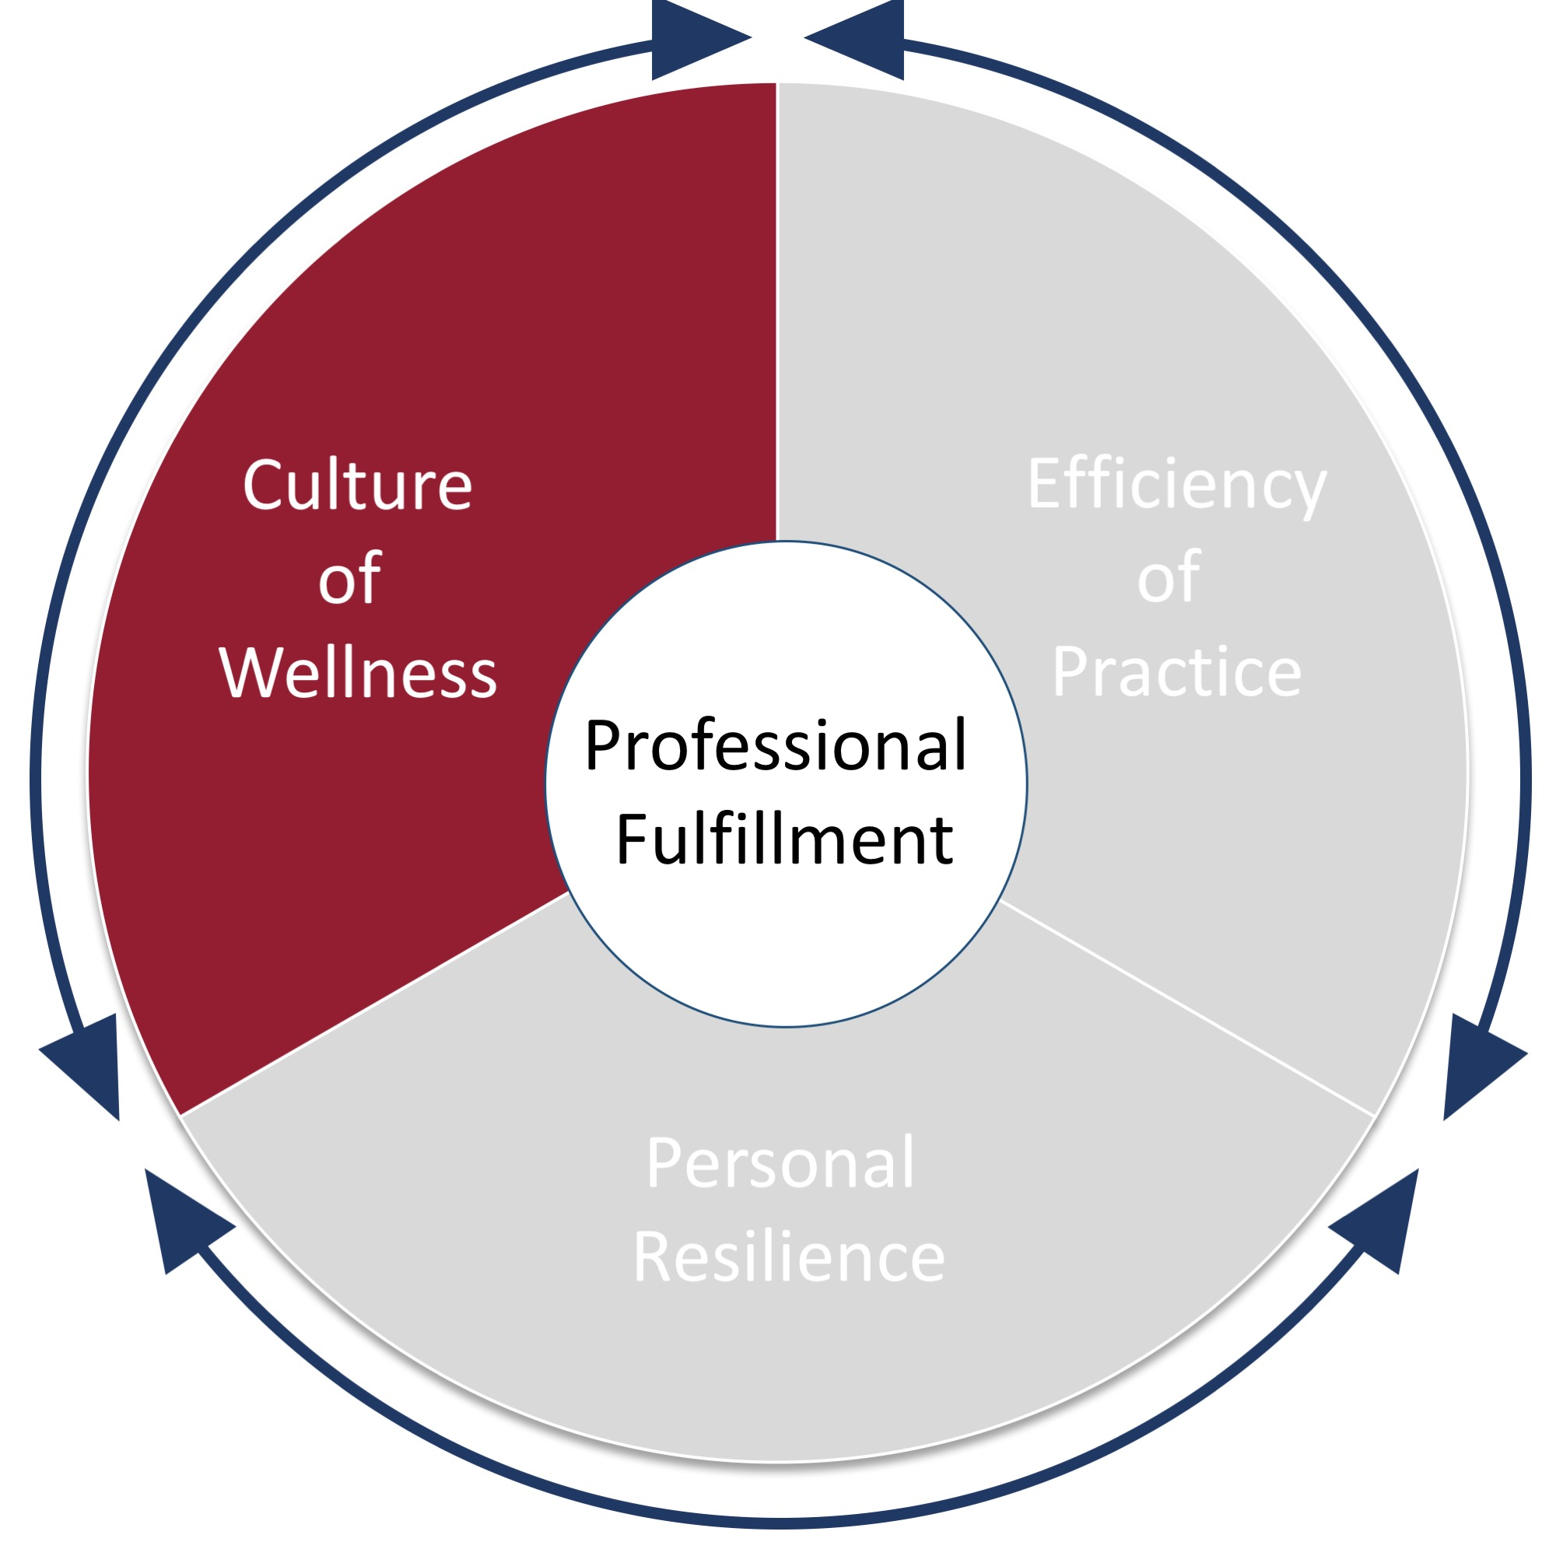
Culture of Wellness
Culture of Wellness: Creation of work environment with a set of normative values, attitudes, and behaviors that promote self care, personal and professional growth, and compassion for colleagues, patients, and self
Ways to Implement:
Define professional wellness as a priority
Utilize the different survey instruments to regularly assess physician well-being
Create a toolkit of interventions such as forums and engagement groups to foster community support
Develop a communication platform for physicians to address daily work challenges
©2016 Stanford Medicine

Slide 10
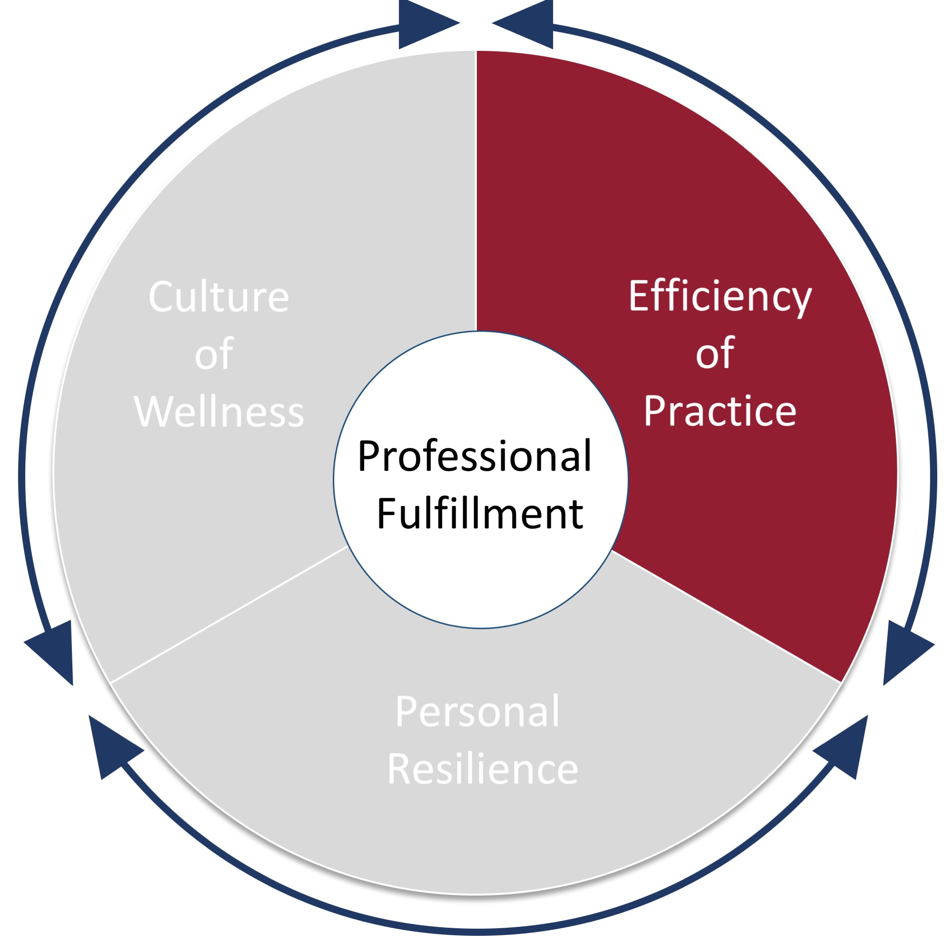
Efficiency of Practice
Efficiency of Practice: Value added clinical work accomplished divided by the time and energy spent
Ways to Implement:
Re-engineer the way work is done and by whom (ex. EHR documentation)
Utilize the Practice Assessment Tool to assess your practice’s current state
Undergo a LEAN event
Engage clinical and operations leadership teams
©2016 Stanford Medicine

Slide 11
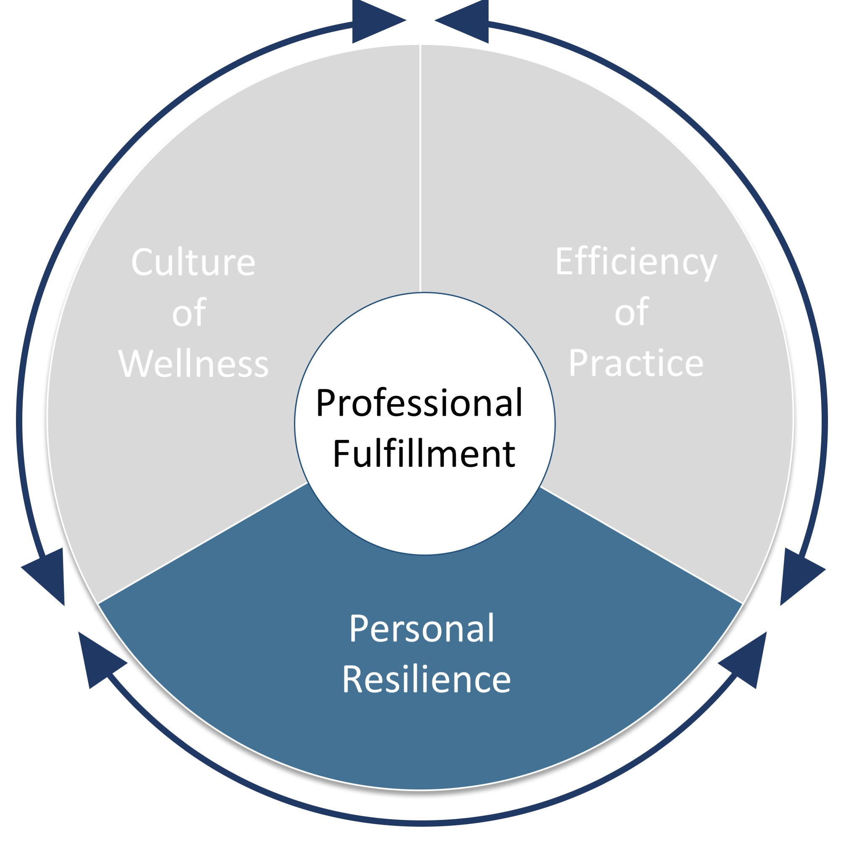
Personal Resilience
Personal Resilience: Set of individual skills, behaviors, and attitudes that contribute to personal physical, emotional, and social well-being, including the prevention of burnout
Ways to Implement:
Provide assistance for physicians in accomplishing basic life tasks
Establish a quiet, refresh, and recharge room for physicians
Provide on-site exercise facilities
Offer peer support programs and off-site psychological counseling services
©2016 Stanford Medicine

Slide 12
Tools/Resources available to your practice
Physician Opinion of the Leadership Quality Survey
Drivers of Burnout and Engagement in Physicians Graph
AMA Wire: 5 Strategies to tame Stress, avoid Burnout in Leadership Role

Slide 13
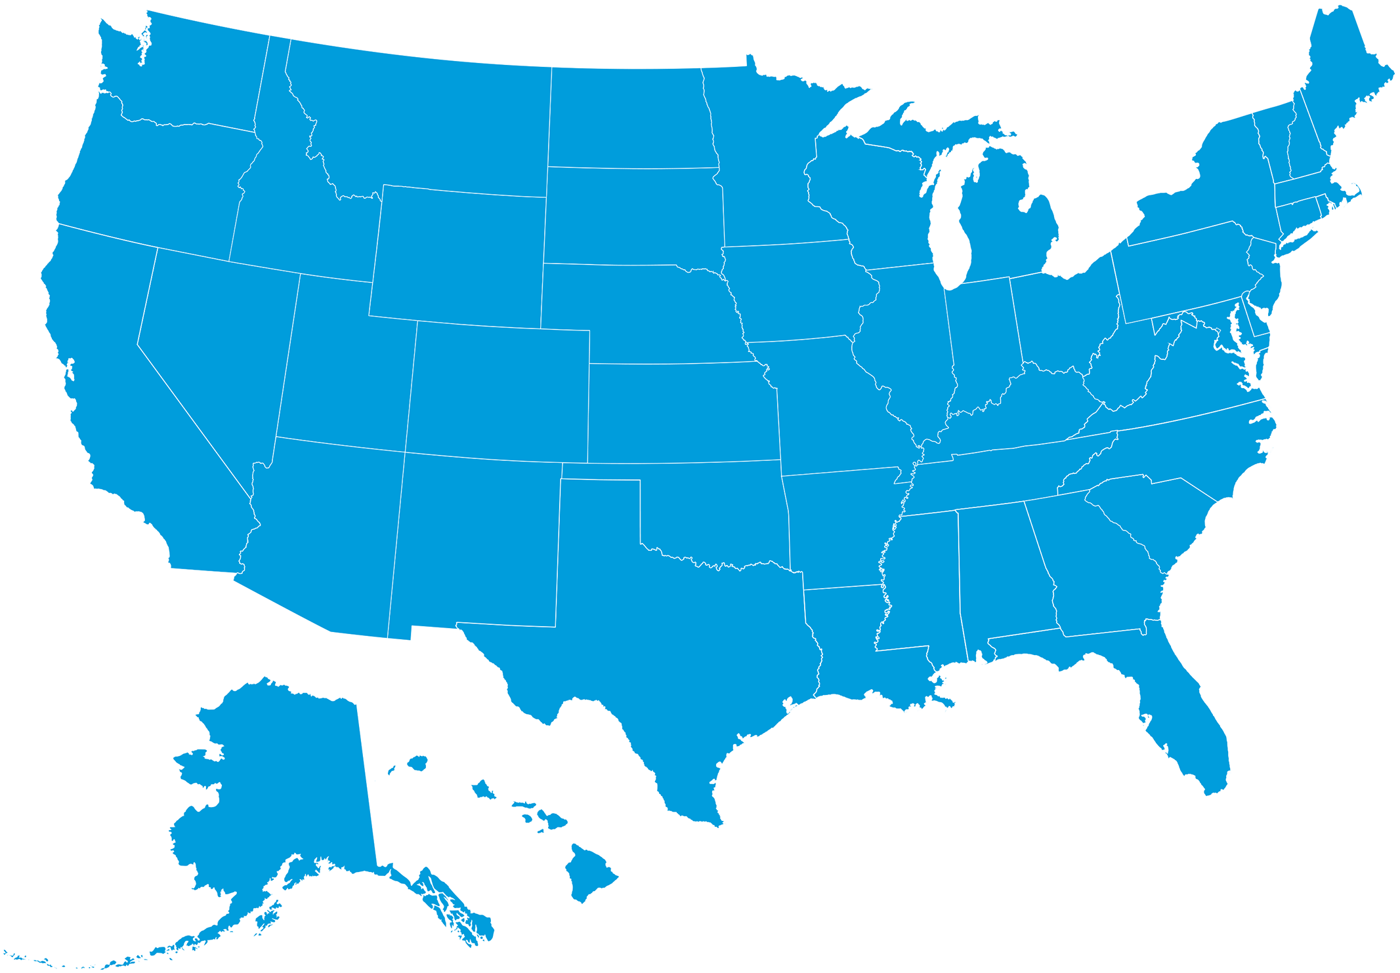
How is it working at other practices?
St. Paul, MN
Rochester, MN
Boston, MA
Baltimore, MD
Stanford, CA
Roanoke, VA
Salt Lake City, UH
Asheville, NC
Denver, CO
Notes:
Steps in Practice Summary = Location Featured Here
Summarize the description of the steps in practice section in a bulleted format
Keep it concise and straight to the point
Think about what information would be helpful to a practice manager that is presenting this information
Review other module pitch decks for examples

Slide 14
“
It’s hard to imagine a more critical issue for health care leaders than combatting burnout and attrition, because our people truly are our most precious asset—the heart and soul of our institutions. Moreover, study after study shows that happier care providers are better care providers, so this is not just a human resources issue. It’s about quality of care and doing what’s best for our patients
”
Paul Rothman, MD
Dean/CEO for John Hopkins Medicine
Notes:
embed video

Slide 15
For additional resources, frequently asked questions and implementation support, visit stepsforward.org

