Slide 1
Physician wellness: preventing resident and fellow burnout
Create a holistic, supportive culture of wellness

Slide 2
“
The most important patient we have to take care of is the one in the mirror.
”
Robert Wah, MD
Former AMA President, Reproductive Endocrinology, National Institute of Health (NIH) and Walter Reed National Military Medical Center
Bethesda, MD
Notes:
embed video

Slide 3
Increasing rates of suicide, depression, burnout and decreasing personal and professional satisfaction emphasize the importance of creating a wellness culture with GME programs.

Slide 4
Five steps to create a wellness culture in your practice
1
Create a framework
2
Develop a program
3
Foster at individual level

Slide 5
Five steps to create a wellness culture in your practice
4
Empower faculty and trainees to confront burnout
5
Create a sustainable culture of wellness and resiliency

Slide 6
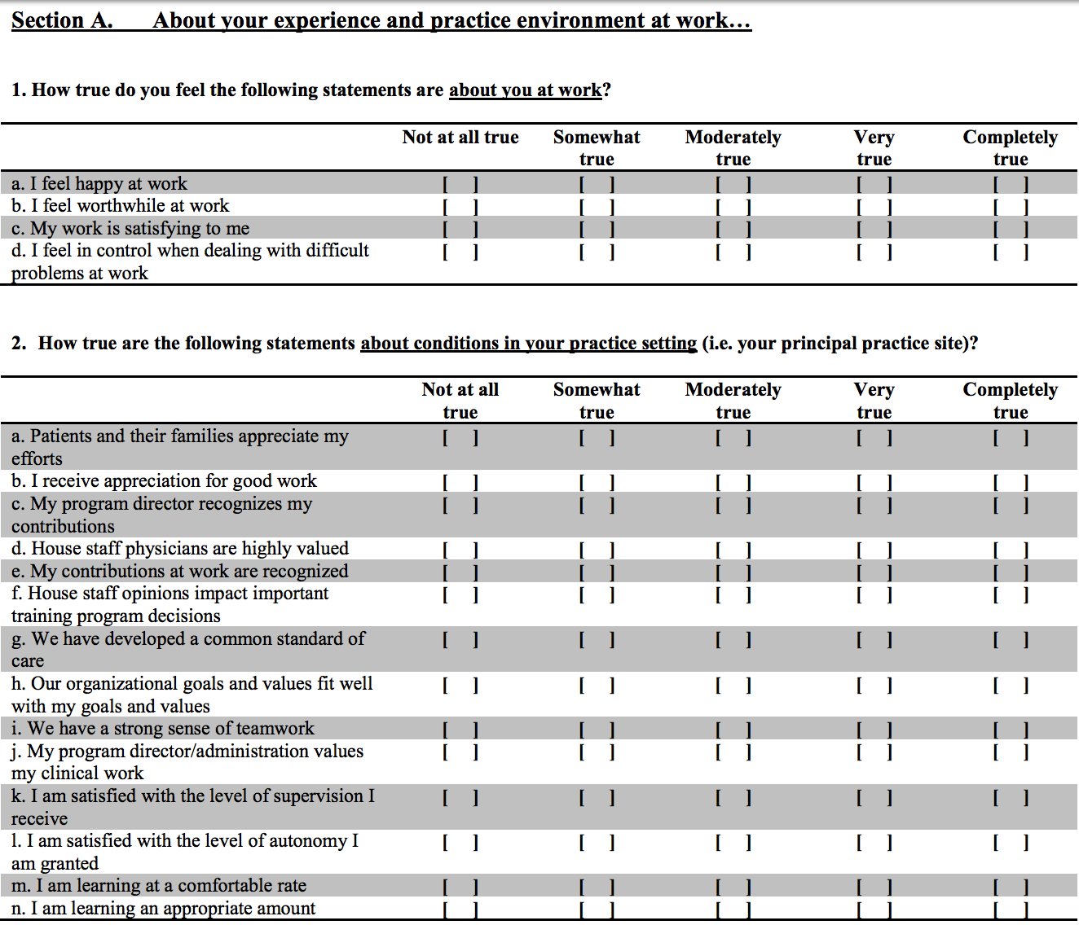
Physician wellness tools: Stanford house wellness survey
6

Slide 7
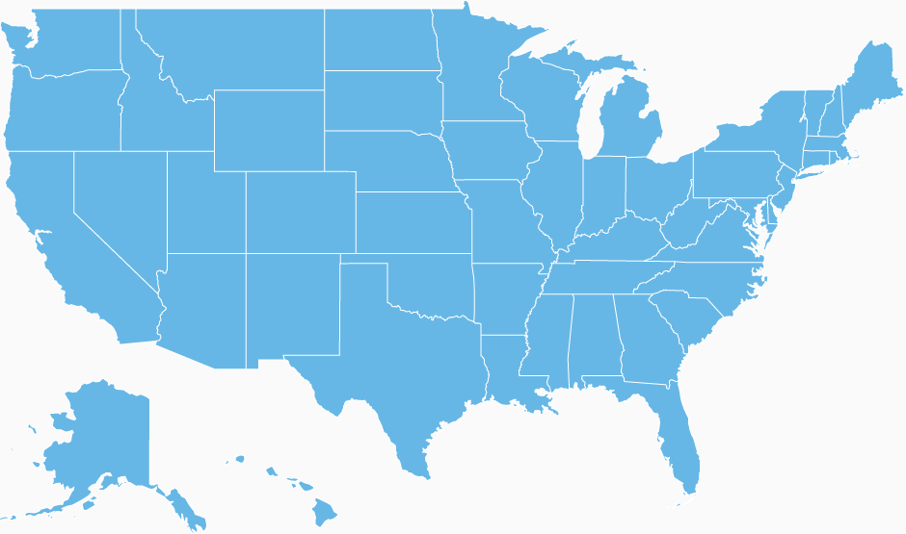
How is it working at other practices?
Nashville, TN
Palo Alto, CA
Jacksonville, FL
Notes:
Steps in Practice Summary = Mayo Clinic, Jacksonville, FL
Background: nearly half of all physicians surveyed for Medscape’s 2014 Physician Lifestyle Report reported experiencing burnout. Available interventions geared towards residents and fellows lag in comparison to those that exist for senior physicians
Actions: Dr. Odunukan pioneered the Fellows’ and Residents’ Health and Wellness Initiative (FERHAWI) in collaboration with the Center for Humanities in Medicine at Mayo Clinic’s campus in Florida to combat stress and fatigue among medical trainees by providing creative outlets in the arts and humanities.
Results: The Internal Medicine residency now earmarks one noon conference every month as “Humanities Thursday” for activities including facilitated discussions of artwork, guided visual imagery and arts projects, such as watercolor painting, screen printing and origami. The FERHAWI initiative also includes weekly ballroom dancing and other activities aimed at decreasing burnout both for residents and fellows and for their spouses or significant others.
Steps in Practice Summary = Stanford Department of General Surgery, Palo Alto, CA
After one of their trainees committed suicide, the group took action
Action: with a committee comprised of three faculty members and four residents, Balance in Life (BIL) was created. BIL is a holistic, multifaceted program with the primary aim of educating about and facilitating physical and mental health among resident trainees.
Results: four years since its inception, BIL’s active leadership team has created a wellness-focused training environment for surgery residents with a number of programs and options.
Steps in Practice Summary = Vanderbilt School of Medicine, Nashville, TN
Background: Dr. Scott Rodgers observed how the current structure of medical education nationwide was creating a toxic environment where the emphasis for students was on surviving, not thriving. Students were suffering from depression, experiencing symptoms of burnout and lacking mental resiliency.
Action: Dr. Rodgers and a group of students formed what is now known as the Student Wellness Program, a medical school-wide initiative that has since become a premier model for other medical schools and even graduate training programs. The program includes activities such as yoga classes, community service events, healthy cooking classes, forums on nutrition and sleep and a mentoring program that pairs second-year students with first-year students.
Results: The Student Wellness Program is the first published model of a comprehensive medical student wellness initiative. This school-sponsored initiative has had a tremendous impact over the last ten years, with nearly every student participating in at least two wellness activities during their training. In addition to participation, student response has been highly satisfactory, as evidenced by their positive feedback.

Slide 8
For additional resources, frequently asked questions and implementation support, visit www.stepsforward.org!

