Slide 1
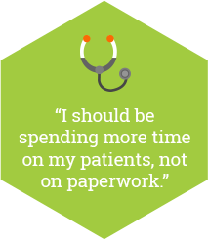
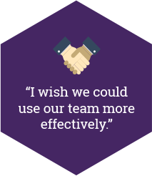
Preventing physician burnout
Improve satisfaction, quality outcomes and provider recruitment and retention

Slide 2
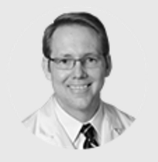
“
Burnout makes it nearly impossible for individuals to provide compassionate care for their patients.
”
Steven Lockman, MD
Senior Medical Director, Neurosciences, Orthopedics and Rehabilitation Service Line
Minneapolis, MN
Notes:
embed video

Slide 3
Measure and respond to burnout by:
Reducing sources of stress
Intervening with programs and policies that support professional well-being
Preventing burnout

Slide 4
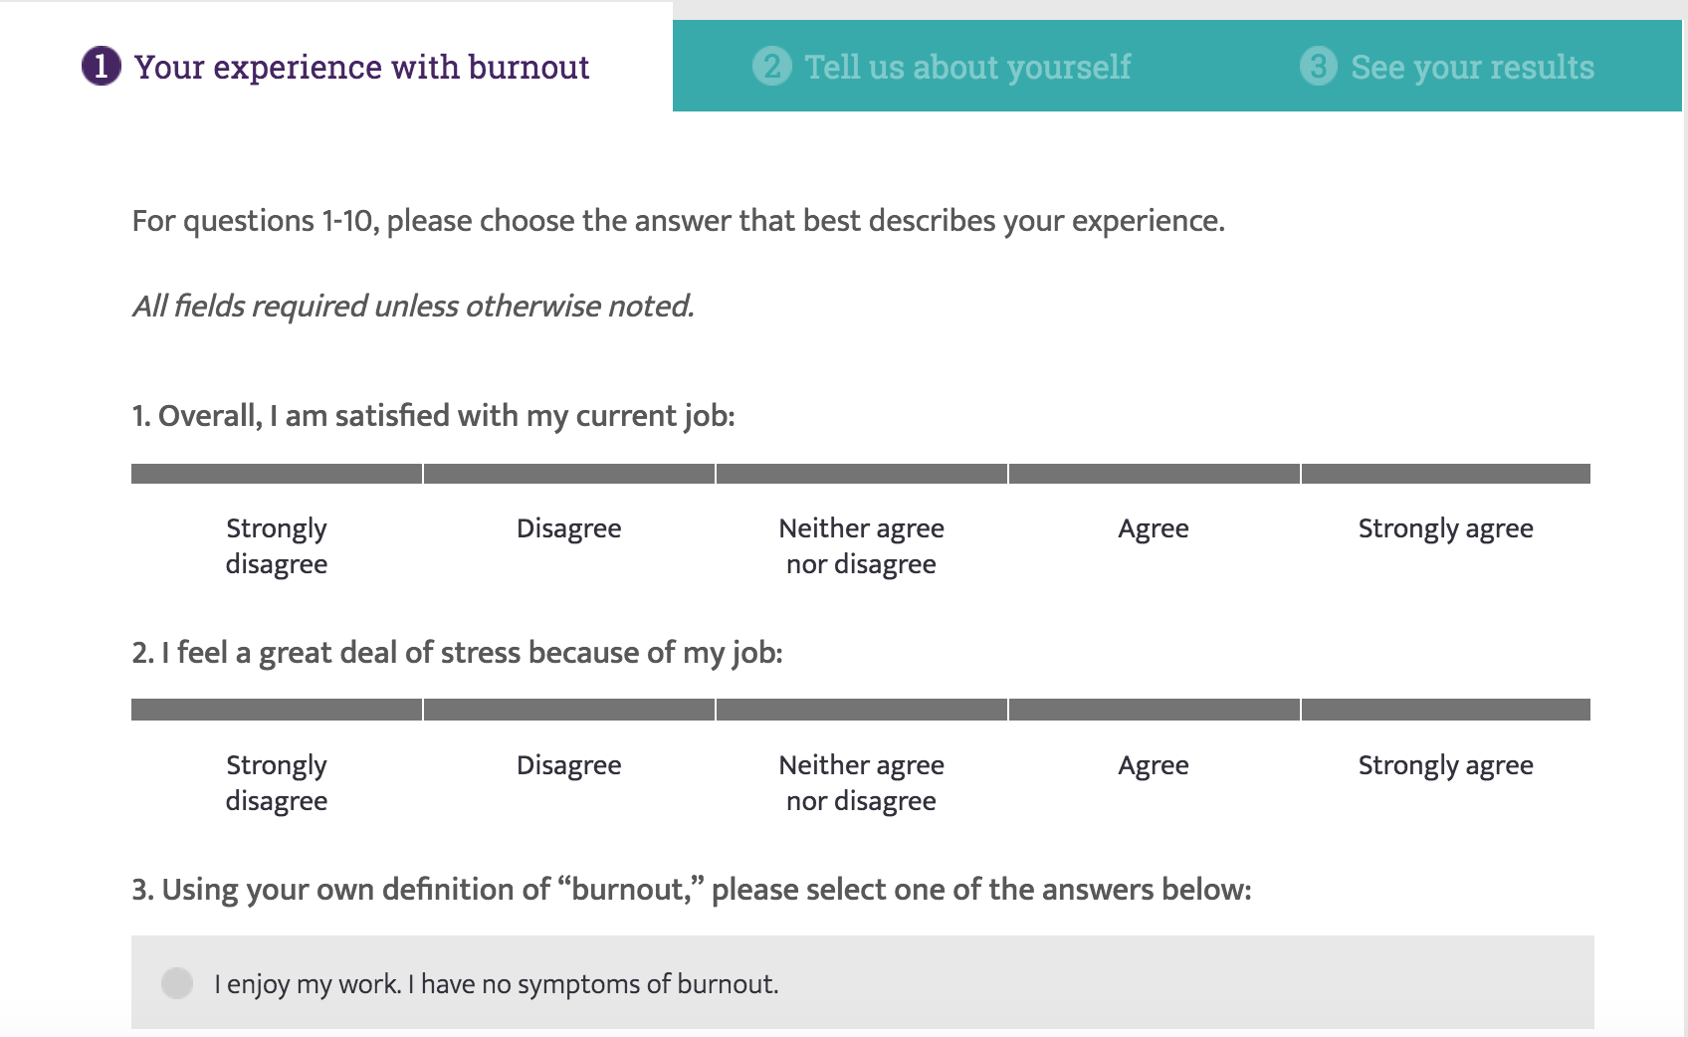
Take the Mini Z burnout survey:

Slide 5
Seven steps to prevent burnout in your practice
1
Establish wellness as a quality indicator for your practice
2
Start a wellness committee and/or choose a wellness champion
3
Distribute an annual wellness survey
4
Meet regularly with leaders and/or staff to discuss data and interventions to promote wellness

Slide 6
Seven steps to prevent burnout in your practice
5
Initiate selected interventions
6
Repeat the survey within the year to re-evaluate wellness
7
Seek answers within the data, refine the interventions and continue to make improvements

Slide 7
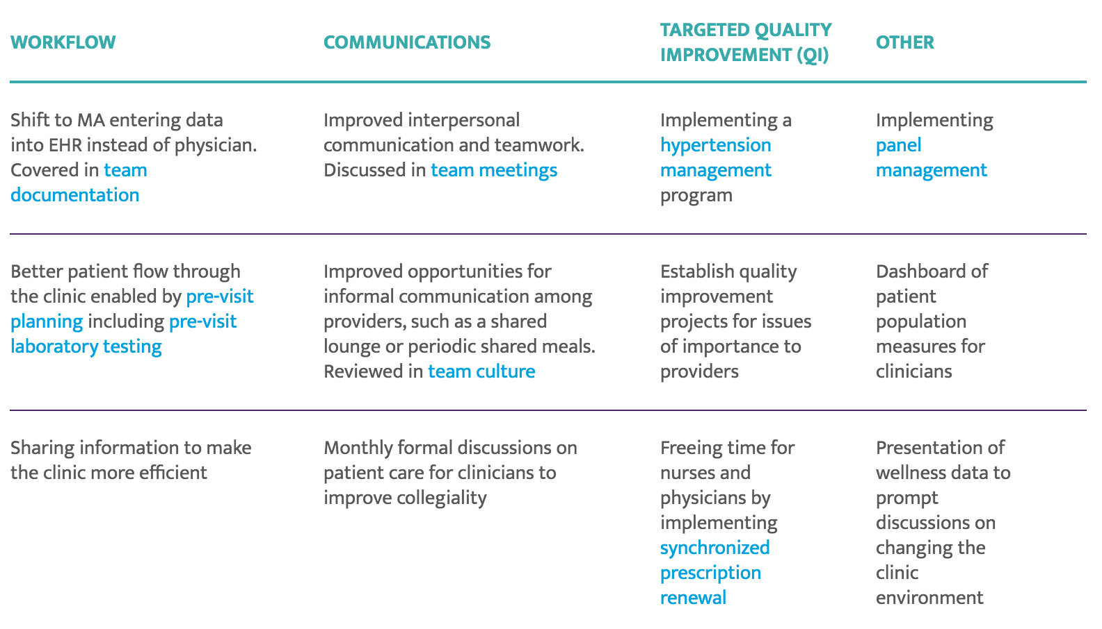
Examples of interventions to reduce burnout in your practice

Slide 8
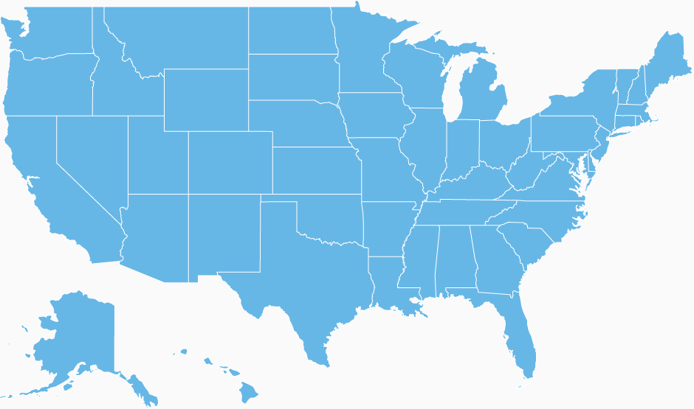
How is it working at other practices?
Boston, MA
Palo Alto, CA
Redwood City, CA
Minneapolis, MN
Notes:
Steps in Practice Summary = Boston Medical Center in Boston, MA
Boston Medical Center (BMC) Wellness Committee: created to combat burnout and reduce physician stress
Developed a wellness website and organized seminars on resiliency training and narrative writing
Also developed various in-person programs, including a monthly clinical case discussion group (modeled after Balint groups)
At this monthly meeting, one clinician presents a difficult case to groups of eight to 12 colleagues. It is an opportunity to overcome the isolation inherent in clinical practice and feel supported by colleagues, which decreases personal and professional stress.
Having a wellness program helps buffer some of the challenges presented with clinical practice in today's evolving health care environment.
Steps in Practice Summary = Kaiser Permanente of North California in Redwood City, CA
Began designing programs supporting physical health, collegiality, community and practice management
Mentoring
Health festivals
Movie day
Wellness Thursday lunches
Birthday letters
Steps in Practice Summary = Hennepin County Medical Center in Minneapolis, MN
Physician parents had issues with picking up their children from daycare because of scheduling issues, causing stress for the providers
To address this challenge, the end‑of‑day schedule was re‑engineered so the last complex patient was scheduled at 4:00 p.m. instead of 4:30 p.m. The appointment slot at 4:30 p.m. was changed to routine care instead of complex. This simple change helped parents leave work on time.
Satisfaction in the department increased from 65 percent in 2013 to 83 percent in 2014, while burnout decreased from 39 percent to 17 percent over the same time period.
Steps in Practice Summary = Stanford University Medical Center in Palo Alto, CA
Stanford Medical Staff Committee for Professional Satisfaction and Support (SCPSS): professional fulfillment of clinicians is inextricably linked to quality, safety and patient‑centeredness.
The Educators‑4‑Care (E4C) program pairs five to six medical students annually with a faculty member, who serves as teacher, mentor and colleague for the duration of the student's time at the school of medicine. A resident peer program supports housestaff after they experience an adverse patient outcome and when they need general support.
The committee has a WellMD website and monthly newsletter with links to self‑assessment tests and contact information for groups, classes and volunteering opportunities regarding exercise and fitness, stress and burnout, depression, mindfulness, resilience and work‑life balance.
A pilot faculty flexibility program provided career development coaching, with a focus on increasing work‑life integration and addressing work‑work conflict (defined as the competing demands faced by faculty as they meet multiple institutional missions). This program had two parts: career customization and a support mechanism with a banking system.
Steps in Practice Summary = Adventist Health System
Four major initiatives:
Physician Support Services: provides individual counseling and coaching services, along with seminars and retreats. These programs are designed to promote personal growth and enrich relationships.
Finding Meaning in Medicine: “self-directed, on-going, values and meaning study groups.” These are meant to help doctors “remember the heart of medicine.” Typically, FMM is initiated by a physician champion who opens their home to invite colleagues over for a casual evening meal and conversation.
Schwartz Rounds: are sponsored by the Schwartz Center for Compassionate Healthcare which was created in memory of health care attorney Ken Schwartz. Schwartz Rounds are designed to promote compassionate care by bringing together health professionals across disciplines to address and bring attention to the personal, emotional and social aspects of patient care.
The Coalition for Physician Well-Being: is a 501(c)6 tax-exempt association of hospitals and related health care entities that are committed to promoting physician wholeness and resiliency. Through mutual learning, networking, facilitating and consulting, the Coalition seeks to help physicians achieve balanced lives, purposeful practices and meaningful relationships.

Slide 9
For additional resources, frequently asked questions and implementation support, visit www.stepsforward.org!

