Slide 1
NIH Predoctoral Fellowship Biosketch 08 November 2022 Lauren B. Armstrong Assistant Director, Office of Grants and Contracts UVA School of Medicine lpb4c@virginia.edu

Slide 2
THE BASICS
A biosketch documents an individual's qualifications and experience for a specific role in a project – think of this as your grant-specific resume or CV
NIH uses the biosketch to evaluate and ensure that an individual’s skills, knowledge, experience, and resources are sufficient to carry out the proposed research
Specific formatting is required for compliance with application guidelines
Font size – 11pt or larger, no more than 15 characters per linear inch, no more than six lines per vertical inch
Recommended fonts: Arial, Georgia, Helvetica, Palatino Linotype (other fonts are acceptable if they meet the above requirements)
Margins – at least one-half inch (½”) for all sides
Do not include headers or footers
Page limits – maximum of five letter-sized (8 ½ x 11”) pages
Miscellaneous
Filename – maximum 50 characters or less (including spaces)
Disable any security/encryption features and do not use password protection

Slide 3
THE BASICS - continued
Citations
Any format is acceptable – NIH does not require a specific format
Use of “et al” is acceptable
NIH suggests using the National Library of Medicine’s standard format if you do not otherwise have one
See Citing Medicine, 2nd edition
Remember to comply with the NIH Public Access Policy when citing applicable papers that arise from NIH-funded research
Include the PMCID reference number [DOIs and/or PMIDs are allowed but not required]
Do not use hyperlinks for citations
Don’t recreate the wheel – utilize SciENcv!
Science Experts Network Curriculum Vitae
https://www.ncbi.nlm.nih.gov/sciencv/
Synchronize with eRA Commons Personal Profile information
Create and save multiple versions
Share with collaborators or administrative staff
Automatic formatting

Slide 4
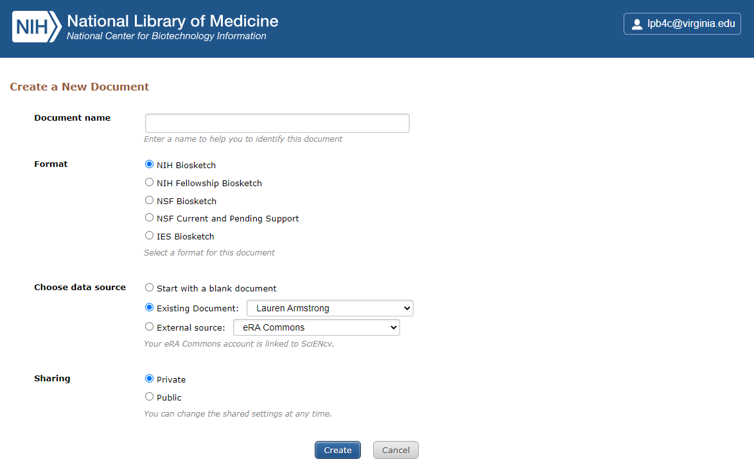
THE BASICS - continued

Slide 5
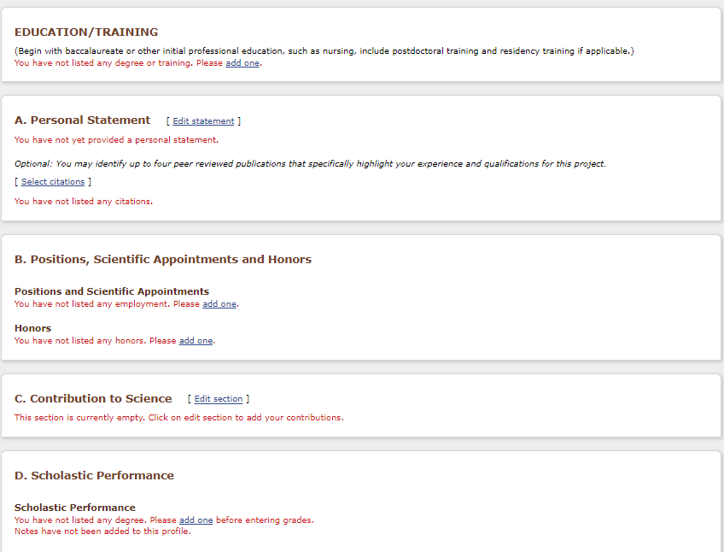
THE BASICS - continued

Slide 6
THE BASICS - continued
NIH Fellowship Biosketch
Blank Format Page
Instructions
Predoctoral Fellowship Sample
FAQs

Slide 7
SECTION A. PERSONAL STATEMENT
Briefly describe why you are well suited for your role on this project
Training, previous experimental work on specific or related topics, technical expertise, collaborators/scientific environment, past performance in this or related fields and any completed or ongoing projects that you would like to highlight
Cite up to four publications or research products that highlight your experience or qualifications (audio/video products, abstracts, posters/presentations, patents, data or research materials, databases, models, protocols, software, instruments/equipment, etc)
Address any factors that may have affected past productivity (family care responsibilities, disability, military service, etc)
Indicate any publications or other products created under another name
Do not include figures or graphics
Tailor this section to the project at hand

Slide 8
SECTION B. POSITIONS, SCIENTIFIC APPOINTMENTS and HONORS
List in reverse chronological order all current positions and scientific appointments both domestic and foreign, including affiliations with foreign entities or governments
Titled academic, professional, or institutional appointments whether or not remuneration is received, and whether full-time, part-time, or voluntary (including adjunct, visiting, or honorary)
List any relevant academic and professional achievements and honors
Scholarships, traineeships, fellowships, and development awards
List current or pending participation in, or applications to, programs sponsored by foreign governments, instrumentalities, or entities, including foreign government-sponsored talent recruitment programs

Slide 9
SECTION C. CONTRIBUTIONS TO SCIENCE
Describe up to five of your most significant contributions to science
No longer than one half-page each, including citations
Content:
the historical background that frames the scientific problem
the central finding(s)
the influence of the finding(s) on the progress of science or the application of those finding(s) to health or technology
your specific role in the described work
For each contribution, you may cite up to four publications or research products that are relevant (note your role if you are not the author)
You may mention manuscripts in process, but you may only cite published works
Figures, tables, or graphics are not allowed
Hyperlinks and URLs are not allowed
You may provide a hyperlinked URL to a full list of your published work. This hyperlinked URL must be to a Federal Government website (a .gov suffix). NIH recommends using NCBI My Bibliography.

Slide 10
SECTION D. SCHOLASTIC PERFORMANCE
List by institution and year all undergraduate and graduate courses, with grades
Explain any grading system used if it differs from a 1-100 scale; an A, B, C, D, F system; or a 0-4.0 scale
Indicate the levels required for a passing grade

Slide 11
QUESTIONS?

