Slide 1
School of medicine Research Administrators Meeting
SOM RAM
16 May 2024

Slide 2
CURRENT Topics
Introductions
NIH Updates/Reminders
NOT-OD-24-115 – Revised NIH Grants Policy Statement has been published
Effective for all award budget periods beginning 10/01/2023
NOT-OD-24-123 – NIH will issue updated RPPR instructions to include specific guidance re: Data Management and Sharing Plans
Effective 10/01/2024

Slide 3
CURRENT Topics – cont’d
NOT-OD-24-109 – FY24 fiscal policies
Updated NRSA stipends and training/fellowship/childcare allowances
Restoration of existing awards is ongoing
NOT-OD-24-111 – Retirement of the Commons Quick Queries page
To find upcoming RPPRs: from the Status page, search for “Type 5” applications with Budget Period Start Dates in your preferred range
To find upcoming closeout/Final RPPRs: from the Status page, choose “Closeout” from the dropdown menu and input the preferred Proejct End Date Range

Slide 4
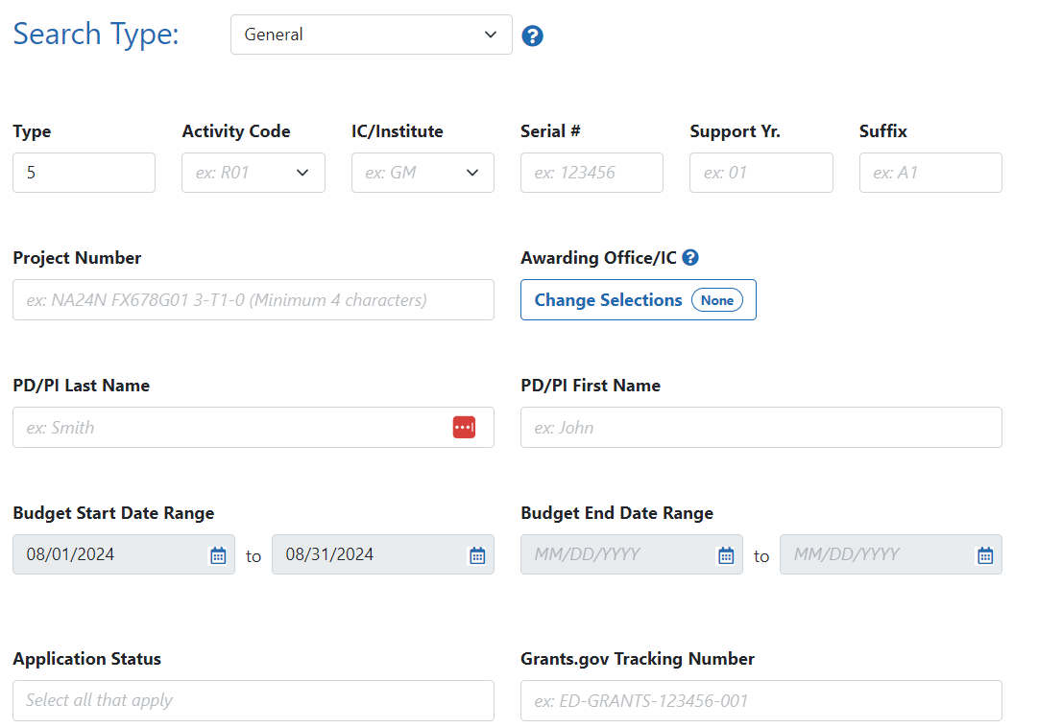
CURRENT Topics – cont’d
Annual RPPR
Final RPPR/Closeout

Slide 5
CURRENT Topics – cont’d
Internal Updates/Reminders
Upcoming NIH deadlines – June/July – remember to build in University holidays to submission timelines!
https://med.virginia.edu/grants-and-contracts/site-menu/grant-deadlines/
RAMP UP application open for 2024/25 cohort
https://redcapsurvey.healthsystem.virginia.edu/surveys/?s=9HY93993FKCKPTF7
You will need to disconnect your High Security VPN to access the application

Slide 6
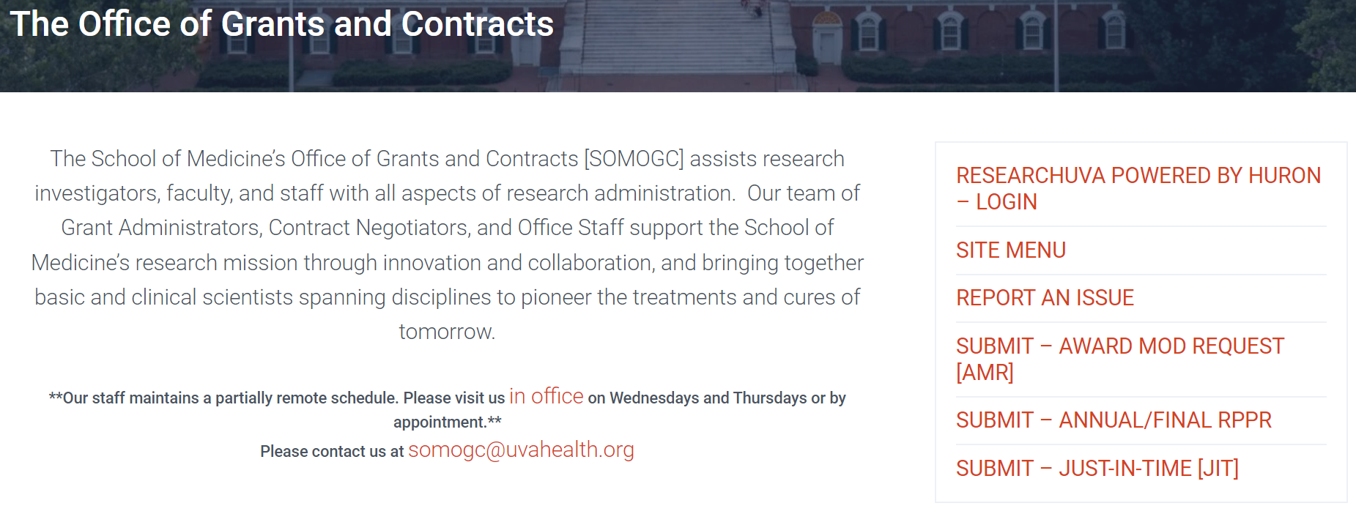
CURRENT Topics – cont’d
New AMR, RPPR, and JIT webforms available on SOMOGC website
LevelUP & RAPTR training resources

Slide 7
TIPS & Reminders
Professional Development opportunities
SRAI Virginia Special Interest Group – Registration Open! – June 14 @ UVA
https://www.srainternational.org/about/srai-sections/southern/va-sig/va-sig-reg
NIH Webinar “Updates to NIH Training Grant Applications” – June 5
https://grants.nih.gov/learning-center/nih-training-grant-application-updates-webinar

