Slide 1
Physics Bootcamp Labs
David Schlesinger, Ph.D.
Einsley Janowski, M.D., Ph.D.
Matt Mistro, M.S.
Kara Romano, M.D.
Sarah Scarboro, Ph.D.

Slide 2
Basic Physics--Lab
Understanding linear accelerators and how radiation is created.

Slide 3
Lab
Go over linear accelerator components
Demonstration of basic linac operation
Walk to MRI linac

Slide 4
Electron Treatments
Understand electron treatment workflow
Define basic goals of simulation
Learn to write a complete prescription
Basic understanding of monitor unit calculations for electrons

Slide 5
Lab Layout
Case presentation
Simulation experience to discuss tools of simulation and the process of simulation
Design an electron field treatment for a skin cancer patient
Electron MU calculation

Slide 6
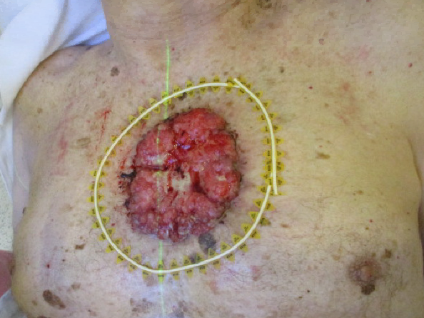
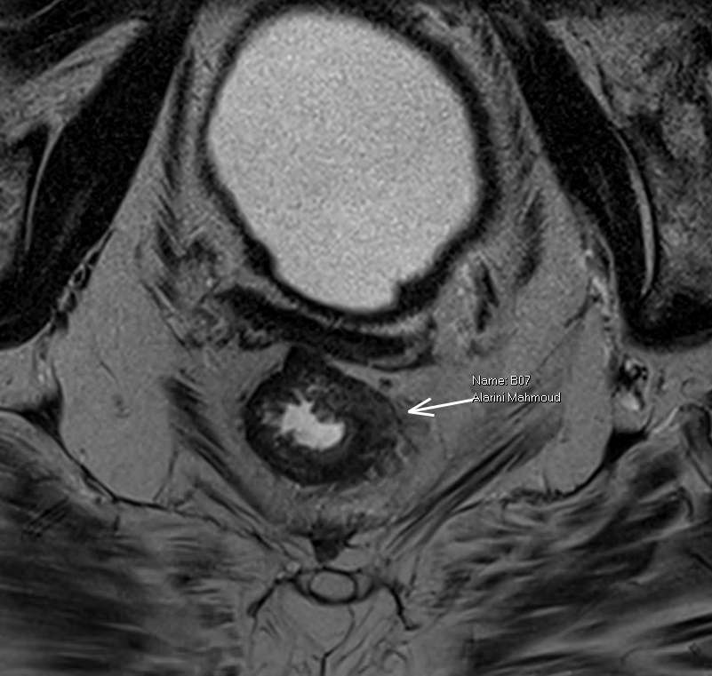
Case Presentation
Patient B is an 83 yo who presents to medical attention with a large fungating mass on the chest. Biopsy shows basal cell carcinoma.
On further questioning, the patient also reveals a long history of bloody stools. Colonoscopy reveals a rectal mass invading through the muscle. Biopsy shows adenocarcinoma.
The decision is made to treat both basal cell and rectal cancers. You will design fields for both. Let’s start with the skin lesion.

Slide 7
Case simulation
1) mark area of concern with wire and determine cone size needed. Can determine if we’ll need a standard cutout or a custom cutout.
2) determine GTV, CTV, PTV and depth needed for treatment
3) determine electron energy needed and dose you want to use; write a prescription in Mosaiq
Notes:
Einsley

Slide 8
Let’s go to sim

Slide 9
Case simulation
Pinnacle demonstration—what does coverage look like with different margins and different electron energies
PDD electron manual
Calculate MUs

Slide 12
Break

Slide 13
Photon Treatments
Simulate a patient for a photon treatment
Understand the workflow from simulation to treatment delivery with photon plans
Review how beam number, energies, wedges, field size, and treatment modality change the dosimetry of your plan.

Slide 14
Case Presentation
Patient B is an 83 yo who presents to medical attention with a large fungating mass on the chest. Biopsy shows basal cell carcinoma.
On further questioning, the patient also reveals a long history of bloody stools. Colonoscopy reveals a rectal mass invading through the muscle. Biopsy shows adenocarcinoma.
Let’s discuss the pelvic field now…

Slide 15
Photon Lab
Determine immobilization strategy
Select isocenter
Contour PTV and critical structures
Select beam arrangements
Write a prescription
Review plan with dosimetrist
Notes:
Stay in conference room and discuss immobilization
Log into syngo via to virtually take us to sim and select isocenter
Pull it up in velocity to contour GTV, CTV, PTV, and critical structures
Transfer to pinnacle and select beam arrangements (have them select)
Write a prescription in Mosaiq
Will stop by dosimetry to review AP/PA and 4 field plans with isodose lines and DVHs

Slide 17
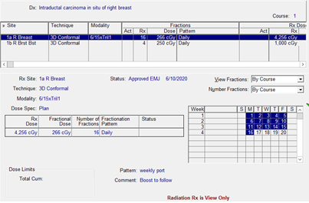
Prescription
A clearly defined dose prescription should include all of the following:
Treatment site
Total dose
Dose per fraction
Number of fractions
Fractions per day (and week)
Type and energy of radiation
Technique and number of fields
Prescription point, surface, or volume
Special instructions (daily kv, bolus)

Slide 18
Pinnacle demonstration
Change energy
Add wedges vs 3 field
Change gantry angle
AP/PA vs 4 field box vs IMRT
Notes:
Sarah here

Slide 19
Break

Slide 20
Brachytherapy Basics
To explain the dose principles in brachytherapy
To familiarize yourself with brachytherapy tools
To understand how an HDR remote afterloader delivers RT dose
To understand the brachytherapy workflow
To explain what an AU, AMP, and written directive are and why these are important
To learn the radiation safety procedures for brachytherapy

Slide 21
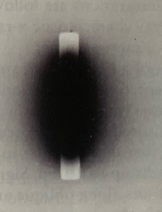
Brachy “Lab”
Film
Time = Dose
Notes:
Sarah will do this and we’ll consider doing dose limits per day, month, year

Slide 22
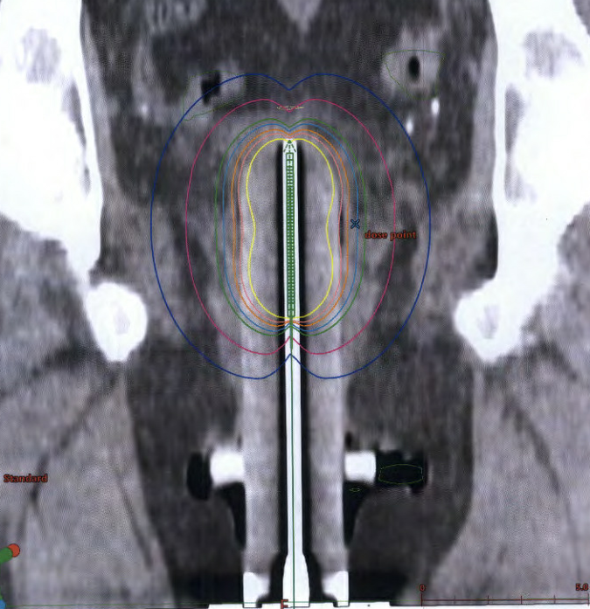
Case 1: Vaginal Cylinder
An HDR treatment is planned to delivery 7 Gy to a depth of 5 mm using a 3 cm cylinder. If a 2.5 cm cylinder was used by mistake, _____ is the approximate dose delivered to the prescription depth in the middle of the cylinder.
3 cm cylinder
Distance from source to dose point ( ): 2 cm
If a smaller 2.5 cm cylinder accidentally placed, then the distance from the source to the prescription dose point ( ) is: 1.75 cm
Therefore, the delivered dose at 5mm depth is approximately:
7 Gy x (2/1.75)² = 9.14Gy

Slide 23
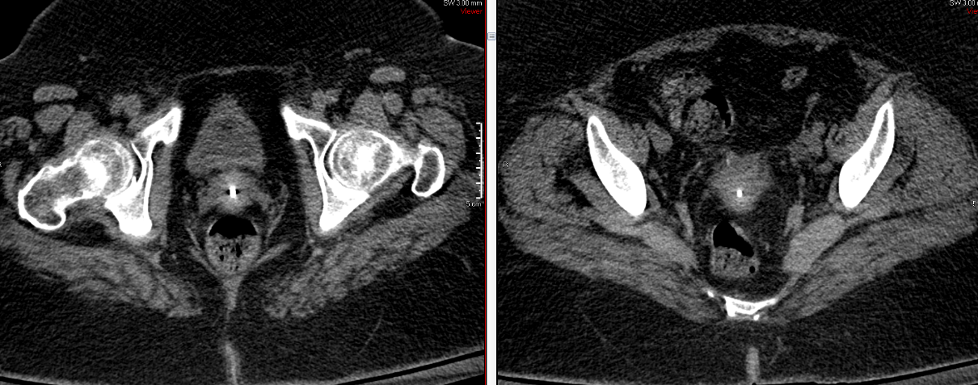
Case 1: Vaginal Cylinder
Ensure the vaginal cylinder is completely inserted to the apex of the vaginal cuff.
Check CT for positioning.
There should be minimal tissue above the tandem of the cylinder
Insertion 1:
not inserted deep enough
Insertion 2:
Looks good

Slide 24
Safety
If the source is out (i.e.. not safely parked in the after-loader or in treatment mode), take the following steps:
AMP pushes the Emergency Stop button at treatment console
AMP pushes the Emergency Stop button at door
If these fail, then only the AMP enters the room
AMP pushes the Emergency Stop button on the back of the HDR Afterloader
AMP retracts source manually (door on side of HDR Afterloader)
If all of these fail, then
The MD comes in to the room to remove the applicator and places it in the lead “pig.” The patient and all staff are surveyed, leave the room, and the door is closed
After the source is safely retracted/removed:
1st call Environmental Health Services (EHS)
Mike Welling is RSO – 434-282-5783 OR EHS 2-4911
2nd call Varian
1-800-864-1672

Slide 25
Break

Slide 26
Emergent Clinical Treatment Lab
Understand the parameters needed to determine MU
Learn to calculate MU for simple field
Learn the options for a second, independent MU calc
Complete a hands-on lab to set up an emergent treatment, including R&V system and hand calc

Slide 27
Emergent Clinical Treatment
Any patient that requires treatment on the same day that they are initially seen by the physician either after clinical hours or on weekends (such that an expedited simulation can not be obtained and dosimetry plan created) will be treated using a clinical setup on the EC4 TB using either:
Right and Left lateral fields (whole brain)
AP/PA fields to midline
A clinical treatment requires 1 therapist and 1 physician
Physics is always available for backup support
Notes:
e

Slide 28
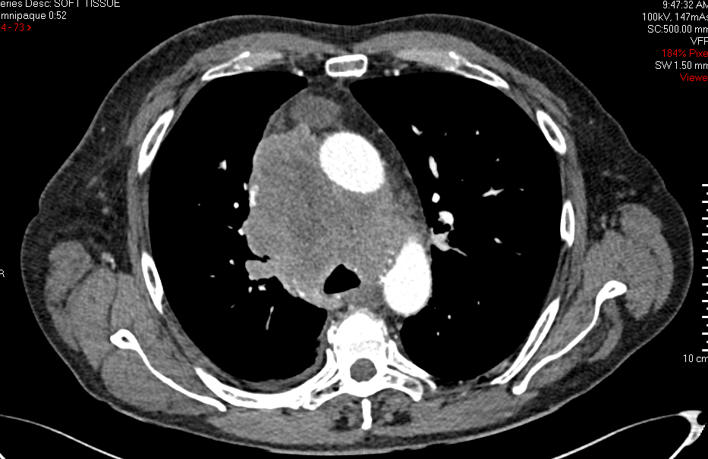
Case presentation
Patient B presents with facial flushing, swelling arms, blood vessels on chest, and shortness of breath. What is the diagnosis?
Notes:
E--0475750

Slide 29
Hands-on Lab Part 1
Discuss case, how to set up patient, what landmarks to look for to define field size.
Set up phantom on treatment table
Review kV images
Set field size and mid-plane iso for treatment
Notes:
Step 1 discuss case and then move to truebeam
Sarah and truebeam (enlist a free therapist)

Slide 30
Information you need to get started
Basic Patient Demographics—register the patient
Name, MRN (if they have one), DOB, gender, referring MD
Site to be treated
Technique – two main options
Whole Brain (Rt and Lt Lateral Fields)
AP/PA to midline
Patient Separation
Prescription dose
Notes:
e

Slide 31
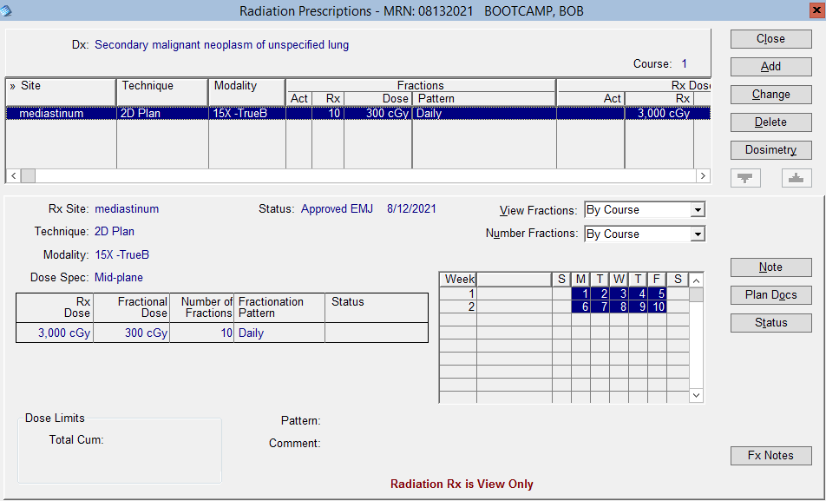
Mosaiq: Prescription Requirements
Before Imaging, check the prescription for the following, and update your treatment field if necessary
Rx Site
Dose
Energy
Technique
Dose Spec
Imaging note

Slide 32
High Level Overview of Tx
Enter patient information in Mosaiq
Therapist generates initial imaging + treatment fields
Bring patient into treatment room and position on table
Measure (and verify) patient separation
Determine iso position using kV imaging with MD
Confirm iso and set field size using MV imaging with MD
Determine MU per field using calc + second check with MD
Confirm all treatment parameters and Rx with MD with a time out
Treat patient
Mark treatment iso and levels before moving patient
Notes:
Emphasize that a lot of these steps are performed by therapists – but the residents should be comfortable and aware of all of them.
e

Slide 33
Clinical setup MU calculation
D
MU =
Invsq
X
TMR
X
TSF
X
TF
Invsq—inverse square factor
TSF=Total Scatter Factor
TF=Block Tray Factor—if used

Slide 34
Let’s get started…

Slide 35
In the Treatment Room
Set the patient up to the approximate isocenter
Measure the separation using calipers
Note this value in the Field Note box in your Mosaiq Tx Fields
Determine the mid-plane depth
Determine SSD according to this depth – adjust this value in your treatment fields
Rotate the Gantry so that the kV source is at 0 (gantry at 90)
This is to verify there will be no collisions
Send plan to 4DITC – kV Films

Slide 36
kV Filming OBI Image Review
Turn the Grid on to help determine borders
With the image on the screen have MD:
Verify Isocenter placement
If isocenter needs to be moved:
Shift the patient according to doctors orders
RE-MEASURE separation, determine depth, and SSD
Repeat the kV filming process

Slide 37
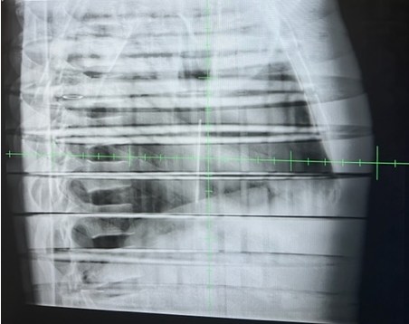
KV iso check

Slide 38
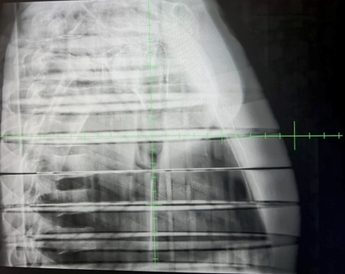

Slide 39
kV Filming OBI Image Review--cont
Set Field Borders
Write it Down
When you are looking at the SCREEN:
X1: Left border
X2: Right border
Y1: Bottom border
Y2: Top border
Close patient and send back to Mosaiq to make adjustments

Slide 40
Mosaiq: Diagnoses and Interventions (D&I)
Open TX field
Fill in X1, X2, Y1, Y2 with physician requested values
If depth and SSD changed due to a change in isocenter, re-enter the proper values
Check treatment fields with MV imaging

Slide 42
Mosaiq: Diagnoses and Interventions (D&I)
Determine the equivalent square using the table
Determine the MU for the Energy, Dose per field, Equivalent Square, and depth – USING 2 INDEPENDENT METHODS
Round to the nearest for equivalent square and depth
Type this MU into the field
Click OK

Slide 44
Hands-on Lab Part 2
Calculate MU needed to deliver 300cGy to field size marked out in Part 1 of lab
Choose method of second check for treatment MU

Slide 45
Monitor Unit calculations
Simplified to:
Dose = MU x calibration dose rate x factors
Calibration dose rate: Set value defined for the machine (O)
Factors: things that account for changes from calibration conditions (OF, Isq, DDF, OAF, and TF)
Notes:
s

Slide 46
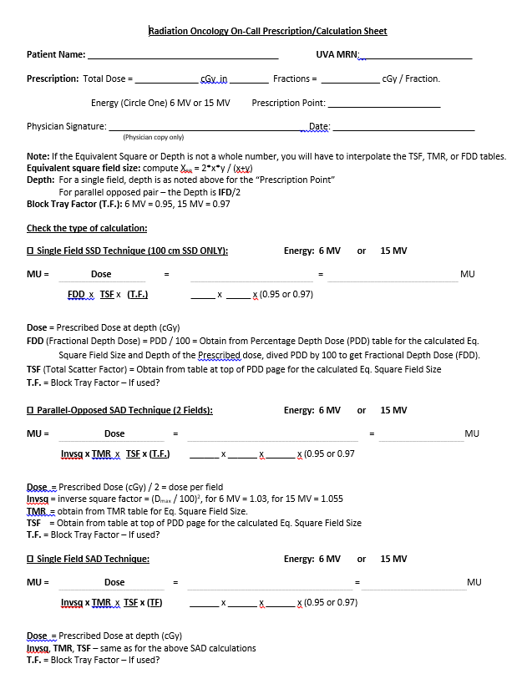
Primary Method for Determining MU
Calculation worksheet
Completed by resident, followed by at least one second check method
Worksheet + beam data found at:
Z:\Research\RADONC_S\weekend_start
Notes:
Need to have this worksheet added to the printed data so we can review it in more detail during lab
s

Slide 47
Second Check Options
Per policy, a second method must be used to verify MU
Can be done by physician or physicist
IM Sure
Simple calculation by entering field data
Phone a friend (make friends early in your residency!)
Call a physicist to do a second calc and check your work
Notes:
Put in picture of IM sure and where to find it
s

Slide 48
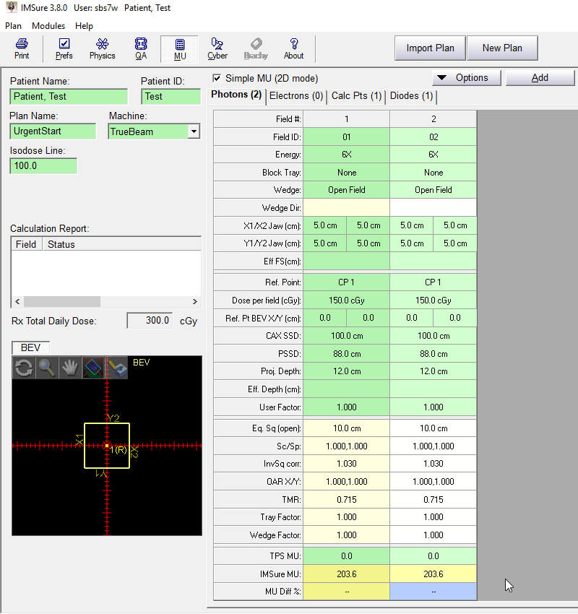
IM Sure
Enter patient data
Select Machine
Enter beam data
Field ID
Energy
Field Size
Depth of Iso
(always midplane)
Notes:
s

Slide 49
Mosaiq: Image Review
The MD should approve images in Mosaiq
If the field size needs to be adjust after MV fields
On the 4DiTC, Close Patient
Wait for it to transfer back to Mosaiq
Adjust BOTH fields per MD
Adjust MU of BOTH fields (if needed and have MD double check)
Repeat process of MV Filming
Once images are approved, have a Time-Out for verification

Slide 50
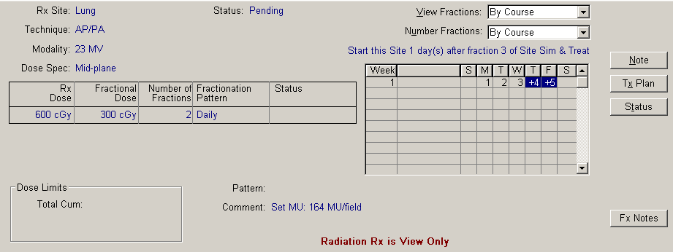
Double Check by MD
Before treating the MD must double check the therapist:
MU in fields are correct according to table
RX energy matches energy of fields
RX comment includes the set MU used
# of fractions is 2 or less (3 fx if it is a long weekend)
Notes:
We allow within 10% difference per field, but 5% overall

Slide 51
Verification Time-Out
Rx is complete and accurate, and includes note for set MU
Check all things between 4DiTC and Mosaiq
Energy of field matches RX
Dose per Field correct (half of Rx dose assuming 2 fields)
MU matches
Gantry, Collimator, and Field Size are appropriately mirrored

Slide 52
Treatment
After image approval and time-out – Treat Patient
Wrap Up
Go into room
Mark ISO
Mark field borders using the appropriate gantry, collimator, and field sizes treated
Take pictures
Once patient is off the table:
Download photos into patient chart in Mosaiq
Place any paperwork under the door to Physicist’s office
Send Physicist and Lead Dosimetrist an email, alerting them that a Sim & Treat was done

