Slide 1
Radiology-Pathology Case Presentation
Lindsay Chatfield, MS4

Slide 2
Objectives
To follow a patient through a radiology procedure and a pathology work up.
To understand the immunomarkers consistent with urothelial carcinomas.

Slide 3
Clinical Scenario
Mr. B is a 76 y.o. male who presents to clinic with hematuria. It started a week ago and has only gotten worse. He denies any pain but does endorse some weight loss.
PMH: AAA, A-fib, HTN, HLD, CVA, COPD
Meds: Aspirin, amlodipine, HCTZ, albuterol, gabapentin, tramadol
PSH: Appendectomy
Fam Hx: Heart disease and stroke. No cancer history.
Soc Hx: 2 ppd smoker. 2 shots of whiskey each night.

Slide 4
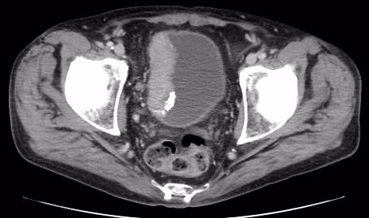
Initial Work Up
Bladder U/S and urine cytology: Results suspicious for malignancy.
Notes:
1. Right lateral wall bladder mass measuring 6.3 x 2.7cm with internal calcifications likely represent a primary bladder malignancy. Some of the images suggest transmural extension with perivesicular lymphadenopathy (see key image). No evidence of renal or ureteral involvement, no evidence of urinary tract obstruction.

Slide 5
Treatment Course
Cystourethroscopy and TURB-T, 01/26/17, > 7 cm bladder mass with biopsy revealing high-grade urothelial carcinoma
Concurrent EBRT (Bladder and pelvic lymphatics), 03/08/17- 04/25/17; Cisplatin (weekly) 03/09/17- 04/13/17 (last dose held for worsening hypomagnesemia)
Urology feels that cystectomy would be too morbid for patient

Slide 6
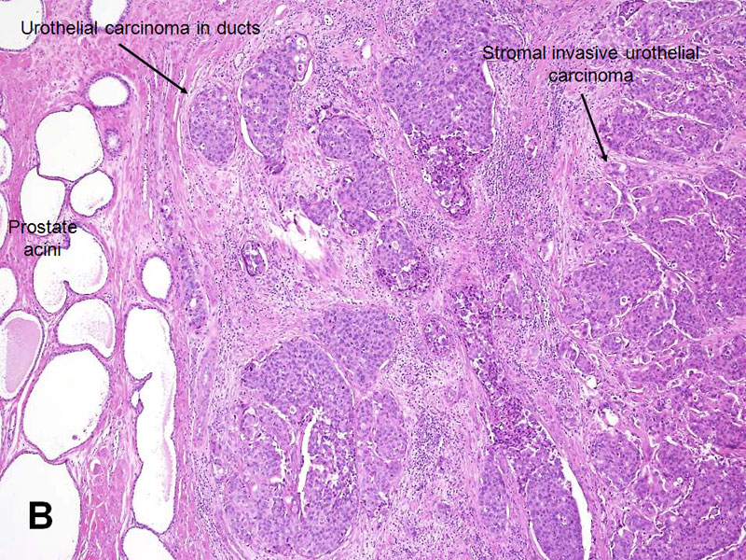

Slide 7
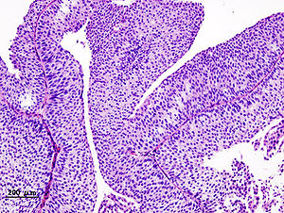
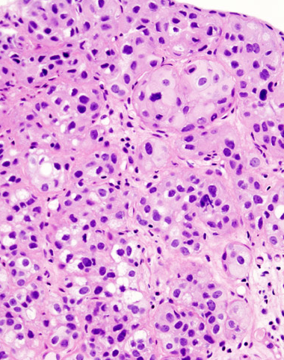
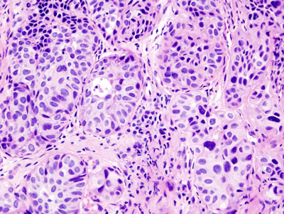

Slide 8
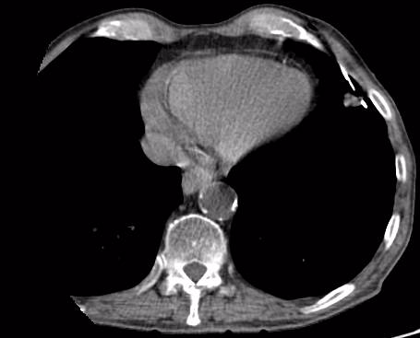
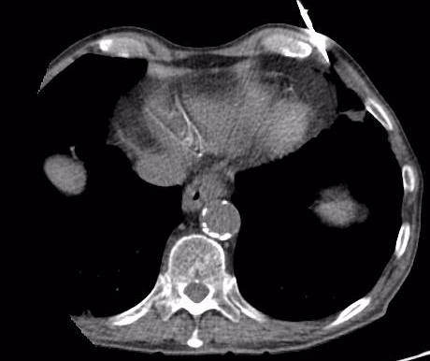
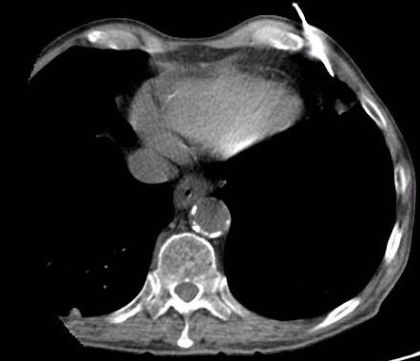
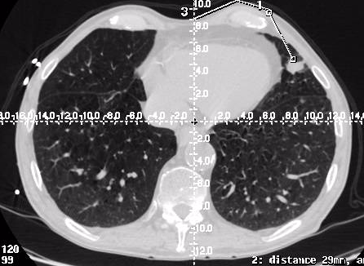
Imaging
Notes:
1. Newly appeared multiple solid pulmonary, subpleural and perifissural nodules in both lung fields, favoring pulmonary metastasis.
2. Unchanged several sub-centimeter sized lymphadenopathy in the mediastinum and paraaortic area in the descending thoracic aorta.

Slide 9
Final Pathology
LUNG NODULE, LEFT LINGULA, CT-GUIDED FNA: METASTATIC UROTHELIAL CARCINOMA.
LUNG NODULE, LEFT LINGULA, CT-GUIDED CORE NEEDLE BIOPSY: METASTATIC UROTHELIAL CARCINOMA. (SEE COMMENT.)
The core biopsies demonstrate a tumor with similar morphology to the patient's previous biopsies (S17-2068). The morphology and immunophenotype are consistent with metastatic urothelial carcinoma.

Slide 10
Immunostaining
Positive
p63: Myoepithelial origin
If negative: Renal collecting duct carcinoma or high grade prostate cancer
GATA-3: 67% of uroepithelial carcinomas
CK 7/CK 20
+/+: uroepithelial
+/-: bladder adenocarcinoma
-/-: adrenal or prostate
Negative
TTF-1: Thyroid transcription factor
Distinguish primary (TTF1+) vs. metastatic (usually TTF1-) lung carcinoma
Napsin
Superior to TTF1 in distinguishing primary lung adenocarcinoma

Slide 11
Resources
http://www.pathologyoutlines.com/topic/bladderurothelialinvasivegen.html
https://www-uptodate-com.proxy.its.virginia.edu/contents/epidemiology-and-risk-factors-of-urothelial-transitional-cell-carcinoma-of-the-bladder?source=search_result&search=urothelial%20carcinoma&selectedTitle=3~80
TTF-1 and Napsin A double stain: a useful marker for diagnosing lung adenocarcinoma on fine-needle aspiration cell block. Fatima et al. Cancer Cytopathol. 2011 Apr 25;119(2):127-33.

