Slide 1
Case 2
HingKiu Chan, MS4
Notes:
1. Initials and Age
Short clinical history
Radiographic images (maximum 5)
4. Hospital Course: outcome, surgery, path, etc. (short paragraph)
5. Diagnosis
6. Radiographic features and differential diagnosis for findings
7. One or 2 pertinent references
8. Medical Student Name
9. Your case will be presented to your colleagues on the last Friday of the rotation.

Slide 2
HPI
DB is a 63 y.o. man with history of GSW in 1990 to LLE s/p multiple surgical repairs and skin grafts who presents to the ED with bleeding from skin wound. He presented to the ED previously with similar complaint. Wound with active stream projecting out of wound at the anterior tibial surface and woke up with a trash bag wrapped around his LLE that was filled with blood.

Slide 3
CT Angiogram
Notes:
Chronic fracture of left tibia and fibula

Slide 4
Notes:
Bright aorta
IVC

Slide 5
Notes:
Aorta splitting into common iliac

Slide 6
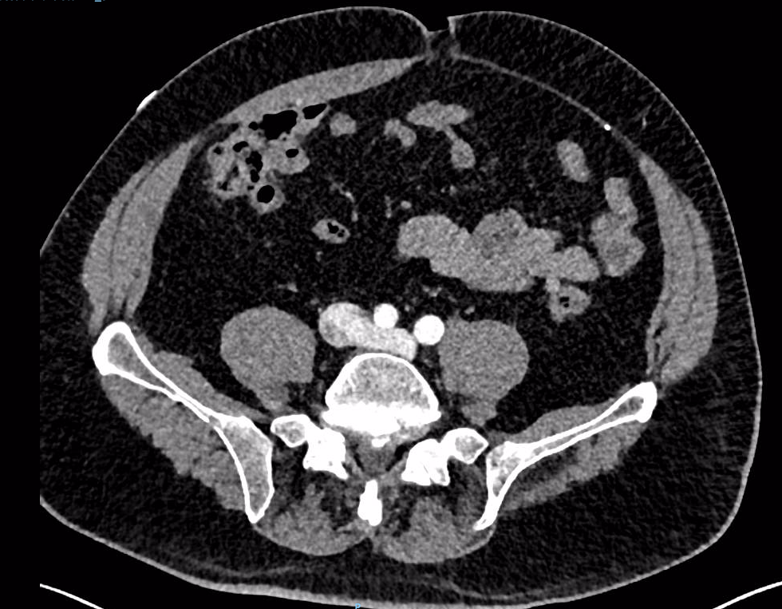
Notes:
IVC splitting into common iliac vein

Slide 7
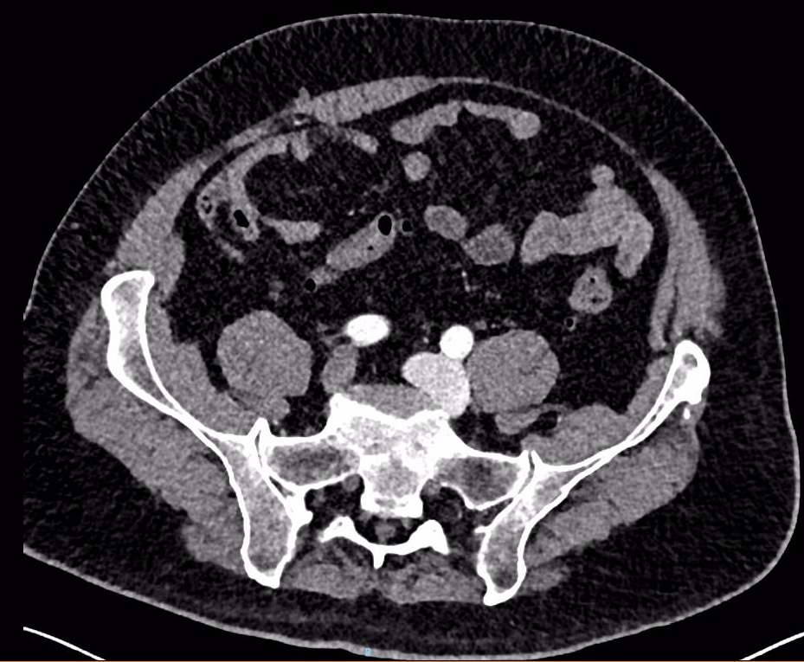
Notes:
Hypertropy of left common iliac artery

Slide 8
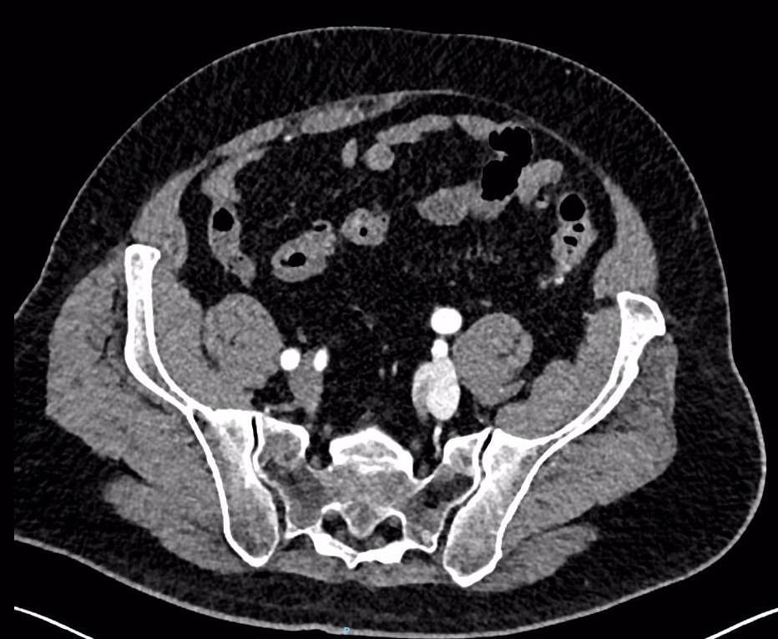
Notes:
Left common iliac into internal and external iliac

Slide 9
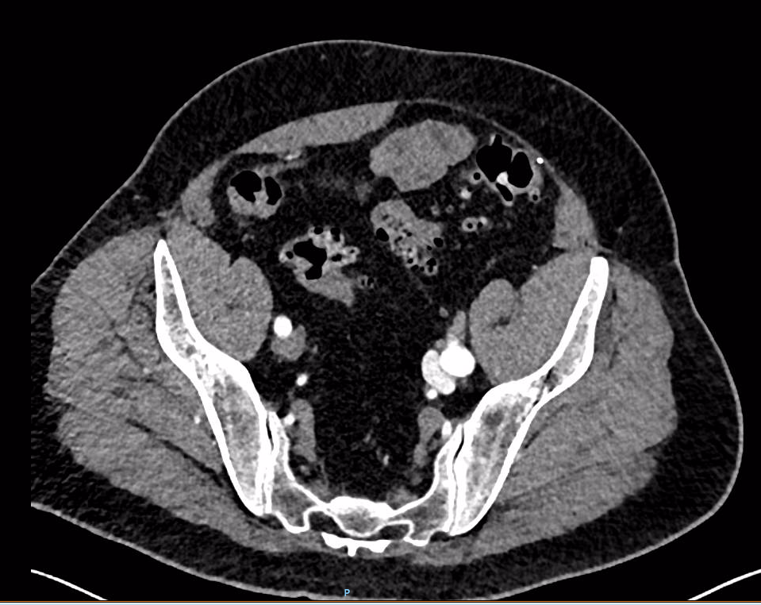
Notes:
Contrast in the left external iliac vein compare to the right
Again external iliac artery is hypertrophic

Slide 10
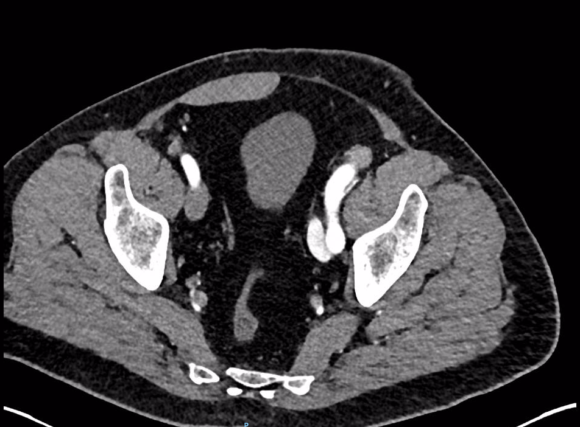
Notes:
Same

Slide 11
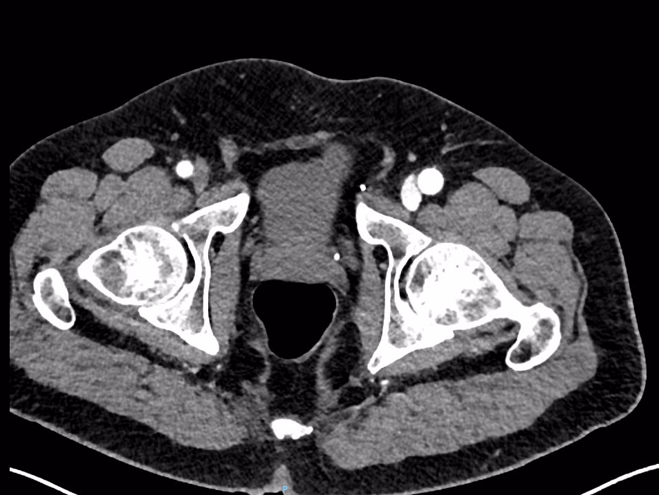
Notes:
Contrast in the left femoral vein

Slide 12
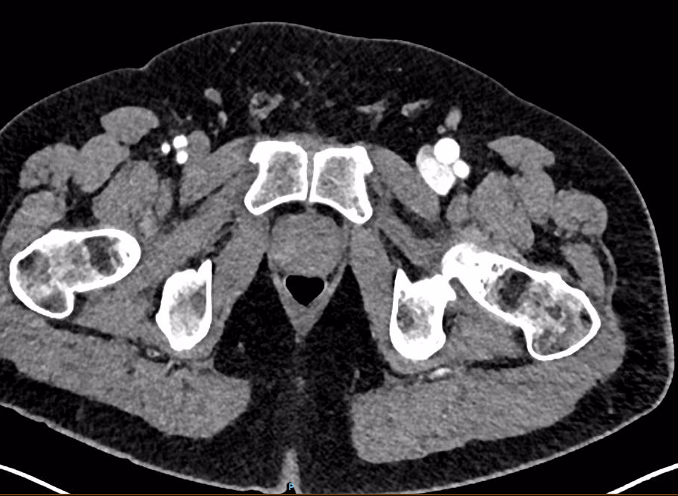
Notes:
Profunda coming off

Slide 13
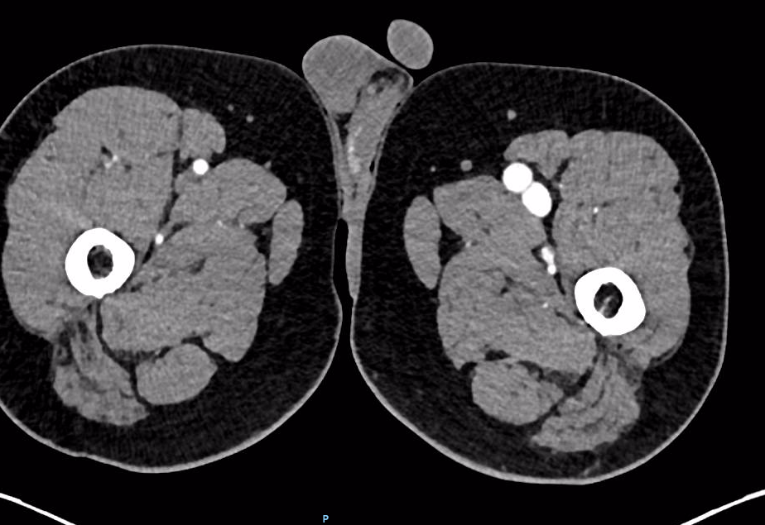
Notes:
Contrast in the left superficial femoral vein
Again SFA is hypertrophic

Slide 14
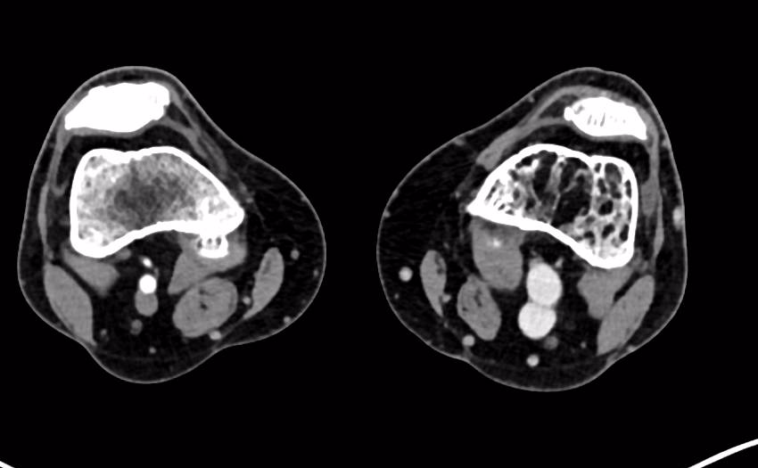
Notes:
Contrast in left Popliteal vein
Popliteal artery is hypertropic

Slide 15
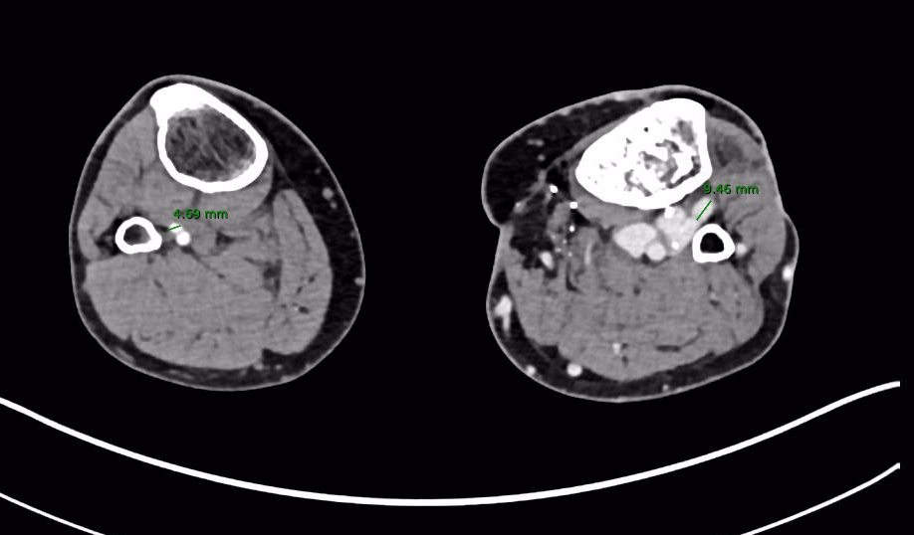
Notes:
Anterior tibial artery coming off (enlarged compare to right)
About 9mm in diameter
Deep venous varices

Slide 16
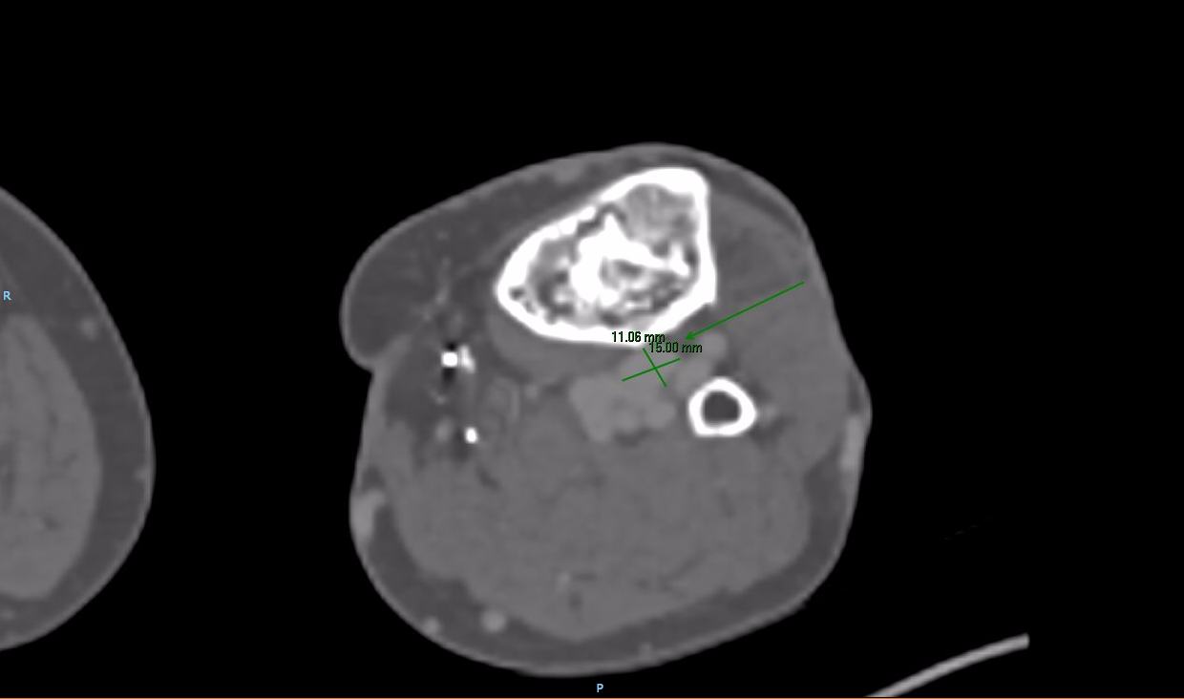
Notes:
Pseudoanerysm 2mm distal to the origin of AT

Slide 17
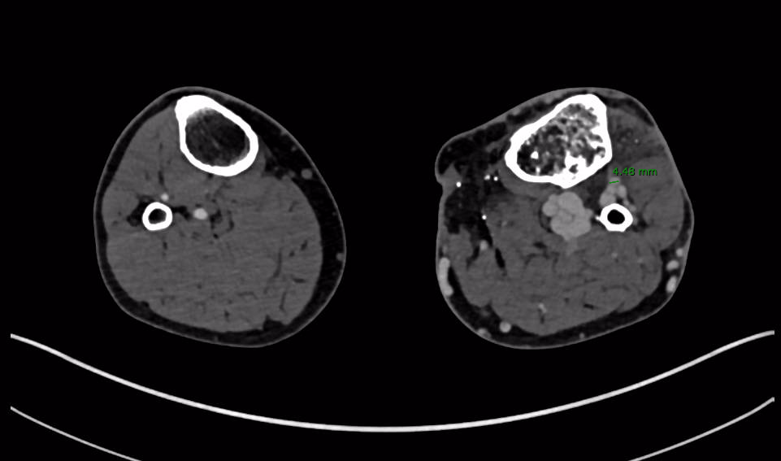
Notes:
Distal to the pseudoanerysm

Slide 18
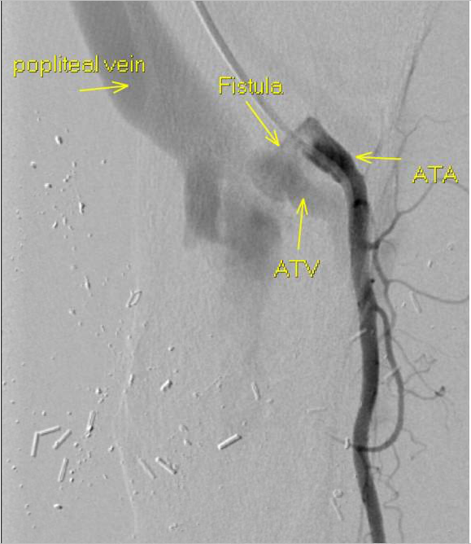
Outcome
Notes:
Underwent a lower extremity angiogram confirming the fistula
Large AV fistula with associated pseudoanerysm arising from just beyond the origin of the anterior tibial artery and draining int o the anterior tibial vein

Slide 19
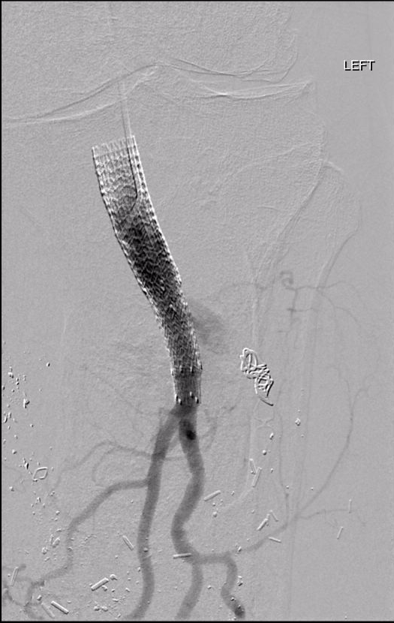
Embolization
Notes:
Successful treatment of an anterior tibial artery to anterior tibial vein traumatic AV fistula with associated pseudoanerysm using overlapping covered stents extending from the tibioperoneal trunk to the popliteal artery as well as plug and coil embolization of the anterior tibial artery and the associated traumatic fistula.
Resolution of the AV fistula at the conclusion of this procedure with preserved 2 vessel runoff
Recovering well after procedure

Slide 20
Diagnosis
AVF secondary to traumatic and previous surgeries
DDx
Cirrhosis imaging can cause hypertrophic vein in some region

Slide 21
Radiographic Features
Early contrast filling of the vein
Hypertrophied vein and artery
Deep venous varices
AVF appears as a blush with rapid opacification of the adjacent deep vein
If AVF is suspect in the beginning, duplex US is the diagnostic test of choice -> mosaic color pattern
Other modality include MRA

Slide 22
References
American Journal of Roentgenology. 2009;193: 1425-1433. 10.2214/AJR.09.2631 Read More: http://www.ajronline.org/doi/ref/10.2214/AJR.09.2631

