Slide 1
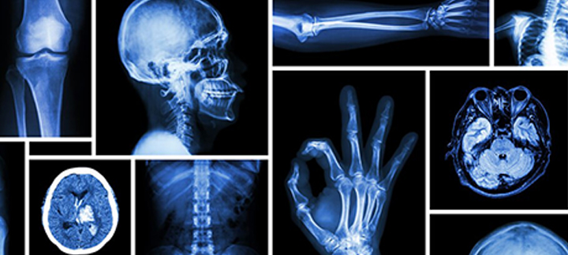
Radiology Cases
Ankita Mathur, M4

Slide 2
Case 1
RDJ, 64 y/o M

Slide 3
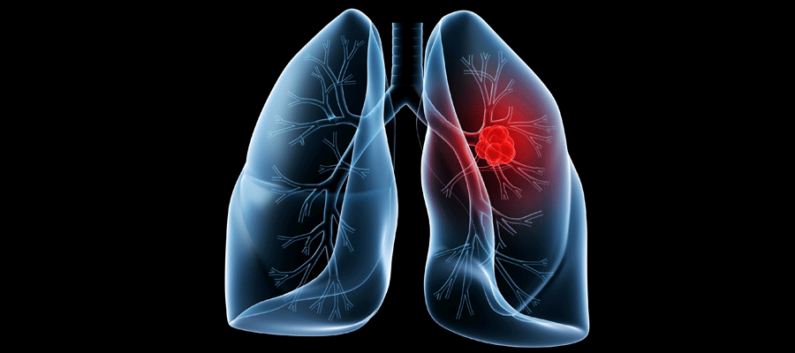
Pertinent Clinical History
64 y/o M s/p L pneumonectomy for adenocarcioma of lung

Slide 4
POD 6
Notes:
Obtained POD 6- large fluid collection in L pneumonectomy space w/ mdeiastinal shifting towards R

Slide 5
CT w/ Contrast
Notes:
CT w/ con (7mm collimation, mediastinal windowing) @ level of LA – large fluid collection w/ homogenous low attentuation in L pneumonectomy space. Fluid attenuation = 6.4 HU. Proved to be chylous @ thoracentesis. Note cardiac displacement to R

Slide 6
Differential Diagnoses
Chylothorax
Cholesterol effusion
Parapneumonic pleural effusion

Slide 7
Work-up
Pleural effusion drainage
Cytology
pH 7.84, fl protein 18 g/L, fluid LDH 511 IU/L, cholesterol 19.08 mg/dL, TG 235.8 mg/dL

Slide 8
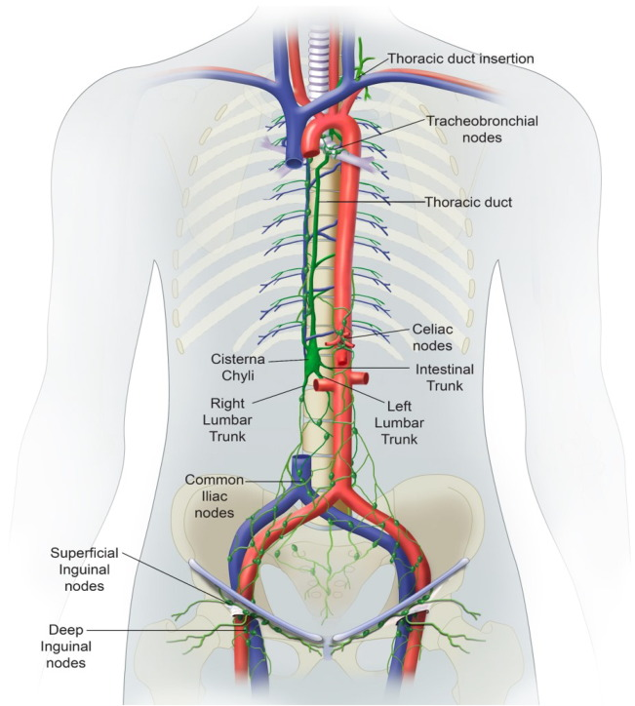
Diagnosis: Chylothorax
TG > 110 → strongly suggestive of chylothorax
TG < 50 → indicates absence of chylothorax

Slide 9
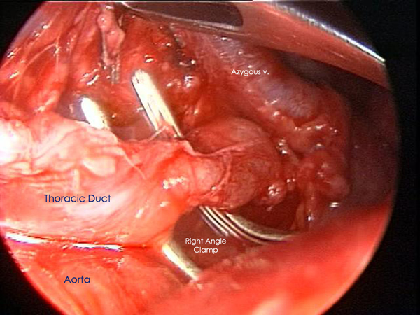
Hospital Course
Pt. improved s/p thoracic duct ligation via video-assisted thoracoscopy

Slide 10
Chylothorax vs. Cholesterol Effusion
Chylothorax
Cholesterol Effusion
Triglycerides
Distruction/Obstrucion of thoracic duct/tributaries
Cholesterol
Chronic pleural inflammation → thickened/calcified pleural surfaces

Slide 11
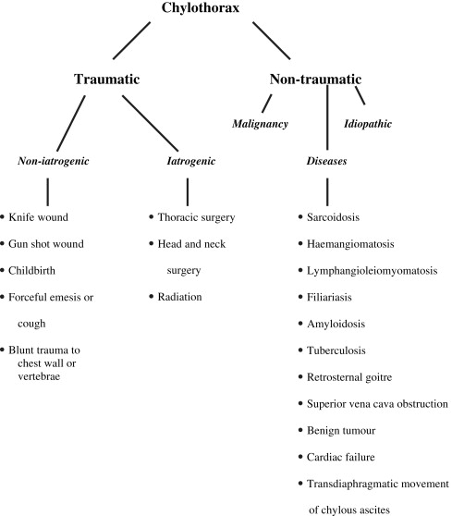

Slide 12
Case 2
HB, 55 y/o M

Slide 13
Pertinent History
55 y/o M w/ h/o DM presents to ED w/ R thigh pain

Slide 14
Work-Up
T 100.6 BP 130/87 P 115
Focal erythema & edema w/ TTP
WBC 40

Slide 15
Radiograph
Notes:
Air lucencies

Slide 16
T2 MR
Notes:
Hyperintense signal in deep intermuscular fascia

Slide 17
T1 MR
Notes:
Tiny foci of signal void in superficial fascia

Slide 18
Gradient-Echo
Notes:
Air foci

Slide 19
Differential Diagnosis
Cellulitis
Gas gangrene

Slide 20
Fasciotomy w/ Surgical Debridement
Notes:
Cx Strep anginosus

Slide 21
References
Ali, S. Z., Srinivasan, S., & Peh, W. C. G. (2014). MRI in necrotizing fasciitis of the extremities. The British Journal of Radiology, 87(1033), 20130560. http://doi.org/10.1259/bjr.20130560
Fahimi H, Casselman FP, Mariani MA, et al. Current management of postoperative chylothorax. Ann Thorac Surg 2001; 71:448.
Kuhlman JE, Singha NK. Complex disease of the pleural space: radiographic and CT evaluation. RadioGraphics 1997; 17:63-79.
Le Pimpec-Barthes F, D'Attellis N, Dujon A, et al. Chylothorax complicating pulmonary resection. Ann Thorac Surg 2002; 73:1714.
Vallières E, Karmy-Jones R, Wood DE. Early complications: chylothorax. Chest Surg Clin N Am 1999; 9:609-616. Medline
Martucci N, Tracey M, Rocco G. Postoperative Chylothorax. Thorac Surg Clin 2015; 25:523.
Shimizu K, Yoshida J, Nishimura M, et al. Treatment strategy for chylothorax after pulmonary resection and lymph node dissection for lung cancer. J Thorac Cardiovasc Surg 2002; 124:499.
Zabeck H, Muley T, Dienemann H, Hoffmann H. Management of chylothorax in adults: when is surgery indicated? Thorac Cardiovasc Surg 2011; 59:243.

