Slide 1
Case Report
Anne Knisely, MS4
Diagnostic Radiology elective
Notes:
MRN 2590078

Slide 2
DC, 12 y.o. F
Presented to the ED via EMS with left shoulder, thigh, and rib pain after she rode her bicycle into a concrete wall w/o a helmet
?LOC, mild HA, no emesis, was moving all extremities after landing in the grass per parents
PMH: seasonal allergies, constipation
PE: significant only for mild abrasions and ecchymosis over left lateral thigh
In ED: FAST, CT head, XR elbow/knee/radius/ulna/shoulder/femur, CXR, CTA chest
Notes:
CT head w/o contrast- no ICH, mass, skull fx

Slide 3
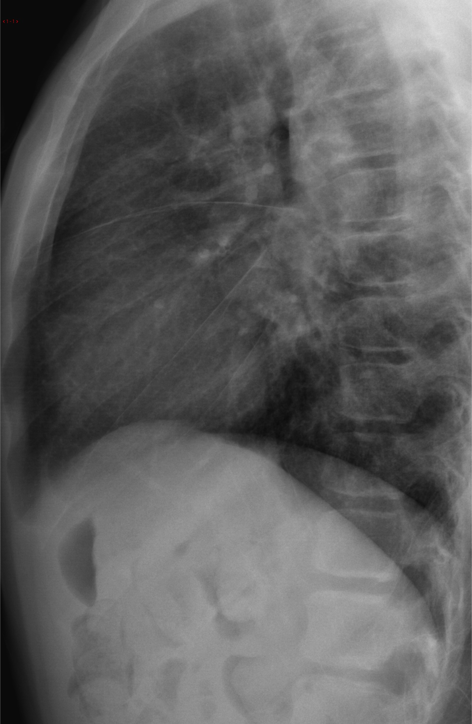
Notes:
Symmetric widening of the superior mediastinum
- could be secondary to presence of thymic tissue, projectional (AP supine film), vascular injury, mediastinal mass/lymphoma

Slide 4
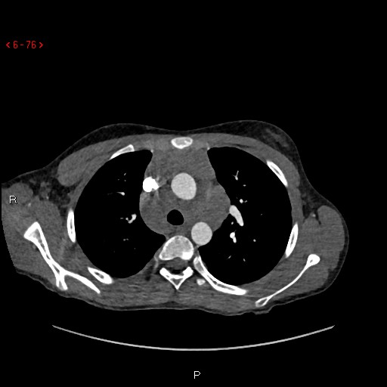
Notes:
Extensive multi-station mediastinal and hilar LAD concerning for lymphoma

Slide 5
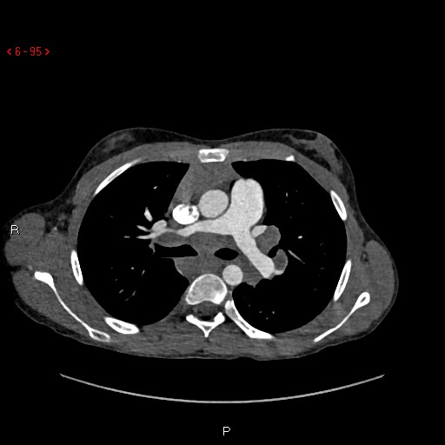
Notes:
R main pulm artery is compressed due to mass effect from perihilar LAD

Slide 6
ED Course
Consult to peds heme/onc
Discussion with parents re: concern for lymphoma
Labs
H/H 11.2/32.6
Rest of CBC, CMP, Mg, phos, PT, PTT, LDH, uric acid- unremarkable
Ambulatory referral to peds heme/onc clinic
Notes:
No B sx!!

Slide 7
Diagnosis/Follow up
Diagnosis: Mediastinal& hilar lymphadenopathy/mass
Follow up
1st clinic visit: Imaging concerning for possible lymphoma, although no worrisome sx, history, labs, or exam findings
PET: “FDG avid mediastinal and hilar lymphadenopathy”
2nd clinic visit: fatigue, submandibular adenopathy
CT-guided FNA: “Atypical lymphocytes”
Flow Cytometry: “normal thymic tissue”
Notes:
Initial ED visit- 5/14
1st clinic visit- 5/17
PET, 2nd clinic visit- 5/25
CT-guided FNA- 5/30

Slide 8
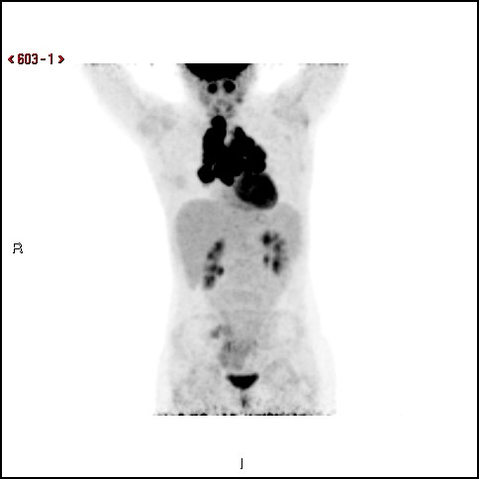

Slide 9
Radiographic Features and Ddx: Mediastinal Mass in a Child
Anterior Mediastinum (most common location)
Solid: prominent/ectopic thymus, thymoma, thymic carcinoma, lymphoma, teratoma
Fatty: lipoma, thymolipoma
Cystic: thymic cyst, lymphatic malformation
Middle Mediastinum
Vascular anomalies
Nonvascular lesions: congenital foregut duplication cyst, bronchogenic cyst, esophageal cyst, neurenteric cyst
LAD: primary neoplasm (lymphoma), metastasis, infection
Posterior Mediastinum (usually neurogenic)
Sympathetic ganglion tumors: neuroblastoma, ganglioneuroblastoma, ganglioneuroma
Nerve sheath tumors: schwannoma, neurofibroma, malignant peripheral nerve sheath tumor

Slide 10
References
Friedmann A. (2008) Evaluation and Management of Lymphadenopathy in Children. Pediatrics in Review 29(2): 53-60.
Ranganath SH et al. (2012) Mediastinal Masses in Children. American Journal of Roentgenology 198(3): W197-216.

