Slide 1
23 yo w/ widespread liver metastasis
HingKiu Chan, MS4
1st Case Presentation

Slide 2
Patient Information
RH is a 23 yo G2P0101 F who is 19 wks pregnant who presents with 10 days of non-stop abdominal pain. Pain is RUQ, worse with eating, dull with sharp breakthrough. The pain was previously intermittent. Previous pregnancy complicated by preclampsia and c-section. Normal BM.
CT A/P 3 years ago for L2 vertebral body burst fracture; otherwise normal
Abdominal US in ED demonstrated widespread focal and confluent hypoechoic lesions with a target appearance most consistent with widespread liver metastases

Slide 3
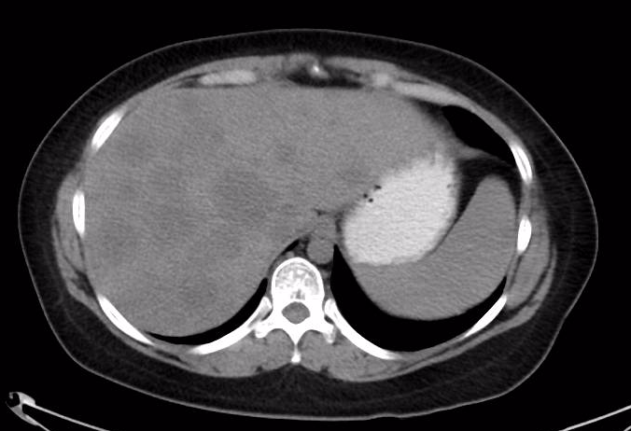
CT Abdomen WO Contrast
Notes:
Inumerable hypodense hepatic lesions throughout the liver

Slide 4
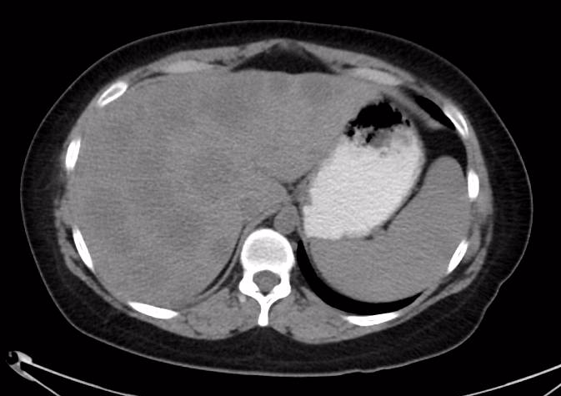
Notes:
Inumerable hypodense hepatic lesions throughout the liver

Slide 5
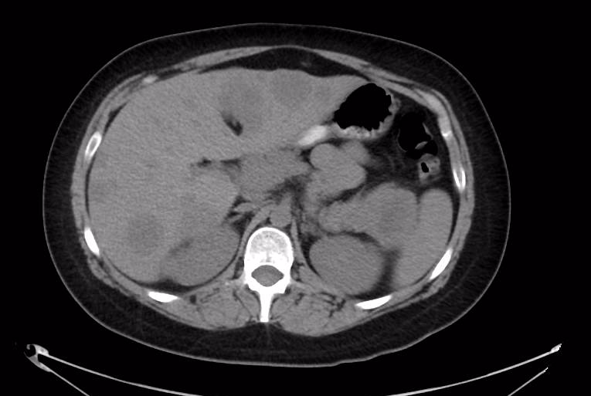
Notes:
In the pancreatic tail, there is a large mass measuring 4.8 x 3.9 x 6 cm with central cystic component

Slide 6
Notes:
In the pancreatic tail, there is a large mass measuring 4.8 x 3.9 x 6 cm with central cystic component

Slide 7
Hospital Course
Initial biopsy of the liver lesion revealed high grade carcinoma, cellular blue cell neoplasm.
CT-guided FNA of pancreas revealed high-grade carcinoma that is morphologically identical to the liver biopsy
Diagnosis favor pancreatoblastoma with liver metastasis
Subsequently underwent chemotherapy and stem cell transplant in 2015
Recently admitted to UVA for laparoscopic cholecystectomy c/b retained stone

Slide 8
CT features
Usually relatively well defined and heterogeneous due to solid and multilocular cystic components with enhancing septae
May demonstrate fine calcifications, similar to neuroblastoma
Most often at head of the pancreas
Hepatic metastases are hypodense
Notes:
From https://radiopaedia.org/articles/pancreatoblastoma

Slide 9
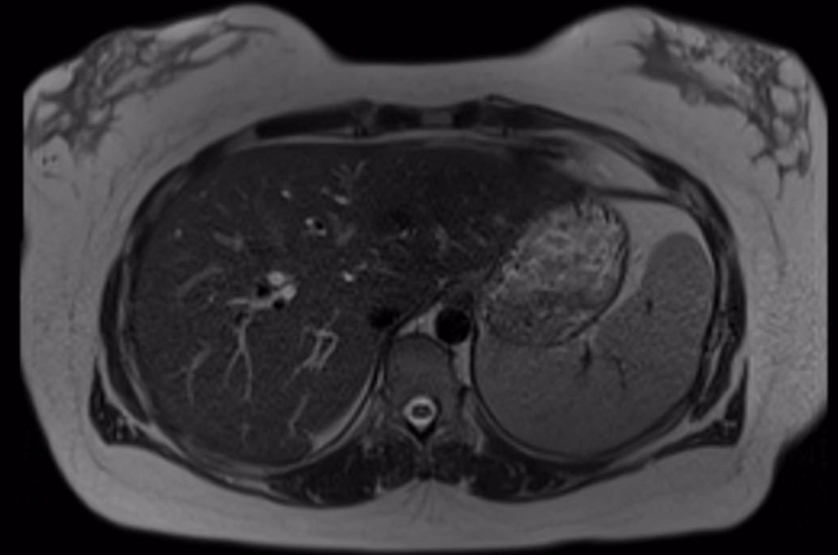
Most Recent MRI (~2 years post treatment)
Notes:
Multiple hepatic hypoenchancing lesions throughout the liver which are unchanged after chemo. No new hepatic lesion

Slide 10
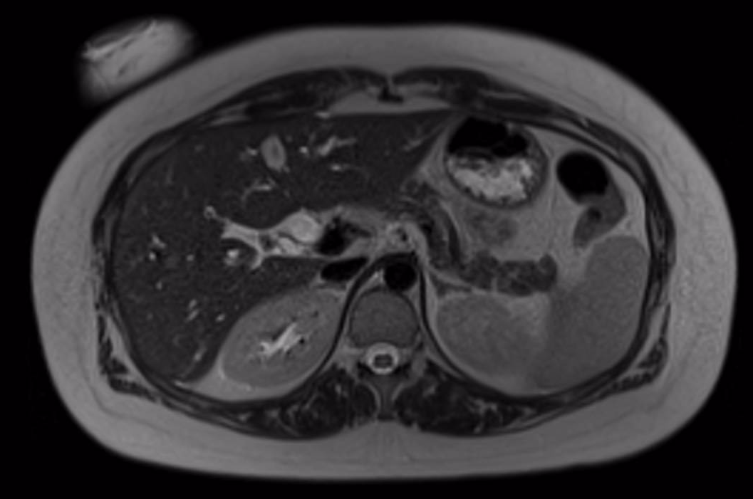
Notes:
Pancreas tail mass gone after chemo

Slide 11
DDx
Solid pseudopapillary neoplasm (rarely metastasize)
Ewing’s sarcoma
Pancreatic acinar tumor
Neuroendocrine tumor

Slide 12
References
Roebuck DJ, Yuen MK, Wong YC, Shing MK, Lee CW et al. Imaging features of pancreatoblastoma. Pediatr Radiol. 2001; 31(7): 501-6.

