Slide 1
JN
71 yo F

Slide 2
Clinical History
JN is a 71 yo F with PMH of CAD and A-fib that presents 1 week s/p CABG with CC of “dizziness and weakness” x 3 days.
Since recent DC:
“Like I am going to black-out”
Exacerbated by standing, made better by sitting
Nausea, Decreased PO intake
Meds:
Lisinopril, Metoprolol, Furosemide, Rivaroxaban

Slide 3
Clinical History
Vital Signs:
BP: 115/80 Supine, 97/65 Standing
HR, RR, and Temp wnl
PE: wnl
Labs:
WBC 17k
UA: wnl
CXR:
Unchanged minimal left basilar sub-segmental linear atelectasis. No acute cardiopulmonary process.
DDx:
Medication-induced orthostatic hypotension vs. Infection

Slide 4
Initial Hospital Course
Lisinopril & Furosemide held, Resuscitated with fluids
TTE: EF 65-70%, Heart wnl
Symptoms resolved by the end of day 2, clearing her for DC the next day
Day of anticipated DC, routine CXR demonstrated new findings…

Slide 5
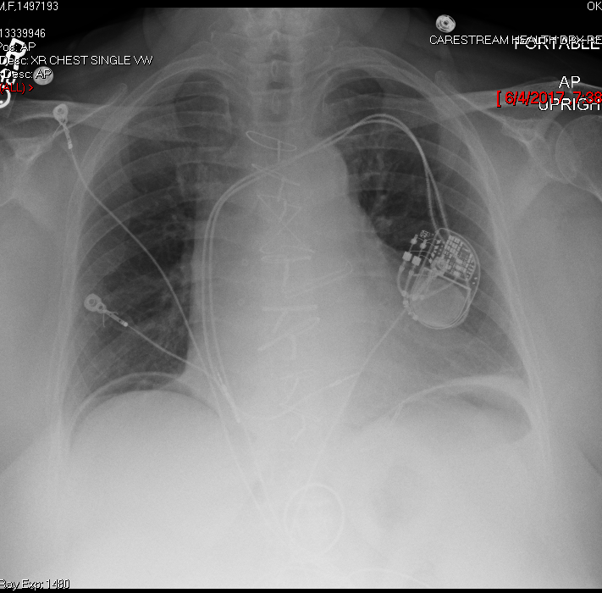
Radiographic Images
Chest X-Ray

Slide 6
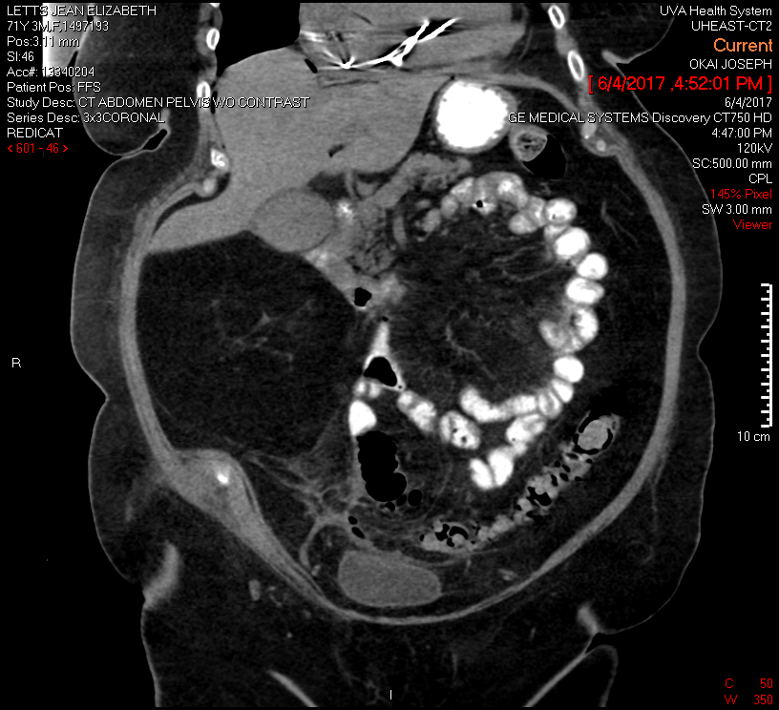
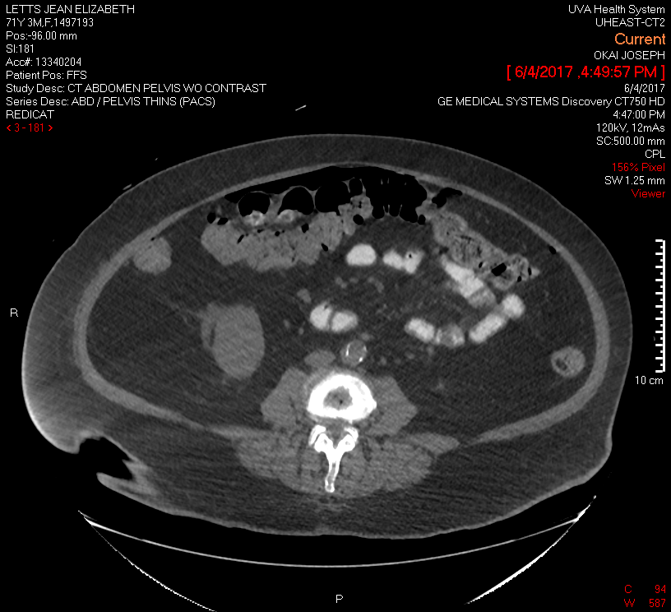
Radiographic Images
Abdominal CT Scan - Coronal
Abdominal CT Scan - Axial

Slide 7
Diagnosis
Pneumoperitoneum: gas within the peritoneal cavity

Slide 8
Hospital Course
Despite these concerning imaging findings and a WBC count elevated to 15k, the patient remained asymptomatic. She was made NPO, started on IV antibiotics (ciprofloxacin and metronidazole), and General Surgery was consulted.
As the patient had a benign abdominal exam, was afebrile, and was hemodynamically stable, non-operative management was pursued.
Follow-up chest x-ray performed 2 days later demonstrated improvement of the pneumoperitoneum, and the patient was discharged on oral antibiotics.

Slide 9
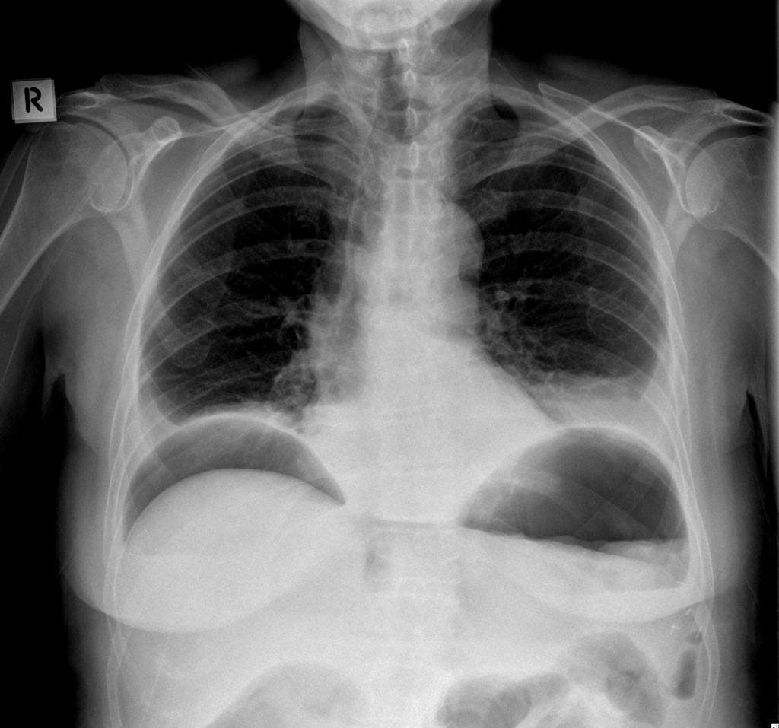
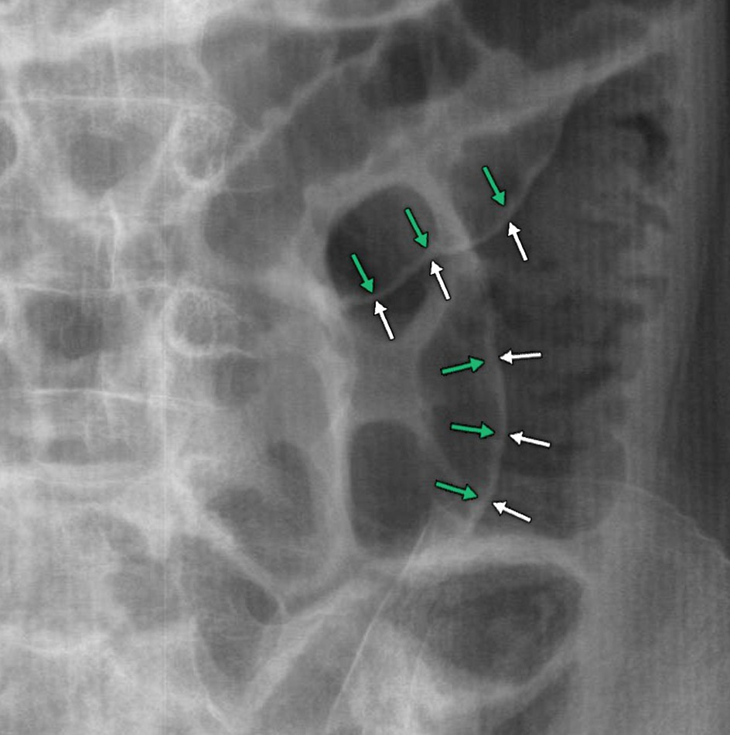
Radiographic Features
Sub-diaphragmatic Free Gas
Double Wall Sign (Rigler’s Sign)

Slide 10
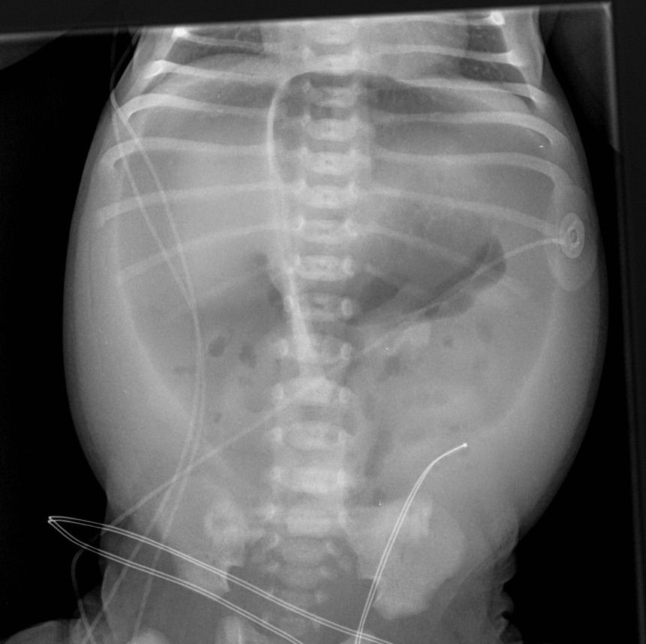
Radiographic Features
Football Sign
Lucent Liver Sign

Slide 11
Differential Diagnosis
Perforated hollow viscus
i.e. PUD, Ischemic bowel, diverticulitis, mechanical perforation
Post-operative free intraperitoneal gas
Peritoneal dialysis
Mechanical ventilation
Pneumomediastinum
Pneumothorax
Vaginal “aspiration”
i.e. via sudden squatting or postpartum exercises
Pseudopneumoperitoneum

Slide 12
References
Jones, Jeremy. "Pneumoperitoneum | Radiology Reference Article | Radiopaedia.Org". Radiopaedia.org. N.p., 2017. Web. 15 June 2017.
"Pneumoperitoneum Imaging: Overview, Radiography, Computed Tomography". Emedicine.medscape.com. N.p., 2017. Web. 15 June 2017.

Slide 13
Blake Niccum 6/5/17 – 6/16/17

