Slide 1
Radiology 4a case presentation
Tim Herberg
6/16/17

Slide 2
Clinical vignette
A.F. 70 y/o F presents w/ tachycardia 3 wks after R total knee replacement
Undergoes CTPA
Notes:
PET 6/1
IMPRESSION:
1. Findings concerning for synchronous lung cancers in the right upper lobe, the larger 1.9 cm mass in the right apex and the smaller 1.5 cm mass just superior to the right hilum. Less likely metastatic disease from suspected renal neoplasm described below in #3. 2. Indeterminate right paratracheal/hilar nodes with minimal increased FDG avidity. 3. Exophytic right renal mass is suspicious for neoplasm.

Slide 3
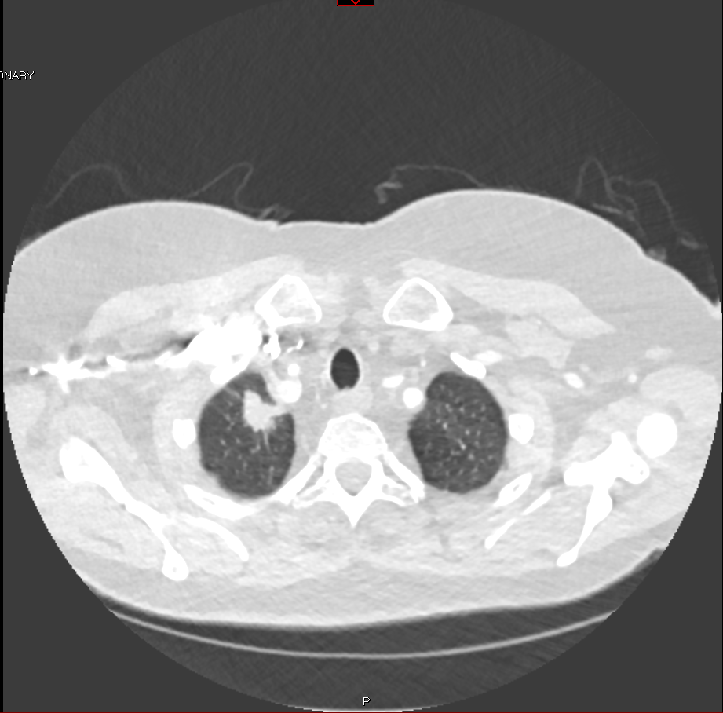
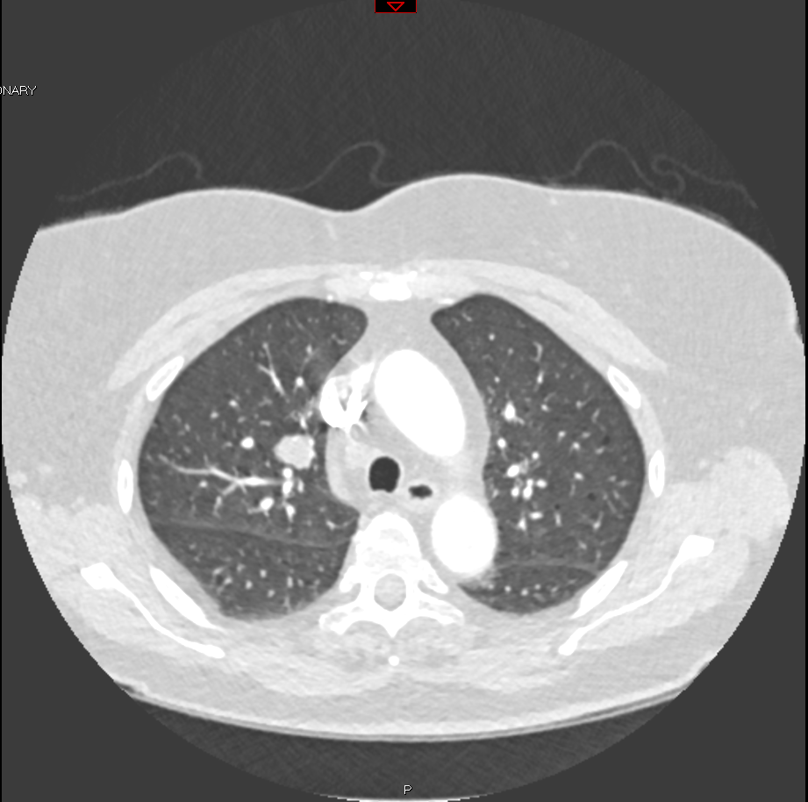
Clinical vignette
18x20mm spiculated nodule in apical segment of RUL, 13x14mm nodule in mid RUL
Notes:
PET 6/1
IMPRESSION:
1. Findings concerning for synchronous lung cancers in the right upper lobe, the larger 1.9 cm mass in the right apex and the smaller 1.5 cm mass just superior to the right hilum. Less likely metastatic disease from suspected renal neoplasm described below in #3. 2. Indeterminate right paratracheal/hilar nodes with minimal increased FDG avidity. 3. Exophytic right renal mass is suspicious for neoplasm.

Slide 4
SPNs
Common, especially >50
Ddx: granulomas, lung CA, solitary mets, abscess, hamartoma, AVM
Benign findings: no growth 2 yrs, calcification pattern (difuse, central, laminated, popcorn), small size
Patholic findings: recent growth, eccentric or stippled calcification pattern
Can be fooled by fluid in fissures, pleural plaques, skin lesions (nipple shadow, mole, lipoma)
mngt guidelines-Fleischner society
Notes:
Granulomas after clinical or subliclinal pulmonary infections

Slide 5
Clinical vignette
A.F. 70 y/o F w/ tachycardia 23 days after R total knee replacement
Undergoes CTPA-18x20mm spiculated nodule in apical segment of RUL, 13x14 nodule in mid RUL
Undergoes PET on 6/1 and CT guided transthoracic lung biopsy on 6/8 via IR

Slide 6
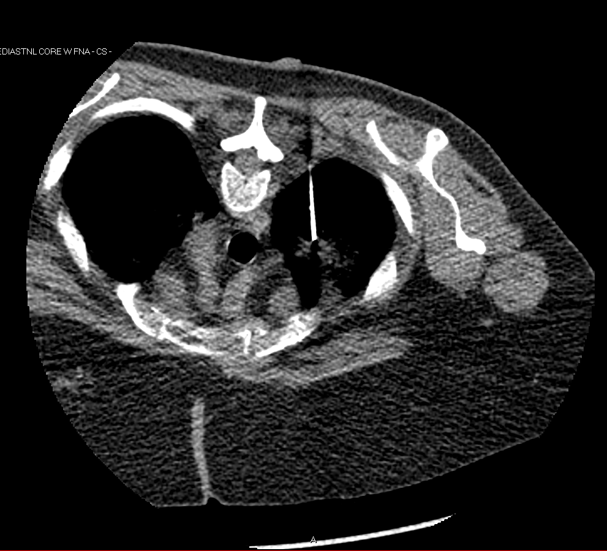
Clinical vignette
A.F. 70 y/o F w/ tachycardia 23 days after R total knee replacement
Undergoes CTPA-18x20mm spiculated nodule in apical segment of RUL, 13x14 nodule in mid RUL
Undergoes PET on 6/1 and CT guided transthoracic lung biopsy on 6/8 via IR

Slide 7
Clinical vignette
A.F. 70 y/o F w/ tachycardia 23 days after R total knee replacement
Undergoes CTPA-18x20mm spiculated nodule in apical segment of RUL, 13x14 nodule in mid RUL
Undergoes PET on 6/1 and CT guided transthoracic lung biopsy on 6/8 via IR
1 day s/p lung biopsy developed right sided chest pain, tachycardia, and diaphoresis

Slide 8
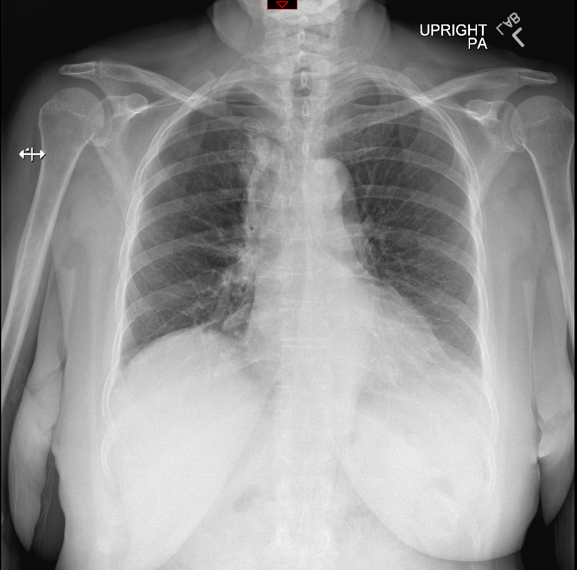

Slide 10
Diagnosis-PTX

Slide 11
Hospital course
Had pigtail chest tube placed with improvement of PTX and symptoms. Discharged the following day. Pathology revealed adenocarcinoma. Will f/u with heme/onc.

Slide 12
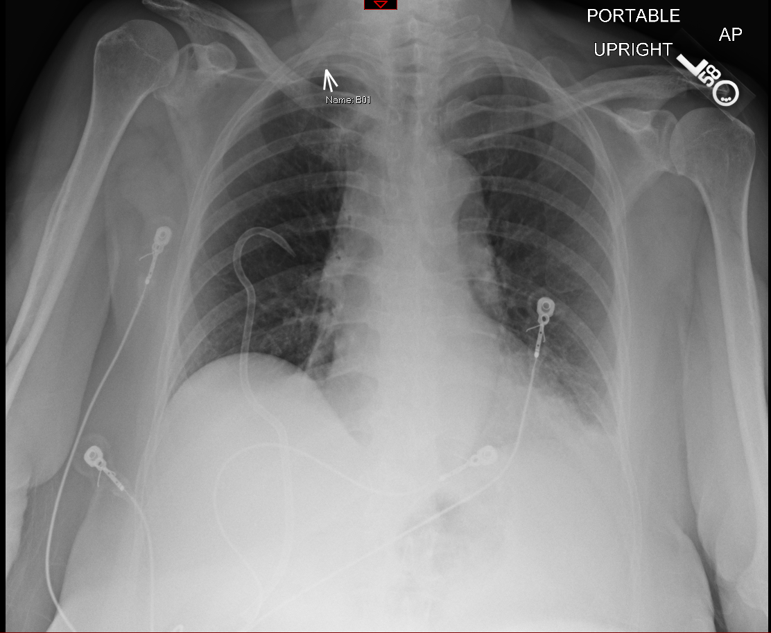
Hospital course
Had pigtail chest tube placed with improvement of PTX and symptoms. Discharged the following day. Pathology revealed adenocarcinoma. Will f/u with heme/onc.

Slide 13
Hospital course
Had pigtail chest tube placed with improvement of PTX and symptoms. Discharged the following day. Pathology revealed adenocarcinoma. Will f/u with heme/onc.

Slide 14
Radiographic features, differential diagnosis for findings, etiologies, mngt
Transition point with peripheral lucency/lack of vascular lung markings
Upright vs supine
Ddx:
Etiologies: iatrogenic, idiopathic, asthma, COPD, trauma, pneumonia, neoplasm, marfans syndrome, smoking cocaine
Mngt:

Slide 15
References
UVA Radiology Tutorial: Introduction to chest radiology. https://www.med-ed.virginia.edu/courses/rad/cxr/Index.html

