Slide 1
Radiology Case Presentation
Sami Natour, MS4
UVA School of Medicine

Slide 2
Clinical History
E.L. is a 58 year old male with a past medical history of PVD, aortic stenosis, HTN, HLD, who was transferred from an OSH for management of MSSA bacteremia complicated by endocarditis and presumed septic emboli to the brain
Presented to OSH with confusion and headache and found to have MSSA bacteremia of unknown source. He began treatment with nafcillin prior to transfer
TEE demonstrated severe AR and multiple aortic valve vegetations
MRI Brain demonstrated findings suspicious for septic emboli

Slide 3
Notable Physical Exam Findings, Labs
Afebrile, Vitals were within normal limits on presentation to UVA
Gen: Oriented to person, place, and time.
Neck: Normal ROM, supple
CV: Holosystolic and early diastolic murmurs loudest at the right 2nd intercostal space, radiating to the carotids. RRR.
Pulm: Crackles heard at bilateral bases
Abd: Soft, no tenderness
Skin: No Janeway lesions or Osler nodes appreciated
Notable Labs
WBC: 28.87 BUN/Cr: 27/1.4
Hgb: 8.3 AST/ALT: 38/<6
PLT: 219
- 7/29, 7/30, 8/8 Blood cultures positive for MSSA

Slide 4
Imaging (performed at OSH)
TEE (AV vegetations, severe AR)
MRI C-Spine, CT Abd/Pelvis, CXR all unremarkable
MRI Brain demonstrated (as follows)

Slide 5
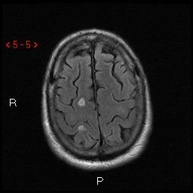
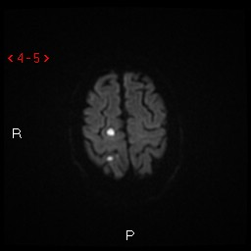
T2/FLAIR
DWI

Slide 6
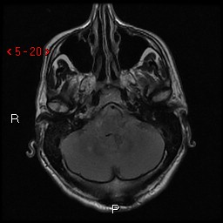
T2/FLAIR

Slide 7
Hospital Course
Patient was admitted to the ACS service and a multidisciplinary team was consulted for management. A source could not be identified and he continued to spike fevers. The decision was made to schedule him for AV repair. Prior to his surgery, he developed chest pain with dyspnea and ST depressions in V1-V4 concerning for posterior MI. Anticoagulation was withheld due to risk of hemorrhagic conversion of brain lesions. Patient was transferred to the CCU for hemodynamic optimization. Nitroglycerin drip was started with resolution of chest pain. On the night of transfer, his respiratory status worsened requiring intubation and troponins trended upward. He was taken for cardiac catheterization with revascularization of obtuse marginal artery but incomplete aspiration from left circumflex. After this procedure he became progressively hypotensive requiring vasopressors and ultimately went into PEA arrest.
The patient’s cause of death was presumed to be cardiogenic shock due to acute MI from septic emboli into coronary circulation.

Slide 8
Radiographic features
Diffuse cerebral (cortical, subcortical, and deep white matter) and single right cerebellar foci of increased T2/FLAIR signal and restricted diffusion corresponding to PCA and MCA territories
T2/FLAIR hyperintensity differential:
- CNS tumors (primary and metastatic disease)
- Vasculitis (e.g. Behcet’s disease)
- Infectious (e.g. abcess or embolic disease)
- Demyelinating diseases
- Ischemic pathology
- Traumatic injury
Use history and clinical findings to guide this broad differential
Notes:
Blood: hemorrhage

Slide 9
References
1. Hoen B, Duval X. Clinical practice. Infective endocarditis. N Engl J Med. 2013 Apr 11;368(15):1425-33. doi: 10.1056/NEJMcp1206782. Review. Erratum in: N Engl J Med. 2013 Jun 27;368(26):2536. PubMed PMID: 23574121.
2. Guzmán-De-Villoria JA, Ferreiro-Argüelles C, Fernández-García P. Differential diagnosis of T2 hyperintense brainstem lesions: Part 2. Diffuse lesions. Semin Ultrasound CT MR. 2010 Jun;31(3):260-74. doi: 10.1053/j.sult.2010.03.002. Review. PubMed PMID: 20483393.

