Slide 1
Case Report
Anne Knisely, MS4
Diagnostic Radiology elective
Notes:
MRN 0734588

Slide 2
SK, 69 y.o. F
Initially admitted with heavy vaginal bleeding and severe anemia
Transfused, started on Megace (megestrol)
5 cm mass on TVUS, grade 1 endometrioid adenocarcinoma on EMBx
Readmitted for surgery 1 week later (robotic TLH/BSO, pelvic LND)
Required 1U pRBCs, d/c’ed on PSD#2 with Foley (removed PSD#11)
Presented to ED on PSD#13 with left leg pain and edema, R-sided pleuritic chest pain, mild SOB
CXR, CTPA, b/l LE Doppler US, TTE
Notes:
PMH: Obesity (BMI 35), HTN, nec fasc of R shoulder c/b A-fib requiring debridement, trach, and PEG tube in 2015
Day after surg, Hct 29.1 → 23.3
31/38 mm invasion on frozen section
Initial PE: R sided basilar crackles, no increased WOB on 4L NC
CXR was normal!

Slide 3
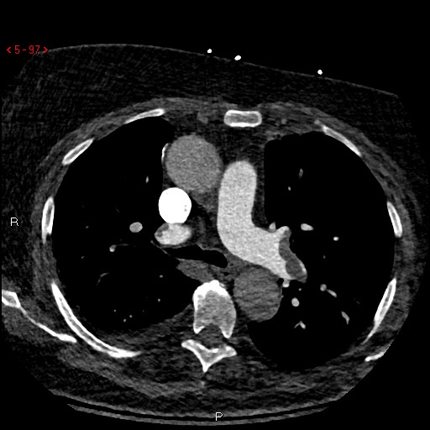
Notes:
Left pulmonary artery with occlusive thrombus (filling defect)

Slide 4
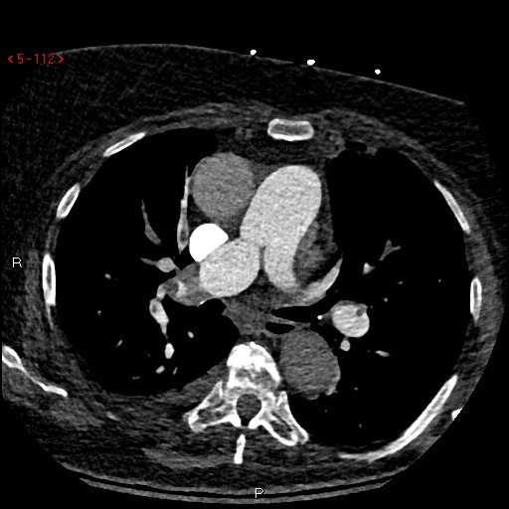
Notes:
Right pulmonary artery with occlusive thrombus (filling defect)

Slide 5
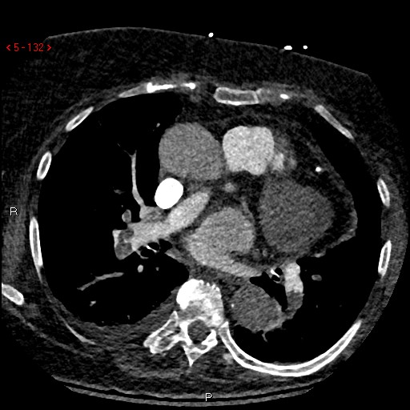
Notes:
Filling defects continue bilaterally
Evidence of right heart strain on CT with RV:LV ratio of 1.26

Slide 6
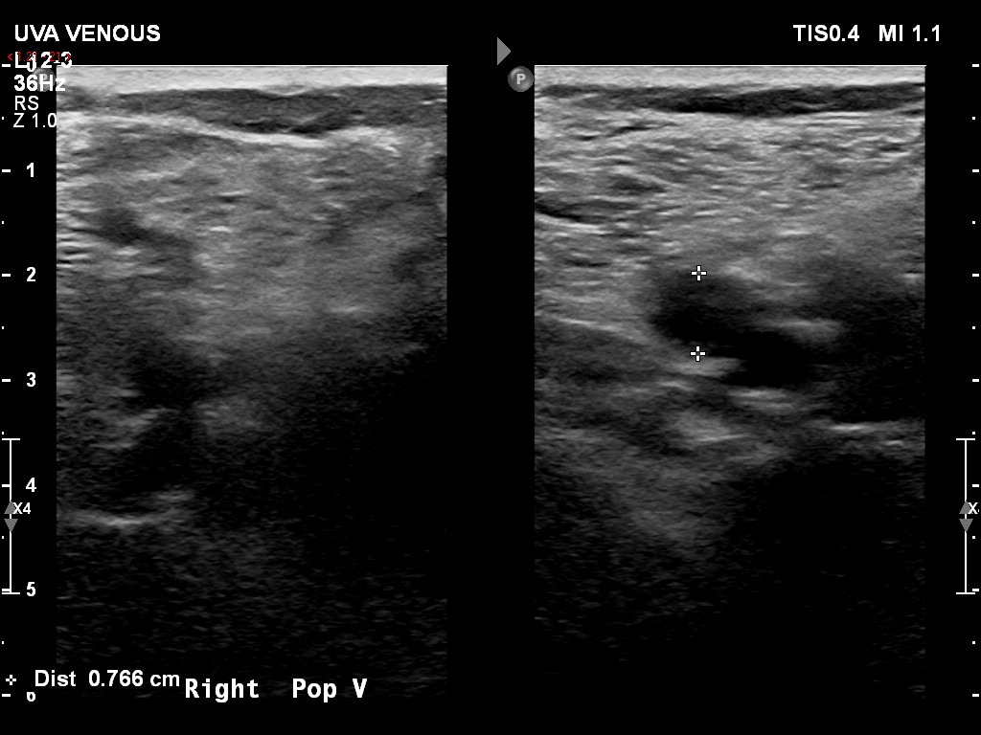
Notes:
Right: occlusive thrombus in R superficial femoral vein, popliteal vein, and R calf veins

Slide 7
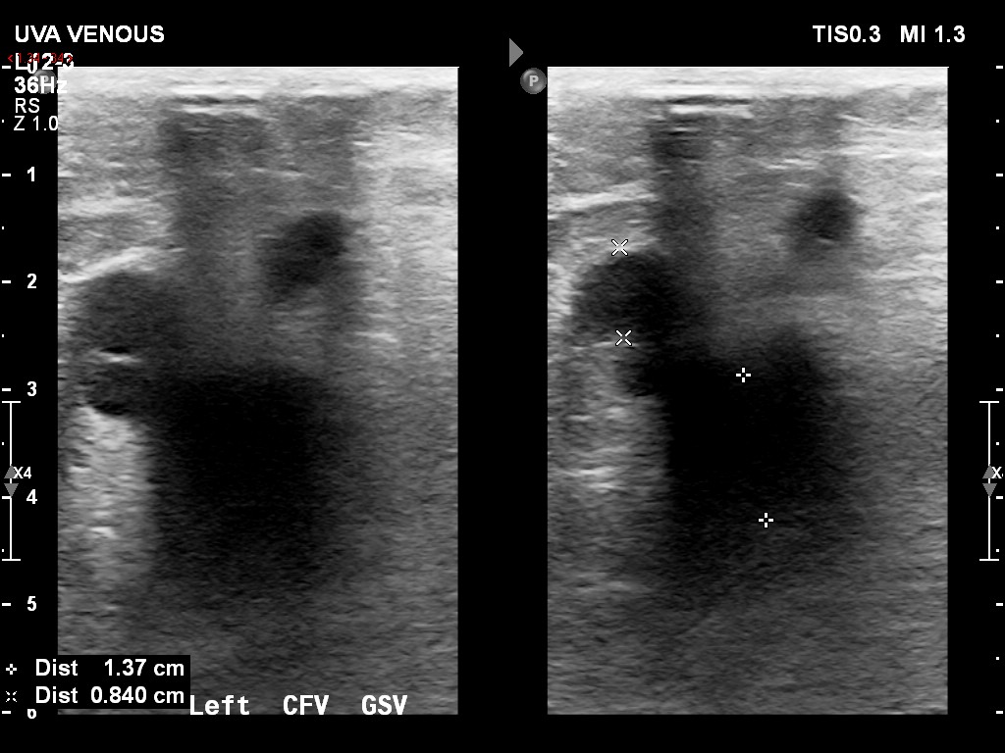
Notes:
Left: occlusive thrombus throughout common femoral vein, superficial femoral, profunda femoral, popliteal, and calf veins and great saphenous vein

Slide 8
Hospital Course
TTE: RV severely dilated with reduced EF, evidence of severe pulmonary artery systolic pressure elevation
Troponin peak of 0.03
Admitted to MICU with telemetry monitoring
Heparin drip → enoxaparin
IVC filter placed by IR
HDS since admission
ESBL-producing E. coli UTI → Bactrim x 7 d.
Discharged on apixaban with Vascular medicine f/u in 1 mo., TTE and IVC filter removal in 3 mo.
Notes:
Held home Megace (can decrease effectiveness of anticoagulation)
**no thrombolytics given b/c of recent surgery

Slide 9
Diagnosis
Submassive bilateral PE
Extensive bilateral pulmonary emboli with evidence of right heart strain (CT with RV:LV ratio of 1.26, TTE)
Bilateral lower extremity deep vein thrombi

Slide 10
Radiographic Features and Ddx
Pulmonary artery intraluminal filling defect(s)
Thromboembolism
Mass compression/tumor emboli
Respiratory motion artifact
Flow-related artifact/vascular bifurcation
Primary pulmonary artery sarcoma
Non-compressible lower extremity vein(s)
Acute thrombus
Chronic thrombus
Proximal obstructions caused by extrinsic masses
Venous distension 2/2 CHF

Slide 11
References
Wittram C et al. (2004) CT Angiography of Pulmonary Embolism: Diagnostic Criteria and Causes of Misdiagnosis. RSNA RadioGraphics 24:5.
DiVittorio R, Bluth E, and Sullivan M. (2002) Deep Vein Thrombosis: Diagnosis of a Common Clinical Problem. Ochsner Journal. 4(1):14-17.

