Slide 1
75 yo male s/p sinus surgery
Luis Goity

Slide 2
Clinical Scenario
75 yom POD1 from b/l maxillary antrostomy, ethmoidectomy, sphenoidotomy, frontal sinusotomy with balloon dilation at OSH for chronic sinusitis. He developed HA, motor and sensory deficits in L foot and suffered two ground level falls after attempting to stand from sitting. Denies dizziness/ lightheadedness preceding the falls.

Slide 3
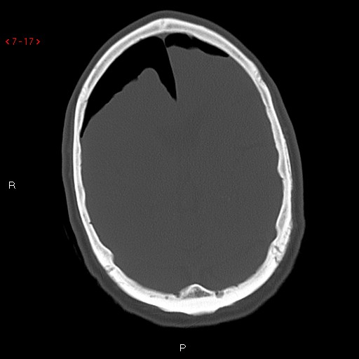

Slide 4
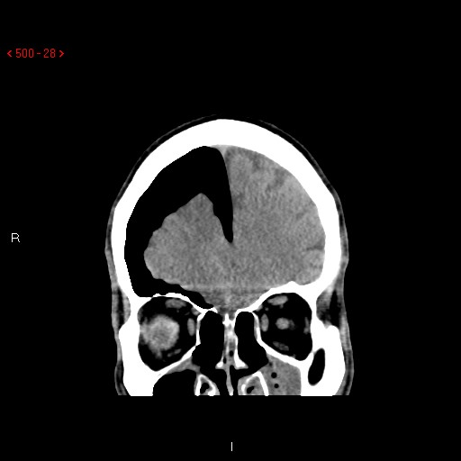

Slide 5
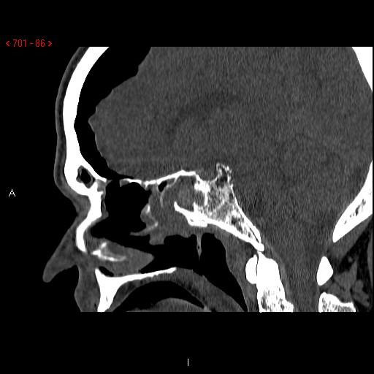

Slide 6
Findings
Intracranial air representing pneumocephalus, with mass effect on brain parenchyma
Leftward mild midline shift
Discontinuous area of bone at right ethmoid roof, likely representing disruption after surgical exploration

Slide 7
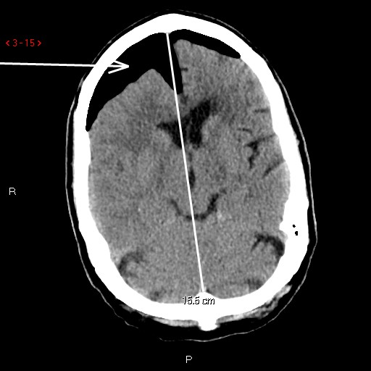

Slide 8
Tension Pneumocephalus
Arises from communication between extracranial and intracranial compartments
Ball-valve mechanism leads to trapped intracranial air and increased ICP, leading to mass effect on parenchyma
Must have neurologic symptoms from increased ICP
Most common cause is trauma to frontal and ethmoid sinuses with associated dural defect, sinus infection, and ENT procedures
CT gold standard – requires only .55 mL air

Slide 9
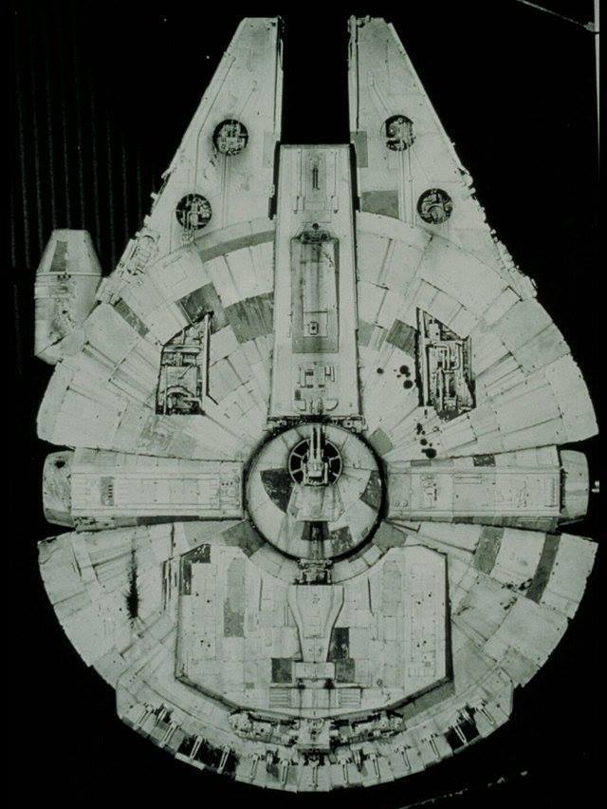
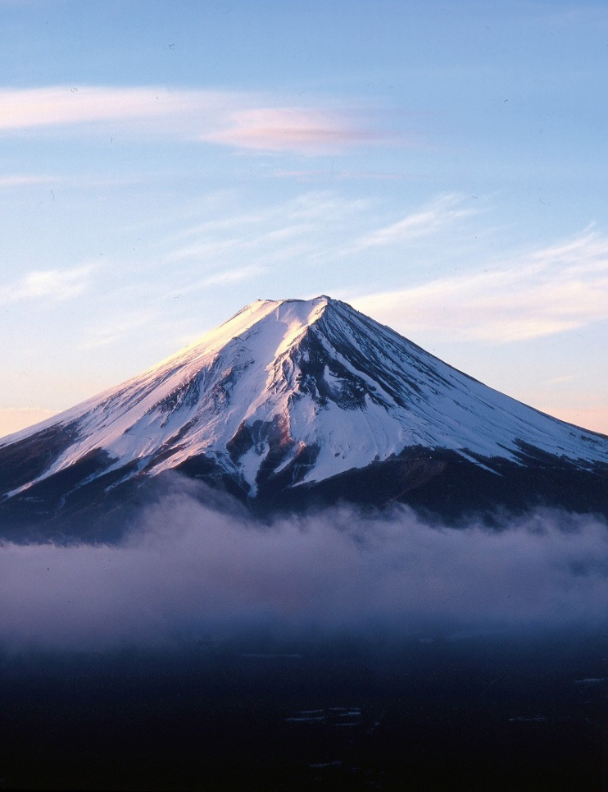
Mt. Fuji Sign
… but should probably be called the Millennium Falcon sign

Slide 10
Next Steps
Often requires surgical decompression, especially if there is significant widening of the interhemispheric space, which indicates more severe pneumocephalus than simple peaking of the frontal lobe tips
Conservative treatment includes Fowler position, avoiding Valsalva, and osmotic diuretics to encourage absorption

Slide 11
Patient Hospital Course
Did not require surgical decompression due to improvement in symptoms and small size of defect (<1 mm)
F/u CT 5 days later demonstrated interval decrease in intracranial air and improvement of midline shift
Discharged with precautions

Slide 12
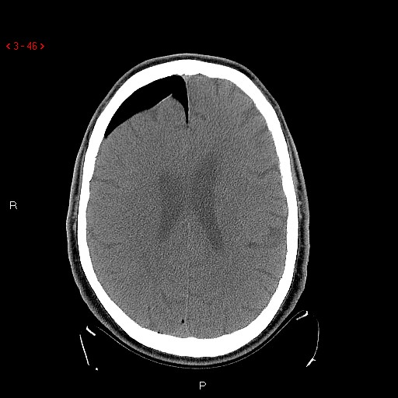

Slide 13
Sources
Loevner, Laurie. Brain Imaging Case Review Series. Mosby, Philadelphia; 2009. pp 271, 272.
http://surgicalneurologyint.com/surgicalint-articles/review-of-the-management-of-pneumocephalus/
https://www.jtbgenesis.com/pic/tour/141231Mt.fuji.Mitsutouge.jpg
http://i1119.photobucket.com/albums/k637/jaiteastu/5%20Foot%20Millennium%20Falcon/Underside/ANH%20Underside/5ft%20ANH%20Bottom%20View.jpg

