Slide 1
Diagnostic Neuroradiology Case
Shenghao Fang
Sept 10, 2017

Slide 2
Initial Presentation
62 y.o female presented with dizziness
Increased imbalance with tendency to drift to the left
Decreased hearing in left ear
Sx started over the past year, gradually getting worse for the last 2mo
No headaches, no incoordination, no vision changes
PMH/FH non-contributory

Slide 3
Exams
PE unremarkable
Audiogram: significant asymmetric left sensorineural hearing loss > 20 dB
MRI scan

Slide 4
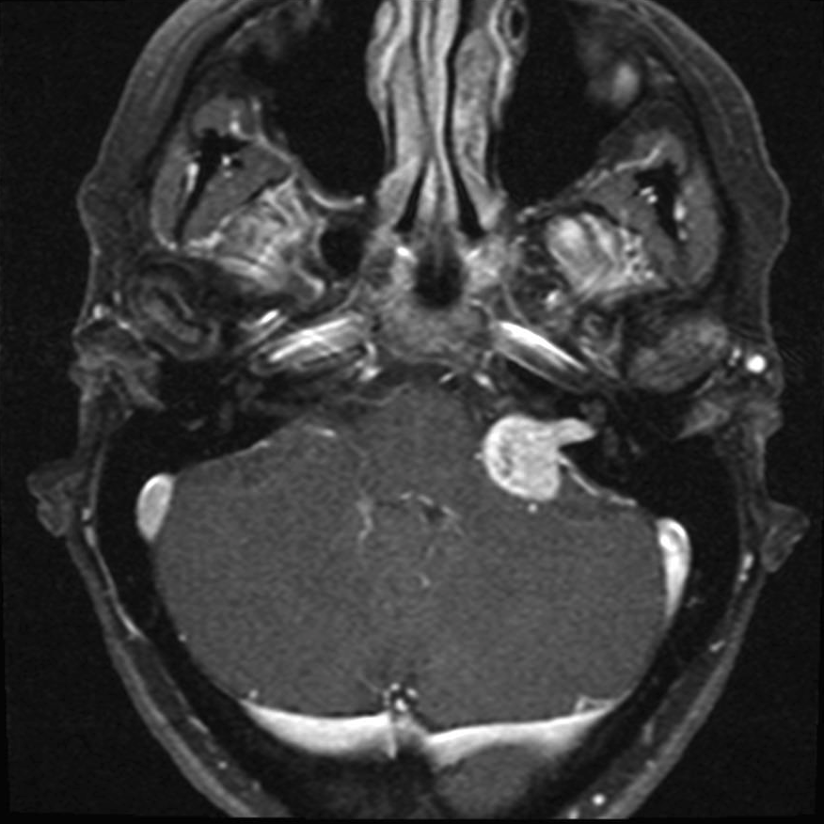
MRI Brain w/wo contrast (T1)

Slide 5
Impression
Left internal auditory enhancing mass and extending into the left cerebellopontine angle cistern (22x18x16mm)
Consistent with vestibular schwannoma

Slide 6
Plan
Options include
Observation w/ repeat MRI and audiogram in 6mo
Gamma knife radiosurgery
Microsurgical resection
Surgical debulking + gamma knife
Decision was made to re-evaluate in 6mo

Slide 7
6 months later
Persistent baseline imbalance + left-sided hearing loss
Endorsed left-sided tinnitus
Also left V2 hypoesthesia
Audiogram worsened
Repeat MRI

Slide 8
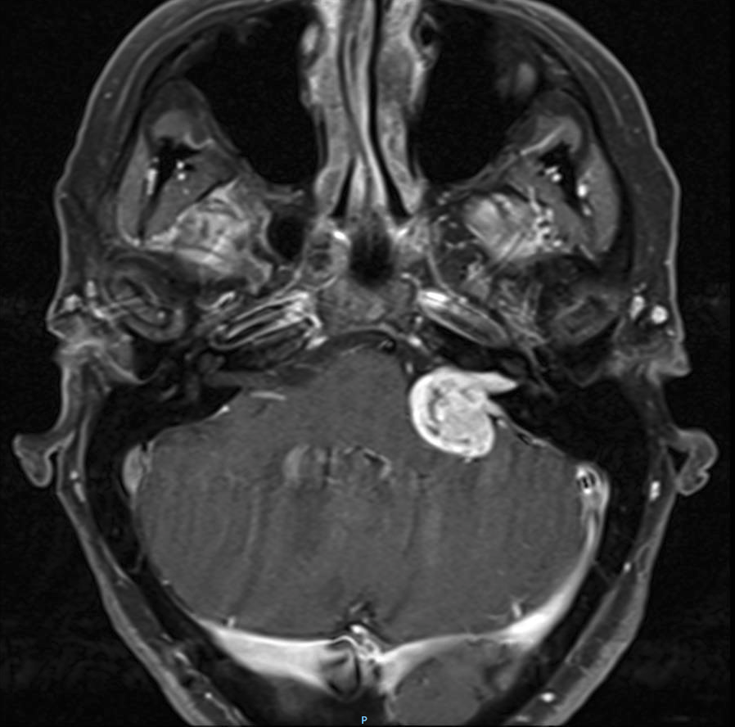
MRI Brain w/wo contrast (T1)

Slide 9
Impression
Increased size (21x24x18mm vs. 17x21x15mm) of the left cerebellopontine angle mass lesion with increased mass effect upon the left middle cerebellar peduncle

Slide 10
Plan
Gamma knife vs. Surgical resection
Decided to proceed w/ left retrosigmoid craniotomy and resection of the tumor after consultation

Slide 11
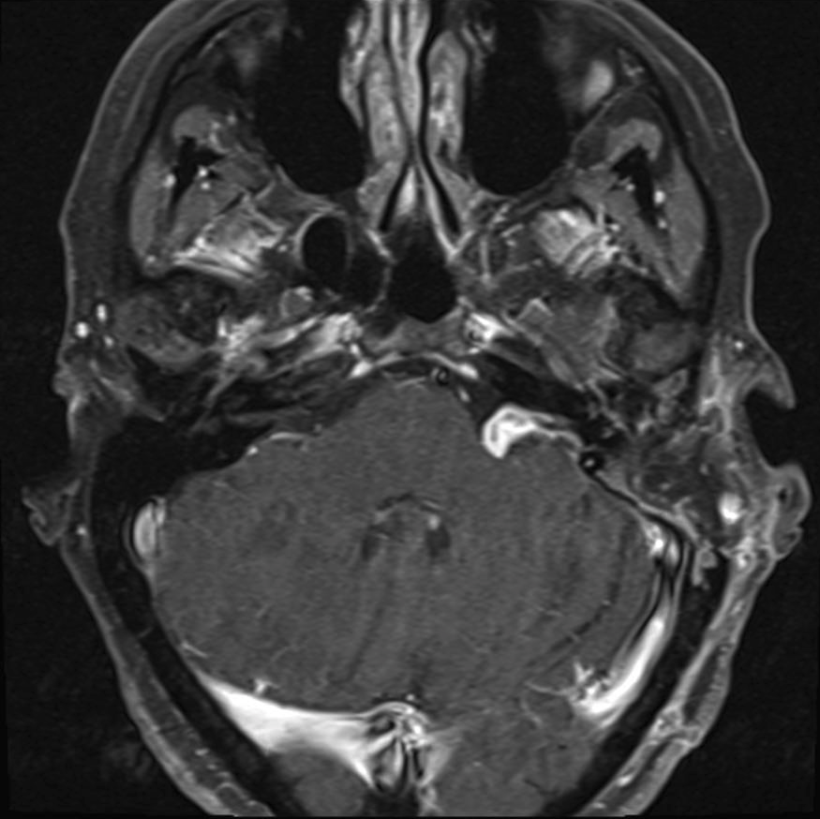
Immediate Post-surg MRI w/wo contrast (T1)

Slide 12
Impression
Postsurgical changes s/p subtotal resection of a left vestibular schwannoma with residual viable tumor measuring 10 x 6 mm

Slide 13
Plan
Gamma knife radiosurgery vs. additional resection vs. observation w/ MRI in 9 mo
Decision was made to observe the residual tumor for now

Slide 14
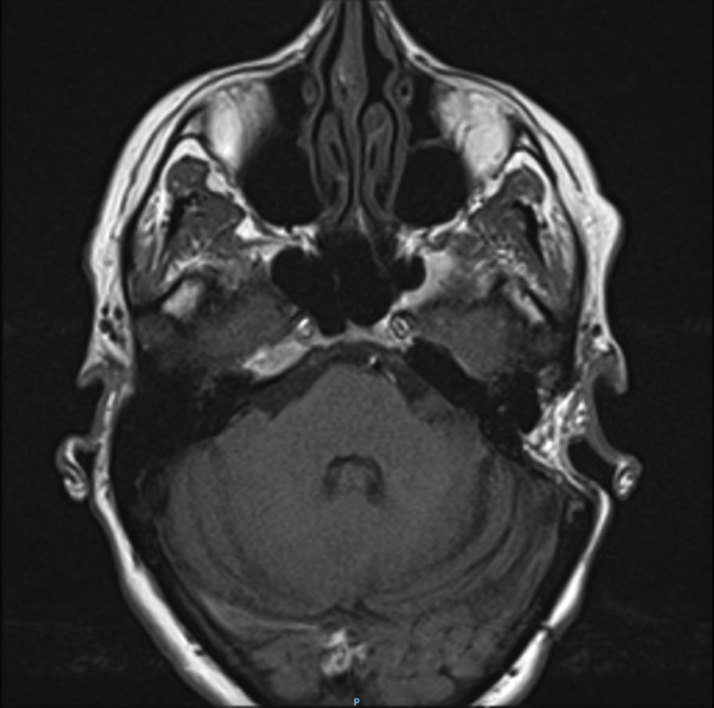
Post-surg (9mo) MRI w/wo contrast (T1)

Slide 15
Impression
Stable residual left acoustic neuroma

Slide 16
Pt reports improved balance, with normal daily activity
No facial weakness
Audiogram shows excellent R ear hearing, L ear is non-functional s/p surgery
Plan is to repeat MRI in a year

