Slide 1
Patient Philanthropy | Faculty Partnerships
Department of Urology
February 21, 2024
Ashley Hanel
Senior Associate Director, Cancer Programs
ahanel@virginia.edu
(c) 704-796-2608
1

Slide 2
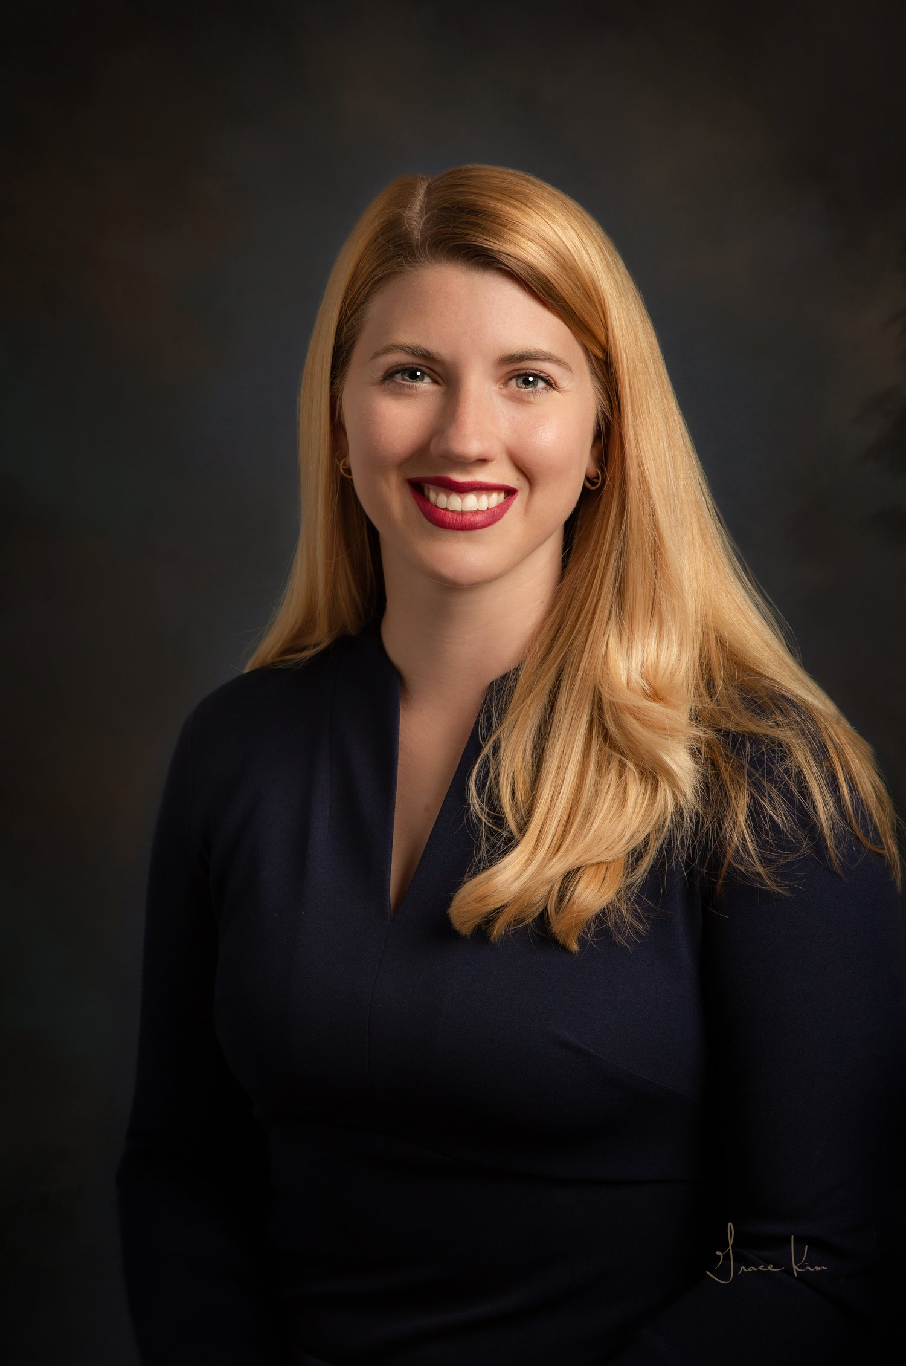
^{Ashley Hanel, M.A.}
Senior Associate Director, Cancer Programs
Focus areas: Hem/Onc and Urology
Ashley joined the UVA Cancer Program’s team in 2022 from Virginia Commonwealth University, where she worked with Major and Planned Gift donors throughout the Southeastern US. Ashley enjoys working with patients and donors, helping to guide their gifting to maximize impact. She has worked in fundraising for 8 years, working at Virginia Tech, Ole Miss, and VCU. Ashley has a M.A. in Higher Education Administration and a BSPH in Public Health.
While not fundraising, Ashley enjoys staying active by hiking, walking, and practicing yoga. Ashley lives in Richmond with her spouse and four pets (2 bunnies and 2 chinchillas.)
ahanel@virginia.edu
(c) 704-796-2608
2

Slide 3
Patient Philanthropy | Faculty Partnerships
Why Patient Philanthropy?
When patients or their families experience exceptional care and support during their medical journey, they can be inspired to give back by making a charitable contribution. This act of gratitude not only helps the healthcare organization but also profoundly impacts the patients and family members themselves.
Grateful patient philanthropy is crucial for organizations to address funding gaps and support various initiatives. With the increasing cost of healthcare and the limited resources available, philanthropic contributions make a significant difference in providing necessary funding for research, technology advancements, and patient care improvements. These gifts can help bridge the gap between what the institution can afford and what is needed to deliver the highest quality of care.
Think of yourself as a donor. What has been meaningful to your life? Why did you make a gift?
Source: The Giving Collaborative
3

Slide 4
Patient Philanthropy | Faculty Partnerships
Recognizing a Potential Donor
Expression of gratitude
If it hadn’t been for your great care, we wouldn’t be able to go home today.
Thank you for all you have done for me and my family.
Your care saved my life!
Patients openly sharing information that indicates they might have ability: expressing interest in research, mentions paying it forward for other patients, owns a business, travels frequently or mentions additional homes.
Engaging a Potential Donor
Accept their gratitude
Offer the opportunity to learn more by putting them in touch with Ashley
Make a referral (send a quick email) to the development team
Each patient referral we log, to reach developmental goals set by Dean Kibbe
4

Slide 5
Patient Philanthropy | Faculty Partnerships
What we hear from patient donors
We want to know about philanthropic opportunities to support those who care for us
Guided by ethical principles
We include opt-out language (from future development communications) on every initial outreach
Only two outreaches per patient typically by phone or email
We have the skills to navigate these conversations thoughtfully, and determine if a patient is open to a gift conversation or not – both outcomes are productive
We can engage with you as little or as much as you want in the process - post-referral
Most faculty will be met periodically to review prospective patient donors and discuss updates
5

Slide 6
Patient Philanthropy | Faculty Partnerships
Thank you, Drs. Greene, Krupski, and Terran Sims
Examples of individual or team priorities for impact –
Examples shared from Dr. Greene:
Clinical trials CRC-this would allow us to open novel studies for prostate cancer. (50K a year)
Oncology fellow-we want to start a fellowship and train future urologic oncologists (80K a year)
Focal ultrasound program: we need to buy a Focal One machine to get the program off the ground and augment our IRE program.
Statistician: we but a percentage of a statistician to help us on projects but this takes funding.(50k a year)
Research fund: this is money to publish articles ($3000 for JAMA) money to pay the registration for major meetings and present our research to increase our prestige and get our research out there (up to $1000 per meeting) and travel funds.

Slide 7
Patient Philanthropy | Faculty Partnerships
Next steps:
Partnering
Think about any patients who have shared their appreciation with you, that I could reach out to
Through our research, I’ll bring a list of names that may have the ability to make a gift
Ongoing - when in doubt, reach out
Send me a quick email (subject line “patient referral”) and include the patient’s name and a brief note explaining why this patient is a referral. We can have a quick call to discuss if you choose.
We do the work:
We initiate conversations with prospects and learn about their philanthropic interests
We connect a patient’s interests to your work
We build relationships and earn their trust, understanding their capacity to give
Cash, financial assets, real estate, bequests and estate planning
We’ll periodically strategize with you about new and existing patient relationships
6

Slide 8
Thank you
for the opportunity to partner with you!
Any questions or comments?
Wrap-up
Ashley Hanel
Senior Associate Director, Cancer Programs
ahanel@virginia.edu
(c) 704-796-2608
7

