Slide 1
Spark Innovation Competition: Removing the "No" From Innovation RESEARCH ENVIRONMENT
2023-2024

Slide 2
SPARK COMPETITION PURPOSE
Think of the last time you said, “What if” or “If only.”
Share those thoughts and ideas on how we can improve our research environment through Spark. We want to hear ideas from every part of the health system, disrupt the norm and create positive change.
Goal | create new pathways for great ideas to be implemented that will make the culture of work at UVA Health both enjoyable and fulfilling.
Transcends traditional hierarchy | governed by diverse project team made up of front-line team members and leaders from 9 departments and 7 entities across the university

Slide 3
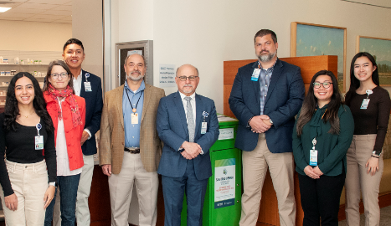
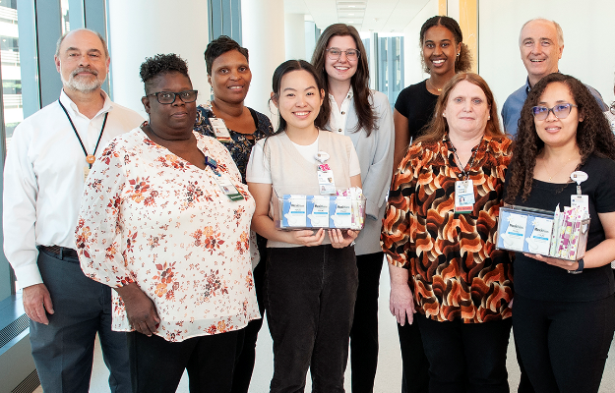
2022 Theme | CLINICAL ENVIRONMENT
Highlights from the 2022 Spark Competition
~ 300 ideas submitted by staff & faculty from 80 different areas of UVA Health
10 ideas awarded $1000 dollars
6 ideas selected for funding and implementation
ALL ideas disseminated to executives and chiefs with each idea being assigned to a local leader for awareness and consideration for implementation at local level
Over 40 ideas implemented at the local level identified at one year follow up assessment
Spark Project Team | Increase safe drug disposal access
Spark Project Team | Free period products for staff & patients

Slide 4
2023 Theme | RESEARCH
What type of ideas are we seeking?
We are seeking ideas that will positively impact the “research culture” within the UVA Health System, broadly defined. This includes ideas that impact the way research is conducted, the processes required to conduct research, or the quality of life of those people within the Health System that are conducting the research, including faculty, staff, students, research subjects and those UVA Health Team members who provide services to the research community.
What is the "research environment"?
The "research environment" encompasses any entity within UVA Health conducting research activities or any entity that supports those efforts. This includes groups conducting or supporting research within the School of Medicine, School of Nursing and Community Health. It also includes the Office of Sponsored Programs, The Office of Grants and Contracts, the Clinical Trials Office, Center for Comparative Medicine, Research Core Facilities, Research Computing, Health Sciences Library, Facilities Management, Hospital Cafeteria, and any other group supporting research activities! Wherever you fit, we want to hear your ideas for how we can improve the culture and enhance the research enterprise!

Slide 5
IDEA SELECTION
Ideas will be judged by the multidisciplinary project team and winner selections will be based on feasibility, impact, and sustainability of idea.
The competition will be judged in two rounds:
First round: We will review all submissions and select 10 winning ideas to be awarded $1,000. Winning teams will be paired with a performance improvement coach to develop their idea for round two of the competition.
Second round: We will review the refined ideas from the 10 first round winners and select 3 ideas for implementation.

Slide 6
FAQs
Can we submit as a group – YES (but only one person can be the submitter)
Can I submit anonymously – YES (but you will not be eligible for the award)
Will my idea be shared? – YES (all ideas will be triaged to an idea database and shared with the relevant department/unit)
Am I solely responsible for carrying out the idea? – NO (we know everyone’s busy, so we will build a team around all ideas selected for implementation regardless of the submitter’s time and capacity).
How well thought out does the idea need to be? – Only a spark!
Is this a grant funding source for research ideas? – NO (this competition is not intended to fund specific research projects, however if you have idea on how to improve the way we conduct research projects, we want to hear them!)

Slide 7
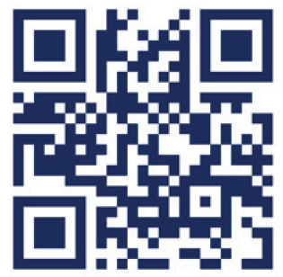
How to submit an idea
UVA Health team members may participate by submitting written ideas to either:
Online submission form: sparkuvahealth.uvahs.org
Hand-written responses submitted on a comment card in the Spark Innovation suggestion boxes found through the research buildings
More information found at sparkuvahealth.uvahs.org or by emailing SPARKUVAHEALTH@uvahealth.org
Submissions due Friday, February 29

