Slide 1
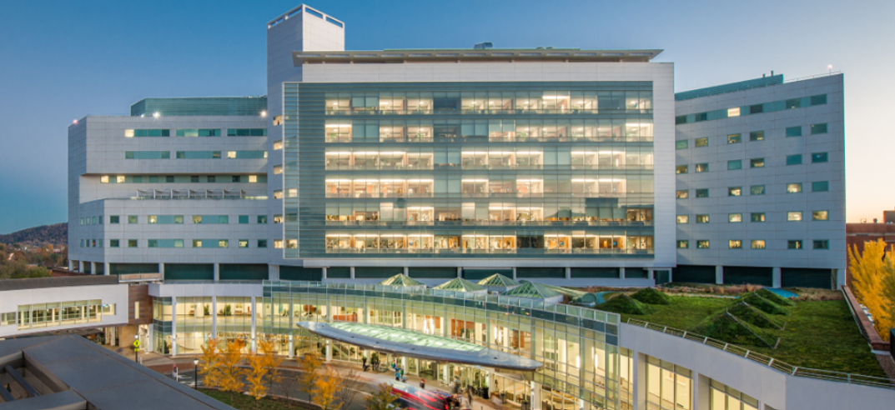
Urology specialty team pilot

Slide 2
introduction
I am Justine and this is Lacey we are both co-heads of the urology service line.
We have a 90 day proposal pilot for the future of UVA Urology at the Main OR to ensure the stability, growth of success in the Urology Department.

Slide 3
With the growth of the urology department, increase of surgical utilization up by 40%. This has led to the primary goal of having a dedicated, specialized urology team for the main operating room. This will decrease communication error, optimize surgical needs, improve patient safety, manage surgical time effectively and decrease cost waste.

Slide 4
How we keep up with growth ​
Through research of evidence base practice systemic review of specialized teams, it has shown that it is vital to have specialized members rather than generalized to meet the needs of specialized complex surgical procedures (Lentz, et.al., 2002). This will include not just nurses and surgical technologists, but other vital team members; vets technicians, central supply staff, and surgical support staff.

Slide 5
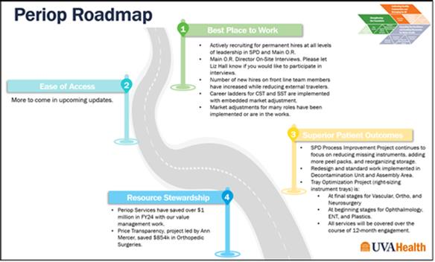
Peri-op Road Map UVA’s Strategic plan
Best Place to Work: Hiring and Recruitment/Retention: This pilot will ensure that the team has well supported team members to promote patient centered outcomes, be a vital resource for the urology specialty, and allow members to feel part of the UVA bigger picture. Proper education/in-services for staff and faculty to be competent and accountable in the urology specialty.
Resource Stewardship: Decrease operative turnover time, decrease supply waste of opened unused supply and decrease unnecessary supply par level and space on the central supply shelves. This leads to an increase of COST SAVINGS.

Slide 6
90 day pilot
-Staff members include Justine Watson, Lacey Pulley, Mia Oppler, Lizze Lucus, Paula O’Buckley, Amanda Green, Rebecca Ann Smith, Tayvia Velasquez, Archelle Booker, Kim Condray, and Megan Landwee --- solely dedicated to urology (not pulled for other specialties).
-Education/In-services of equipment, supplies, instrumentation.
-Effective communication.
-
6
6

Slide 7
Perioperative staff
-Education of equipment use and troubleshooting.
- Urology mobile cart fully stocked
- Responsible for communication to Tayvia on par level supply.
- Auditing preference card accuracy
-Effectively communicating with VETS Leaders of any change of instrumentation needed per case.
- Review weekly needs of complex cases.
- Support each team member with vital feedback or appraisal.
- Delegate to SST Facilitators of specialized equipment or supplies needed.

Slide 8
vets leaders
Having the cases setup up properly is a key role in success for our safety outcomes for the patient by ensuring proper checklists are managed to decrease “Be Safes”.
These staff members would be solely responsible for Urology endo and robotic cases, in addition to add on / Urgent emergency cases requiring utilization of visual instrumentation.
This will ultimately provide support to new oncoming staff to ensure that they are feeling efficient and successful in these cases.

Slide 9
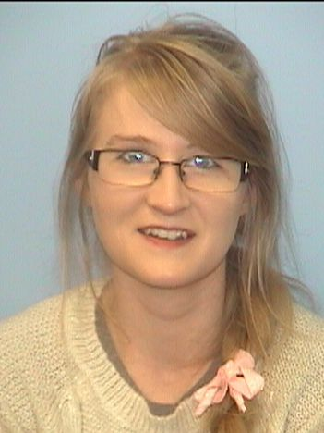
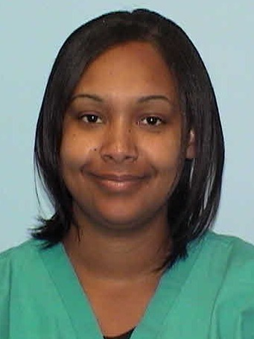
Vets leaders
This will be led by Amanda Green and Rebecca Ann Smith, who are two of the best outstanding employees that have knowledge of the case requirements for Urology.
With any case concerns of instrumentation in regard to case posting or lack of having the instruments, communication will be immediately reported to all team members.

Slide 10
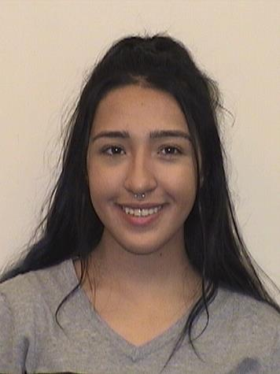
Central supply staff
Tayvis Velasques would be the point person over all Urology supplies and ensure instrumentation is correctly pulled. She has over excelled in prepping us for cases in the evenings, goes the extra mile, and will have ordering capability to be able to track status of supplies.
She will work aside Keith Smith and Brittany Brennon to ensure that supply par levels are managed, instrumentation p.o.’s are followed, and communicate effectively with the heads of service.
10

Slide 11
SST Facilitators
These team members will be educated on all urology equipment; where it is located, and proper equipment needs per case.
Knowledge to trouble shoot equipment after proper in-services.
Educated to be supply runners for any needs that may be found on the urology cart supply for cases.
Communication with clinical engineering and head of services when equipment is out of service.
Manage the flow of equipment use per case load.

Slide 12
Pilot outcomes
Decrease cost waste – proper picked cases.
Increase patient safety- proper equipment is provided with knowledge of use.
Increase in teamwork moral- well supported by many different departmental staff
Decrease travel staff members- increase team building with permanent staff
Decrease turnover time- well working staff communication
Creating a well skilled dedicated team.
Eliminating unnecessary equipment/supplies in rooms
Setting a positive model of consistence commitment of teamwork.

Slide 13
Pilot review
-Monthly Survey to attendings to reflect on performance.
- Monitor “Be Safe” specifically to Urology monthly.
Huddle weekly with UROLOGY team members on self performance/debrief.
Cost savings before and after pilot launch.
At the end of the 90 day pilot, data will be collected and presented.

Slide 14
THANK YOU
Justine Watson
jw3er@uvahealth.org
Lacey Pulley
fdu5wk@uvahealth.org

Slide 15
References
Forse, R., Bramble, J., & McQuillan, R. (2011). Team training can improve operating room performance . Clinical Key, 771-778.
Lentz, C. M., Wijngaarden, R., Willeboordse, F., Hooft, L., & van der Laan, M. (2022). Dedicated teams to optimize quality and safety of surgery: A systematic review . International Journal for Quality in Health Care , 34(4).
Teunissen, C., Burrell, B., & Maskill, V. (2020). Effective Surgical Teams: An intergrated literature review . Sage Journals.

