Slide 1
Urology Annual Retreat
Research Guidelines.

Slide 2
Olu’s job responsibilities.
Coordinate multiple clinical trials simultaneously and manage multiple PI relationships including budgets and compliance with local state and federal policies
Liaison with sponsor
Assist PI in developing clinical trial protocols and submit required documents to IRB, University or sponsor. (study protocols, amendments, consent forms recruiting materials)
Conduct research data analysis and literature searches
Strategic planning and analysis of research portfolios in conjunction with department management

Slide 3
Olu’s job responsibilities
Oversee financial accounting of multiple research projects: Budget, billing reconciliation, quality and oversee quarterly review of PI studies
Develop admin and financial recommendations for department management
Compile data and documents during internal and external audits
Manage coordinators and liaison with support staff like lab or pharmacy

Slide 4
45 CFR 46
The HHS regulations for the protection of human subjects in research at 45CFR 46 include five subparts.
Subpart A, also known as the Common Rule, provides a robust set of protections for research subjects;
Subpart B: Pregnant Women.
Subpart C: Prisoners.
Subpart D: Children.
Subpart E: IRB.
Many of our studies had people listed who had not done CITI training

Slide 5
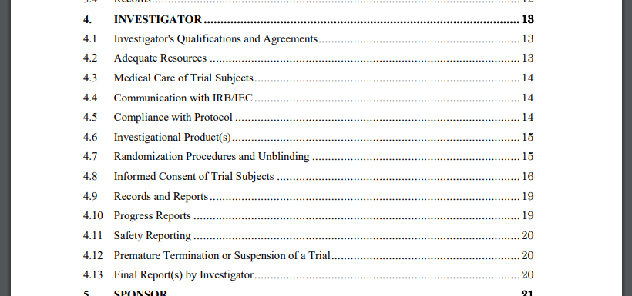
E6(R2) ICH Guidelines.

Slide 6
Principal Investigator Responsibilities www.hhs.gov.ohrp/regulations-and-policy
Ethical research consistent with approved IRB
  Obtaining and documenting informed consent
  Obtaining prior approval from IRB for modifications of the previously approved protocol.
  Ensuring that progress reports and requests for continuing review and approval are submitted it IRB as referenced in the OHRP approved federal wide assurance

Slide 7
Principal Investigator Responsibilities
WWW.hhs.gov.ohrp/regulations-and-policy
Ethical research consistent with approved IRB
  Providing to the IRB prompt reports of unanticipated problems
  Providing to IRB prompt reports of serious or continuing non compliance with regulations or requirements
  Keep records for 3 years after completion of study

Slide 8
Common Clinical Investigator FDA Inspection Findings
Inadequate subject protection: informed consent issues
Failure to follow the investigational plan: protocol deviation
Inadequate study records
Safety reporting failure to report or record adverse events
    Recent PAM Audit found study without consent. Original consent copies missing and participants not properly consented.
    IRB for a database is only to acquire data. To query the database you need expedited IRB

Slide 9
Common Clinical Investigator FDA Inspection Findings
Failure to comply with Form FDA 1572 requirements
Inadequate accountability and or control of investigational product
Failure to comply with 21 CRF part 56 (IRB) requirements
Failure to conduct initial and/or continuing review of research
    For Adstilidrin- Dr. Krupski did this form 7 times, each time one thing changed
    Using India Ink in urinary track we had to submit reports to FDA for IND exemption

Slide 10
Missing Vital Regulatory/Study Requirements: my findings so far.
Consenting Process: mostly not completed. According to UVA IRB.
DOA log: - mostly not done. Will discuss why it is a vital regulatory document.
Eligibility Checklist: - mostly not done for studies with consent form, inclusion and exclusion criteria.
Proper reporting of AEs and SAEs:- probably due to most protocol not clearly stating the active & follow-up phase of the study(study timeline) and the end of subjects participation.
Source documents not properly done and collected.
Not using REDCap data fields or sponsor’s EDC to prepare source documents.
6. Training log: most not done (None). Protocol, CITI, EDC.
7. Data: in REDCap and OnCore usually not up-to-date.
8. Study team meetings: Mostly not done.

Slide 11
Informed Consent: From 45 CFR 46.116
The person obtaining consent will sign the form and subjects will be given a copy of the signed consent form. Study procedures will then begin.
DATE?: OHRP(Office for Human Research Protections (OHRP) recommends that it be dated so that the IRB and others can document that informed consent was obtained prior to a subject’s participation in the research.

Slide 12
According to UVA IRB inform consent is a 2 steps process;
  Informed Consent signing.
  Inform consent documentation:
  The informed consent process for each individual subject will be documented in the subject’s study file/ medical record.

Slide 13
Informed Consent Form issues. common findings at Audit
  Incorrect version
  Lack of reconsenting
  Inadequate Documentation or lack of documentation
  Performing Study Procedures Prior to obtaining consent.
  ICF copy not provided to participants.

Slide 14
Maintenance of Informed Consent Documentation
Principal Investigators are responsible for maintaining original copies of consent/authorization forms signed by subjects, in a secure location, for at least six (6) years following completion of the research and longer, if required by the funding source or sponsor. If the study might affect the clinical care of the subject a copy of the informed consent document must be placed in the subject's medical record in accordance with Virginia state and local government regulations. In cases where Principal Investigators transfer their research programs to other institutions, the disposition of consent/authorization forms must be discussed with the IRB administrative staff.

Slide 15
Investigator Qualifications/ Agreements
Qualified by education, training, and experience to assume responsibility for the proper conduct of the trial, should meet all the qualifications specified by the applicable regulatory requirement(s), and should provide evidence of such qualifications through up-to-date curriculum vitae and/or other relevant documentation requested by the sponsor, the IRB/IEC, and/or the regulatory authority(ies).
thoroughly familiar with the appropriate use of the investigational product(s), as described in the protocol, in the current Investigator's Brochure

Slide 16
Investigator Qualifications/ Agreements
4.1.3 The investigator should be aware of, and should comply with, GCP and the applicable regulatory requirements
The investigator/institution should permit monitoring and auditing by the sponsor, and inspection by the appropriate regulatory authority(ies
The investigator should maintain a list of appropriately qualified persons to whom the investigator has delegated significant trial-related duties.

Slide 17
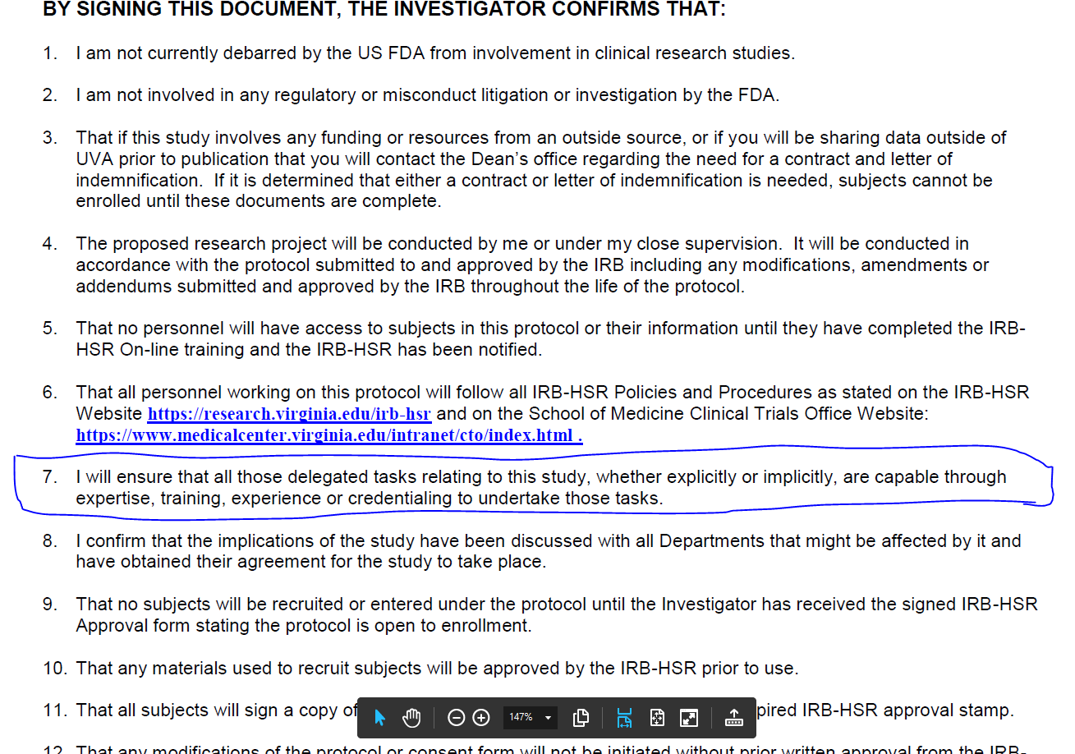
INVESTIGATOR RESPONSIBILITIES:
IRB:

Slide 18
Investigator Qualifications/ Agreements
a potential for recruiting the required number of suitable subjects within the agreed recruitment period.
the investigator should have sufficient time to properly conduct and complete the trial within the agreed trial period
The investigator should have available an adequate number of qualified staff and adequate facilities for the foreseen duration of the trial to conduct the trial properly and safely.
The investigator is responsible for supervising any individual or party to whom the investigator delegates trial-related duties and functions conducted at the trial site.

Slide 19
Eligibility: common findings at Audit
Inclusion/Exclusion criteria not met.
No eligibility checklist
Randomization prior to meeting eligibility

Slide 20
Inclusion Criteria: |  | Comments
Informed Consent signed by the patient. | ❒ Yes –or-  No Date of Informed Consent Signed: ___________
 | ❒ Yes –or-  No
 | ❒ Yes –or-  No
Exclusion criteria:
 | ❒ Yes –or-  No
 | ❒ Yes –or-  No
 | ❒ Yes –or-  No
PI/sub-I Confirmation of Eligibility:
PI/Sub-I Name: ________________________ Signature:__________________________ Date:____________

Slide 21
Additional PI responsibilities
initiating a trial, the investigator/institution should have written and dated approval/favourable opinion from the IRB/IEC for the trial protocol, written informed consent form, consent form updates, subject recruitment procedures (e.g., advertisements), and any other written information to be provided to subjects.
Adverse Events: missed OR late reporting of AE
  Sponsored studies have strict timelines to report if serious
  4.11.3 For reported deaths, the investigator should supply the sponsor and the IRB/IEC with any additional requested information (e.g., autopsy reports and terminal medical reports).
  Medical care of subject- have to medically address AE

Slide 22
Additional PI responsibilities
Compliance with protocol
  should not implement any deviation from, or changes of the protocol without agreement by the sponsor and prior review and documented approval/favourable opinion from the IRB/IEC of an amendment, except where necessary to eliminate
  The investigator, or person designated by the investigator, should document and explain any deviation from the approved protocol.
4.9.5 Essential documents should be retained until at least 2-years after the last approval of a marketing application in an ICH region and until there are no pending or contemplated marketing applications in an ICH region or at least 2-years have elapsed since the formal discontinuation of clinical development of the investigational product. These documents should be retained for a longer period however if required by the applicable regulatory requirements or by an agreement with the sponsor. It is the responsibility of the sponsor to inform the investigator/institution as to when these documents no longer need to be retained (see 5.5.12).

Slide 29
The contact in the Grants & Contracts Office for grants and clinical trials is Candice Wills
Candice Wills
cpw4d@virginia.edu
Urology Grant officer,
Cynthia Hicks
cdt8p@uvahealth.org
The negotiator is
Sandy Ulmer
bdd9sf@virginia.edu

Slide 30
Recap:
Participants should be properly enrolled.
Proper consenting process
Participants meeting all inclusion/exclusion criteria.
PI signing inclusion/exclusion criteria checklist before randomization.
3. Proper reporting of all SAEs and unexpected AEs.
4. Data is up-to-date.
5. Adequate study supervision.

Slide 31
R01 | NIH Research Project Grant Program (R01) Used to support a discrete, specified, circumscribed research project. NIH's most commonly used grant program. No specific dollar limit unless specified in funding opportunity. Advance permission required for $500K or more (direct costs) in any year. Generally awarded for 3-5 years. Utilized by all ICs. See parent announcements: PA-20-183 (Clinical Trial Required), PA-20-184 (Basic Experimental Studies with Humans Required), and PA-20-185 (Clinical Trial Not Allowed).
R03 | NIH Small Grant Program (R03): Provides limited funding for a short period of time to support a variety of types of projects, including pilot or feasibility studies, collection of preliminary data, secondary analysis of existing data, small, self-contained research projects, development of new research technology, etc. Generally, limited to two years of funding. Direct costs generally up to $50,000 per year. Not renewable. Utilized by more than half of the NIH ICs. See parent announcements: PA-20-200.

Slide 32
References
1. ICH - International Council for Harmonisation of Technical Requirements for Pharmaceuticals for Human Use
2. FDA -
3. DHHS – U.S Department of Health and Human Services.
4. NIH –
5. UVA IRB
6. Clintrix International.
7. ACRP

