Slide 1
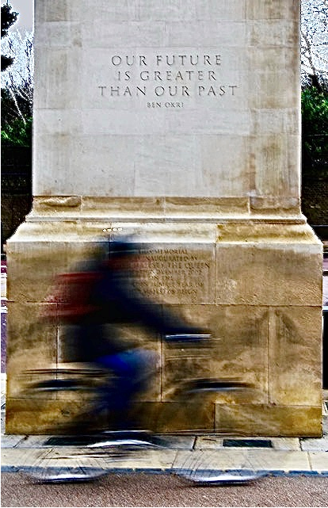

Slide 2
Resident Clinic
PGY 2, 3
Two Sessions/week (1 full day)
6 Month Average
E/M Encounters Vasx Cysto Other Proc
Monday 52 2.3 9.3 2
Thursday 52 4.5 6 2

Slide 3
Clinic
Opportunity
Potential for ownership/continuity
Team activity (Nursing, MAs)
Breadth of cases
Embedded Skills
Effective Charting
Coding
Procedures with Awake patients
**Translation to practice from 3.5 days in OR to 3.5 days in clinic

Slide 4
Clinic
Challenges
EPIC-facing
Distraction, burnout
Creation of work
Data follow-up
Not indexed like cases- how to objectify experience?
AAMC/UCSF Study 2016
Most care is outpatient, but even in PC residency, only 1-1.5 days/week in clinic
**54% of PC residents want to stay in it after residency
Find hospital/in house more interesting

Slide 5
Orientation
Goals
Valuable learning
Increase patient exposure
Create work habits to minimize drudgery
Instill confidence
Measure indicators

Slide 6
Orientation
Walk-through
Orient to patient experience, nurse offices, radiology, supplies and storage
Review Scheduling and Templates
Expectations for disposition, test review, communication, specialty consultation, OR posting
Patient flow in clinic
AM Huddle, team identification, radiology coordination, order sets
**Policy on Orders
Documentation
Standardize
“Clean cloning”
.phrase use
Coding-E/M, modifiers, audit, demystify
Dr Sands
Margie Speight

Slide 7
Orientation
Procedures
History, exam, consent, prep, post instructions
Same-day visits
Coordination with access/nursing

Slide 8
Clinic
Conclusions
Clinic is opportunity for ownership/longitudinal care
Data-driven improvement (timeliness, productivity, patient experience)
Engaged Leadership
Care Coordination
Team-based Care
Toolbox for efficient management

