Slide 1
Urology Annual Retreat
Research Guidelines.

Slide 2
Agenda : research
8:45am PI Responsibilities – Olusegun Adelaja, MD, CCRC, ACRP-PM
9:05am Overview of Office of Clinical Research – Tracey Krupski, MD, MPH
9:15am Review of UVA Resources – Christine Ibilibor, MD, MSc
Creating a Research Manual
9:30am Clinical Urology Research Projects – T. Krupski
9:45am Basic Science Research Projects – Stephen Culp, MD, PhD
10:00am Resident Involvement in QI/Research – Jacqueline Zillioux, MD
10:20am 10-Minute Break
10:30am Summarize the pseudo-SWAT Analysis – T. Krupski
11:00am Aspirational Goals – Team Brainstorm
11:30am Reorganization/Operationalizing for Success – T. Krupski

Slide 3
Office of Clinical Research (OCR) Clinical Trials Navigator (CTN
The Office of Clinical Research (OCR) Clinical Trials Navigator (CTN) offers services to all oncology groups looking for assistance with:
Creation of patient accrual programs for all clinical research at UVA
Identification of barriers to participation in clinical trials
Creation of strategies to eliminate barriers to patient enrollment
Development of study specific recruitment plans
Support for Spanish-speaking patients

Slide 4
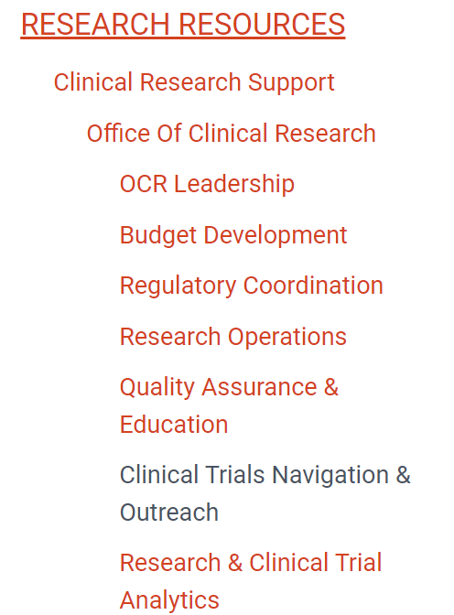
OCR & CTN

Slide 5
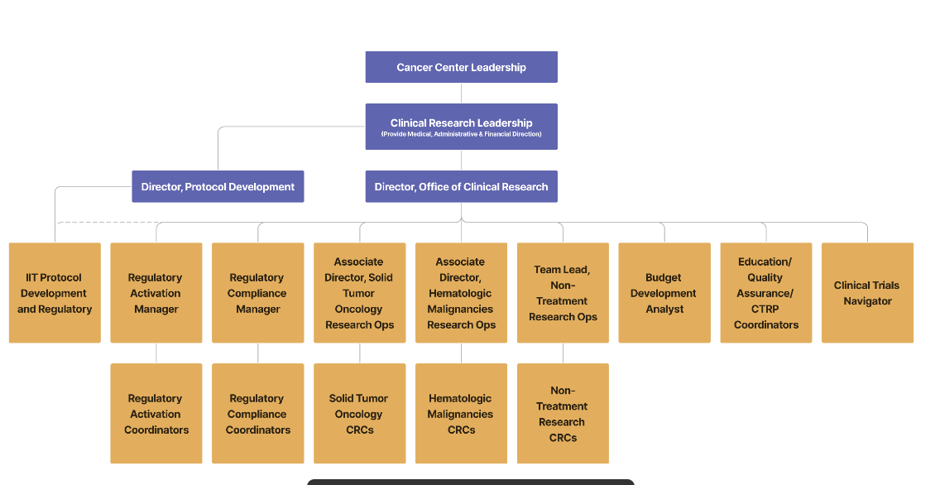

Slide 6
OCR & CTN

Slide 7
Ferring ABLE-41 ( Research Mentor)
Steps for getting an industry sponsored study
Confidential Disclosure Agreement ( Sign CDA before they will tell you details)
External feasibility- how many patients are eligible, competing studies)
Pre – Site visit ( remote usually and will want to know IRB timeline etc)
Site Selection
Internal Feasibility
Internal Committee reviews ( PRC, biologics, )
IRB
Site initiation

Slide 8
Ferring ABLE-41 ( OCR)
Verity Rogers in OCR did for us
Protocol Review Committee (PRC) this is for cancer studies
Gene therapy so Institutional biosafety committee (studying the response)
Local IRB signed off on the Central IRB for a UVA study number
Added local UVA IRB language to the sponsored ICF
Submitted a Data Security plan
Brought in pharmacy so they were aware of Phase IV and Standard of Care
Isharwal and I had to bring before Pharmacy and therapeutics committee to get on formulary

Slide 9
Ferring ABLE-41 ( OCR)
Verity Rogers in OCR continued
Good Clinical Practice guidelines
Initial training log
Delegation of Authority
PI and sub PI GCP and Citi training
Non- FDA approved drug
1572 Statement of Investigator (med or device)
Financial disclosures
Lab CLIA Certificates

Slide 10
Ferring ABLE-41 ( OCR)
Verity Rogers in OCR continued
She executed the contract
Jasmine Lu Clinical CRC
She coordinated the Site initiation visit
She got all PI access to the electronic data collection software EDC
PI had to do Florence training
Transfer to Jessie Winters (ongoing study regulation)
PI regulatory updates
Sign off on new Staff added to DOA within 3 days
Review new protocols and sign signature pates, training logs and other study documents

Slide 11
Benign Team:
Olu Adalaja , Senior CRC
Skilled to perform site initiation
Budget formulation
Regulatory compliance
Francesca Whitlock
Consenting process
EDC start up
Continuation
DoA etc
Joe Cardella- invoicing and collections (PTAEO)

Slide 12
Agenda : research
8:45am PI Responsibilities – Olusegun Adelaja, MD, CCRC, ACRP-PM
9:05am Overview of Office of Clinical Research – Tracey Krupski, MD, MPH
9:15am Review of UVA Resources – Christine Ibilibor, MD, MSc
Creating a Research Manual
9:30am Clinical Urology Research Projects – T. Krupski
9:45am Basic Science Research Projects – Stephen Culp, MD, PhD
10:00am Resident Involvement in QI/Research – Jacqueline Zillioux, MD
10:20am 10-Minute Break
10:30am Summarize the pseudo-SWAT Analysis – T. Krupski
11:00am Aspirational Goals – Team Brainstorm
11:30am Reorganization/Operationalizing for Success – T. Krupski

Slide 13
Current Urology Projects
Benign
Malignant
17338 Congenital Hydronephrosis Suspicious for Ureteropelvic Junction Obstruction and the Procedures Ordered – A Multicenter Descriptive Study Trial Sean Corbett
Focus group and survey on Men's Health Corbett
Pediatric CAKUT Research Database Sean Corbett
Robotic Urologic Surgery Outcomes in Pediatric Patients Corbett
Consortium on Urolithiasis in Pediatrics S. Corbett
International Penile Advanced Cancer Trial (International Rare Cancers Initiative study) Stephen Culp
Therapeutic drug targeting using ex vivo cultures from prostate cancer patients Stephen Culp
Risk classification of prostate cancer based on nuclear structure from histopathology images Stephen Culp
Pre-Habilitation and Mindfulness Program for Patients Undergoing Radical Cystectomy Christine Ibilibor

Slide 14
Current Urology Projects
Benign
Malignant
Assessment and Management of Chordee N Kern
Parental perceptions on contrast enhanced voiding ultrasonography versus voiding cystourethrography Nora Kern
Prenatal Hydronephrosis Registry Nora Kern
Prolonged Inflatable Penile Prosthesis (IPP) Drains Nicolas Ortiz
AUASI and USSQ stent symptoms correlative study Nishant Patel
Cystectomy Database- Strictures query Krupski
Partial Nephrectomy and Small Renal Mass Database S Culp ( RO1)
Pelvic organ prolapse and sexual function outcomes following female cystectomy Zillioux
Identifying Lifestyle Markers of Long-Term Survival After Surgery for Urologic Cancers: A Prospective Oncology Surgical Patient Database Ibilibor

Slide 15
Current Urology Projects
Benign
Malignant
A Study to Evaluate Inter-Observer Variability and Cancer Detection rates with Cystoscopy Performed by Physicians and Physician Extenders Krupski
Elevated PSA Database -Query of Prostatectomy Outcomes Kirsten Greene
Analysis of operative factors related to post-operative urinary retention David Rapp
Home Conservative Tx I the Treatment of SUI and urge incontinence David Rapp
Prevalence of Cognitive Decline in Patients who have undergone AUS Placement David Rapp
Molecular Urinalysis for Point-of-Care Detection and Management of Nephrolithiasis NSS / Sands
ReSKU- Registry for Stone of the Kidney and Ureter NSS/ Sands

Slide 16
Current Urology Projects
Benign
Benign
Intersection of Transplant and Urology Zillioux
The Examination of Surgically Removed Tissue and Organs from Gender-Affirming Patients to Determine Impact of Hormonal Therapies Sean Corbett
Treatment Survey For Erectile Dysfunction (ED) Patients Ryan Smith
Phosphatidylserine (PS) Infertility Semen Analysis Study Ryan Smith
Environmental Exposure Burden and Male Infertility Ryan Smith
Low Intensity Shockwave Therapy for Erectile Dysfunction Ryan Smith
Outcomes of Clomiphene Citrate Treatment on Male Fertility and Hypogonadism Ryan Smith

Slide 17
Agenda : research
8:45am PI Responsibilities – Olusegun Adelaja, MD, CCRC, ACRP-PM
9:05am Overview of Office of Clinical Research – Tracey Krupski, MD, MPH
9:15am Review of UVA Resources – Christine Ibilibor, MD, MSc
Creating a Research Manual
9:30am Clinical Urology Research Projects – T. Krupski
9:45am Basic Science Research Projects – Stephen Culp, MD, PhD
10:00am Resident Involvement in QI/Research – Jacqueline Zillioux, MD
10:20am 10-Minute Break
10:30am Summarize the pseudo-SWAT Analysis – T. Krupski
11:00am Aspirational Goals – Team Brainstorm
11:30am Reorganization/Operationalizing for Success – T. Krupski

Slide 18
Strengths

Slide 19
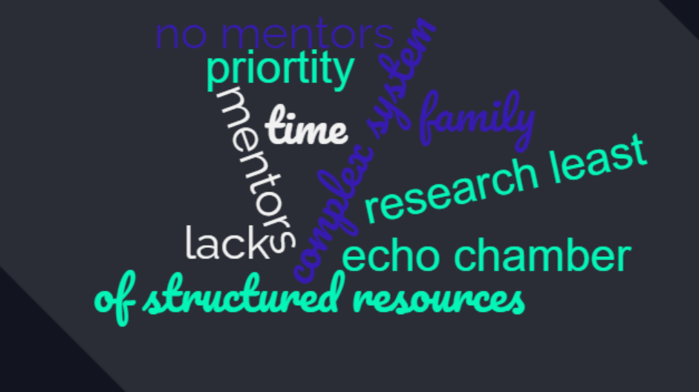
Weaknesses

Slide 20
What is our Identity as Department?
Clinical Excellence Research Excellence Good research Clinical Acumen

Slide 21
What is our Identity as Department?
Are we wanting to be a unique program
characterized by research excellence like only a handful are now?
This requires a significant investment, so this question has to be answered with the understanding that an affirmative answer means something distinct in terms of action.

Slide 22
What is our Identity as Department?
Are we really wanting to develop clinical centers of excellence for our region?
Subspecialties covered by experts who are highly clinically active/focused, giving them the time to focus on emerging service development (new technologies, e.g., SpaceOAR, Perineal Bx,

Slide 23
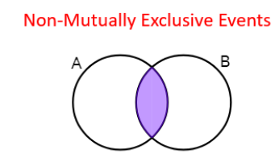
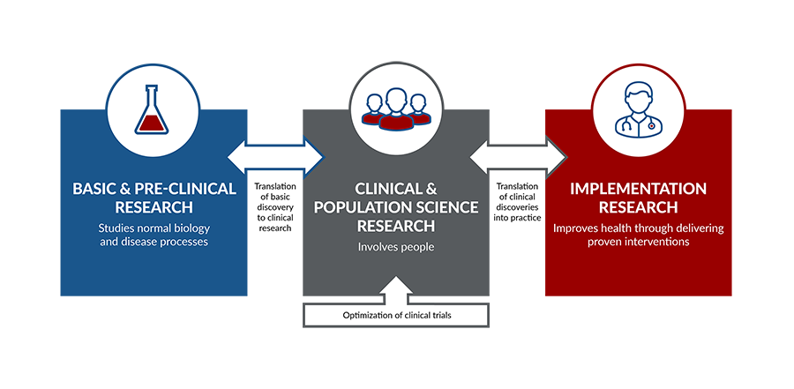
Intentional not just reactive
Models of academic productivity
Current Division champion Solitary focus

Slide 24
Vision
Identify the who?
Allocate the Time?
Invest our limited resources toward a common goal?

Slide 25
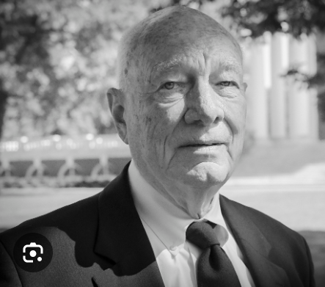
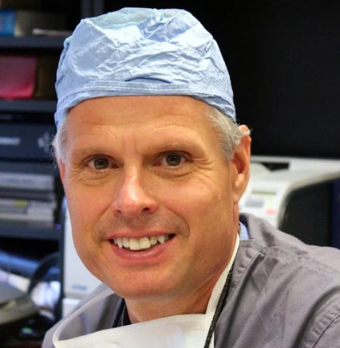
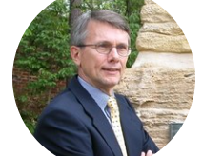
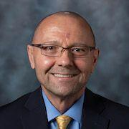
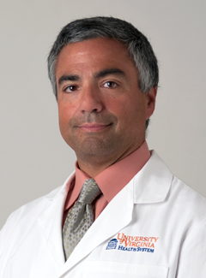
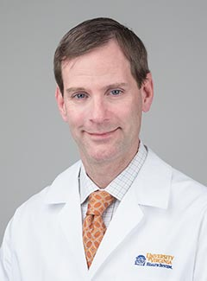
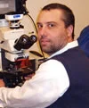
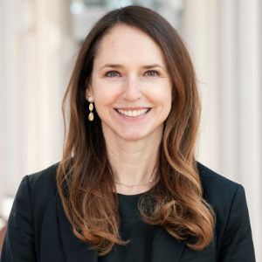
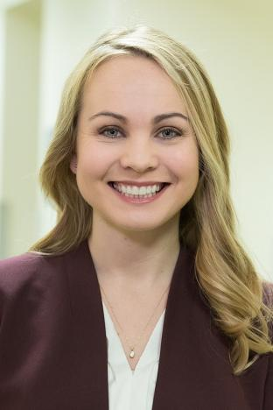
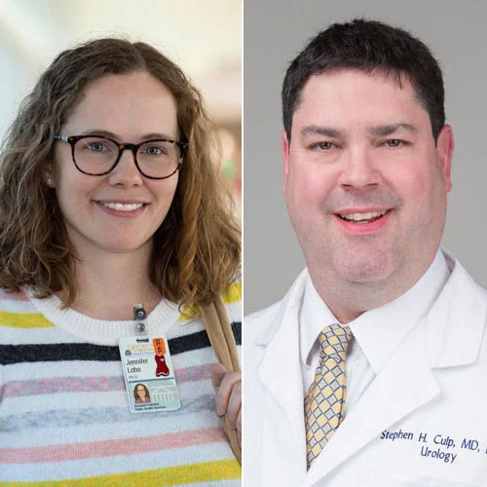

Slide 26
Thank you

Slide 27
STRENGTHS
our CRC team. I would be drowning without them currently
We have a historically good name. our patient population is unique for the access to rural and low SES patients without access to care which means higher grade and unscreened disease. We are a supportive group and close knit.
We have very strong research team with Rapp/Krupski and Zillioux/tuong in charge of research fellow and residents. Smart use of research resident for high yield projects ( both short and long term) are better than hare-brained "one - off" pet projects.
Getting Ali May with her lab here should be a real coup. She seems like a successful "doer" type and should be able to thrive.
Getting Jessica Qiu in our residency. I cannot gush enough about her. She is a research Machine. She has generated hypothesis for 3 of her own projects! I know it is a trite statement, but, she is the BEST medical student I have ever worked with. If you want resident research, we need to keep her here. She already has away Sub-I's at Hopkins and Michigan. She will be highly recruited elsewhere. If she keeps current trajectory, she is a future chair at some program ( and I have never said that about any other medical student I have met)..

Slide 28
STRENGTHS
Utilize Greg Eure for clinical studies? He has a great track record
. Everyone is very collegial and willing to help out. We have a great student, resident, attending involvement and drive overall. The departmental support is seemingly very good.
we are allowed to pursue our passions whether they are research related or clinical
positioned to converge on an inter-divisional project among those faculty who are passionate about their respective areas
reasonable control of our schedule and we are not pressured to produce a crazy amount of RVUs
a collegial environment which can foster collaboration among subspecialties

Slide 29
Weaknesses
having an area of focus and not doing it all; I will probably still try to do it all but it's nice to not have the pressure
Want to try to get provisional patent, hard to understand system
One problems of only being at one institution for a long time is you don’t know how it is for other people. It actually isn’t that bad here but things get to be an echo chamber and then everyone believes their complaints as truth in the universe without a comparison or perspective
. Research is everyone's least priority. After they finish work, they want family time, but are stuck finishing charts and emails at home. Nowhere to fit in the research and academics. It is a society-wide phenomenon where impatient correspondents get upset if routine emails are not addressed same day
A third barrier is the huge emphasis on clinical productivity by the administration. Research takes real time. People need time and monetary incentives to be productive. Right now all financial incentives are for clinical productivity ( which of course makes sense, since it pays the bills). Back in the day, Hopkins Urology was famous for paying ultra-low salaries to pay for their academic mission. I am not advocating that, but maybe taxing clinical revenues a little to pay for academics is something to consider.

Slide 30
Weaknesses
Get more research productivity out of the Andrology fellow? Raise the research minimal bar for all our fellows.
We don't have a lot of 'research' faculty. I think this will hash out in the new comp plan
biggest weakness is a lack of structured understanding about what our research goals are and how we accomplish them. And, I would think that this meeting, coupled with the ongoing compensation plan process, is a great time to discuss/potentially even reach an early consensus on those goals and how we start to accomplish them
second biggest weakness is the lack of research mentors. That is, those faculty in the department who have a sufficient research background to foster the young faculty in their research growth.
biggest weakness is that we don’t have enough departmental level resources (CRCs, statistician and grant administrators per faculty) nor knowledge of extra-departmental resources that can facilitate projects for that subset of research oriented faculty members.
general support/collaborative nature of our faculty, the many many resources that UVA has to offer,

Slide 31
Aspirational
burnt out from research so I don't have an aspirational project at the moment haha
. Better opportunities for statewide cooperative projects. WE have a stalled project of Raman Spectroscopy with Virginia Tech. Maybe new Chair at VCU will help?
. I personally have wondered if we should change our research requirement? Such as have presented two abstracts at a local, regional or national meeting and submit two manuscripts.
I would say there is a lot more consistent encouragement needed to get them involved in projects and see them to fruition. The enticement of going to a meeting doesn't seem to be enough. I also think there has been less interest in other educational activities, I plan to encourage more next year, like going to MA_AUA, VUS, MA Residents day, etc.

Slide 32
Aspirational
Not interested in publications (bare minimum P&T)
It seems reasonable to have divisions in general within the department and we do this already somewhat in Andrology. For instance, Nico and I (and Mei and D. Rapp) collaborate on a lot of papers, we have our own Andrology research meeting once a month, etc. We don't necessarily need to delineate more clinical/research among us as andrology faculty, but have found that collaboration is essential and then we can get things done and finalized as a group.

