Slide 1
Faculty Retreat 2024 Residency Review

Slide 2
2024 Match!
Hannah LeBlanc
Jacob Tannenbaum
Davis Temple

Slide 3
2024 ACGME Survey Data

Slide 4
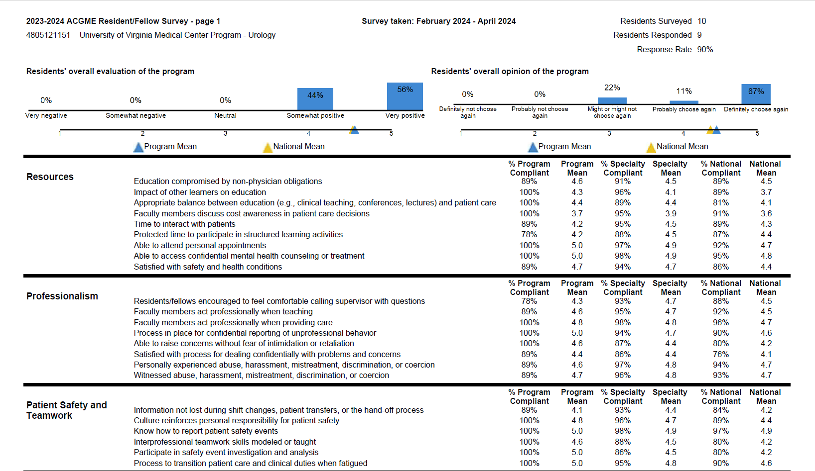

Slide 5
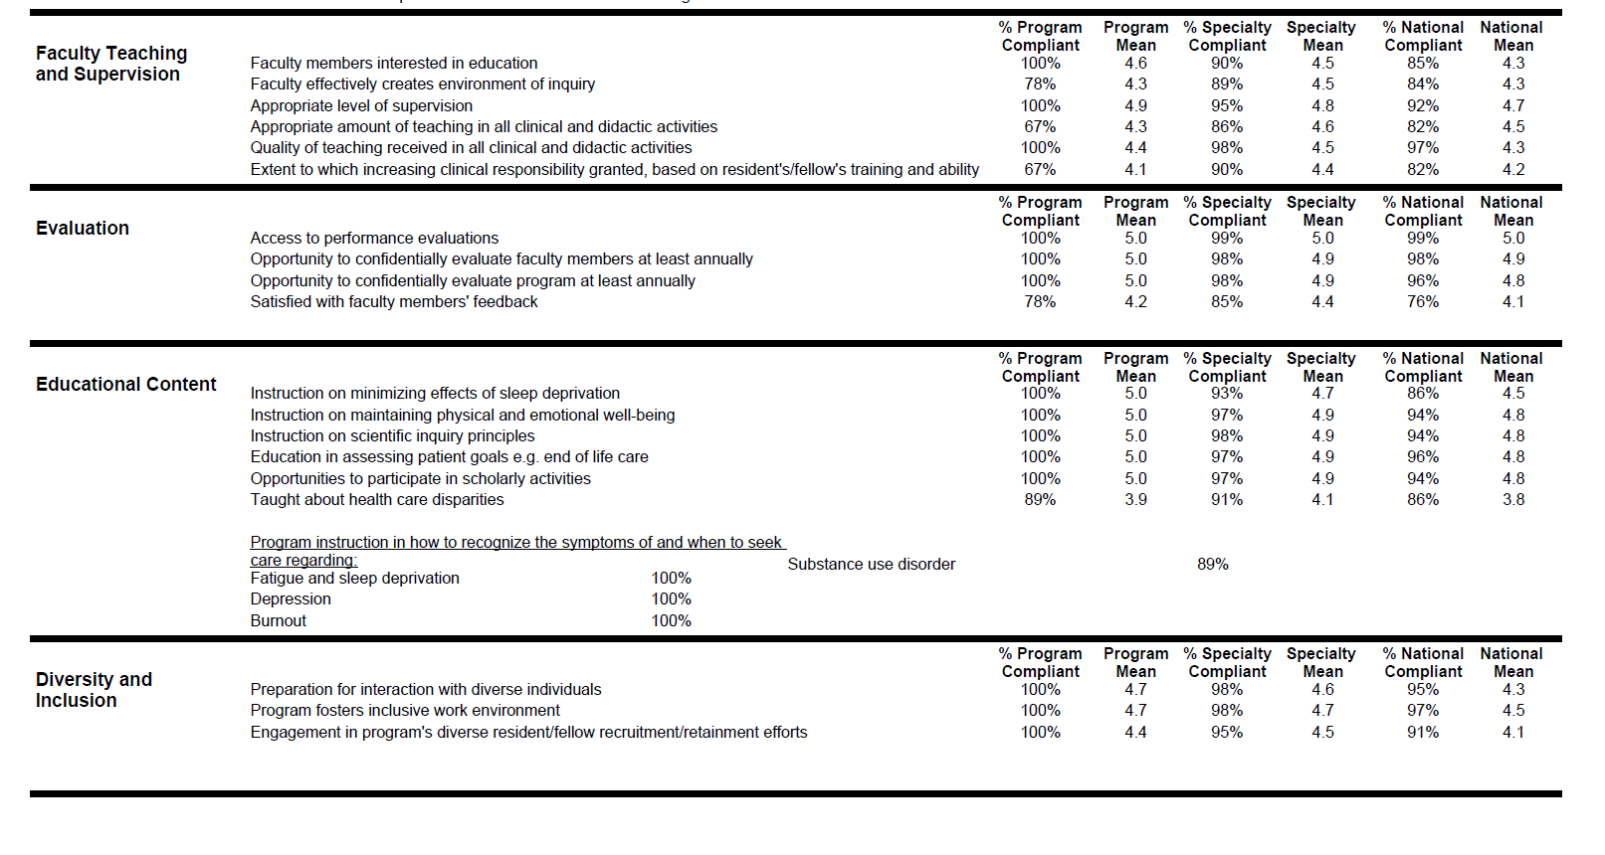

Slide 6
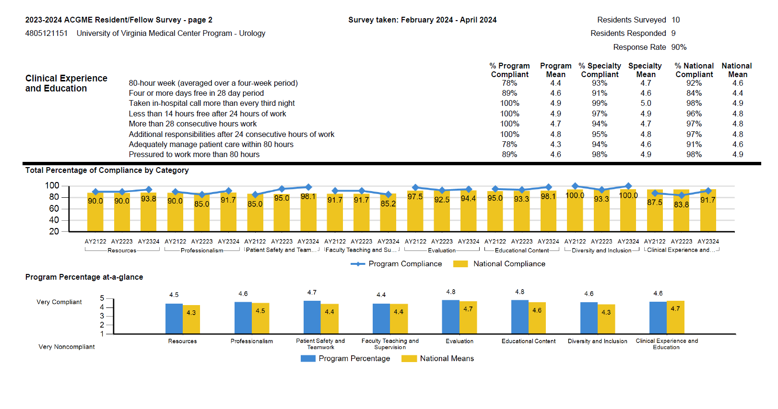

Slide 7
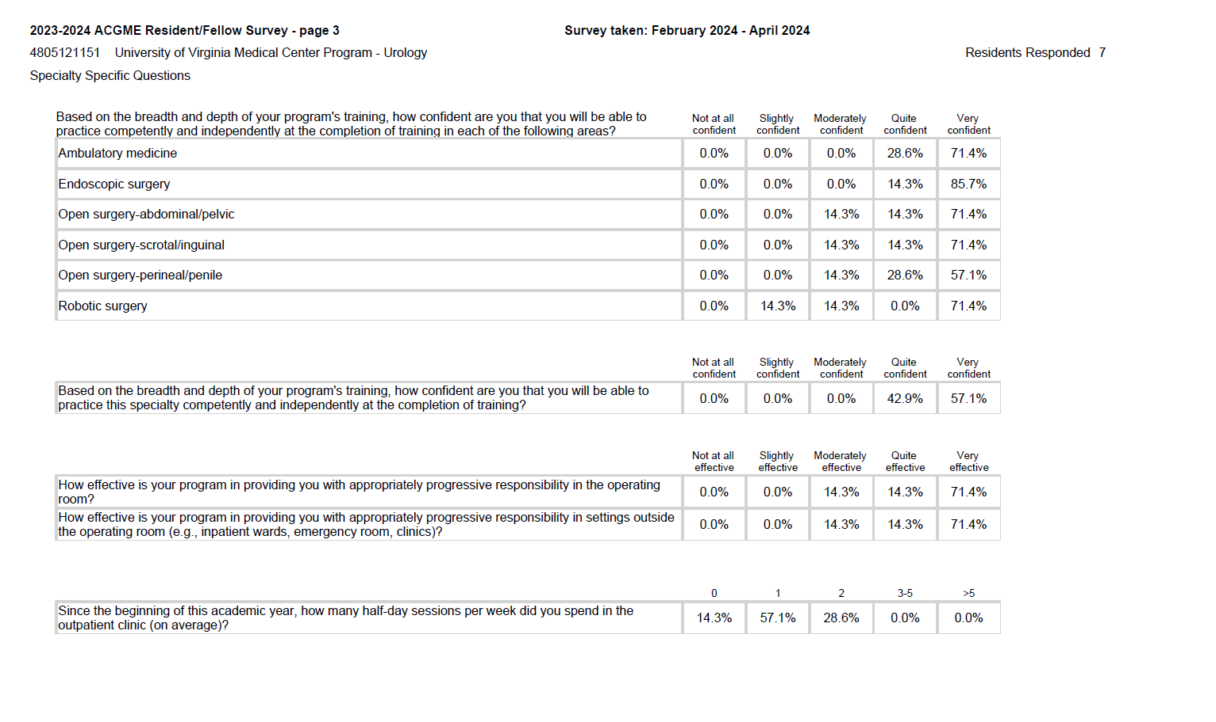

Slide 8
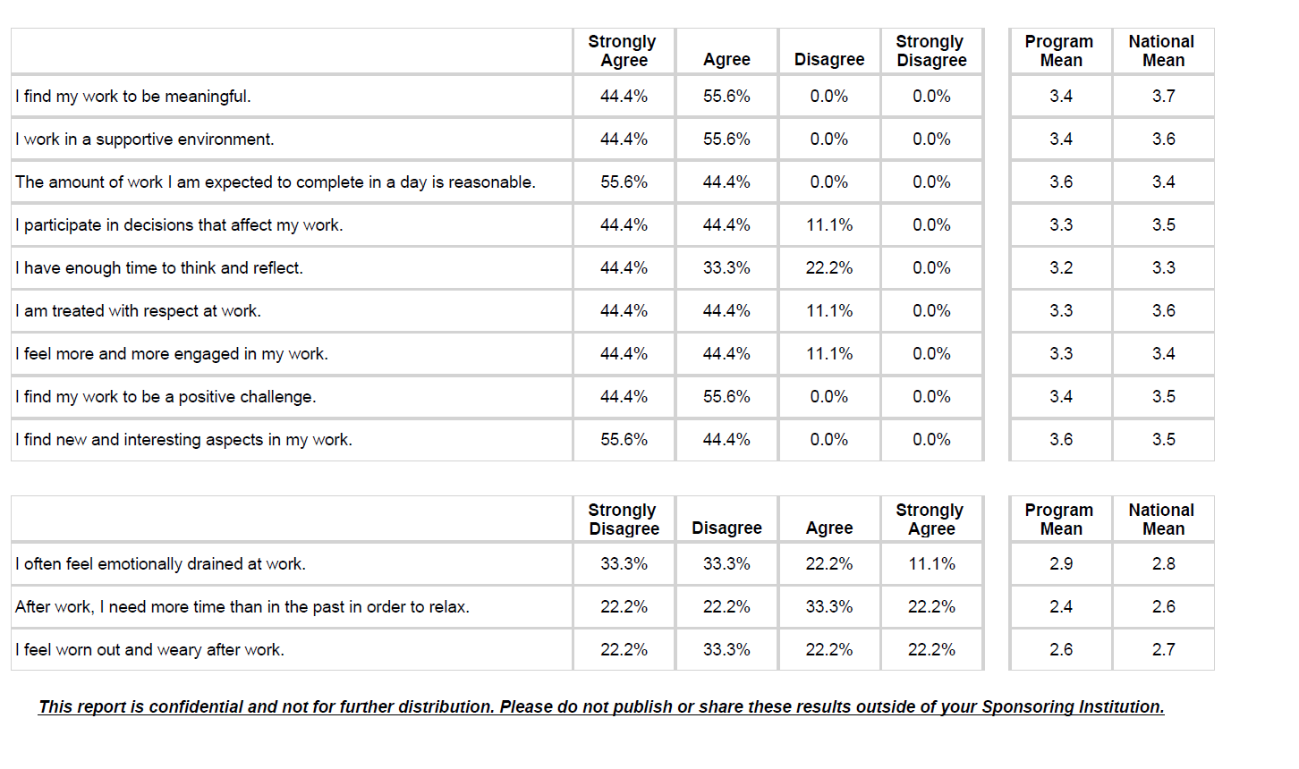

Slide 9
PEC Update
Consult Block
Pro:
Better continuity of care
Cons:
Workload
Late sign out
4 weeks
Wellness/Burnout
Encouraged to go home after busy call (residents advocate for each other and ensure to update faculty)
Move sign out to 5 pm
Other residents assist call resident
Better adherence to block schedule

Slide 10
PEC Update
ACGME Surveys
OR Teaching:
Better feedback in OR (before cases set expectations and debrief after)
Not interested in app for feedback
Junior faculty have residents less involved (offset by increased volume)
Set well defined goals for each year (Intern card, etc.)
Discuss case more with faculty before

Slide 11
PEC Update
ACGME Surveys
Clinic Teaching/Didactics:
Resident/Faculty contributions
More oral boards style/questions and interactive
Beller BPH lecture as example
Professionalism
Anonymous feedback on internal site
GME survey
Resident culture

Slide 12
2023 ACGME Survey Data

Slide 13
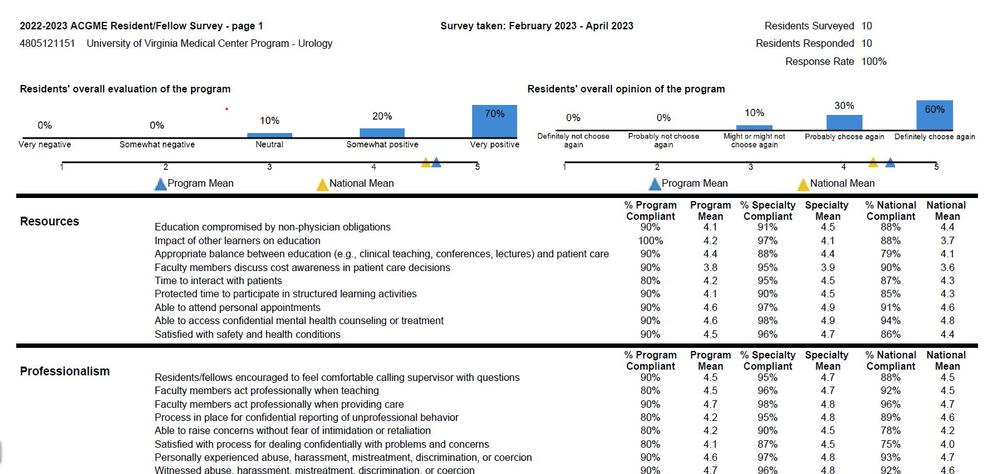
Notes:
*is this in our wheelhouse?

Slide 14
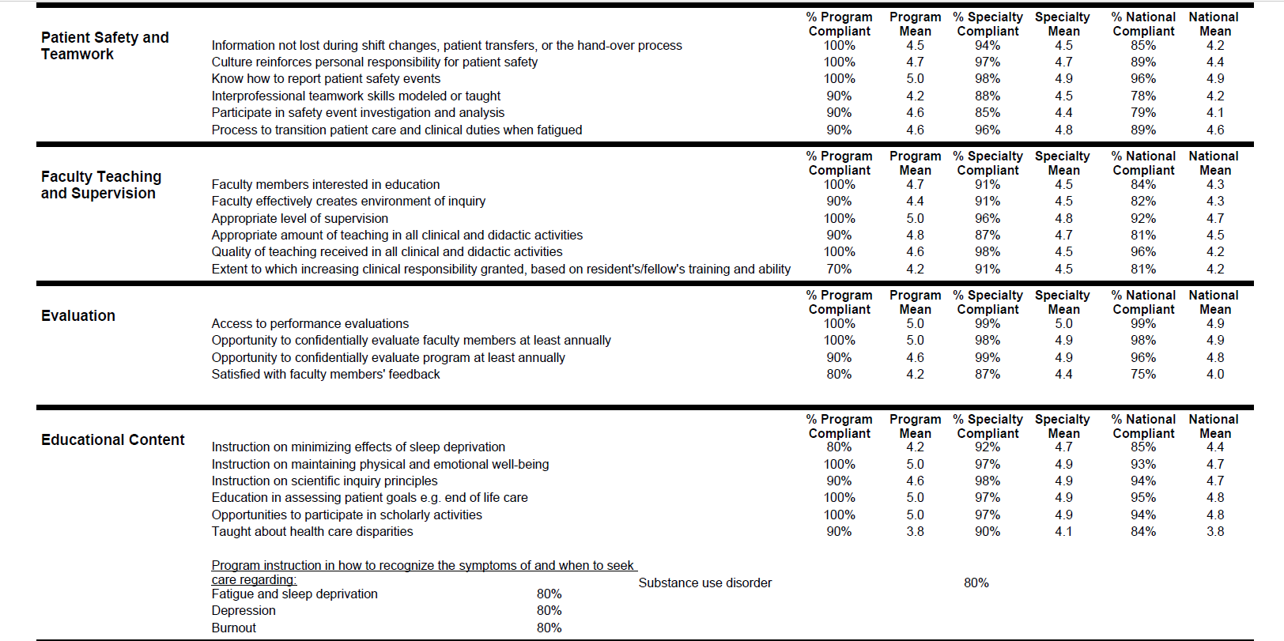

Slide 16
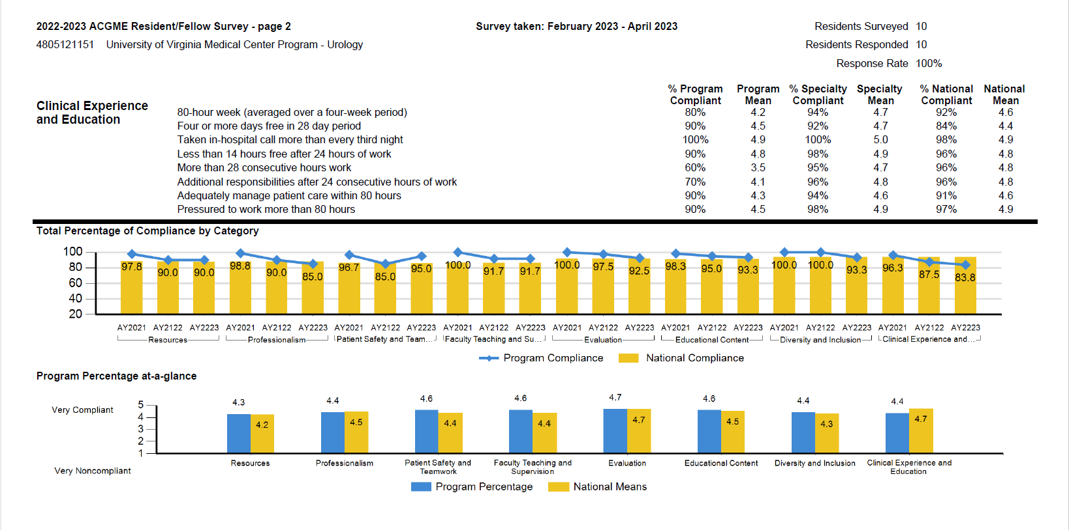

Slide 17
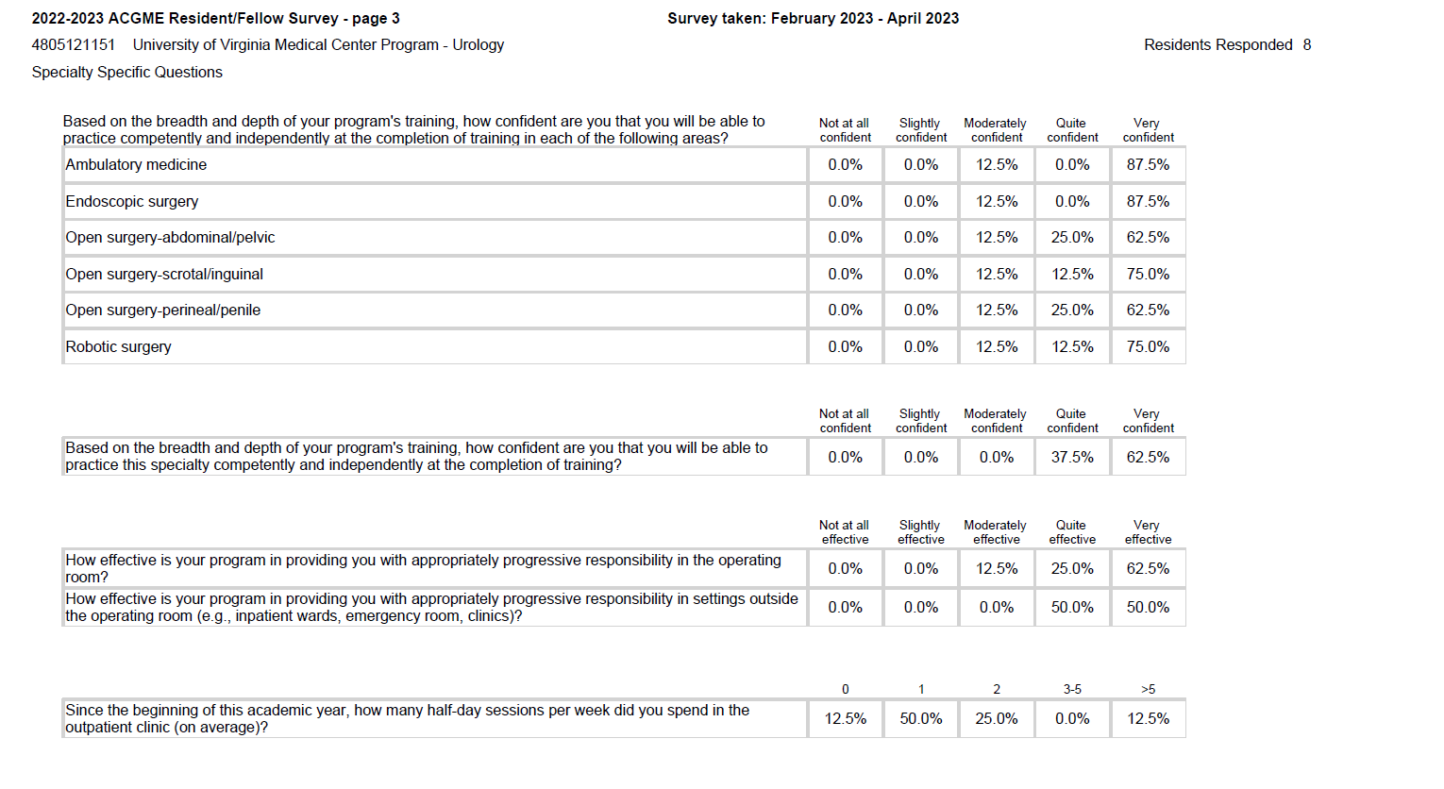

Slide 18
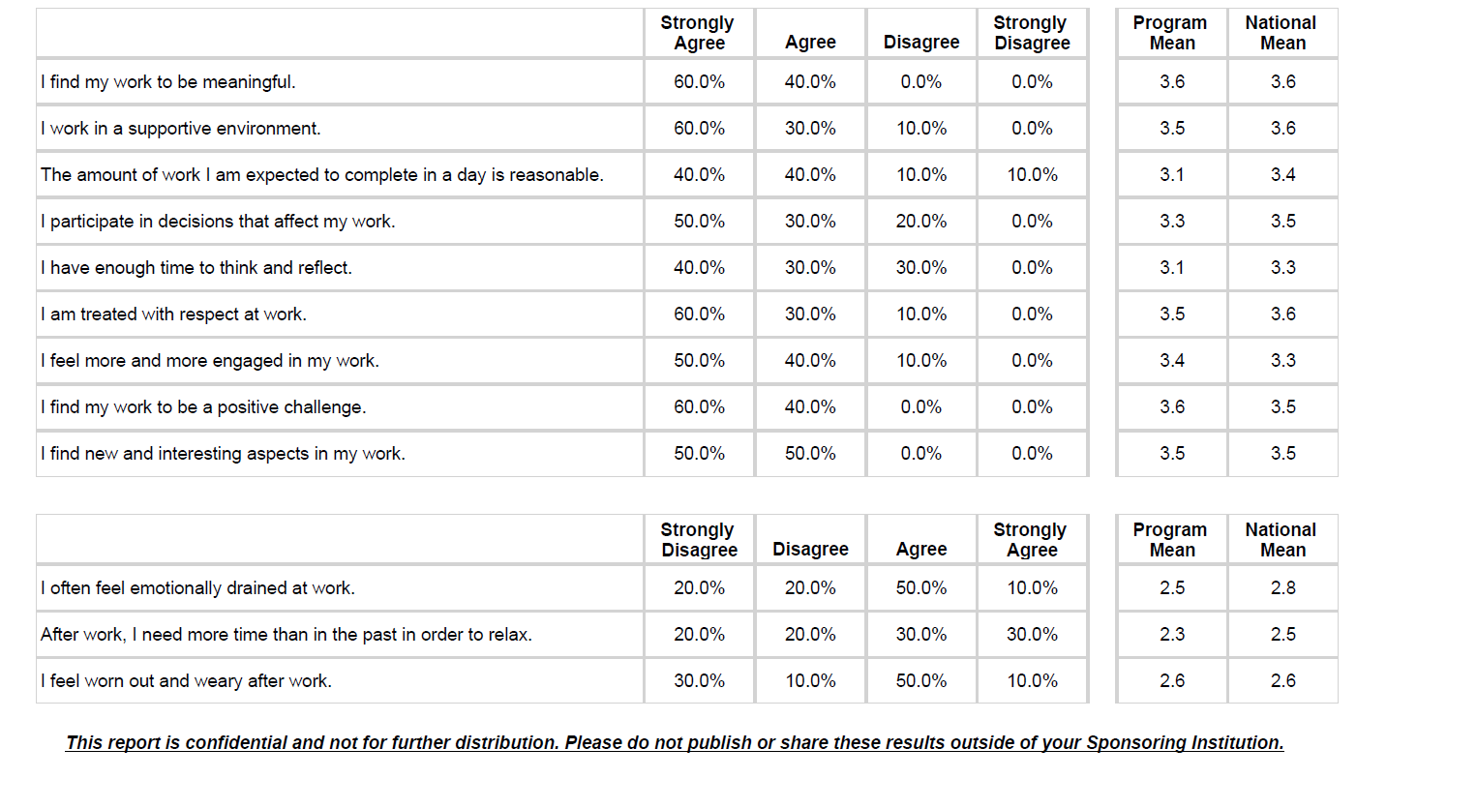

Slide 19
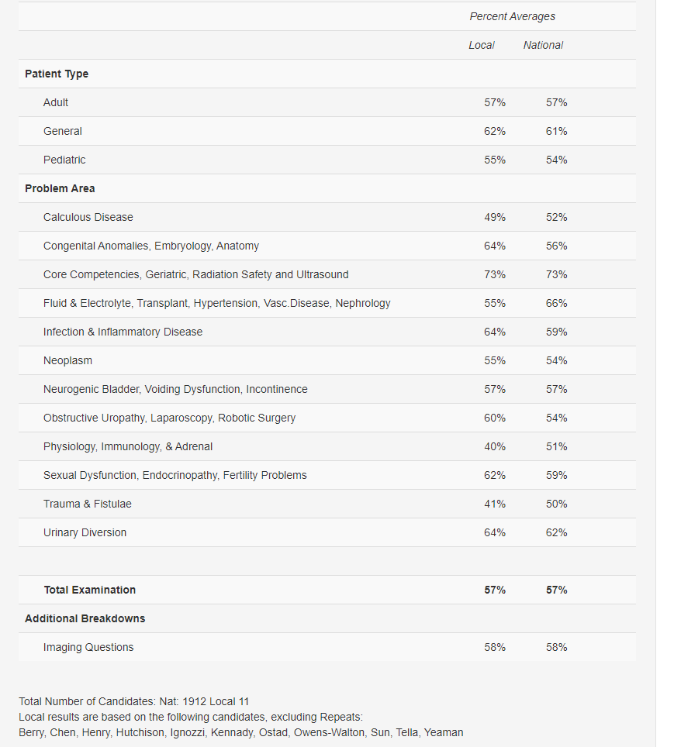
In-Service Scores
Weakest areas: Congenital/Embryology, Nephrology/Renal/Physiology, Trauma/Fistulae/Diversion, Stones
Overall improved from 2023

Slide 20
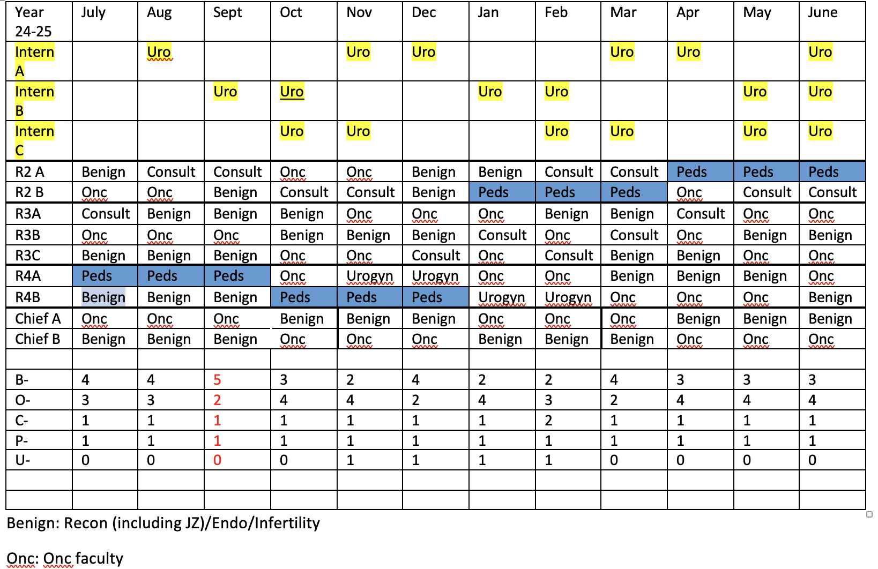
Rotations/Block Schedule
Keep Subspecialty blocks with better adherence (rough draft pictured)
Benign, Onc Split
Better incorporate Dr. Zillioux (2nd/4th yr)
Discussed with Dr. Zillioux
Future consideration: Elective block year 4/GHLT, Fertility block with Smith, Research block
Consult block for year (Chen/Berry)
Night/weekend call three months in advance

Slide 21
Consult block
Feedback…?
Comprised of Uro 2/3 (4 weeks)
No weekend call for consult resident
Peds resident remains separate
Weekend call from Fri PM-Sun AM
Faculty of the week-teaching opportunity

Slide 22
Consult Block
Need to monitor as resident group to ensure wellness/avoid burnout
Karie Mon-Thurs, Intern all day Friday
Avoid call immediately post consult block
Sign out 5 pm as opposed to 6 pm
? In person/phone sign out
Resident go home post-call emphasized

Slide 23
Intern Orientation-Gillock, Sands, Wilson
Work with Karie and consult block resident
Karie-Interdisciplinary rounds/cystectomy ERAS
Intern all day Friday
Take phone calls from the floor
Take floor calls at night later in the year
Interns come in on Sat/Sun 1/2 day to help call resident
Residents to develop intern checklist of core skills/diagnoses
Interns will do 6 months of general surgery (core rotations SICU, NF, Green/Orange, VA, Peds, Blue, EGS).
Adjust yearly based on feedback
Maybe Plastics in the future
Take Step 3 early (before end of June)

Slide 24
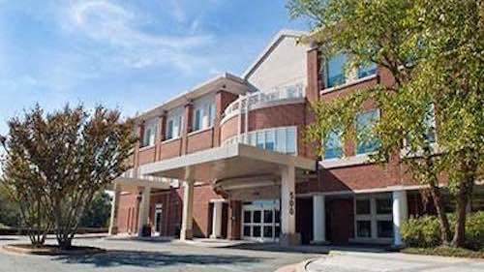
Resident Clinic-Gillock
Faculty-
Notify Meghan if you will be away!
Residents are going to provide an advanced schedule of time away/call schedule/vacation
Chen/Berry completed
Night/weekend call three months in advance
PGY-2 resident clinic remains the same this year
PGY-3 residents will rotate (remain as 2 residents in clinic at a time and off when they are on consult block)
Closed June/July (aside from Schenkman days)

Slide 25
Resident Research-Zillioux
QI Projects/Longitudinal project
Change resident research requirement
Abstract presentation requirement ?
Travel funds (rollover)
Steers Fellow
Luis Gonzalez Miranda MD, MPH

Slide 26
Resident Curriculum-Tuong
2-year, rotating
Align with Grand Rounds and Surgical skills labs
Format-more oral boards-style, increased faculty participation

Slide 27
Wellness/Morale
Resident appreciation day
Change in call structure
Consult resident
Intern role/ 3 resident complement
Karie/APP help
Lippert donations

Slide 28
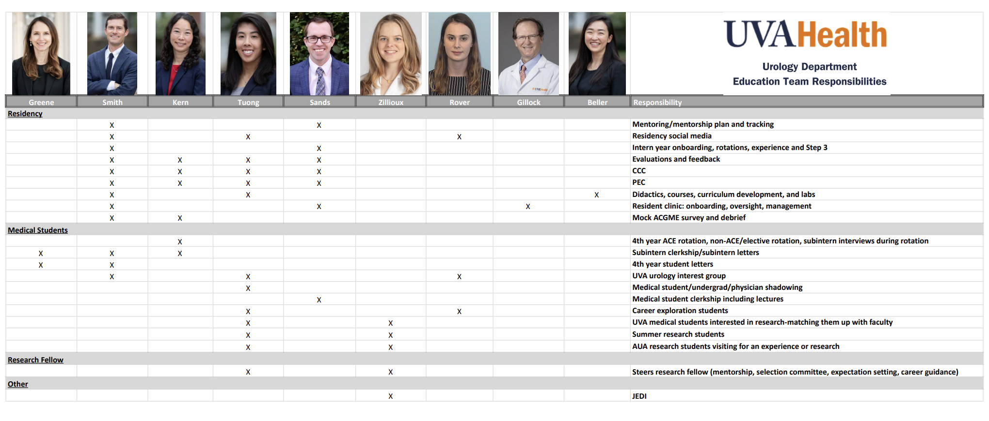
Website/Internal Site
Thank you, Jessica!
Anonymous Feedback
Education team contacts
Resident handbook

Slide 29
Other Items
Important dates
Graduation June 15th
Intern General Surgery Orientation June 24/25, GME 6/20, 6/21
Uro Resident Orientation July 3
Interview format
How many candidate s (37)/interview (3)days?
Sub-I’s on day #3
Limit faculty interviewers, have to interview all 3 days
Dates: Tues Nov 19, Thurs Nov 21, Monday Nov 25 (sub-I)
3 Residents per year
Other rotational opportunities (general urology, Haymarket, Culpeper, Stuart’s Draft)
Improved engagement with VUS, Bunts-Hackler, MA-AUA Residents Day

Slide 30
Thoughts?

