Slide 1
Provider and Location Star Ratings & Comments Patient Experience Office Strategic Marketing & Communications Email us at transparency@uvahealth.org

Slide 2
Provider Eligibility
Patient volume and survey participation:
Providers who see at least 50 patients per month are surveyed with Press Ganey
Survey response minimum:
Providers must have 30 survey responses within the past 24 months to generate a star rating
Exceptions for lower volume are considered for Providers in specialty clinics
Ambulatory clinic providers only
Includes most ambulatory clinic providers affiliated with UVA University Medical Center, UVA Community Health Medical Group, and UPG Clinical Practice Group
Once Provider meets the 30 responses, their star rating and comments will be published
945 providers set to sample today
780 providers to date with ≥30 responses

Slide 3
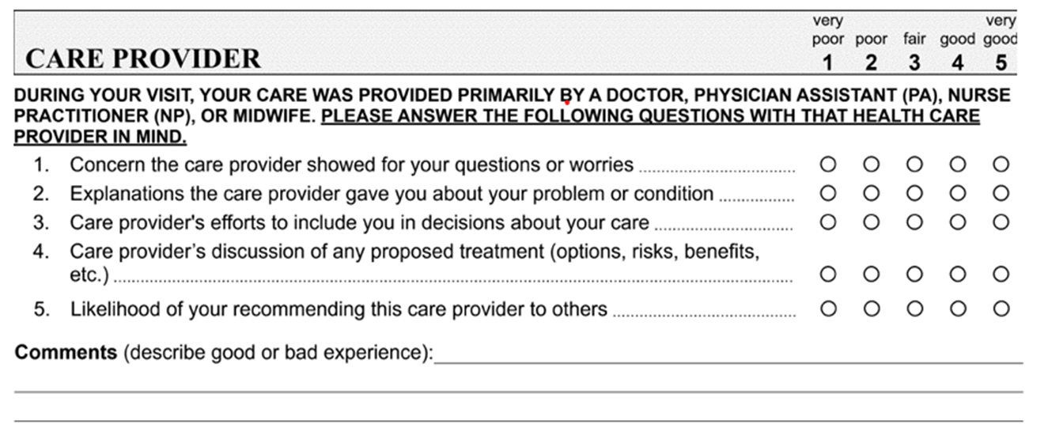
Star Ratings & Comments
Data comes from the patient experience Medical Practice survey 'Care Provider' domain (below)
Ratings are collected on a 0-100 scale, when then translates to a 1 - 5 scale star rating
Star ratings and comments will be posted on the UVAHealth.com Provider & Location Directory
Star ratings and comments will be published on the Provider profile of third-party sites (e.g., WebMD, Vitals)
The Patient Experience Office can provide an analysis of comments and trends, identify areas of strength and opportunity, offer real time observations, and share best practices.

Slide 4
Patient Comments
Most providers find their patients’ feedback is overwhelmingly positive
The majority of patient comments will be posted unedited
Comments will not be posted if a comment falls within a narrow set of exclusion criteria:
Protected health information (PHI)
Reference to other providers or staff
Profanity or libel
Billing or insurance
Parking, facilities, or other off-topic comments
Providers can view and appeal their comments before publishing on the provider directory page
Appealed comments are reviewed by the Transparency Appeals Committee
Members: Providers, Patient Experience Office, Marketing & Communications
The Committee will meet monthly to review appeal requests and make informed decisions guided by an established criteria and guidelines.
Comments not appealed are routed for publishing

Slide 5
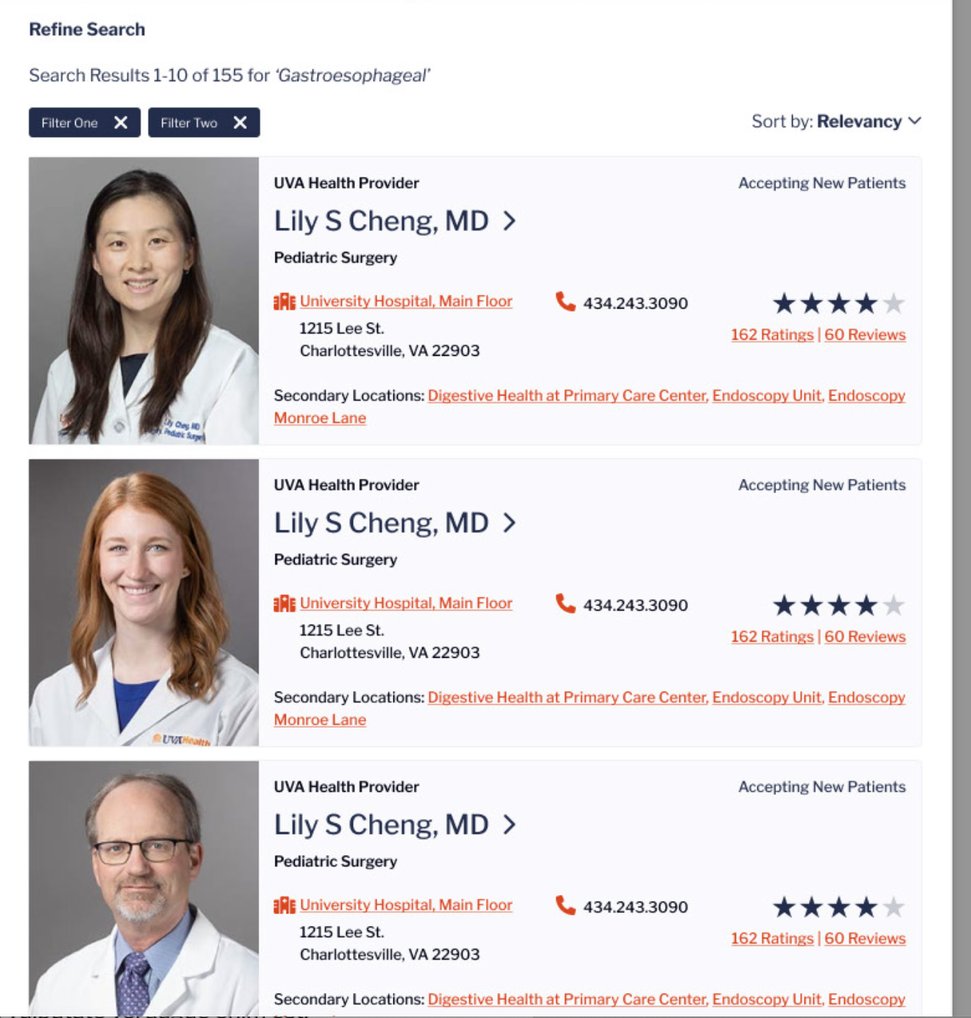
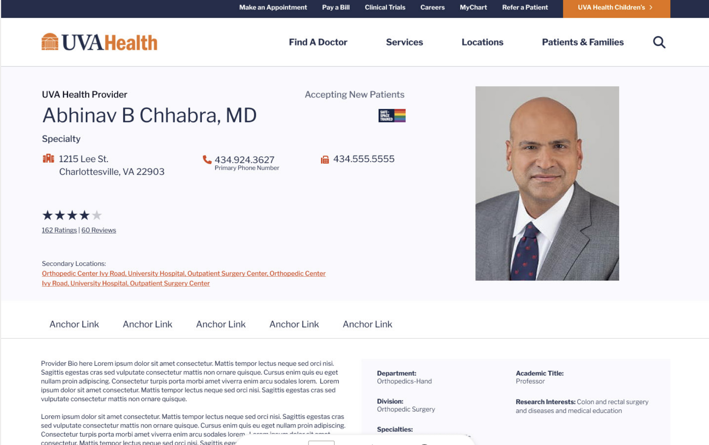
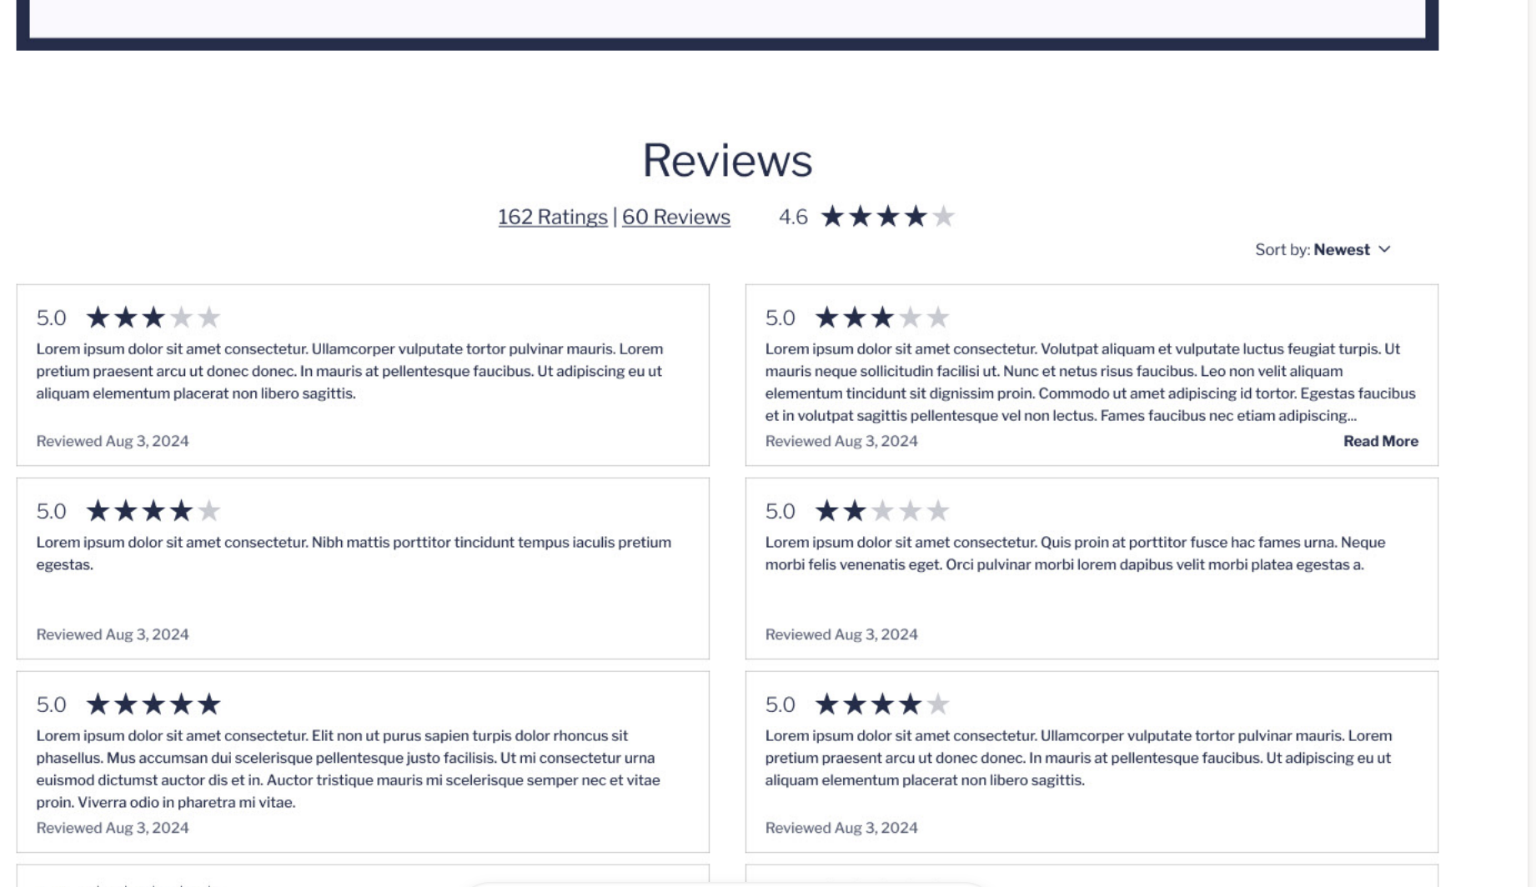
Provider Search Results & Profile Page Examples for placeholder only

Slide 6
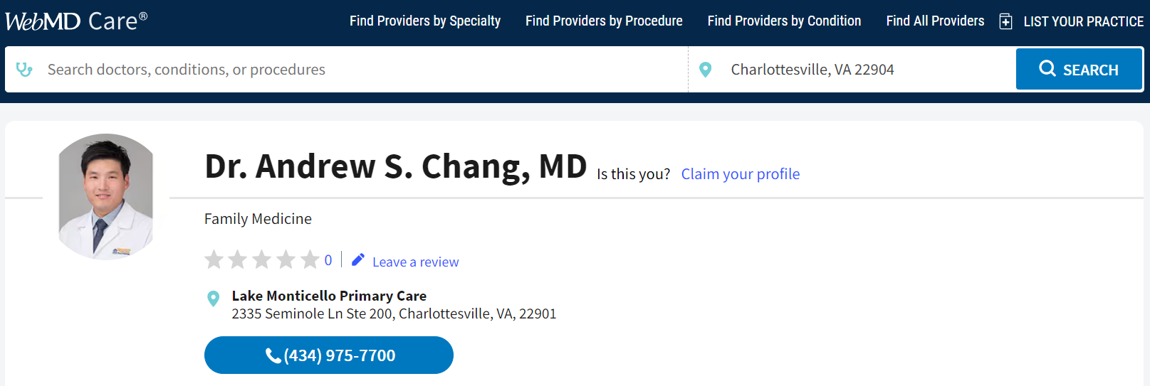
Provider Third-Party Profile Page Example
We have more robust 1st party data and can improve 3rd party provider profiles
UVA Press Ganey Data:
942 survey returns
38 comments
4.8 star rating
UVA Press Ganey Data:
500 survey returns
34 comments
4.6 star rating
Provider Image
Provider Name
Provider Image
Provider Name

Slide 7
What Provider Ratings Look Like Today

Slide 8
Timeline
Phase 1
Mid-July
Internal go-live of the Provider Dashboard
Phase 2
Mid-September
Star ratings and comments will be published to the UVAHealth.com provider web profiles
Publishing of star ratings and comments to third-party sites
View star ratings and manage comments
Ask questions and seek coaching
Phase 3
Mid-Oct

