Slide 1
Piedmont Liability Trust Faculty Lecture series FY 2025
Bruce Gehle, CEO
Rachel Horvath, Claims & Litigation Counsel
Skip White, COO & General Counsel
Judy Fortineux, Senior Risk Manager
Kirin Johnstone, Legal & Operations Coordinator
Amy Rossello, Chief of Staff

Slide 2
Outline
National Picture
PLT Update/Urology Claims Experience
Virginia Medical Malpractice Cap
New Developments in State Licensure Matters
Provider Options for Misbehaving Patients
Question & Answers

Slide 3
Survey of National Med Mal Landscape
December 2023 (FL) - $261M verdict against Johns Hopkins Children’s Hospital St. Petersburg for Peds ER visit
November 2023 (NY) - $120M to patient following delayed stroke diagnosis that resulted in permanent brain damage
In 2023, 57 verdicts over $10M; half of those reached $25M
See https://www.medscape.com/viewarticle/mega-malpractice-verdicts-against-physicians-rise-2024a10002bz?form=fpf

Slide 4
Nuclear Verdicts: 2013 - 2022
Defined as any verdict $10,000,000 or more
See: Medical Liability Monitor: July 2024

Slide 5
Most Common Verdicts: 2013 - 2022
Medical Malpractice
Birth Injuries
Nursing Home Deaths
Med Mal lawsuits made up 20.3% of all nuclear verdicts studied
Only products liabilities (23.3%) and auto accidents (23.2%) produced more jury verdicts in excess of $10M
See: Medical Liability Monitor: July 2024

Slide 6
Highest Risk States: 2013 - 2022
Illinois – 39.1% of all verdicts
New York - $434M alone in 2022
California – most nuclear verdicts across all lines of coverage, but only 5.5% for medical malpractice
See: Medical Liability Monitor: July 2024

Slide 7
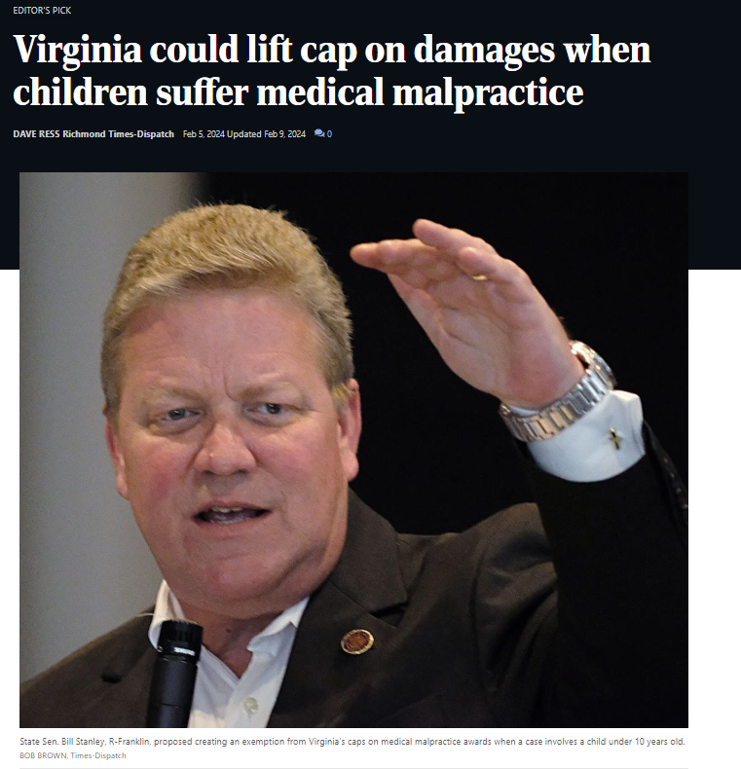
Virginia Med Mal Cap
VA Code 8.01-581.15 – Limitation on Recovery
July 1, 2008, through June 30, 2012 | $2.00 million
July 1, 2012, through June 30, 2013 | $2.05 million
July 1, 2013, through June 30, 2014 | $2.10 million
July 1, 2014, through June 30, 2015 | $2.15 million
July 1, 2015, through June 30, 2016 | $2.20 million
July 1, 2016, through June 30, 2017 | $2.25 million
July 1, 2017, through June 30, 2018 | $2.30 million
July 1, 2018, through June 30, 2019 | $2.35 million
July 1, 2019, through June 30, 2020 | $2.40 million
July 1, 2020, through June 30, 2021 | $2.45 million
July 1, 2021, through June 30, 2022 | $2.50 million
July 1, 2022, through June 30, 2023 | $2.55 million
July 1, 2023, through June 30, 2024 | $2.60 million
July 1, 2024, through June 30, 2025 | $2.65 million
July 1, 2025, through June 30, 2026 | $2.70 million
July 1, 2026, through June 30, 2027 | $2.75 million
July 1, 2027, through June 30, 2028 | $2.80 million
July 1, 2028, through June 30, 2029 | $2.85 million
July 1, 2029, through June 30, 2030 | $2.90 million
July 1, 2030, through June 30, 2031 | $2.95 million

Slide 8
Virginia Med Mal Cap
Actions Being Taken / Next Steps:
General Assembly next convenes in January 2025
PLT and UVA Health Leadership Continue to Monitor
Etc.

Slide 9
Licensure & managing difficult patients

Slide 10
Medical Licensure
Care is considered rendered in the state where the patient is physically located
However, a court may consider the location of the provider as evidence of proper jurisdiction
Current State: if a provider is “practicing medicine” on a patient, they most likely need to be licensed in the state where the patient is physically located.
See Bourdin v. Radice holding DC had jurisdiction over a VA patient and a VA doctor due to the fact provider spoke with patient while she was physically in DC.

Slide 11
MacDonald vs. NJBOM
Patient: New Jersey Infant / Doctor: Massachusetts Radiation Oncologist
Patient had a rare and aggressive brain tumor, sought expert treatment
Due to Covid and loosening of licensure rules, patient was temporarily permitted to see out-of-state MDs; convenience and efficiency was touted and enjoyed by both parties
After Covid waivers expired in 2022, MDs were no longer permitted to see him without a NJ license; family filed suit arguing violation of commerce clause & “antiquated” regs
Currently in litigation; AMA has come out and adopted a middle-of-the-road approach (licensure laws should remain with exceptions for existing P/P relationships)

Slide 12
Misbehaving Patients
190 Reported Cases resulting in Dismissal - 47% increase over FY23
56% in Prim Care
62% Problem Behav
38% Trust/Non-Compl
12% Involving Threat
7% Sexual Misbehav (increase->1.5% in FY23)
Documentation is Crucial
Effectively Communicate Expectations

Slide 13
Patient Dismissals FY24
Management of Pt Behav Issues
Looking Forward
Address Behaviors Early & Document Efforts to help
Tools
Behavioral Agreements
Warning Letters
Threat Assessment, UVA Security, UPD or Local Law Enforcement
Training opportunities for managing and de-escalating problem behaviors
Staff training for consistent response
Goal –
Reducing stress/burnout for health care workers – staff & providers
Helping patients be successful

Slide 14
Board of Medicine Requirements
Written Notice
Reasonable Transition Time
Medical Records

Slide 15
APPs and Physician Liability (national data)

Slide 16
Apologies

Slide 17
Questions or Comments

