Slide 1
UVA SOM Research Administration Partnership
Urology Faculty Meeting
09/18/2024

Slide 2
Who are we?
Steve Lichtenstein - Assistant Dean, School of Medicine
Director Office of Grants and Contracts
Candi Wills – Senior Grants Administrator, School of Medicine, Office of Grants and Contracts
Urology is part of Mrs. Wills’ portfolio in the Office of Grants and Contracts. She is the liaison with the department for submission of all grants and initial agreement processing for School of Medicine approval through the Huron system.
Cindy Hicks - Grants & Contracts Administrator for the Departments of Neurology, Otolaryngology & Urology. Ms. Hicks will work with you to submit all initial transactions through the Huron system. This includes all Funding Proposals and Agreements (MTAs, DUAs, CSAs, etc).

Slide 3
What Ancillary Reviews are needed?
Agreement [Non-Funded] – NFA-Quick Guide | Principal Investigator (PI Certification AR) | Department Chair / Delegate* (Department/School Review AR) | School Admin / SOMOGC (Department/School Review AR)
Confidentiality Agreement | X |  | X
Consortium Agreement | X | X | X
Data Use Agreement | X |  | X
Intellectual Property Management Plan | X | X | X
Licensing Agreement | X |  | X
Master Agreement | X |  | X
Material Transfer Agreement (MTA) | X |  | X
Multi-Purpose Agreement | X | X | X
Other Agreement | X | X | X
Physical Asset Loan Agreement | X |  | X
Teaming Agreement | X | X | X
Agreement [Outgoing Subaward] | X | X | X
Agreement [Internally Funded Outgoing Subaward] | X | X | X

Slide 4
What is the process for grant submission?
PI/
Department
Locates funding opportunity
SOMOGC
Advise about application preparation to enhance proposal quality.
Work with study team to ensure successful proposal submission.
Sponsor
Submission is sent to sponsor after SOM approves in Huron.
Communicates intent to submit to Department RA.
With combined effort, an application is created in the Huron system.
Applications should not be submitted to the sponsor without SOM approval (even if sponsor does not require institutional approval).
Review for compliance with all applicable sponsor and institutional policies.

Slide 5
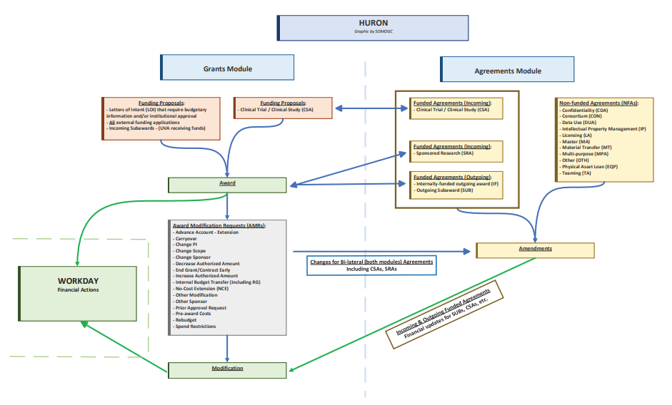

Slide 6
Other Reminders/Notes:
Deadline Policy – How does this work and what is the limit on late submissions? https://med.virginia.edu/policies/timely-submission-of-grant-proposals-and-related-documents-2/ https:d.virginia.edu/policies/timely-submission-of-grant-osals-related-documents-2/
Conflict of Interest – Please make sure that this is up to date in the Huron system.
New Meeting - A monthly check-in meeting will be set up with the department administrator and the SOMOGC administrator to talk about upcoming projects and current awards with questions. This will be a time that any PI/team can ask questions as well if needed. It is a forum to invite questions and start lines of communication regarding new projects that need research administration assistance.

