Slide 1
Resident Research Current Needs Survey & Next Steps
Faculty Meeting
Jan 2025

Slide 2
Agenda
Resident research needs survey results
Resident research gaps & opportunities discussion
Medical student research oversight

Slide 3
Resident Research
Fundamental learning objectives:
To critically appraise literature
To formulate a research question and basic study design to answer
To effectively communicate / present research findings
Aspirations:
Foster curiosity and scientific inquiry
Instill habit of evidence-based medicine (practice-based learning)
Instill quality improvement mindset

Slide 4
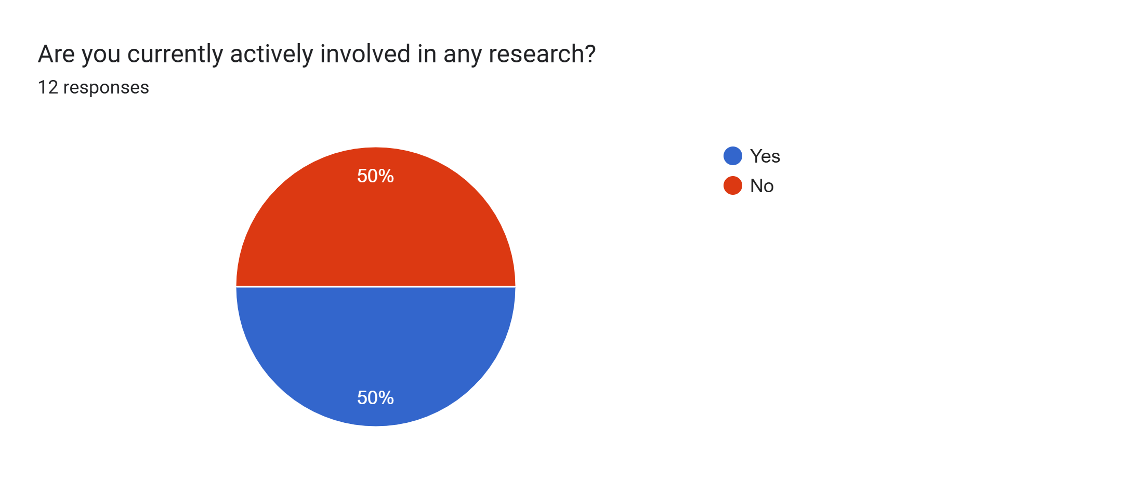
Survey Results

Slide 5
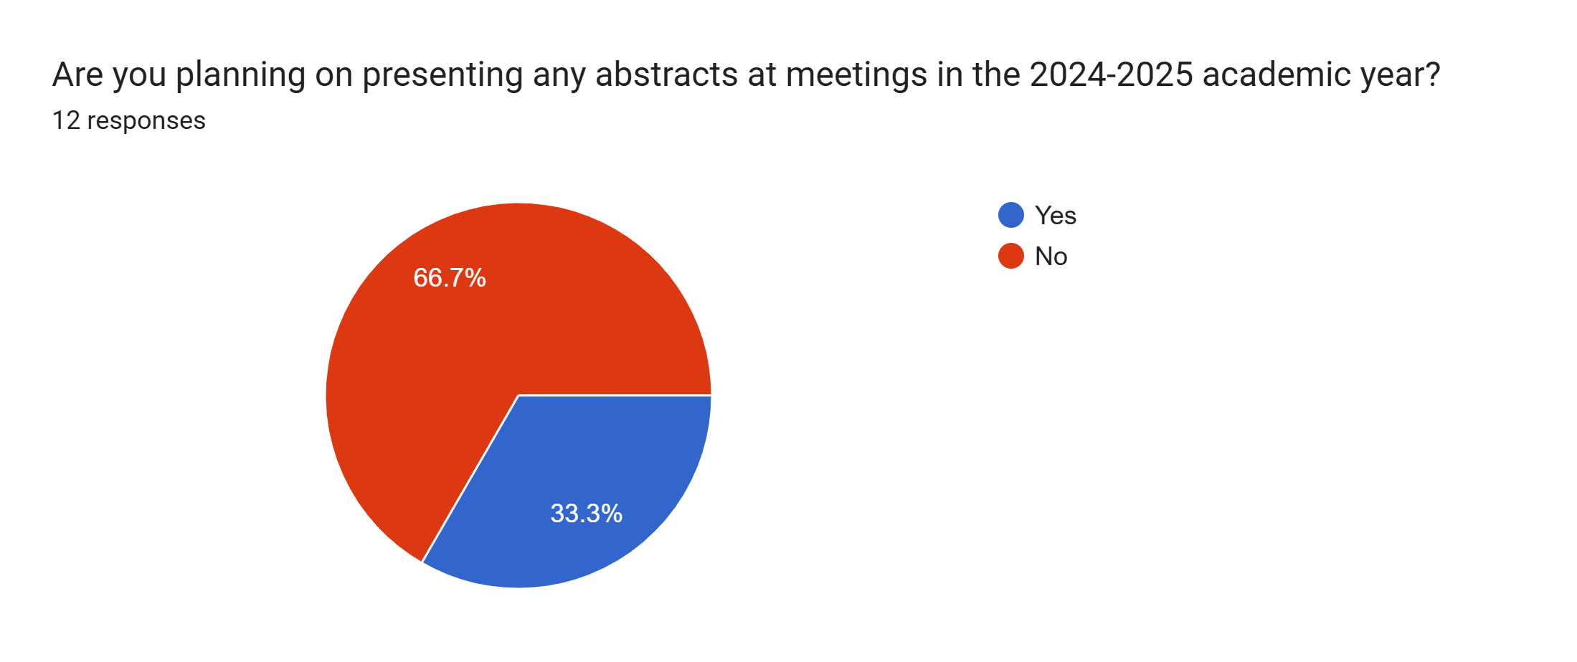

Slide 6
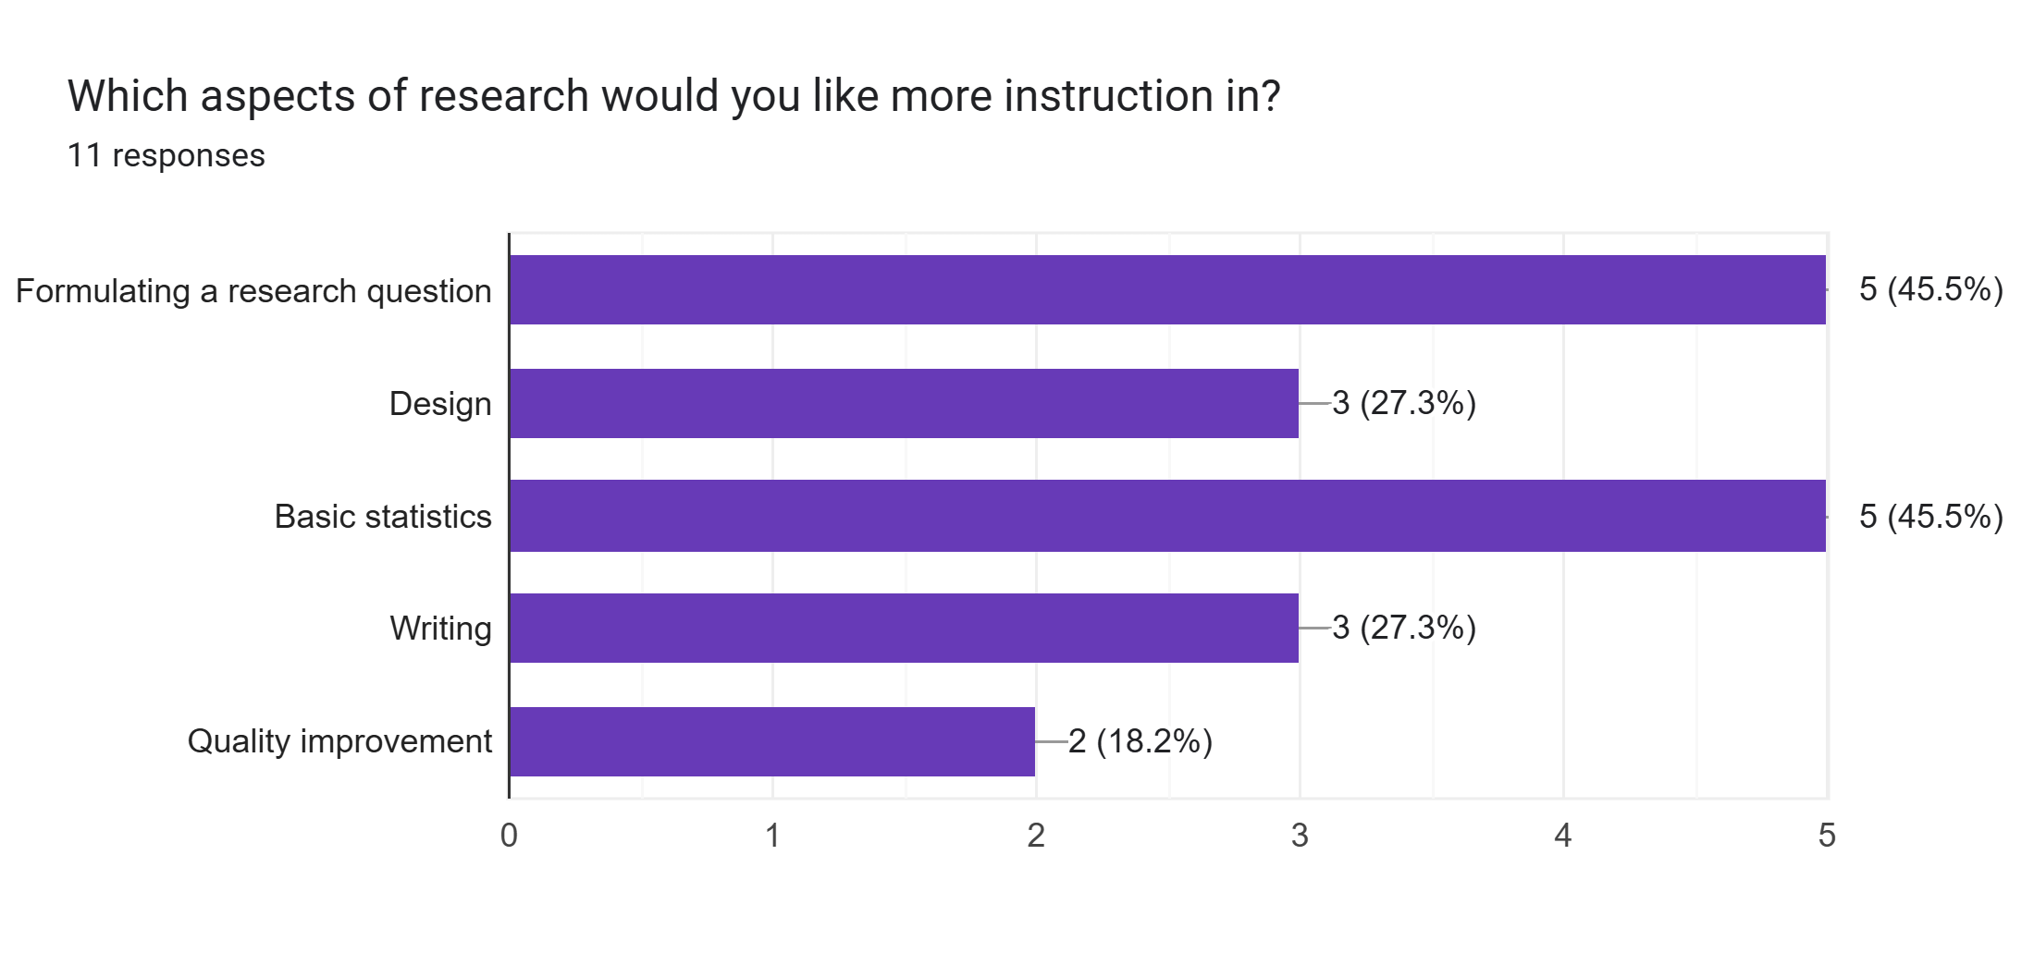

Slide 7
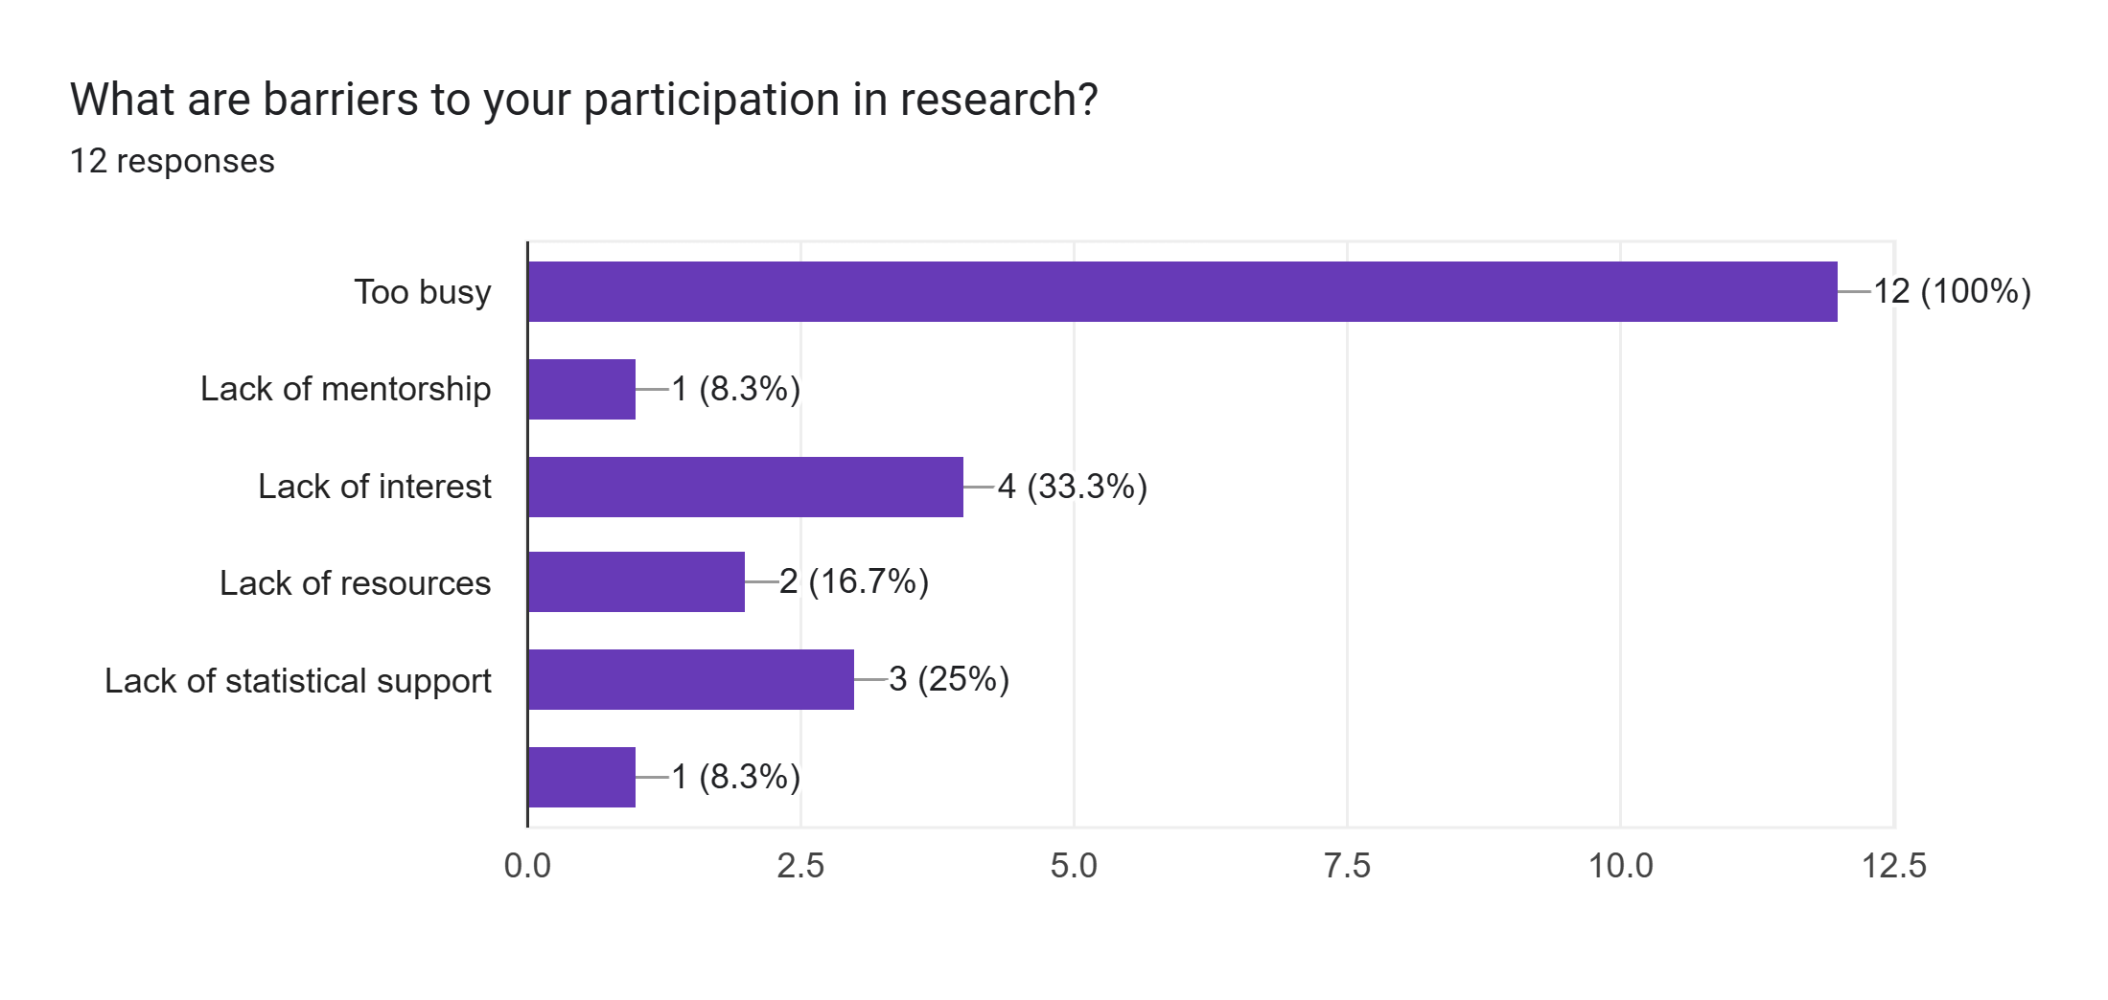

Slide 8
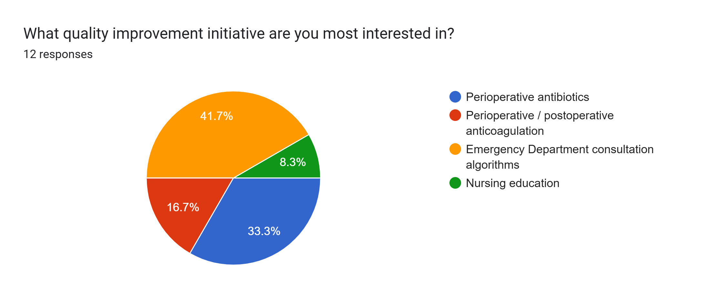

Slide 9
Other comments [paraphrased]
Not enough time and can fall bottom of priority lists with all other things need to do
No available projects that peak interest
No reliable data collection help
Would be helpful to know what faculty are working on and whether there are things just need help getting across finish line

Slide 10
Gaps
No formalized research curriculum
Loss of AET + Erosion of didactics / conference time
No easy way to match interested trainees with faculty projects

Slide 11
Opportunities
Statistics lectures upcoming this yr arranged by Dr. Tuong
Formalize a research track / curriculum with dedicated time?
Centralized list of active projects to help match trainees with projects?
Quality improvement
Win-win-win
Create formal curriculum starting intern year (a few other depts are doing this)

Slide 12
Medical Student Research
Issue with lack of oversight
Students toil without faculty face time, mentorship, or gain
Thoughts on formally prohibiting residents working with students without faculty onboarding / mentorship?

