Slide 1
Perioperative Roadmap Expansion Plan
March 2025
Notes:
Paola – lead-in, touching on retreat

Slide 2
Today's Discussion
Growth Trajectory
Strategic Initiatives
Efficiency Plan
Expansion Overview
Staffing Glidepath
Summary

Slide 3
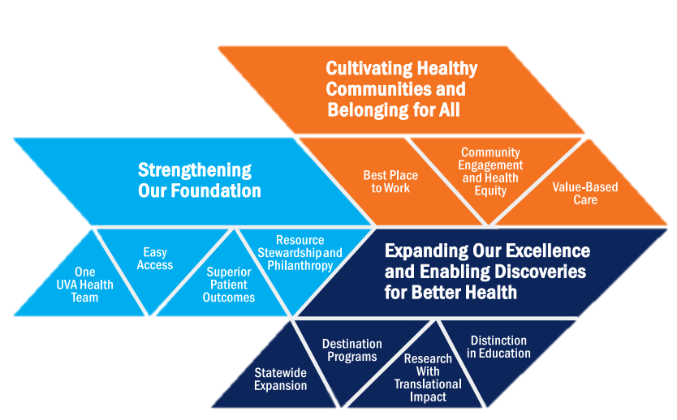
Periop Roadmap: Strategic Initiatives
Best Place
To Work
Easy
Access
Resource Stewardship
Superior Patient Outcomes
Easy Access
Superior Patient Outcomes
Resource Stewardship
Best Place to Work
Growth Trajectory
Strategic Initiatives
Efficiency Plan
Expansion Overview
Staffing Glidepath
Summary
Attract and retain top talent with career pathways, competitive pay and inclusive environment
Meet patient needs by creating capacity through efficiency efforts and expansion plans
Focus on quality and culture of innovation and continuous improvement
Supply variance reduction and minimization of waste
Notes:
THIS IS A REFURBISHED "PERIOP ROADMAP PLAN", WHICH WE'VE BEEN USING FOR THE PAST YEAR TO REPORT PROGRESS ON OUR FOUR KEY INITIATIVES WHICH ARE IN SUPPORT OF THE UVA STRATEGIC PLAN. TODAY'S DISCUSSION AROUND EXPANDING PERIOP CAPACITY FALLS UNDER IMPROVING "EASY ACCESS"

Slide 4
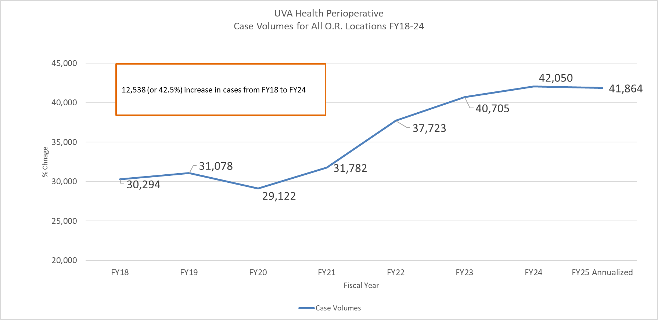
Growth Trajectory FY18-25 All Perioperative Sites – OR Volumes
FY25: On-target to exceed budget for case volumes; 5% ahead for Main OR and 2% for all sites.
OR25 Closure, Baxter, OR29 Renovations
Growth Trajectory
Strategic Initiatives
Efficiency Plan
Expansion Overview
Staffing Glidepath
Summary
Covid
4 OR SCR
Acquired
4 OR Tower
Expansion
2 OR OCIR
Opening
Notes:
THIS TELLS WHERE WE'VE BEEN/WHAT WE'VE DONE RELATED TO O.R. CAPACITY AND VOLUMES

Slide 5
Easy Access: Periop Roadmap Expansion Plan
Planned Expansion in FY26 & FY27 adds the equivalent of 6 ORs
Today
Jul 2025
FY26
Oct 2025
FY26
Apr 2026
FY26
Jul 2026
FY27
MOR
MOR Phase I
MOR Phase II
MOR Phase III
IMRIS
Nights and Weekend:
12-hr weekday blocks: .2
Sat elective blocks: 1.5
Nights and Weekends:
12-hr weekday blocks: 8
Sat elective blocks: 3
Equivalent OR: .3
Nights and Weekends:
12-hr weekday blocks: 14
Sat elective blocks: 3
Equivalent OR: 1.1
Nights and Weekends:
12-hr weekday blocks: 16
Sat elective blocks: 6
Equivalent OR: .9
Renovated IGS (formerly IMRIS) OR2 complete
Biplane with +shielding opens:
Equivalent OR: 1.0
OCIR
SCR
Open OCIR ORs 3&4
Shifting cases opens:
Equivalent Main OR 1.0
Equivalent OPSC OR 1.0
Growth Trajectory
Strategic Initiatives
Efficiency Plan
Expansion Overview
Staffing Glidepath
Summary
Full Anesthesia coverage in Procedure Room
Shift Ophth to Pro Room opens:
Equivalent OR: 1.0
Cumulative equivalent OR gain: 2.3 3.4 4.3 6.3
Notes:
Foundation – staffing, SPD
Expansion: 1) efficiencies, 2) extend hours/new space, 3) actual new-build OR’s
Focus on option #2 first: extending hours, making expanded use of current space = 6 OR’s = 12% increase in capacity

Slide 6
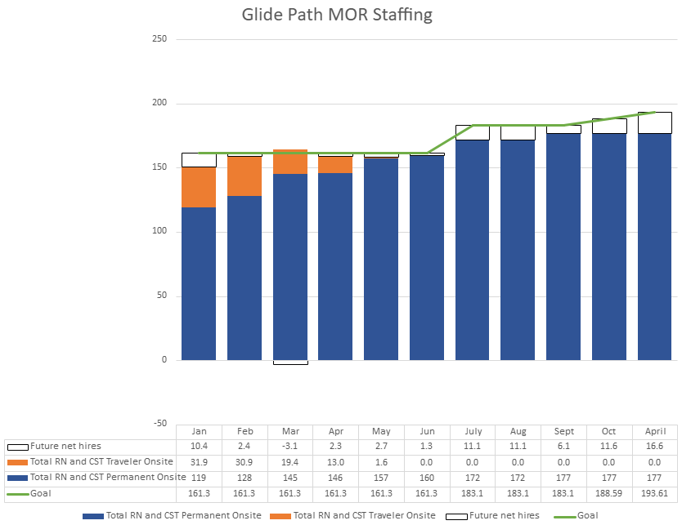
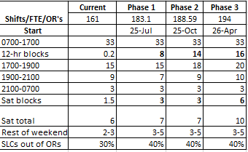
Main OR RN and CST staffing
Growth Trajectory
Strategic Initiatives
Efficiency Plan
Expansion Overview
Staffing Glidepath
Summary
PHASE I
PHASE II
PHASE III
Phase I-III need for RN/CST: 20%
Net RN/CST headcount increase past 12-months: 84%
Current Main OR RN/CST ratio is 75/25 with goal of 60/40. ST EWYL program aimed at shifting the ratio.
Number dependent on future net hires
Notes:
Hiring plans of new grads/EWYL during FY26 is still 48 starts

Slide 7
Growth Trajectory
Strategic Initiatives
Efficiency Plan
Expansion Overview
Staffing Glidepath
Summary
Anesthesia Support*
Jul
FY26
Oct
FY26
Apr
FY26
MOR Phase I
MOR Phase II
MOR Phase III
Nights and Weekends:
12-hr weekday blocks: 8
Sat elective blocks: 3
Equivalent OR: .3
Night Impact +6 late ORs
Attending: $103,000
One additional attending needed for 3 more hours/night
Cost partially offset by professional fees
CRNAs: $457,600
Eight rooms covered with permanent staff converted to 12-hour shifts. No incentive pay. Represents 2 extra hours/day from current state
Resident Pay: $52,000
Additional 2 non-call residents to stay late
Saturday Impact - + 3 ORs
Attending: $136,500
One additional attending needed for 3 more ORs. Asking $350/hr payment as represents new Saturday shift and is current market rate.
Cost partially offset by professional fees
CRNAs: $270,000
Covering 3 additional ORs per Saturday with 1099 employees
OCIR, IMRIS and SCR expansions absorbed by Dept. Of Anesthesia and current CRNA hiring.
*Note: estimated costs are stated as annual expenses. Impact to FY26 would pro-rate Phases II and III according to actual roll-out.
Saturday Impact - +1.5 OR
Attending: $86,000
One additional attending needed for incremental 1.5 OR Saturday electives at $250/hour.
Cost partially offset by professional fees
CRNAs: $135,000
Covering with 1099 employees for 1.5 more CRNA shifts per Saturday
OCIR
Open OCIR ORs 3&4
Shifting cases opens:
Night Impact + 2 late ORs
CRNAs: $114,400
Two additional late rooms with permanent staff.
Notes:
1099 CRNA will cost $225 vs. current external traveler CRNA which is $288 ($260 plus travel) – saves $131k annually per CRNA and $1.9 M in the Phase III model
Converting current ext trav will save almost $1M

Slide 8
Efficiency Plan: Driving Sustainable Improvement
The leadership team is collectively focused on reduction of white space by improving turnaround times, case durations and optimizing staggers.
Establishing a Rapid Improvement Framework
Deploying a new team structure to oversee efficiency initiatives and drive measurable outcomes.
Engaging Systems Engineering and Project Management for additional support in workflow optimization.
Transparent Data Sharing & Accountability
Regularly tracking and sharing performance metrics with key stakeholders.
Providing data progress updates to department chairs at defined intervals.
Long-Term Strategy: Driving Accountability by linking into Annual Performance Goals
Establishing baseline metrics and performance benchmarks to track year-over-year progress.
Notes:
White space for Main OR: to get to 50th percentile:
TAT improvement = 5 rooms per month (it's not all additive) but for reference FCOT only represents 1.3

Slide 9
Growth Trajectory
Strategic Initiatives
Efficiency Plan
Expansion Overview
Staffing Glidepath
Summary
"The future of perioperative services is about reimagining care along this roadmap—driven by strategic growth, data-driven efficiency, and partnership with each of you—to enhance patient outcomes for Virginians and beyond."

Slide 10
Appendix

Slide 11
Main OR support staff needs

