Slide 1
Faculty Retreat 2025

Slide 2
2025 Survey Data : Not Available Yet

Slide 3
2024 Survey Data

Slide 4
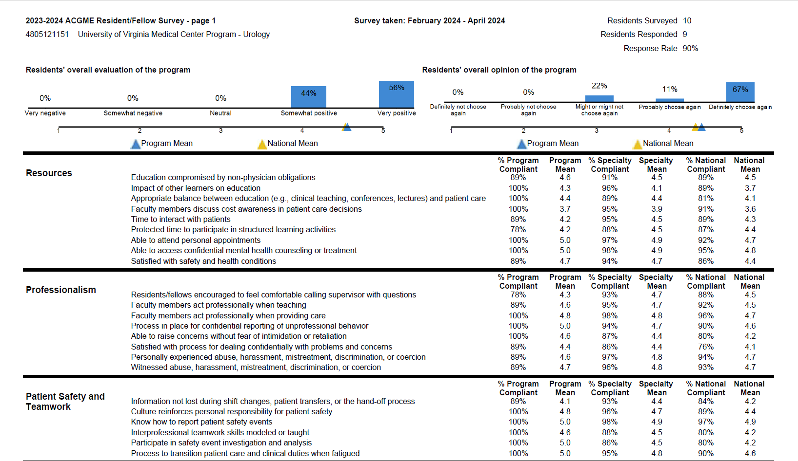

Slide 5
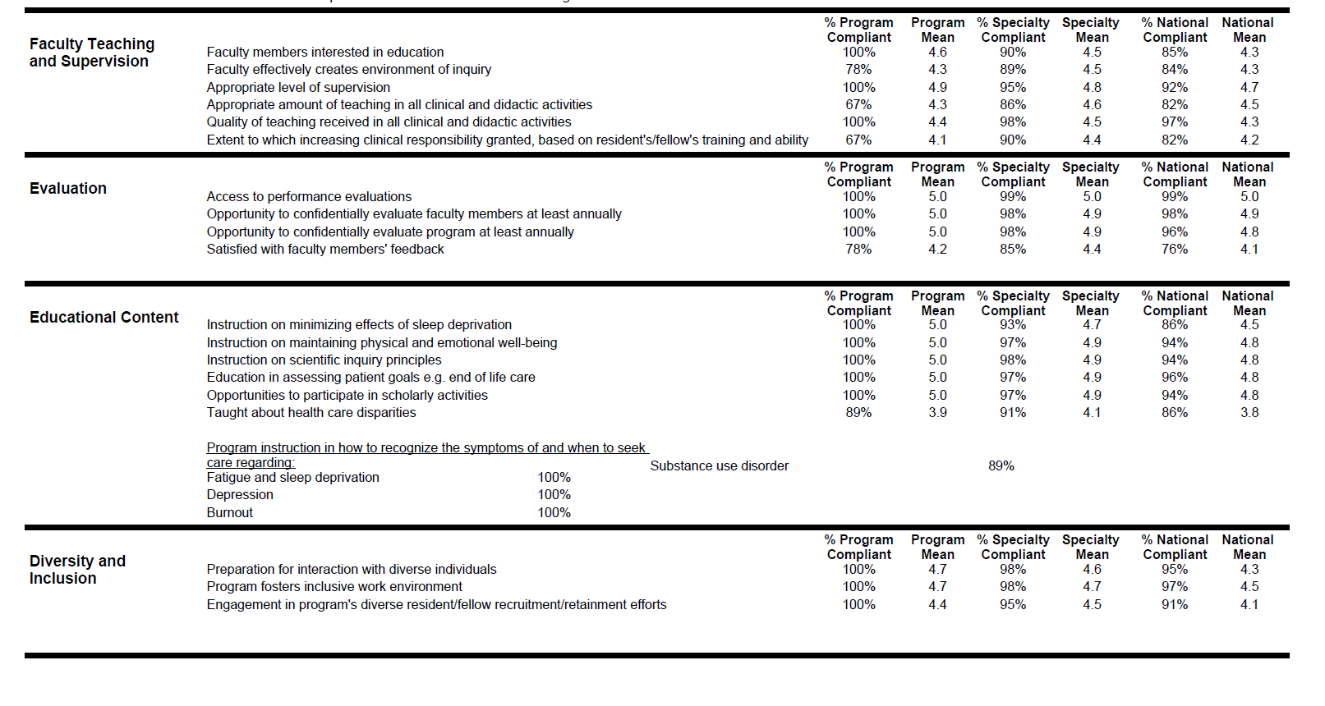

Slide 6
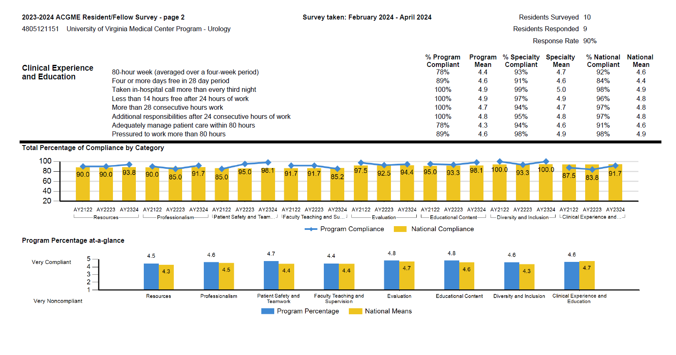

Slide 7
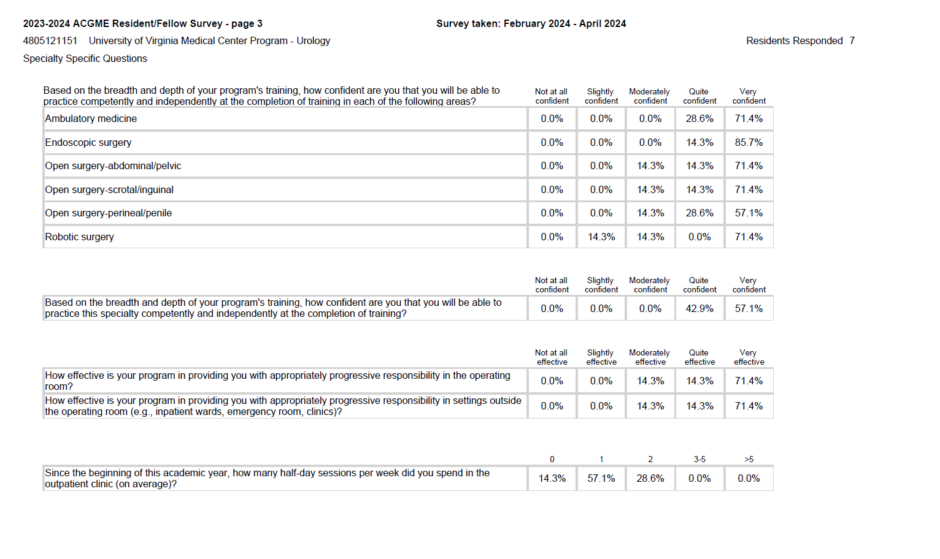

Slide 8
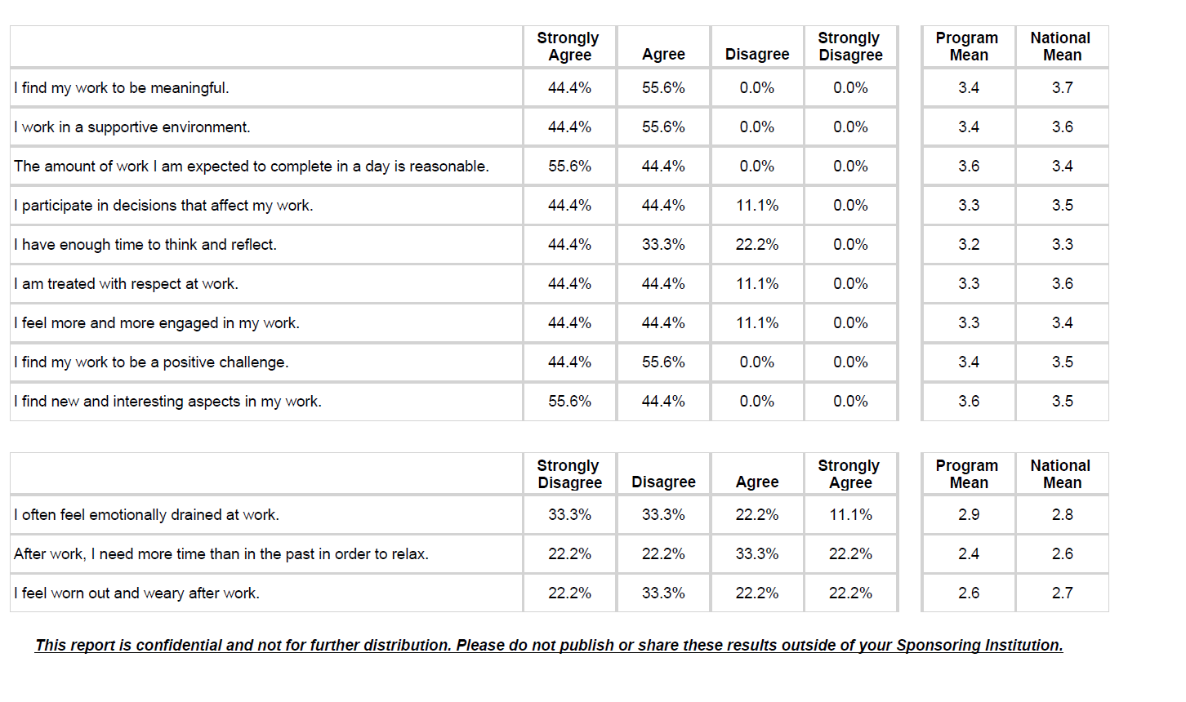

Slide 9
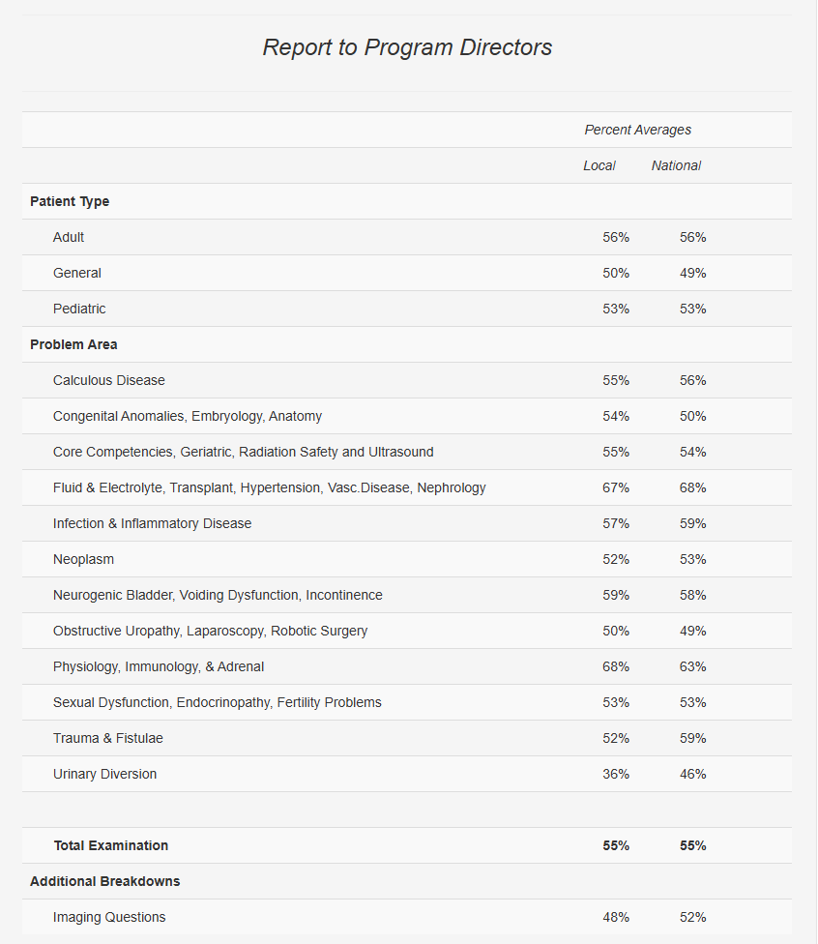
InService Scores
Overall improved performance compared to prior years
Thank you to Dr. Tuong for work on the curriculum!
Positive feedback on conference structure (oral boards style)
Weakest area
Urinary Diversion

Slide 10
Rotations/Block Schedule
Keep Subspecialty blocks with better adherence
Subspecialty clinic time
Future consideration: Elective block year 4/GHLT
Change in Rounding/Teams (proposal and pilot)

Slide 11
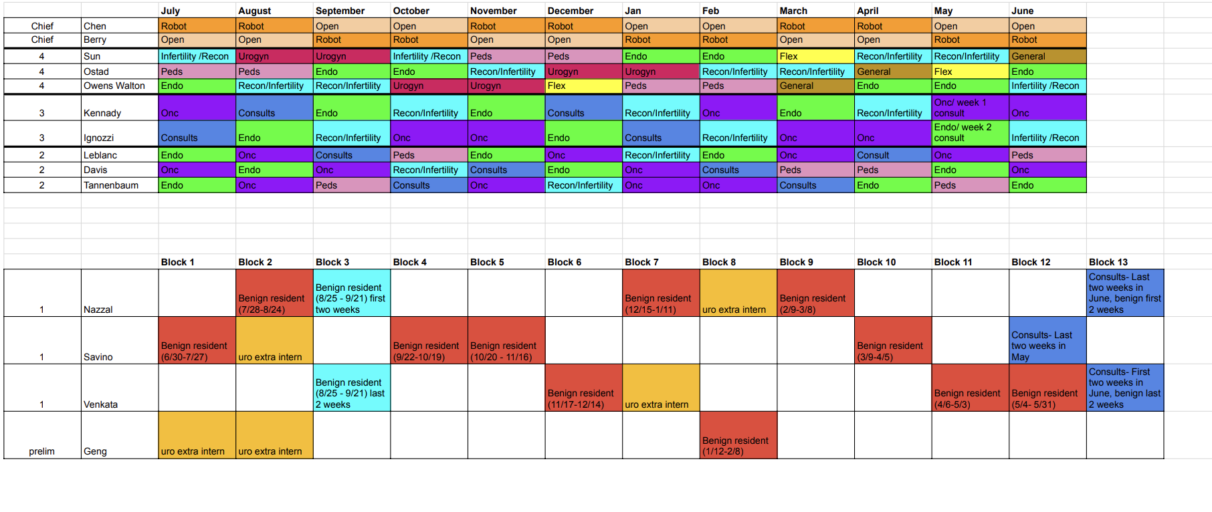

Slide 12
Intern Schedule

Slide 13
Split Services

Slide 14
Morning Rounding Structure
Benign- Endo
Oncology +
Consult
PGY 4s- Chief (GUOR Chief)
PGY 5- Chief
PGY 1 (Intern)
Kari +
PGY 1 (Intern- when there are two)
Benign Intern to share written plans with consult resident. If issues arise, they are to update consult resident, escalate to chief or attending on call
Consult
PGY 4 will round, establish plans. Intern will staff patients with attendings in the morning
Consult resident to call and staff patients in the morning
Notes:
High Risks Eg:
Cystectomy
Nephrectomy
Complex readmissions

Slide 15
Overnight Call Structure
Sign out overnight
PGY 5- Chief- Oncology (all other- new consults)
PGY 4- Chief- Benign
PGY 1- Intern Benign
Sign out overnight
PGY 2-4 overnight resident
Consult Resident
Sign out overnight

Slide 16
Resident Clinic
Closed June 15-July 1
R3 on Monday/R2 on Thursday (rotate based on consult block)
Fewer vasectomies (permission for Riverside rotation approved by GMEC)
No ramp up
R3’s 30/15
R2’s 60/30

Slide 17
Intern Roles
See prior rounding proposal (benign/endo and oncology proposal)
Interns come in on Sat/Sun day to help call resident
Saturday block time-assist
Interns will do 6 months of general surgery (core rotations SICU, NF, Green/Orange, VA, Peds, Blue, EGS).
Take Step 3 early

Slide 18
Resident Research-Zillioux
Steers Fellow
Rahwa Ghenbot, UVA

Slide 19
Sub-I rotations-Kern
Interviews?

Slide 20
Other Items
Interview format
How many candidates/interview days?
Sub-I’s on day #3
Limit faculty interviewers
Tuesday, November 18th and Thursday, November 20th for in-person, and Monday, November 24th (virtual)

Slide 21
Expectation Setting (additional slides sent)
Working group
Familiarize with Handbook
Included:
General competency-based goals/objectives
ACGME
Program-based by PGY year
Subcategorized by Medical Knowledge, Patient Care, Professionalism
EPA’s/Entrustable Procedures by PGY level
Must call list
Available on website, still needs updates even though we make changes annually
Reinforce @ orientation and throughout the year
In the moment feedback
Hold Residents Accountable

Slide 22
Thoughts?

