Slide 1
Patient Philanthropy | Faculty Partnerships
Abby Kimbrough
Senior Associate Director
abby.kimbrough@uvahealth.org
(c) 919-323-5980
Ashley Hanel
Senior Associate Director, Cancer Programs
ashley.hanel@uvahealth.org
(c) 704-796-2608
Department of Urology
April 16, 2025
1

Slide 2
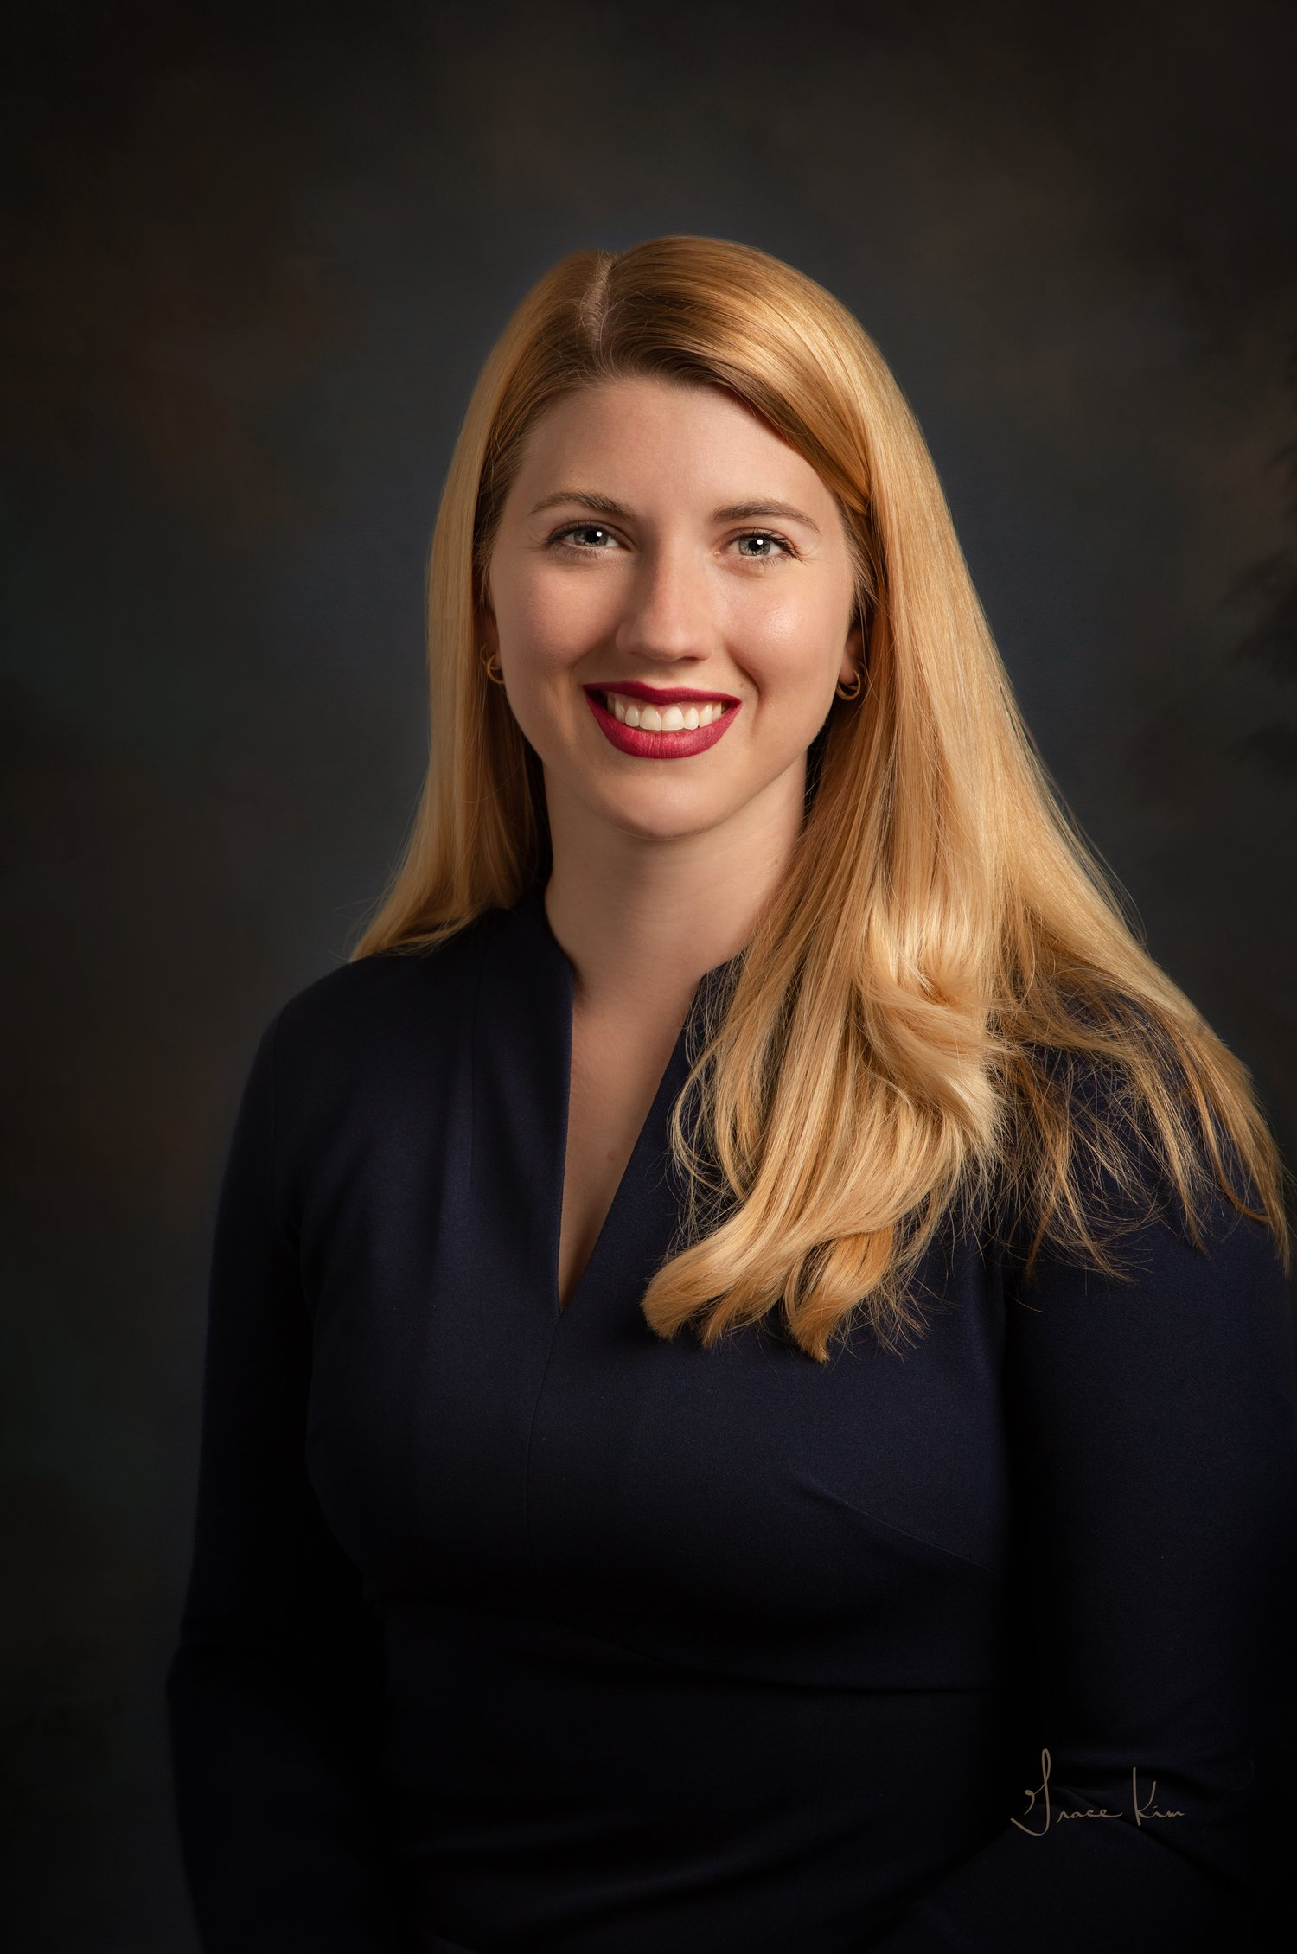
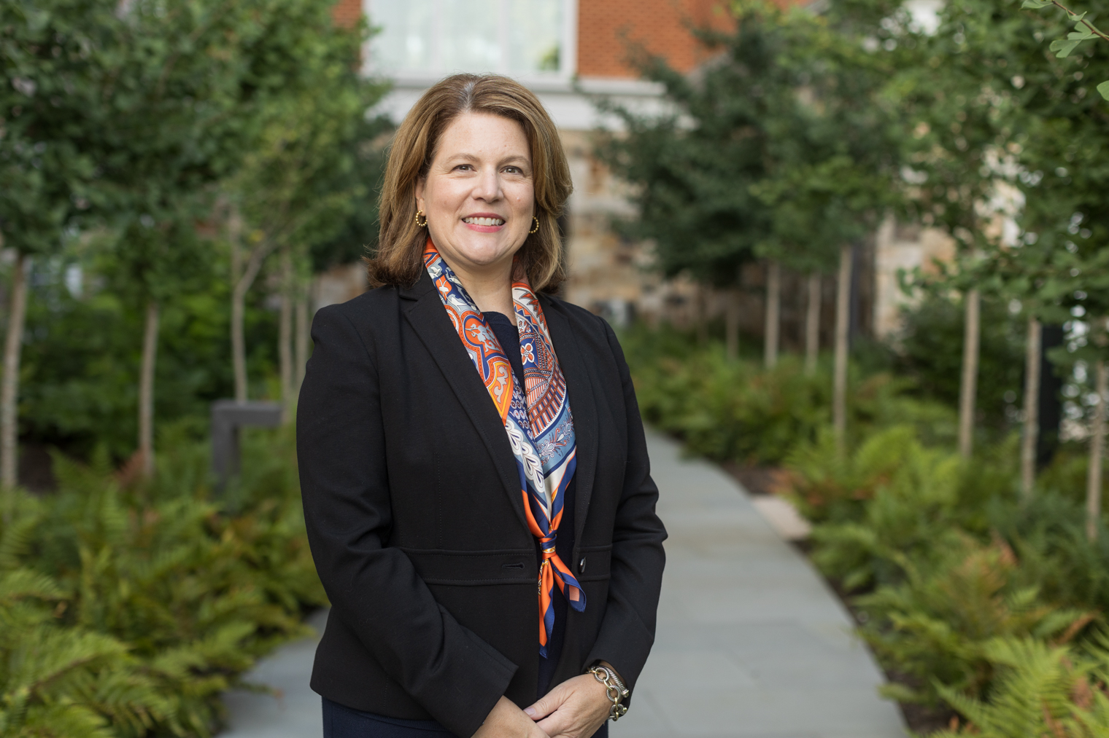
^{Ashley Hanel, M.A.}
Senior Associate Director, Cancer Programs
Focus areas: Hem/Onc and Urology
Abby Kimbrough
Senior Associate Director, Health System Partnerships
Focus areas: Patients and families across UVA Health
2

Slide 3
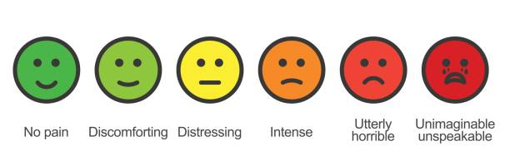
Your Participation in Fundraising
No pain Uncomfortable Distressing Intense Agony Unspeakable

Slide 4
Patient giving is on the rise
5 year patient giving average of $31.2M (excluding $100M gift)

Slide 5
Provider partnerships are deepening
 | FY23 | FY24 | % Increase
Provider Referrals | 307 | 642 | 109%
Development Referrals | 1768 | 2374 | 34%

Slide 6
How referrals translate to fundraising visits and gifts 3 year period – FY22-24
$16M in gifts
Average gift: $173K
$5.3M in gifts
Average gift: $30K

Slide 7
How to recognize a potential donor
Expressions of gratitude
Openly sharing
How to engage the patient in philanthropy
Email, text, or call Ashley or Abby with FULL NAME and DOB
Remember: we are guided by ethical principles
4

Slide 8
What Happens Next?
Our outreach methods
Grateful patient stories: Justin T. and Tom V.
5

Slide 9
Take the meeting!
Thank you, Drs. Greene, Krupski, Sands, and Terran Sims
Examples of individual or team priorities for impact –
Examples shared from Dr. Greene:
Clinical trials CRC-this would allow us to open novel studies for prostate cancer. (50K a year)
Oncology fellow-we want to start a fellowship and train future urologic oncologists (80K a year)
Focal ultrasound program: we need to buy a Focal One machine to get the program off the ground and augment our IRE program.
Statistician: we but a percentage of a statistician to help us on projects but this takes funding.(50k a year)
Research fund: this is money to publish articles ($3000 for JAMA) money to pay the registration for major meetings and present our research to increase our prestige and get our research out there (up to $1000 per meeting) and travel funds.
Named surgical suite – dream big!

Slide 10
Feel Better?
No pain Uncomfortable Distressing Intense Agony Unspeakable

Slide 11
Thank you
for the opportunity
to partner with you!
Ashley Hanel
Senior Associate Director, Cancer Programs
ashley.hanel@uvahealth.org
(c) 704-796-2608
Abby Kimbrough
Senior Associate Director
abby.kimbrough@uvahealth.org
(c) 919-323-5980
7

